Slide 1

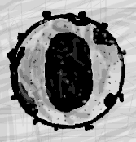




CROI 2018
UNICEF Webinar:
Selected PMTCT,
Pediatric, Adolescent, and Maternal
Abstracts
Lynne M. Mofenson MD
March 27 2018 (abbreviated set)

Slide 2
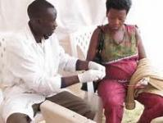

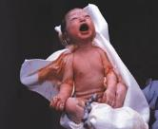
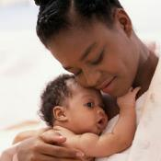
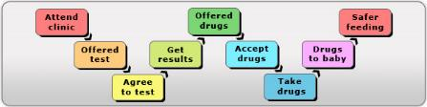
PMTCT Cascade

Slide 3
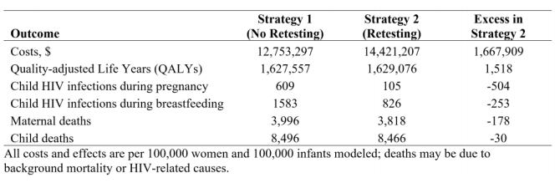
Economic Evaluation of Repeat HIV Testing in Kenya
Rogers AJ et al. CROI 2018 Boston Abs. 1147
Evaluated the cost-effectiveness (CE) of repeat HIV testing during late pregnancy in Kenya.
Repeat testing had incremental CE ratio of $1,098/QALY; cost-effective for the Kenyan setting using a threshold of $1,367/QALY
In a hypothetical cohort of 100,000 women:
  504 ↓ infant infections AP & 253 less PP by BF; 93.1% excess if no re-testing
  173 ↓ deaths among mothers and 30 less in children over 10 year period
  Excess cost of repeat HIV testing $16 per woman
  Cost/infant infection averted $2,203; cost/mother/infant death averted $8,018
$1,667,909/
1,518 QALYs =
CE ratio $1098/QALY

Slide 4
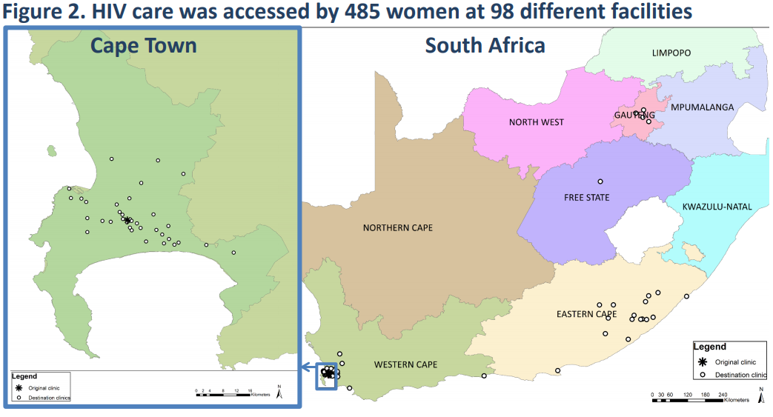
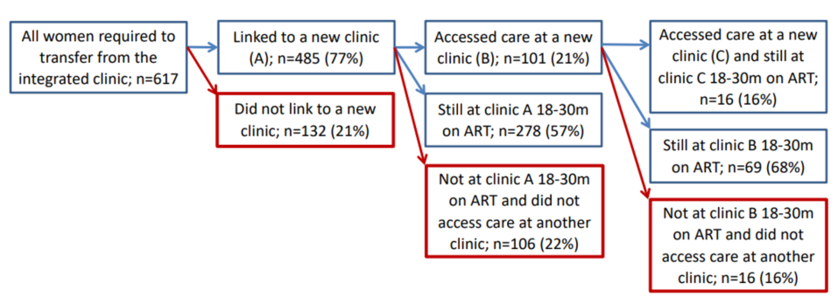
Postpartum Mobility and Transfer of Care of HIV+ Women on ART, South Africa
Phillips TK et al. CROI 2018 Boston Abs. 1088
Electronic health data to assess HIV care access & mobility in women pregnant starting ART in Cape Town, 3/2013-6/2014
Transfer to HIV clinic required postpartum; care was accessed at 98 different facilities!
21% never linked to care
In 485 linked, 21% attended >2 clinics
In 485 linked, 90% accessed care at 12 mo, 82% at 24 mo; 75% at both 12 & 24 mo (only 59% all women)
Among 338 retained women (55% overall population) with VL available after 12 mo on ART, 87% had viral suppression (49% all women)
Younger age and unemployment were risk factors at multiple steps

Slide 5

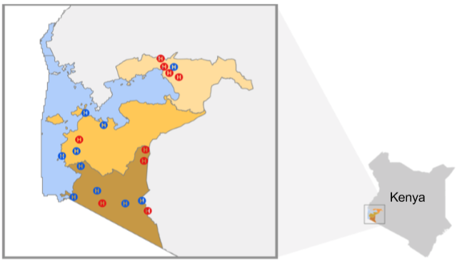
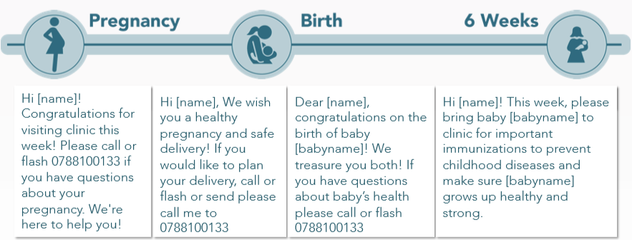
Text Messaging for Retention in PMTCT:
Stepped Wedge Cluster Randomized Trial, Kenya
Odney TA A et al. CROI 2018 Boston Abs. 818
Phase 1: 10 health facilities randomized to SMS messaging (N=569), 10 as control facilities (N=713)
Phase 2: Step wedge implementation in 20 facilities for SMS (N=1,044)
SMS used 14 text messages tailored for specific points during pregnancy and the postpartum period
Text messaging had small not significant ↑ (post adjustment) in infant test (91 vs 85%, p=0.3), maternal retention (90 vs 76%, p=0.1)

Slide 6
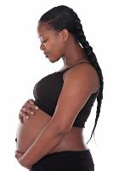
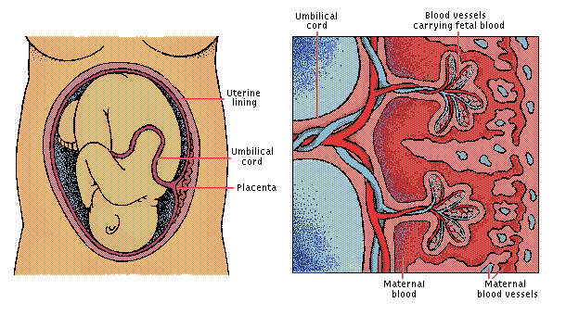
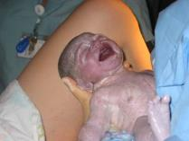

Pregnancy Outcome

Slide 7
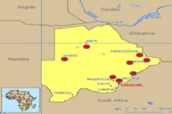
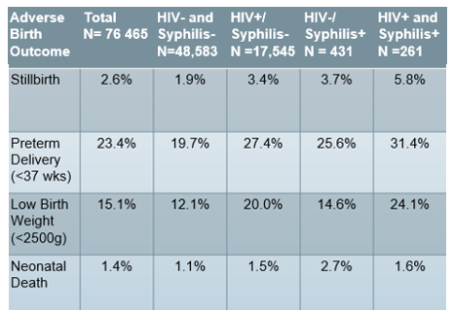
High Rates Adverse Pregnancy Outcomes with
Maternal HIV/Syphilis Coinfection
Shava E et al. CROI 2018 Boston Abs. 833
Data abstraction from 75,770 maternity records from 5 sites 2008-2011 and 8 sites 2014-2016 in Botswana, including antenatal HIV and RPR result and infant birth record
27.1% HIV+; 1.0% RPR+
HIV/syphilis coinfection present in 37.7%
HIV/syphilis coinfection significantly associated with:
  Stillbirth (OR 1.75, 1.02-2.97)
  LBW (OR 1.85, 1.26-2.74)

Slide 8
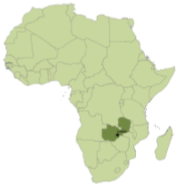
Preconception ART & Risk PTD, Zambia
Winston J et al. CROI 2018 Boston Abs. 830
Zambia Preterm Birth Prevention Study (ZAPPS) cohort: 929 have given birth; 214 (23%) women HIV+ and 623 HIV-
In HIV+ women, 121 (56%) on preconception ART (most TDF/XTC/EFV); 50% had VL <40 at first ANC visit
Between Aug 2015-Sept 2017, 929 deliveries 946 infants (17 twin)
  16% (n=153) SGA
  2% (n=27) stillborn
  14% (n=129) preterm <37 weeks (54% spontaneous)
Factors associated with PTD: prior PTD; twin gestation; short cervix; preconception ART; in sensitivity analysis limited to spontaneous PTD, preconception ART remained significant.
Preconception ART was not statistically associated with very PTD <34 weeks.

Slide 9

Birth Defects in Infants of HIV+ & HIV- Women, Uganda
Musoke P et al. CROI 2018 Boston Abs. 829
Hospital-based birth defect surveillance program at 4 hospitals in Kampala; data reported for 43,293 births (4,634, 11%, were to HIV+ women: 93% on ART, 77% on TDF-3TC-EFV).
475 birth defects identified (1.1% in HIV-exposed and 0.9% in HIV-unexposed). Prevalence was similar in HIV+ and HIV-.
Common Birth Defects | # | Non HIV-exposed | HIV-exposed | Prevalence/10,000 births HIV- women | Prevalence/10,000 births HIV+ women
Talipes equinovarus | 51 | 45 | 6 | 11.7 (8.3-15.1) | 12.9 (2.6-23.3)
Hypospadias | 48 | 43 | 5 | 21.3 (15-27.7) | 20.9 (2.6-39.1)
Neural tube defect | 36 | 34 | 2 | 8.8 (5.9-11.8) | 4.3 (0-10.3)
Limb reduction defect | 24 | 23 | 1 | 6.0 (3.5-8.4) | 2.2 (0-6.4)
Omphalocele | 20 | 18 | 2 | 4.7 (2.5-6.8) | 4.3 (0-01.3)
Cleft lip/palate | 18 | 17 | 1 | 4.4 (2.3-6.5) | 2.2 (0-6.4)
Gastroschisis | 11 | 11 | 0 | 2.9 (1.2-4.5) | 0
Prevalence in HIV+ on preconception or 1st trimester ART vs 2nd/3rd trimester similar: 10.4 vs 7.3 [OR 1.4 (0.7-2.8)] p=0.3

Slide 10
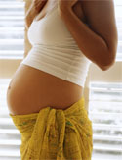
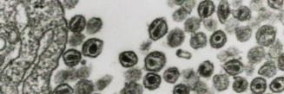

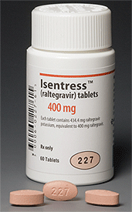
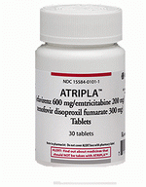
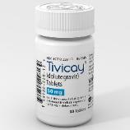
Pregnancy and ARV
Drugs

Slide 11

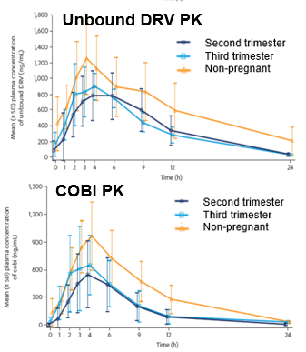

ARV Drugs in Pregnancy
CROI Boston 2018
Sconza R et al. CROI Boston 2018 Abs. 806:
  RAL used in 7% (n=709) of pregnancies in NSHPC; no difference pregnancy outcome with preconception vs during pregnancy start
  Birth defect rate similar general population 3.1%
Crawels H et. Women and HIV, Boston 2018 Abs. 36
  DRV/COBI PK in 6 pregnant women: decrease in DRV exposure with COBI, more pronounced than observed with DRV/rtv, and similar to observed for elvitegravir/ COBI; viral suppression only 83%
Waitt CJ et al. CROI 2018 Boston Abs. 807
  Randomized to DTG vs EFV ART in women presenting at 28-36 wk gestation; analysis on 1st 16 pt for PK, safety, VL
  2 AE/arm (DTG LFT ↑, stillbirth nuchal cord; EFV ↑BP, polydactaly)
  Modest ↓ in DTG in 3rd trimester not warranting dose increase
  2 viral failure in DTG , 3 in EFV; issues adherence for both ARV

Slide 12
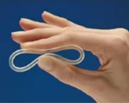

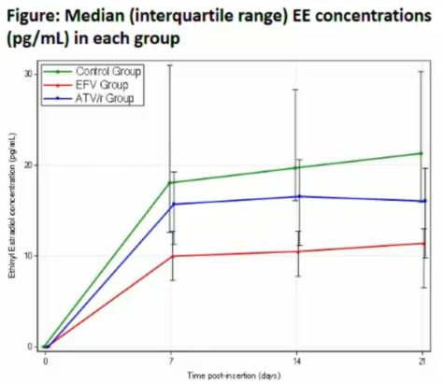
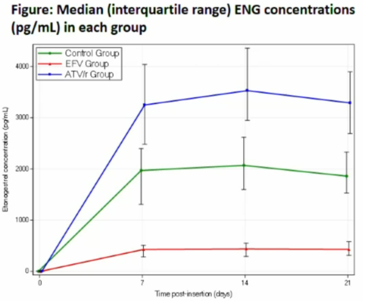

Interaction Vaginal Contraceptive Hormonal Exposure by EFV and ATV-Based ART
Scarsi KK et al. CROI 2018 Boston Abs. 141
Assessment of ethinyl estradiol (EE) and etonogestrel (ENG) administered via vaginal ring in women receiving no ARV (N=25), EFV-ART (N=25) or ATV/r-ART (N=24)
EE exposure ↓ 53-57% with EFV and ↓ 29-35% by ATV/r
ENG exposure ↓ 76-79% with EFV and ↑ 71-79% by ATV/r
ATV/r unlikely to impact efficacy but EFV ↓ EE (>50%) & ENG (>75%) & may ↓ vaginal contraceptive efficacy

Slide 13
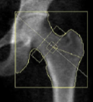
Pregnancy/BF & Bone in Option B+ ART, Uganda
Nabwire F et al. CROI 2018 Boston Abs. 721
Pregnancy/lactation are associated with physiological ↓ in bone mineral density (BMD) up to -4.5% in HIV- women, with recovery post weaning. Minimal data on BMD in PP HIV+ women
Assessed whole body, LS, & total hip DXA and bone turnover markers (BTM) at 36 wks gestation & PP wk 2/14 in breastfeeding 95 HIV+ women on TDF-ART & 96 HIV- women
Primary comparison change in BMD and BTM from PP week 2 to PP week 14, comparing HIV+ and HIV- women
DXA: BMD↓ in both HIV+/HIV- PP wk2-wk14; hip BMD ↓ greater in HIV+ than HIV-; whole body/lumbar spine not differ
BTM: Increase in markers of bone turnover higher were seen in both HIV+ and HIV- but were greater in HIV+ than HIV-

Slide 14

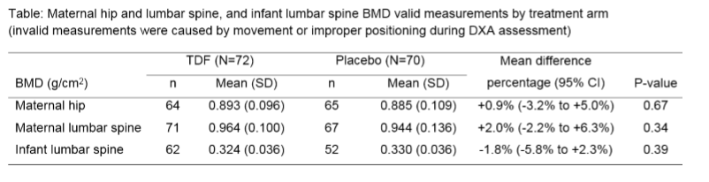
Effect TDF Exposure on Maternal and Infant BMD: iTAP Trial of TDF Prophylaxis for HBV
Salvadori R et al. CROI 2018 Boston Abs. 720
Maternal hip and lumbar spine (LS) BMD and infant LS BMD were measured at 12 mos after delivery/ birth using dual-energy X-ray absorptiometry (DXA) at 3 participating sites, with central blinded review
No significant differences in maternal hip/LS BMD or infant LS BMD between arms at 12 mos postpartum (10 mos after HBV+ mother stopped study treatment)

Slide 15

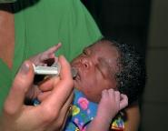
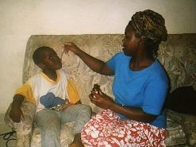
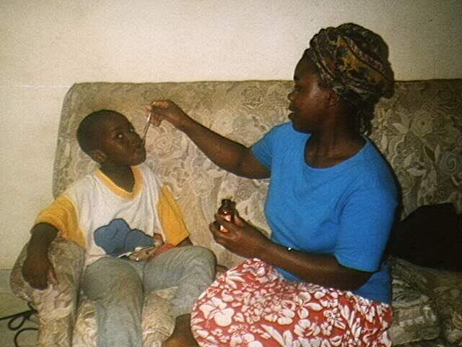
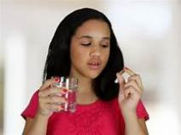
Testing, Treatment and Retention for Children and Adolescents
Testing, Treatment and Retention for Children and Adolescents

Slide 16
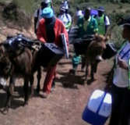
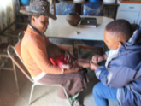
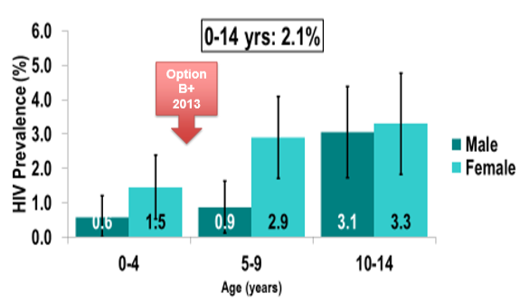
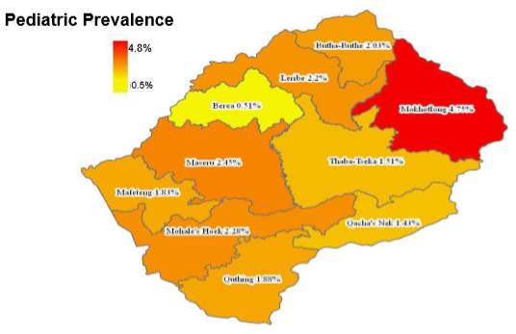
High Burden in Children in Lesotho:
Population-Based HIV Impact Asessment
Frederix K et al. CROI 2018 Boston Abs. 824
Nationally representative sample children <15 years underwent household-based rapid HIV testing Nov 2016-May 2017. Children <18 mo with +Ab tested with DNA PCR
3966 tested; overall prevalence 2.1%
Highest 10-14 (3.2%) vs 0-4 yr (1.0%)
Corresponds to 13,300 children LWH
Female 2.6%, male 1.5%
Sexual activity reported in 9.3% 10-14 yr/o (15.3%♂, 3.3%♀)
Varied across districts, highest in Mokhotolong (4.8%), lowest Brea (0.5%)

Slide 17

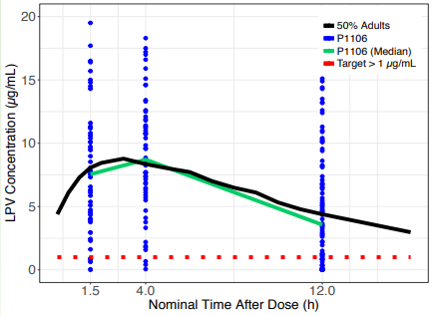

LPV-r: PK Solution in LBW & Normal BW Newborns;
Pellet Formulation Viral Efficacy and Safety Children
CROI 2018 Boston
Bekker A et al. CROI 2018 Boston Abs. 841
  P1106 PK & safety LPV-r (300/75mg BID) in low & normal BW newborns
LPV/r levels by time after dose
P1106 vs adults
Levels similar to adults, most >C_{trough} 1μg/mL target including LBW, SGA & <42 wk GA
No treatment-related AE; all Gr 3/4 events unrelated to LPV/r
Andrieux-Meyer I et al. CROI 2018 Boston Abs. 842
48 wk FU LIVING study in Kenya/Uganda efficacy/ safety of LPV-r pellets+AZT or ABC/3TC in 610 pt (522 ART-exp switch, med age 20 mo; 58 naïve, med age 47 mo)
Baseline/wk 48 VL available for 220 children
Good viral efficacy in exp and naïve pt
21 with 67 AE Gr 3-4; only 2 led to ART d/c
Overall baseline | Overall Week 48
VL Median 2.5 25.5% <50 50.3% <400 55.2% <1000 | VL Median 1.6 55.4% <50 80.0% <400 83.2% <1000
Notes:
Abstract Number:
841 PHARMACOKINETICS AND SAFETY OF LOPINAVIR/RITONAVIR SOLUTION IN HIV-INFECTED NEWBORNS
Author(s):
Adrie Bekker¹, Nathan Hanan², Mae Cababasay³, Jiajia Wang³, Firdose Nakwa⁴, Elizabeth Smith⁵, Jack Moye⁶, Avy Violari⁴, Mark Cotton¹, Lubbe Wiesner⁷, Jennifer Norman⁷, Barend Fourie¹, Edmund V. Capparelli², Mark Mirochnick⁸
¹Stellenbosch University, Cape Town, South Africa,²University of California San Diego, La Jolla, CA, USA,³Harvard University, Cambridge, MA, USA,⁴University of the Witwatersrand, Johannesburg, South Africa,⁵DAIDS, NIAID, Bethesda, MD, USA,⁶NIH, Bethesda, MD, USA,⁷University of Cape Town, Cape Town, South Africa,⁸Boston University, Boston, MA, USA
Abstract Body:
Reports of life-threatening cardiac, metabolic, renal and CNS dysfunction in newborns receiving lopinavir/ritonavir (LPV/r) in the first weeks of life have led to a recommendation that LPV/r should not be used in newborns <2 weeks postnatal and <42 weeks postconceptional age. Due to limited treatment options, however, clinicians may initiate LPV/r in newborns if benefit outweighs risk. Data on pharmacokinetics (PK) and safety of LPV/r in newborns are few.
IMPAACT P1106 is a multi-arm Phase IV study of PK/safety in newborns on antiretroviral and antituberculosis medicines received for clinical care at two South African sites. HIV-infected newborns in whom LPV/r was initiated at 1 μg/mL. Safety evaluations included echocardiograms (ECHOs) at baseline and weeks 1 and 6, and electrocardiograms at baseline, day 5, and weeks 1, 2, and 6. Adverse events (AE) were classified as expected (associated with prematurity) or unexpected.
Twenty-five newborns were enrolled;13 (52%) male and 22 (88%) black African. The median (interquartile range (IQR)) birth weight and gestational age were 2130 (1775, 2630) grams and 35 (32, 37) weeks, respectively. The median (IQR) age at enrollment was 45 (35, 61) days old. As of August 2017, 22 newborns contributed to 124 LPV concentrations. Median C0 was 4.7 (IQR 1.5, 7.4) µg/mL, with 1.5 and 4 hour levels approximately 1.5-2 times higher, similar to adults. LPV C0 was above target in 41/50 samples (figure 1). Of the 24 newborns with safety data, 11 had Grade 3/4 unexpected AEs (none treatment related) and four newborns had Grade 3/4 expected AEs. Most AEs were infection related (n=11). One infant died from presumed sepsis on day 2 of LPV/r. Infant ECHOs were normal except for two with mild abnormalities. No abnormal PR or QTc interval prolongation was observed. Median serum osmolality post LPV/r initiation was 289 (IQR 287, 291) mOsm/kg.
No treatment related adverse events were observed in this study of LPV/r safety and PK in newborns and very young infants. LPV concentrations were similar to adult levels, with most C0 >1 μg/mL.
Session Number:
P-Q2
Session Title:
SOMETHING OLD, SOMETHING NEW: PHARMACOKINETICS AND SAFETY OF ARVs FOR INFANTS, CHILDREN, AND ADOLESCENTS
Presenting Author:
Adrie Bekker
Presenter Institution:
Stellenbosch University
Poster:

Slide 18

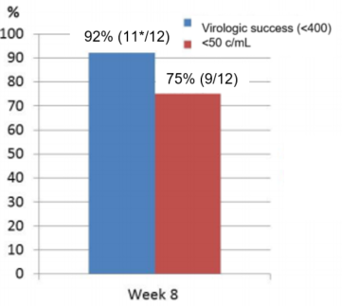
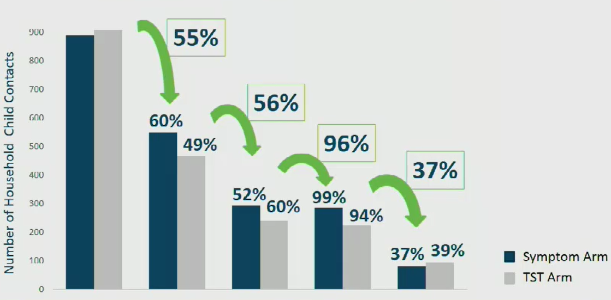
HIV/TB Coinfection in Children
CROI 2018 Boston
Krogstad P et al. Abs. 845
RAL given with RIF-containing anti-TB rx in 12 HIV+ children age >2-<6 yrs (median 3 yr)
Doubling RAL dose for TB-HIV co-infected pt on RIF achieved adequate PK levels, good viral response & was safe
Salazar-Austin N al. Abs. 32
*1 pt who did not meet the VL success criterion had RAL held temporarily x3 wk due to an AE.
Cluster-randomized trial Sx- vs TST-based screening household contacts <5 y/o to see if improve IPT in S Africa
Pediatric TB Cascade of Care
IPT 51.4% in 550 contacts Sx-based vs 56.5% in 467 contacts with TST screening (p=0.55) (non-inferior)
Entry into & retention in pediatric TB preventive care was abysmal for both
9% estimated contacts complete IPT
Notes:
Current antiretroviral (ARV) treatment options for children co-infected with TB and HIV-infection are limited. RIF induces UDP-glucuronosyltransferase activity accelerating the clearance of raltegravir (RAL). In adults, doubling the RAL dose partially overcame this PK interaction with no safety concerns. We sought to determine the optimal and safe dose of RAL when administered with RIF-containing anti-TB therapy in HIV-infected children.
P1101 is a dose finding study for RAL for HIV-infected children receiving RIF-containing TB therapy for at least one week, with three age cohorts: Cohort 1: 2 to <6 years (closed), Cohort 2: 6 to <12 years of age and Cohort 3: 4 weeks to <2 years, aiming to enroll 12 evaluable children for PK and safety in each cohort. At enrollment children start 3 ARVs, including chewable RAL formulation at 12 mg/kg/dose twice daily (twice the recommended pediatric dose). Intensive RAL PK sampling is done 1 week after ARV therapy is initiated and then a 4th ARV is added. Clinical and lab assessments are routinely completed. RAL is stopped at TB treatment completion and children are followed for additional 3 mos. PK targets are a geometric mean (GM) AUC12h of 14-45 (µM-h) and GM C12h ≥75 nM. Here we report the results from Cohort 1.
Among 12 children, 7 (58%) were male, median age 3 years (IQR 2-5), baseline Log10 RNA median 4.91 (IQR 4.42-5.42), median CD4 count 559 cells/mL (IQR 390-1185), median CD4 percent 15% (IQR 9-24). PK at Week 1 showed GM AUC12h (%CV) of 28.8 mMxh (50%); the GM C12h was 229 nM (76%). 1/12 (8% with 95% CI [0%,34%]) had a grade 3 elevation of ALT at Week 4 deemed possibly related to RAL. RAL/ART were temporarily withheld for 21 days and then restarted, with no subsequent recurrence. While RAL was held temporarily, this child did not achieve virologic success (>1 log10 drop from baseline at Week 8 or HIV RNA ≤400 copies/mL). 11/12 (92%), were virologically suppressed by Week 8, with 95% CI (62%, 100%). For n=12 at Week 8, median log10RNA change from baseline was -3.16 (IQR -3.79, -2.55), median CD4 change from baseline was 101 cells/mL (IQR -70 to 230], median CD4 percent change from baseline was 6.1% (IQR 1.9-9.7).
A 12mg/kg dose twice daily of the oral chewable formulation of RAL safely achieved PK targets in HIV-infected children 2 to <6 years with TB

Slide 19
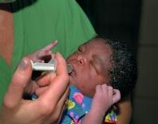


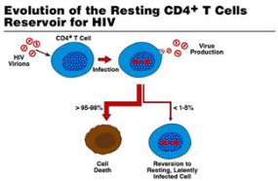

Early Treatment
and
Viral Remission

Slide 20

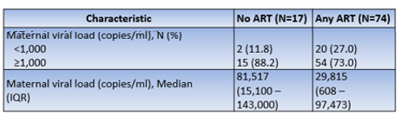
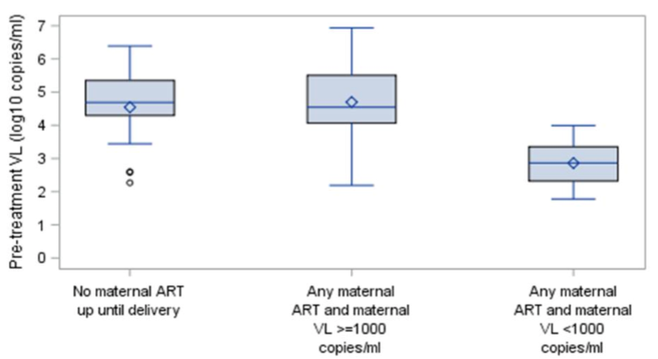
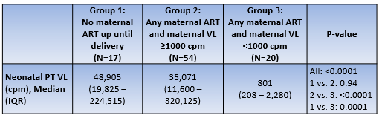
Maternal Antepartum ART and HIV-Infected
Infant Pre-Treatment VL, South Africa
Patel F et al. CROI 2018 Boston Abs. 862
Evaluated maternal VL & pre-ART VL in 91 infants with IU HIV from universal birth testing program (17 had mothers with no ART until delivery, 74 mothers on ART, 53% for >12 weeks)
HIV+ infant pre-ART VL significantly lower when mother reported being on ART & had maternal VL <1,000 than when mothers on ART but had VL >1,000 or mothers on no ART
Median
48,905 c/mL
Median
35,071 c/mL
Median
801 c/mL
Pre-ART Infant VL (log10 c/mL)
No maternal ART
up to delivery
(N=17)
Any maternal ART
& maternal VL
>1000 c/mL
(N=54)
Any maternal ART
& maternal VL
<1,000 c/mL
(N=20)

Slide 21
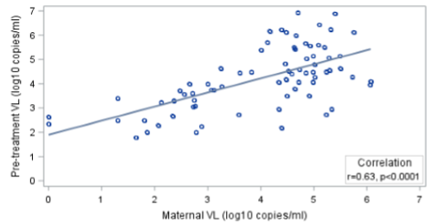
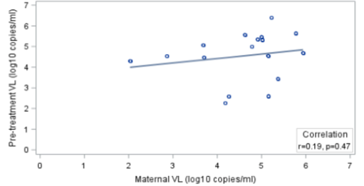
Maternal Antepartum ART and HIV-Infected
Infant Pre-Treatment VL, South Africa
Patel F et al. CROI 2018 Boston Abs. 862
Among infants with low pre-ART VL <1,000, 55.6% had mothers on ART compared to 13.7% among infants with pre-ART VL >1,000 (p=0.0001)
Infant pre-ART VL was significantly correlated with maternal VL if mother was on ART but not when mother not on ART
Neonatal Pre-ART VL & Maternal VL
Any Maternal ART Group
Neonatal Pre-ART VL & Maternal VL
No Maternal ART Group
Correlation
r=0.63, p<0.0001
Correlation
r=0.19, p=0.47

Slide 22




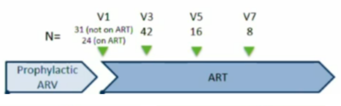

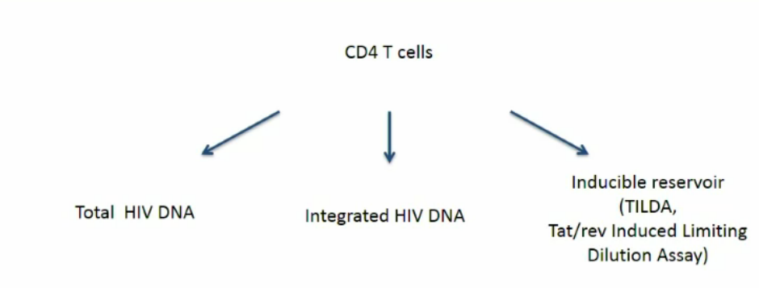
ARV Prophylaxis/ART at Birth Limits Reservoir Size in Children
Massanella M et al. CROI 2018 Boston Abs. 135
Evaluation of reservoir in longitudinal cohort (HIVNAT 209) of children receiving 3-drug ARV prophylaxis (proARV), which was either continuous or interrupted & ART restarted when found HIV+ vs cross-sectional cohort (HIVNAT 194) of children starting ART at <6 mo (range 3-26 wk)
HIVNAT 209
HIVNAT 194
Cross-sectional cohort
N=46
ART initiation age <6 mos (med 3.9 mo)
Med age at evaluation on ART
5.1 (3.5-7.1) years
HIVNAT 209
Longitudinal cohort
ART initiation med 2.4 mo
Continuous
3-ARV/ART (24)
ProARV stopped
then →ART (31)
N=42
Med age 1.2 yr
N=46
Med age 5.1 yr
Reservoir measurements:

Slide 23
ARV Prophylaxis/ART at Birth Limits Reservoir Size in Children
Massanella M et al. CROI 2018 Boston Abs. 135
Before ART, baseline VL correlated with total/integrated DNA and frequency of productively infected cells
Compared to interrupted proARV→ART, continuous ARV/ART significantly ↓ VL, number cells with total/integrated DNA & size of inducible reservoir
After ART, total/integrated HIV DNA ↓ but remained detectable in almost all; integrated DNA stable on 1-4.7 yrs on ART
Age at ART start correlates with integrated DNA/inducible reservoir on ART (lowest when younger start); infants starting ART at age <6 wks lowest reservoir in all markers
Comparing infants with continuous proARV from birth (ART med 1.2 yr) to delayed starting ART (med age 16 wks, ART med 5.1 yr):
  VL significantly lower (p<0.001)
  Total DNA and integrated DNA levels significantly lower
  Trend toward lower inducible reservoir

Slide 24
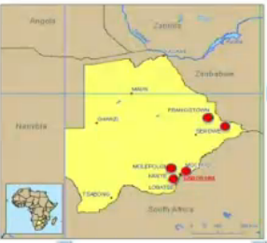
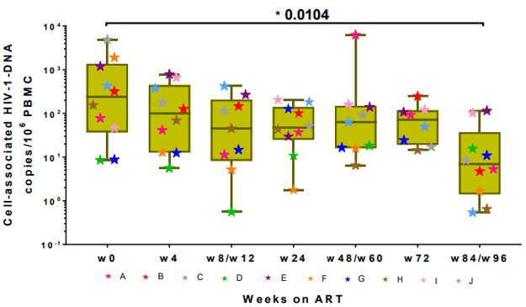
Low HIV Reservoir at 84 Weeks in Very Early Treated Children Botswana
Shapiro R et al. CROI 2018 Boston Abs. 136
Early Infant Treatment (EIT) study diagnoses HIV in nb & starts ART 1st wk life; screened 8,815; MTCT 0.4% (n=35)
33 children enrolled in EIT, started immediate ART (1 death, gastroenteritis)
  11 >84 weeks on ART (9 with complete testing for this report)
  21 <84 weeks on ART
On 9 with 84 wk data on ART, significant ↓ in cell-associated DNA on ART (to lower levels than in other early ART cohorts):
  Entry: med 154 copies/10⁶ PBMC
  84 wks: med 5.3 copies/10⁶ PBMC
Patient

Slide 25
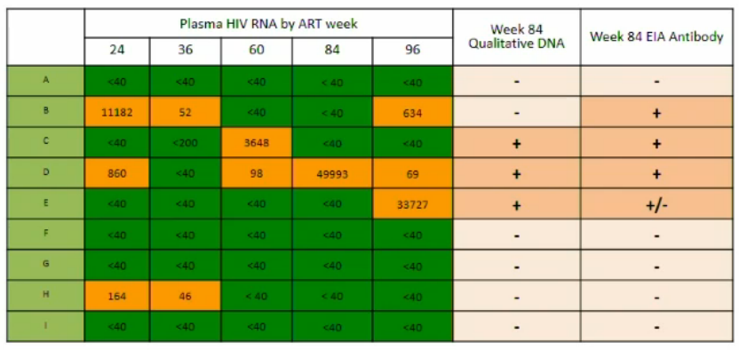
Low HIV Reservoir at 84 Weeks in Very Early Treated Children Botswana
Shapiro R et al. CROI 2018 Boston Abs. 136
9 with complete testing at 84 wks (med baseline RNA 3,145 [<40 to >10 million], med age ART start 2d [1-5d])
  4 (44%) had RNA >40 c/mL at >1 visit (almost all re-suppressed with improved adherence)
  8 (89%) have RNA <40 at 84 wks, 6 (67%) at 96 wk
  6 (67%) have qualitative DNA PCR-; 5 (56%) EIA -
  All 4 with consistent RNA <40 have negative DNA and EIA
Patient
84
96
Week 84
Qualitative DNA
Week 84
EIA Antibody

Slide 26




Time to Viral Rebound After Starting ART in Children Treated from Infancy in CHER
Violari A al. CROI 2018 Boston Abs. 137
326 interruption arms
[81 not interrupt death, LTFU, CD4, etc]
245 interrupted ART
[57 not suppressed at interruption]
188 suppressed at interruption
[3 LTFU, 2 VL gap >12 mo]
183 suppressed & in analysis
Deferred ART
(ART started when met WHO 2006 CD4 or clinical criteria)
N=125
ART-Naïve HIV+ Infants
Age 6 to <12 weeks
CD4 >25% (N=411)
After stop ART, restart when CD4<25% (N=40)
N=451
Early Time-Limited ART for 40 Wks
(ART started immediately, continued for 40 weeks then stopped)
N=163
RNA from stored samples measured at 8 wks post interruption and then q 12 wks
Early Time-Limited ART for 96 Wks
(ART started immediately, continued for4 96 weeks then stopped)
N=163
Enrolled 2005-2008
Suppressed: 2 consecutive VL <400 c/mL
Rebound: 2 consecutive VL >400 c/mL
Time to rebound: date of 1st of VL >400 c/mL
FU censored at ART re-initiation date if rebound or last VL measured if not rebounded
1st line: AZT/3TC/LPV-r

Slide 27



Time to Viral Rebound After Starting ART in Children Treated from Infancy in CHER
Violari A al. CROI 2018 Boston Abs. 137
N=183 suppressed at interruption | Median (IQR) or N (%)
Viral load had suppressed within 40 wks | 157 (86%)
Had viral rebound after stopping ART | 177 (96%)
Time to rebound (months) | 1.8 (0.8-13.1) mo
VL at rebound - ART-40 weeks - ART-96 weeks | 354,615 (91,040, 750,000) 418,760 (100,001, 750,000) 325,000 (78,000-642,000) (p value ART-40 vs ART-96 wk: 0.19)
ART restarted | 131 (72%)
Estimated Probability of Rebound
In multivariate model, longer time to rebound associated with:
  Higher baseline CD4%
  Higher birth weight
  Faster viral suppression (within 40 wk ART start)
But not age ART start (all start 6-12 wk) or duration ART
Estimated cumulative probability
rebound after ART interruption
2 months: 70% (63, 76)
4 months: 80% (74, 85)
6 months: 94% (90, 97)
8 months: 99% (96, 100)

Slide 28




Adolescents and HIV Risk

Slide 29


Factors Associated with HIV in Women Aged 15-24 Yr Zambia
Cai H et al CROI 2018 Boston Abs. 918
Household survey 2016: HIV reported 3x > ♀ vs ♂ 15-24 yrs (5.7 vs 1.8%)
2,189 young ♀ reported having >1 sexual partner past 12 months
Blood test HIV prevalence in these young ♀ was 7.8% (95% CI 6.5-9.0%)
ZAMPHIA 2016: HIV Prevalence
2,189 Young ♀ Age 15-24 Yrs with >1 Sex Partner Last 12 Mos
by Associated Characteristics
Multivariate Logistic Regression Model
2,189 Young ♀♀ Age 15-24 Yrs with >1 Sex Partner Last 12 Mos
Factor | % | Adjust OR, 95% CI
Age group 15-19 20-24 | 34.3% 65.7% | Referent 2.23 (1.5, 3.5)
Residence Rural Urban | 42.3% 57.7% | Referent 2.29 (1.6, 3.4)
Syphilis Tested negative Tested + Past infection Recent infection | 94.7% 2.42% 2.91% | Referent 2.42 (1.1, 5.2) 3.41 (1.9, 6.28
Not significant in model Marital status Education Age 1st sex # partners past 12 mo Sex with non-marital, non-cohabiting partner Condom use last sex Transactional sex HBV infection
On multivariate analysis, age 20-24, urban residence and past or recent syphilis infection independently associated with HIV+

Slide 30


Sexual Partner Type and Risk of Incident HIV in Adolescent Girls in HPTN 068
Nguyen N et al CROI 2018 Boston Abs. 923
Monthly cash tx for 80% school attend in 2,533 S African girls 13-20 yrs, Gr 8-11(neg result); entry 1,034 HIV- with >1 sexual partner
Annual ACASI self-interview and HIV test; 63 incident infections (6%)
Self-identified partner type not associated; latent analysis type was
Older partners associated with incident infection (>3x risk); peer-age partners also risky (unprotected peer partner >2x risk)

Slide 31

Self-Reported Risky Sexual Behaviors Adolescent Botswana
Chakalisa U et al CROI 2018 Boston Abs. 926
Baseline self-report sex behavior in 2,311 16-24 yr/o sexually-active youth (20% household survey 30 peri-urban& rural communities)
♀ > ♂ report HIV dx (20% vs 4%) or newly dx in survey (5% vs 2%)
Differences in risk behaviors ♀ (red boxes) vs ♂
Economic stress (eg food insecurity) strongly associated with risky behavior in ♀
+ HIV status in young ♀ was associated with inter-generational sex (aPR 1.3)
+ HIV status in young ♂ was associated with earlier sexual debut (aPR 3.3)

Slide 32




PrEP in Adolescents and Women

Slide 33





High PrEP Updated Among Pregnant Women in Antenatal Care in Kisumu, Kenya
Kinuthia J et al. CROI 2018 Boston Abs. 1047
5,329 HIV-uninfected pregnant women at 16 ANC clinics in Kenya approached re: PrEP June-Dec 2017
Screened all for behavioral risk factors
16% (853) women approached accepted PrEP; those more at risk more likely to initiate PrEP

Slide 34



Risk Behavior, Perception and Reasons for PrEP in Young African Women in HPTN 082 Celum C et al. CROI 2018 Boston Abs. 1049
HPTN 082 ongoing (in FU) to evaluate PrEP acceptance in young women 16-25 yr and adherence in those who accept
Uninfected women
Age 16-25 yr
Johannesburg, Cape Town, S Africa
Harare, Zimbabwe
Women can accept or decline PrEP at enrollment
Target: 400 accepted PrEP and <200 decline
High acceptance of PrEP
High uptake (95%) despite reported low perceived risk
Risk behavior high in those accepting PrEP, indicating reaching women at risk
High prevalence curable STIs (39%) demonstrating high risk of these women
Half had sx depression and reported IPV in past year

Slide 35


Patterns of Oral PrEP Adherence and HIV Risk in East African Women
Pyra M et al. CROI 2018 Boston Abs. 1043
233 HIV- women (22% <25 yr) in open-label PrEP demonstration project as part of serodiscordant couples
Adherence and risk trajectory types were identified
ADHERENCE TRAJECTORY TYPE
Early declining adherence (9%), mean 1.5 doses/wk
Late declining adherence (8%), mean 4.1/wk
Moderate steady adherence (29%), mean 5.4/wk.
High steady adherence (55%), mean 6.7/wk.
RISK TRAJECTORY TYPE
Declining risk (22%), mean 5.1/wk
Steady risk (78%), mean 5.9/wk
Risk & adherence groups significantly associated, p<0.0001
Behavioral Risk Trajectory Type
Steady risk group more likely high steady adherence, compared to declining risk group
Declining risk group more likely to have early/late declining adherence, compared to steady risk group
Adherence Trajectory Type

Slide 36


Dapivirine Ring
PrEP

Slide 37








Open-Label Dapivirine (DPV) Ring FU Studies: ASPIRE →HOPE; Ring Study → DREAM
Baeten J et al. CROI 2018 Boston Abs. 143LB
Nel A et al. CROI 2018 Boston Abs. 144LB
Dapivirine Ring
vs
Placebo Ring
Dapivirine Ring
vs
Placebo Ring
2,629 women 18-45 yrs
1,959 women 18-45 yrs
2:1
randomization
Dapivirine Ring
1,313 women
Placebo Ring
1,316 women
Dapivirine Ring
1,307 women
Placebo Ring
650 women
27% reduction
(CI 1, 46), p=0.046
31% reduction
(CI 1, 52), p=0.04
71 infections
(3.3/100 p-y)
97 infections
(4.5/100 p-y)
4.1 100 p-y
(77/1300)
6.1/100 p-y
(97/650)
1 year open-label extension
1 year open-label extension
N=1,299 (92%) used open-label ring
89% DPV ring level <23.5 = adherent
12 infection in 616 PY FU
N=900 (46%) used open-label ring
96% DPV ring level <23.5 = adherent
11 infections in 623 PY FU

Slide 38

HIV Incidence and Adherence in DREAM: Open-Label Trial of Dapivirine Ring
Nel A et al. CROI 2018 Boston Abs. 144LB
Initial trial results similar (27% ASPIRE & 31% Ring Study) ↓ risk
1 yr FU incidence similar (12/616 PY HOPE vs 11/623 PY DREAM)
Compared to estimated placebo group from the clinical trial/same PY, in open-label (use of known effective product), ↓ HIV incidence was 46% & 54%
HIV incidence
4.1
(95% CI 3.2-5.1)
HIV incidence
3.9
(95% CI 2,9-4.9)
54%
reduction
p=0.01
46%
reduction
HIV incidence
1.9
(95% CI 1.0-3.4)
HIV incidence
1.8
(95% CI 0.9-3.2)
Placebo
EXPECTED
HOPE
OBSERVED
Placebo
EXPECTED
HOPE
OBSERVED

Slide 39


Maternal Health
Issues

Slide 40





HIV Acquisition Risk/Coital Act is Elevated During Pregnancy and First 6 Months Postpartum
Thomson KA et al. CROI 2018 Boston Abs. 45
2,751 HIV- ♀ in African HIV serodiscordant couples followed for ≤48 mos in 2 HIV prevention studies; 22% pregnancies (12.5/100 py)
The Partners in Prevention
HSV/HIV Transmission Study
2004-2007
Botswana, Kenya, Rwanda, South Africa
Tanzania, Uganda, Zambia
3,408 couples for 24 months
No effect acyclovir on HIV incidence
The Partners PrEP Study
2008-2012
Kenya, Uganda
4,747 couples up to 36 months
Significant reduction HIV incidence
with daily oral PrEP
Frequent testing of HIV and pregnancy (quarterly or monthly)
Sexual act frequency and condom use reported monthly
Frequency sex lower late pregnancy/PP; condomless sex higher early pregnancy
Genetic linkage of incident infections (78 incident infections)
Study time categorized as early pregnancy, late pregnancy, up to 6 mos postpartum, or non-pregnant
Early
Pregnancy
0-13 wks gestation
Postpartum
Delivery – 6 mo
(less for losses)
Late
Pregnancy
14 wks – delivery/loss
Unrelated
Not Pregnant
or Postpartum

Slide 41

Male-Female HIV Transmission by Reproductive Stage
Thomson KA et al. CROI 2018 Boston Abs. 45
aRR: Adjusted for condom use, age woman, active PrEP use, male partner HIV RNA
(aRR 3.97)
p=0.01
(aRR 2.76)
p<0.001
(aRR 2.82)
p=0.01
Transmission Probability/1,000 Condomless Sex Acts
(aRR 2.07)
p=0.14
1.05
(0.6, 1.9)
2.91
(0.4, 9.3)
1.05
(0.6, 1.9)
2.19
(0.4, 9.3)
2.97
(0.7, 10.9)
4.18
(0.7, 17.7)
 | Non-pregnant, Non-PP | Pregnancy-PP (6m) |  | Non-pregnant, Non-PP | Early pregnancy (0-13 w) | Late pregnancy (14 w-deliver) | PP (deliver-6 m)
Reference case: 25 yr/o non-pregnant woman not using PrEP, with partner VL 10,000 c/mL

Slide 42
Male-Female HIV Transmission by Reproductive Stage
Thomson KA et al. CROI 2018 Boston Abs. 45
aRR: Adjusted for condom use, age woman, active PrEP use, male partner HIV RNA
(aRR 3.97)
p=0.01
(aRR 2.76)
p<0.001
(aRR 2.82)
p=0.01
Transmission Probability/1,000 Condomless Sex Acts
(aRR 2.07)
p=0.14
1.05
(0.6, 1.9)
2.91
(0.4, 9.3)
1.05
(0.6, 1.9)
2.19
(0.4, 9.3)
2.97
(0.7, 10.9)
4.18
(0.7, 17.7)
 | Non-pregnant, Non-PP | Pregnancy-PP (6m) |  | Non-pregnant, Non-PP | Early pregnancy (0-13 w) | Late pregnancy (14 w-deliver) | PP (deliver-6 m)
Reference case: 25 yr/o non-pregnant woman not using PrEP, with partner VL 10,000 c/mL

Slide 43


Maternal Health with Continued vs Discontinued ART After Breastfeeding: PROMISE 1077BF
Taha TE et al. CROI 2018 Boston Abs. 139
Maternal Health component of PROMISE study (continue vs discontinue ART after cessation breastfeeding) [1077BF]
Fowler MG. NEJM 2016
Flynn P. JAIDS 2018
Cessation
breastfeeding
Antepartum
(14 wks-term)
Postpartum
Maternal Health
PROMISE
1077BF/FF
(N=557)
R
a
n
d
o
m
i
z
e
Continue ART
N=3490
14 sites
India, Malawi, South Africa, Tanzania, Uganda, Zambia, Zimbabwe enrolled 4/2011-9/2014
R
a
n
d
o
m
i
z
e
3-drug ART
R
a
n
d
o
m
i
z
e
3-drug ART
Antepartum women,
CD4 >350
Stop ART
AZT+sdNVP
Infant NVP
(no maternal ART)
Primary Question: What is effect of extending ART after BF cessation vs discontinuing ART?
Very low rate AIDS/death, incidence 0.23% both arms
Gr 3/4 AE more common in continue arm (9.7 vs 5.5%, p=0.03)
81 another pregnancy (42 cont, 39 d/c); no difference outcomes

Slide 44
Maternal Health Outcomes in Women Continuing vs Discontinuing ART in PROMISE, BF vs Formula
Hoffman R et al. CROI 2018 Boston Abs. 138
Maternal Health component of PROMISE study (continue vs discontinue ART after cessation breastfeeding [1077BF] or after delivery if formula feeding [1077HS])
Fowler MG. NEJM 2016
Flynn P. JAIDS 2018
Cessation
breastfeeding
PROMISE
1077BF/FF
Antepartum
(14 wks-term)
Postpartum
Maternal Health
N=3490
14 sites
India, Malawi, South Africa, Tanzania, Uganda, Zambia, Zimbabwe enrolled 4/2011-9/2014
R
a
n
d
o
m
i
z
e
R
a
n
d
o
m
i
z
e
3-drug ART
R
a
n
d
o
m
i
z
e
3-drug ART
Continue ART N=801
Antepartum women,
CD4 >350
Stop ART
Infant NVP
(no maternal ART) N=811
AZT+sdNVP
Currier J. PLosOne 2017
PROMISE
1077HS
Delivery
Maternal Health
1. Comparison 1077BF - breastfeeding
Women randomized to ART antepartum
Antepartum women,
CD4 >400
on ART for PMTCT
R
a
n
d
o
m
i
z
e
N=1652
52 sites
Argentina, Botswana, Brazil, China, Haiti, Peru, Thailand, US
enrolled 1/2010-11/2014
Continue ART
→801 continue both PP & after BF vs
→811 d/c PP (infant NVP)
Stop ART
2. Cross study comparison to 1077HS – formula feeding

Slide 45


Primary Endpoint AIDS/Death Uncommon in Both Women Continuing vs Discontinuing ART Post Delivery (P1077BF)
Hoffman R et al. CROI 2018 Boston Abs. 138
Women who discontinued ART had persistently lower CD4 than those who continued
But did not go below CD4 threshold (<350) to initiate ART
CD4 threshold
to restart ART
(<350)
P1077BF: Time to WHO Stage 4 or Death
Outcome | Continue ART |  | Discontinue ART |  | Hazard Ratio (95% CI)
 | No | /100py | N | /100py
WHO 4/death | 3 | 0.24 | 8 | 0.49 | 0.55 (0.14, 2.1)
WHO 4 | 1 | 0.08 | 4 | 0.25 | 0.36 (0.04, 3.3)
Death | 3 | 0.24 | 7 | 0.43 | 0.65 (0.17, 2.5)
p=0.37
Deaths
Continue: 3 deaths: disseminated TB (1), suicide (1), ruptured ectopic pregnancy (1)
Discontinue: 7 deaths: bacterial pneumonia (1), bacterial sepsis (2),
        pulmonary hypertension (1), pulmonary TB (1) diabetic ketoacidosis (1), hepatitis/liver failure (1)

Slide 46

Comparable Outcomes Between Breastfeeding (1077BF) Women in LIC & Formula Feeding (1077HS) Women in HMIC
Hoffman R et al. CROI 2018 Boston Abs. 138
1077BF
1077HS
In both 1077BF & 1077HS, WHO 2/3 events significantly lower if continuing ART
Outcome | 1077BF Breastfeeding (N=1612) |  |  | 1077 HS Formula-feeding (N=1652)
 | Continue N (rate) | Discontinue N (rate) | HR (95% CI) | Continue N (rate) | Discontinue N (rate) | HR (95% CI)
Primary | 2 (0.24) | 8 (0.49) | 0.55 (0.14, 2.1) | 4 (2.1) | 6 (0.31) | 0.68 (0.19, 2.4)
AIDS | 1 (0.08) | 4 (0.25) | 0.36 (0.04, 3.3) | 2 (0.10) | 3 (0.15) | 0.67 (0.11, 4.0)
Death | 3 (0.24) | 7 (0.43) | 0.65 (0.02, 2.5) | 2 (0.10) | 4 (0.20) | 0.52 (0.09, 2.8)
Safety | 160 (15.3) | 189 (13.9) | 1.03 (0.82, 1.3) | 260 (18.4) | 232 (15.4) | 1.16 (0.97, 1.4)
WHO 2 or 3 | 33 (2.7) | 72 (4.7) | 0.60 (0.39, 0.9) | 39 (2.0) | 80 (4.4) | 0.48 (0.33, 0.7)

Slide 47


Viral Rebound and Safety Outcomes After ART Discontinuation in Women in PROMISE
Le CN et al. CROI 2018 Boston Abs. 337
1,076 women randomized to discontinue ART after delivery or BF cessation; med duration on ART before d/c 17 wk
Evaluated time to rebound & adverse clinical events through 6 mo post d/c ART.
Med age 28 yr
Entry CD4 766
98% WHO Stage 1
% Women with Viral Suppression After Randomized to Stop ART
Survival Function for the Time to Viral Rebound
While 94% (N=993) rebounded within 6 mos of d/c ART, only 4% had decline CD4 to threshold to start ART and clinical and laboratory adverse events were rare (10%)
Median time to rebound 2 weeks.
Only 6% who d/c ART
estimated to stay suppressed off ART through 6 mo.
Percentage Remaining Virally Suppressed
Time since randomized off ART (in weeks)

Slide 48



Predictors of Viral Failure in Women Continuing ART PP in PROMISE 1077HS
Hoffman R et al. CROI 2018 Boston Abs. 812
Analysis: 802 women randomized to continue ART after delivery and on ART for >24 weeks
Med FU 2.3 yr
15% dc ART
S America/Caribbean had highest estimated probability of VF
Multivariate: VF predictors included missed ART dose in prior 4 wks, younger age, shorter duration pre-entry ART, & region
Resuppression in only ~50%

Slide 49




Safety of INH Preventive Therapy (IPT)
Given During or After Pregnancy: TB APPRISE
Gupta A et al. CROI 2018 Boston Abs. 142LB
Is it safe to give INH preventive therapy during pregnancy or can you wait until postpartum period?
13 sites, 8 countries
956 HIV+ Pregnant Women (all on ART)
14-34 wks gestation, without TB disease, living in
high TB burden area (prevalence >60/100,000)
IMMEDIATE IPT (N=477)
Initiated at entry on INH 300 mg daily for 28 weeks,
then placebo
DEFERRED IPT (N=479)
Initiated at entry on placebo until 12 weeks postpartum, then INH 300 mg daily for 28 weeks
Blinded study drugs (INH/placebo) plus open label pyridoxine (vitamin B)
and open label prenatal multivitamin terminated at 40 weeks postpartum
Follow-up through 48 weeks postpartum
Endpoints: 1º - maternal safety (Gr >3 treatment-related/drug dc; all-cause AE); 2º - pregnancy outcome, infant (Gr >3 AE, TB, death) & maternal safety (hepatotoxicity, TB, death)

Slide 50

No Significant Difference in Primary Maternal Safety Endpoints by Study Arm
Gupta A et al. CROI 2018 Boston Abs. 142LB
Safety Endpoints | Immediate | Deferred | IR/100 PY | IRD (95% CI)
1º Maternal Safety
Gr >3 rx-related AE or drug d/c | 15.5% | 15.2% | 15.4 vs 14.9 | 0.5 (-4.4, 5.4)
Gr >3 all-cause AE | 30.5% | 28.4% | 35.4 vs 31.3 | 4.2 (-3.6, 12.0)
2º Maternal Safety
All-cause hepatotoxicity | 6% (N=29) | 7% (N=34) | 5.8 vs 6.7 | -0.9 (-4.0, 2.2)
Drug d/c due to toxicity | 4% (N=17) | 6% (N=28) | 3.3 vs 5.5 | -2.1 (-4.7, 0.4)
Death | 0.4% (N=2) | 0.8% (N=4) | 0.4 vs 0.8 | -0.4 (-1.3, 0.6)
Hepatic Toxicity by Study Arm
Median ALT (SGPT) by Study Arm
No difference hepatic toxicity, but higher LFTs observed after delivery
regardless of whether on IPT or type of ART (EFV vs non-EFV, not shown)
Gr 3
LFT
Gr 4
LFT
Bili >2
& ALT >2
ALT >2 &
Sx hepatitis
Any
hepatotoxicity

Slide 51
Causes of Maternal Deaths
Gupta A et al. CROI 2018 Boston Abs. 142LB
 | Immediate IPT |  | Deferred IPT
 | 1 | 2 | 3 | 4 | 5 | 6
Location | Zimbabwe | Botswana | Zimbabwe | Tanzania | Tanzania | Tanzania
Age (yr) | 34 | 38 | 27 | 35 | 24 | 33
CD4 | 459 | 469 | 402 | 609 | 431 | 553
GA entry | 33 | 21 | 31 | 26 | 26 | 30
PP wk at death | 12 wk | 40 wk | 5 wk | 19 wk | 7.5 wk | 5.5 wk
Time on INH | 13 wk | 28 wk | Never started | 1 wkPP | Never started | Never started
ART (when started before entry) | TDF/3TC/EFV (1 wk) | TDF/3TC/EFV (2.5 yr) | TDF/3TC/EFV (4 mo) | TDF/3TC/EFV(14 mo) | TDF/3TC/EFV (3 wk) | TDF/3TC/EFV (1 mo)
Cause death | Fulminant hepatitis Related | Bacterial sepsis Not related | Fulminant hepatitis Not related | Fulminant hepatitis Related | Hepatitis Not related | Pneumonia Not related
4 deaths due to hepatic toxicity, 2 deaths related to INH (1 immediate, 1 deferred) and 2 not related as never started INH (EFV or other reason?)

Slide 52
Overall Adverse Pregnancy Outcomes
More Frequent in Immediate IPT Arm
Gupta A et al. CROI 2018 Boston Abs. 142LB
926 deliveries (460 immediate, 466 deferred)
  915 singleton, 11 twins – 937 fetuses/infants
  26 stillbirths (fetal edeath)
  2 abortions (1 spontaneous, 1 induced)
  909 live births
p=0.009
p=0.07
p=0.29
p=0.09
p=0.26

Slide 53
Deferring IPT Until PP Appears Safe and Not Associated with Excess TB Incidence in the ART Era
Gupta A et al. CROI 2018 Boston Abs. 142LB
No significant difference maternal safety profile, maternal hepatoxicity (but higher ALT postpartum regardless IPT arm or type ART), infant AE or maternal/infant death.
Maternal TB rate (0.6/100 PY) and infant TB rate (0.1/100 PY) low in both deferred and immediate arms in ART era.
IPT during pregnancy appeared associated with higher risk of overall adverse pregnancy outcomes.
Deferring IPT until postpartum period appears safe and does not result in excess TB cases, while immediate IPT during pregnancy may be associated with adverse pregnancy outcome.

Slide 54


ARVs in Breast Milk

Slide 55

ARVs in Breast-Milk
Waitt C et al. CROI 2018 Boston Abs. 55
Talk on ARV drugs in breastmilk – multiple factors associated with infant exposure to drug that must be considered for each drug.

Slide 56


Breast Milk:Maternal Plasma (BM:BP) Ratio Varies Between Drugs
Waitt C et al. CROI 2018 Boston Abs. 55
NNRTI
BM:MP ratio
generally <1
Waitt C. JAC 2016
NRTI
BM:MP ratio
more variation and some (3TC, AZT) >1; very low penetration of TFV

Slide 57


Breast Milk:Maternal Plasma (BM:BP) Ratio Varies Between Drugs
Waitt C et al. CROI 2018 Boston Abs. 55
PI
BM:MP ratio
very low with little penetration into milk
Waitt C. JAC 2016
INSTI
Very limited data; for DTG one mom/baby pair followed over 10m, showing significant DTG transfer in BM to infant
DTG levels in milk were ~0.10 ng/mL, translating to BM:MP ratio of 0.02. Infant DTG levels were 100 ng/mL during EBF, declined during supplementary feeding; this level is ~ similar to trough level in adults. Neonates have slower clearance than adults (T½ 33 vs 14 hr)
100 ng/mL
Kobbe R. AIDS 2016

Slide 58

Breast Milk:Maternal Plasma (BM:BP) Ratio Varies Between Drugs
Waitt C et al. CROI 2018 Boston Abs. 55
Generally, infant plasma levels are low
Infant plasma: breast milk drug levels generally <10% - limited exposure of infant to drug.
For EFV (depending on maternal genotype), NVP, 3TC (and DTG?) levels may get >10%.

Slide 59





Key Unanswered Questions on ART & Breastfeeding
Waitt C et al. CROI 2018 Boston Abs. 55

