Slide 1






10th International Pediatric HIV Workshop
and 22nd International AIDS Conference
Selected Pediatric, PMTCT,
and Maternal/Adult
Abstracts
Lynne Mofenson MD 08/06/2018
webinar version

Slide 2
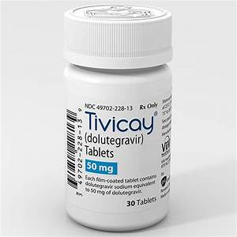
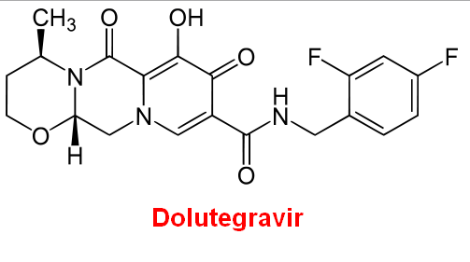
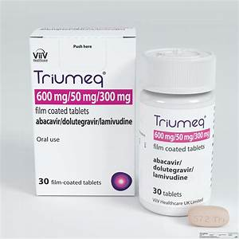

Main Subject -
Everything Dolutegravir
Studies in HIV-Infected Adults/Adolescents
Meireles MV et al. IAS, Amsterdam, July 2018 Abs. TUAB0101
Brazil MOH using national ARV and lab data, 6 mo viral suppression rates with DTG/TDF/3TC 42% better than EFV ART and >50% better than PI ART
Van Wyk J et al. IAS, Amsterdam July 2018 Abs. TUPDB0102
Neuropsychiatric symptoms were similar in adults receiving DTG and non-DTG ART regimens in analysis 5 RCT in >3,500 patients

Slide 3

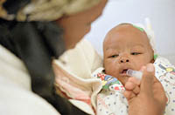
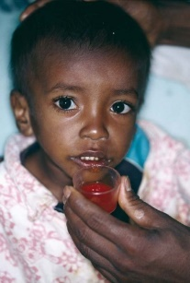
Main Subject -
Everything Dolutegravir
Studies in HIV-Infected
Infants and Children

Slide 4
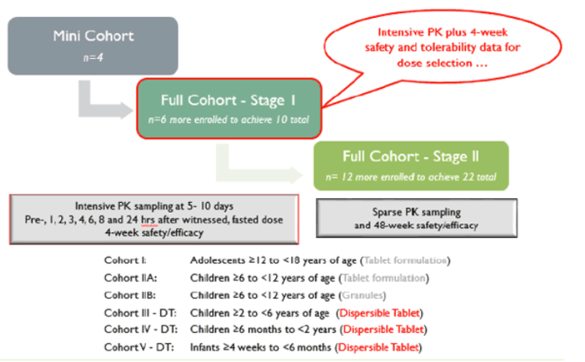
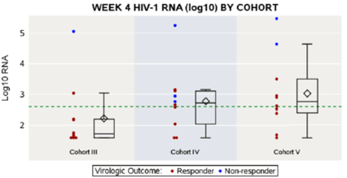
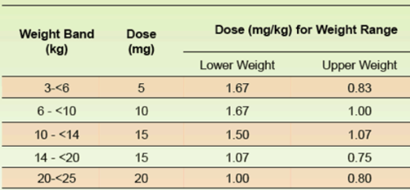
PK and 4-Week Safety/Efficacy DTG Dispersible Tablets in HIV+ Children 4 Weeks-6 Years: P1093
Ruel T et al. IAS, Amsterdam July 2018 Abs. LBPE023
Design of P1093
Children received DTG monotherapy or DTG added to stable-failing or empiric background ART. Intensive 24-hour PK sampling done between d5-10 with fasting, after which background regimens optimized based on enrollment genotypes.
N=30; 10 per age cohort
53% RNA >50,000
Week 4 Viral Response – HIV RNA by Cohort
Weight-Based DTG Dispersible Tab Dosing
400
>2yr-<6yr
>6mo -2yr
>4wk-<6mo
Responder: RNA <400 or >2 log ↓ Nonresponder: RNA >400 or <2 log ↓
At Week 4, 24/30 (80%) had RNA <400 or >2 log ↓ from baseline
Notes:
In P1093, once daily dosing of DTG-DT at median dose of ~ 1.2 mg/kg was well-tolerated, achieving mean AUC₂₄ and C_{24h}results within target range with universal declines in plasma HIV-1 RNA
No Grade 3 or 4 AE attributed to study drug, no d/c of drug due to AE
Given the moderate inter-subject PK variability, higher doses are likely needed for children 2 to < 6 years of age to reliably achieve a C_{24h} within the acceptable range

Slide 5
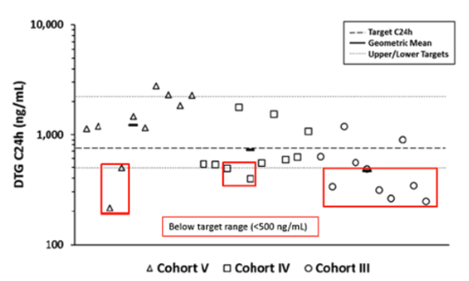
PK and 4-Week Safety/Efficacy DTG Dispersible Tablets in HIV+ Children 4 Weeks-6 Years: P1093
Ruel T et al. IAS, Amsterdam July 2018 Abs. LBPE023
Intensive PK Parameters by Age Cohort & Adult GM Targets
Cohort (N=10 each) | Age yr | Dose mg/kg | AUC₂₄ mg x h/L (arithmetic CV%) | C₂₄ ng/mL
III >2-<6 yr | 4.0 | 1.1 | 40 (36%) | 461 (59%)
IV >6m-<2yr | 1.2 | 1.2 | 51 (38%) | 711 (60%)
V >4wk-<6mo | 0.34 | 1.2 | 61 (44%) | 1207 (55%)
Adult target GM |  |  | 46 (range 37-86) | 750 (range 500-2260)
Geometric mean (GM) AUC₂₄ & C₂₄ were within target range except for C₂₄ value for Cohort III (>2-<6yr)
24 Hour Trough DTG by Age Cohort
DTG 5 & 10 mg doses in children >4wk-<6mo had exposures similar to adults
DTG 15 & 20 mg doses in older children >6mo-<6 yr generally had exposures in target range but C₂₄ values trended lower; thus, ↑ doses being assessed.
Clearance expected to be higher in older children as CYP3A4 and UGT1A1 matures
>4wk-<6mo
>6mo -2yr
>2yr-<6yr
Notes:
Due to moderate inter-subject PK variability, higher doses are likely needed for children 2 to < 6 years of age to reliably achieve a C_{24h} within the acceptable range
Clearance in older children may be expected and DTG metabolic enzymes UDT1A1 and CYP3A4 are immature in the neonate and mature to adult levels in first years of life

Slide 6
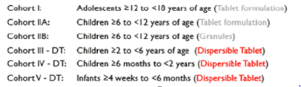
Emergence of INSTI Resistance After DTG Treatment in 6-18 Year Old Children Enrolled in P1093
Vavro C et al. AS, Amsterdam July 2018 Abs. THPEB114
Incidence of VF higher for youth 12-18 yr (18/46, 39%) than children 6-12yr (1/15, 7%)
P1093 cohorts
Viral failure: ↓RNA of <1 log at > Wk12 (unless <400); confirmed >400 > Wk24; resistance testing done with VF
VF associated with lack adherence in most cases
 | Cohort I >12-18 yr, tab | Cohort IIA >6-<12y, tab | Cohort IIB >6-<12y, granules
Enrolled | 23 | 23 | 15
VF | 12 | 6 | 1
INSTI resistance | 2 | 0 | 1
Time/mutation detected | Wk 36 - R263R/K Wk 192 - G118R+L74M | - | Wk 52 - G118R+E138E/K
INSTI resistance found in 3/19 (16%) children 6-18 yr with VF (all VF due to adherence issues)
INSTI mutational pathway with R263K or G118R, the latter having a greater impact on reduced DTG susceptibility
Notes:
In P1093, incidence VF was higher for adolescents 12-18yr than children 6-12yr and most cases were associated with non-adherence to >1 component of regimen
Among 6-18 year old participants receiving DTG containing regimen in P1093, INSTI resistance developed in 3 of the 19 (16%) who experienced VF.
INSTI resistance in these children followed either of two mutational pathways, R263K and G118R, the latter having a greater impact on reduced DTG susceptibility.

Slide 7
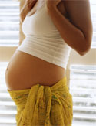

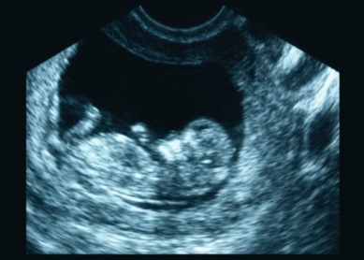
Main Subject -
Everything Dolutegravir
Studies in Pregnant Women

Slide 8
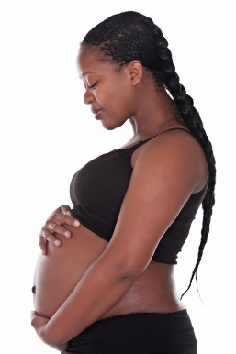

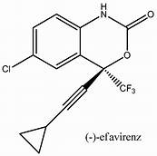
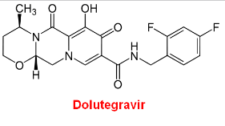
When Started During Pregnancy,
Do Pregnancy Outcomes
Differ Between Women on
DTG vs EFV-Based ART Regimens?

Slide 9
When Started During Pregnancy, No Difference Pregnancy Outcomes EFV vs DTG-Based ART
Zash R et al. Lancet Global Health 2018;6:e804-10
No difference in
Major Birth Defects with
First Trimester Exposure
EFV: 1/395 (0.3%)
DTG: 0/280 (0%)
(no NTD either drug)

Slide 10
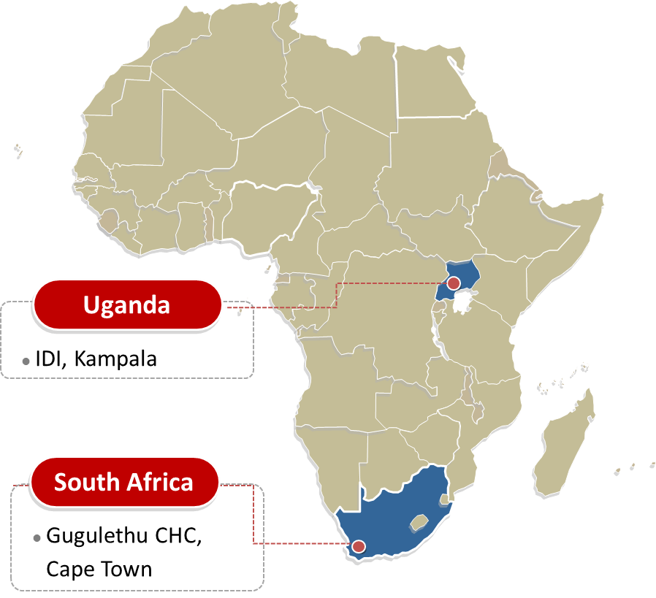

DTG vs EFV When Starting ART in Late Pregnancy
Orrell C et al. IAS, Amsterdam July 2018, Abs. THAB0307LB
Open-label randomized trial of DTG+2NRTI vs EFV+2NRTI in 60 pregnant ART-naïve women presenting to antenatal clinic at ≥28-36 weeks gestation in Kampala and Cape Town
Primary endpoint DTG PK 3rd trimester and 2 wk PP; secondary endpoints % VL<50 at delivery-2 weeks PP and safety
Randomize median 3 d
delivery
Start
EFV
ART
2 wk
PP
4 wk
PP
2 wk
4wk
ART-
naïve
>28-26
wks
gest
EFV + 2 NRTI
EFV + 2 NRTI
Maternal VL all
Maternal VL DTG arm
DTG+ 2 NRTI
EFV + 2 NRTI
Infant VL (dx)
DTG PK (24 hr)
60 enrolled : DTG (29 [27 in analysis]), EFV (31 [30 in analysis])
Median gestation age at enrollment, 31 weeks
No difference in baseline VL, CD4, previous obstetric history, gestation, BMI
21% reported use of traditional medicines
Notes:
In this pilot tudy, a significantly greater proportion of mothers initiating ART late in pregnancy achieved HIV-1 RNA <50 copies/mL with DTG- compared to EFV- based regimens
DTG exposures in T3 were relatively low. In-utero accumulation of DTG was high (121%).
Breast milk accumulation of DTG was 3% with higher exposures in breastfed infants, likely due to reduced drug clearance
Upon cessation, DTG was rapidly eliminated from breast milk; however infant washout was prolonged.
Safety of DTG and EFV was comparable; however evaluation is limited by small sample size, relatively short follow-up and by prior EFV use in all DTG mothers initiating ART
DolPHIN-2 (NCT03249181) is a randomised comparison of DTG vs EFV initiation in third trimester (28w – labour; N = 250).

Slide 11
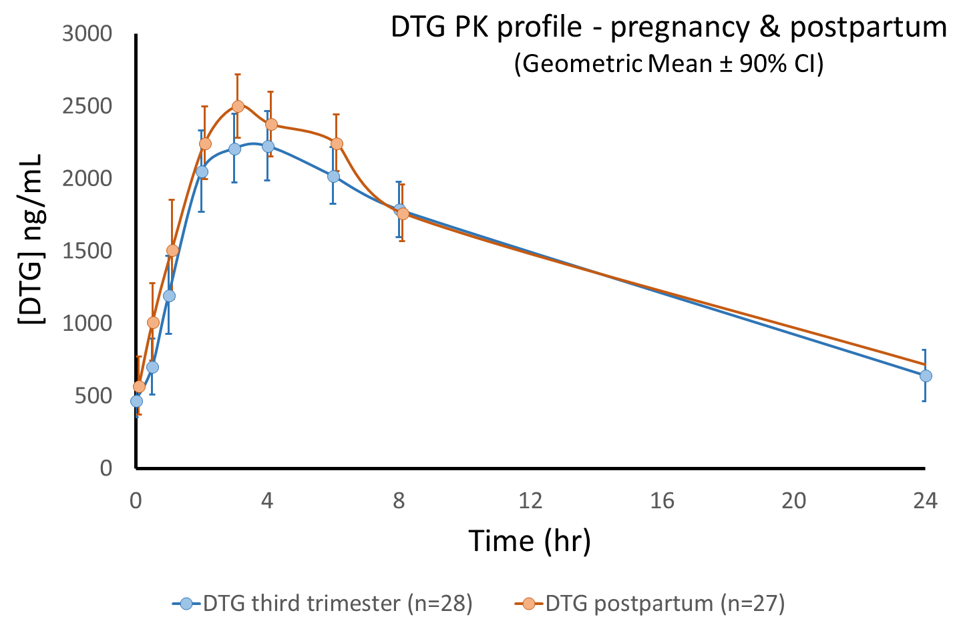
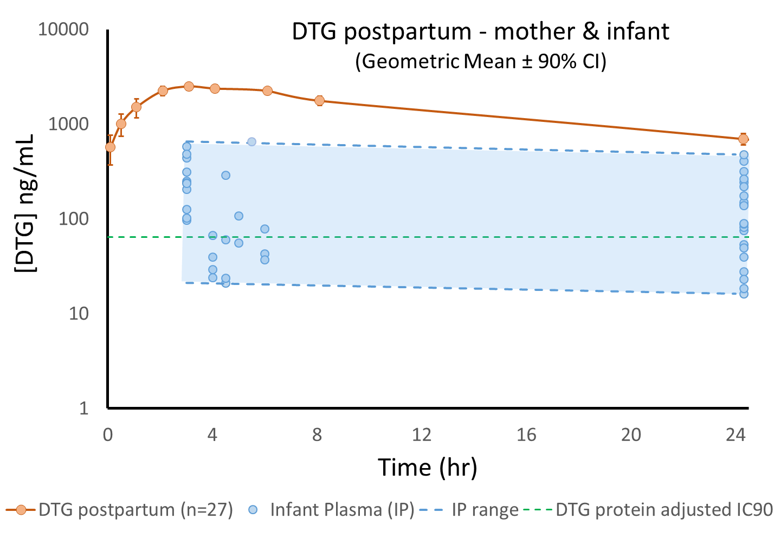
PK of DTG in Late Pregnancy/BM/Infant
Orrell C et al. IAS, Amsterdam July 2018, Abs. THAB0307LB
Modest ↓ of DTG 3rd trimester not warranting dose ↑; all but one DTG level > IC₉₀ 64 ng/mL
Median (range) maternal:cord blood ratio = 1.21 (0.51 – 2.11)
Breast milk/maternal plasma ratio:0.03 (3%)
MEC: 324 ng/ml
IC₉₀ 64 ng/ml
Maternal Plasma vs Infant Plasma (IP) DTG
High infant plasma levels: peak: 111 (50-172) ng/mL; trough: 87 (47-127) ng/mL
Infant/maternal plasma ratio: 5-12%
Slow washout of DTG in infants after maternal DTG cessation (immature glucuronidation enzyme)
64 ng/mL

Slide 12
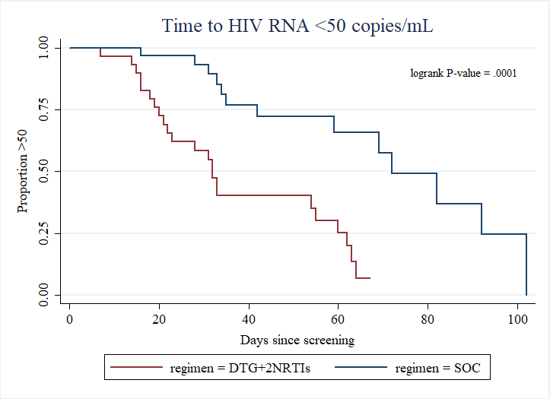
DTG Associated with More Rapid VL Decline Orrell C et al. IAS, Amsterdam July 2018, Abs. THAB0307LB
ITT (M=F) | DTG (N = 29) | EFV (N = 31) | P value **
HIV-1 RNA level at PP visit
<50 copies/mL * | 20 (69.0%) | 12 (38.7%) | 0.02
≥50 copies/mL | 9 (31%) | 19 (61.3%)
* <50 copies/mL or UD (Roche Ampliprep Cobas Taqman HIV-1 2.0)
** Pearson Chi-squared
Includes individuals missing or discontinued by visit
Median time to RNA <50 copies was approximately halved with DTG compared to EFV
By ITT, significantly greater proportion of DTG than EFV subjects achieved viral suppression at PP (2 wk) visit
1 mother in the DTG arm had undetectable DTG concentrations, with no VL response; another with [DTG] < 64 ng/mL experienced virological rebound (had 3-class drug resistance from baseline sample)

Slide 13
When Started Pre-Conception,
Do Pregnancy Outcomes
Differ Between Women on
DTG vs EFV-Based ART Regimens?

Slide 14
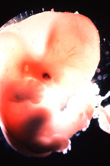
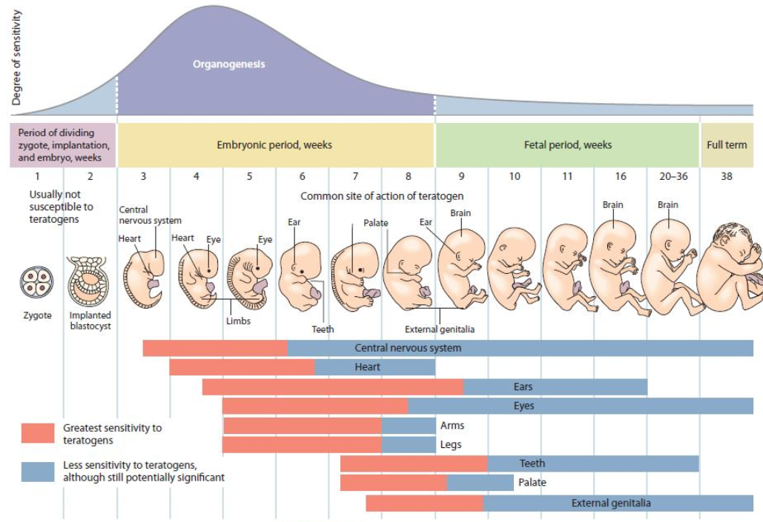
Timing of In Utero ARV Exposure
and Fetal Risk
First 2.5 Weeks Post-Fertilization:
Pre-Organogenic Period
generally not sensitive to teratogens

Slide 15
Timing of In Utero ARV Exposure
and Fetal Risk
Examples:
Neural Tube Closure by
Day 28
(e.g. myelomeningocele)
Oral Structure Formation by
Day 36
(e.g. cleft palate)
Weeks 3 to 8 Post Fertilization
Embryogenesis: Period of Major Organ Development
most sensitive period to teratogens

Slide 16
Timing of In Utero ARV Exposure
and Fetal Risk
Examples:
Alcohol after 24 weeks &
fetal-alcohol syndrome
Smoking after 20 weeks
and IUGR
After 8 Weeks Post-Fertilization
Fetal Development Period
Fetal growth; teeth; external genitalia; continued brain develop

Slide 17
Timing of In Utero ARV Exposure
and Fetal Risk
Greatest risk for serious defects is not in women starting during pregnancy but in those who conceive while receiving drug -
but most studies do not distinguish between 1st trimester and preconception exposure

Slide 18
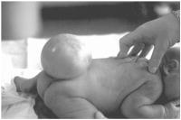
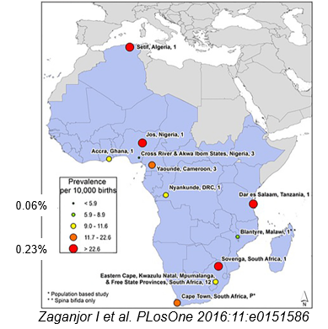

Expected Incidence of Neural Tube Defects
Blencowe H et al. Ann NY Aca Sci 2018;1414:31-46
Estimated prevalence of NTD in 2015 globally was 0.19% (0.15% to 0.23%) [19 (15–23)/10,000 birth outcomes]
About 50% of cases were elective terminations or stillbirths, so evaluation of only live births gives underestimation
African Region: Data from 11 studies from 8 countries analyzed
Median prevalence of NTD in Africa was 0.12% (range 0.06% to 0.23%)
P Musoke – CROI 2018 Abs 829
43,293 births (4,634 HIV+ women, 77% on EFV ART) in Uganda
Prevalence NTD: HIV-uninfected 0.09%, HIV+ 0.04%

Slide 19
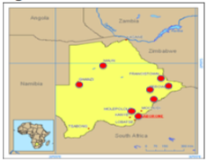
Botswana Tsepamo Study – Birth Surveillance
Zash R. IAS, Amsterdam July 2018 Late Breaker
Zash R et al. N Engl J Med 2018 July 24 epub
Designed to evaluate the risk of neural tube defects (NTD) with preconception EFV exposure
Prospective birth outcomes surveillance for major surface birth defects, 8 large maternity wards, population-based (45% of Botswana births)
  Trained hospital-based midwifes surface exam
  Research assistant consent mother for photo
  Medical geneticist reviews blinded to exposure
Good denominator with control groups and ability to distinguish between ARV regimens
  HIV-uninfected
  HIV-infected ART preconception or started in pregnancy
Notes:
The Tsepamo study started in august 2014, it s a birth outcomes surveillacne study funded by NICHD. The primary aims developed in 2014 were to evaluate adverse birth outcomes by HIV-status and ART regimen and determine if there is an increased risk of neural tube defects among infants exposed to EFV from conception
In 2016, Botswana became the first country to switch ART from TDF/FTC/EFV to TDF/FTC/DTG for all adults including pregnant women. Analysis plans updated include births exposed to dolutegravir
The antenatal record available at delivery for >99% of women, >95% of women delivery in a healthcare setting and termination of pregnancy is extremely rare
Large number of exposures in Botswana—due to a high HIV prevalence in pregnant women of about 25%, a high uptake of ART in of >90 % and also multiple ART regimens in use concurrently with more than half of women starting their ART prior to conception
For congenital abnormalities, trained hospital-based midwives do infant surface exams and congenital abnormalities. Then, as part of routine care, the midwife records details of the surface exam in the obstetric card which is abstracted.
Additionally, when an abnormality is noted, the midwife contacts the Tsepamo research assistant who then attempts to consent the mother for a photo of the abnormality.
These photos are reviewed by Dr. Lewis Holmes, a expert at MassGeneral Hospital in Boston, who is blinded to exposure

Slide 20
Botswana Tsepamo Study – Birth Surveillance
Zash R. IAS, Amsterdam July 2018 Late Breaker
Zash R et al. N Engl J Med 2018 July 24 epub
86 NTDs identified in 88,755 births
  0.10% (95% CI 0.08%, 0.12%)
  42 meningocele/myelomeningocele, 30 anencephaly, 13 encephalocele and 1 iniencephaly
  57% had photos, 43% descriptions
N=22 (25%) of all NTDs occurred among stillbirths
Among live-born babies with NTDs, 25 (39%) died within 28 days, and 1 had unknown vital status
Notes:
In total population identified 86 neural tube defects, a prevalence of 0.1%--these included 42 , 20, 13, 1 and 57% had photos
25% of all of our NTDs occurred among stillbirths and an additional 39% of the live-born infants with NTDs died in the hospital within 28 days.

Slide 21
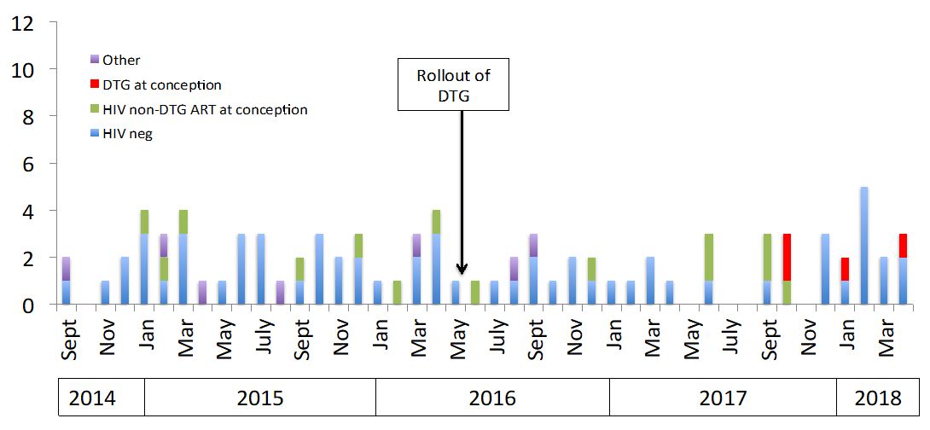
No Recent Increase in NTDs Overall
No clustering by site (3 different sites)
No difference in a common minor abnormality (polydactyly) to suggest a differential ascertainment
Date of conception
* Formal sensitivity analysis showed same results when restricting to births occurring after the rollout of DTG

Slide 22
Tsepamo Study: Neural Tube Defect (NTD)
Zash R. IAS, Amsterdam July 2018 Late Breaker
Zash R et al. N Engl J Med 2018 July 24 epub
Deliveries up to 1 MAY 2018
DTG at conception:
  4/426 (0.94%; 95%CI 0.37%, 2.4%)
Non-DTG ART at conception:
  14/11,300 (0.12%; 95%CI 0.07%, 0.21%)
EFV at conception:
  3/5,787 (0.05%; 95%CI 0.02%, 0.15%)
DTG started during pregnancy:
  0/2,812 (0.00%; 95%CI 0.0%, 0.13%)
Non-DTG ART started during pregnancy:
  3/5,624 (0.05%, 95% CI 0.02%, 0.16%)
HIV-uninfected
  61/66,057 (0.09%, 95%CI 0.07%, 0.12%)
Notes:
Unexpected signal of increase in NTD with preconception DTG exposure, 95% CI do not overlap any other group

Slide 23
NTD Prevalence Difference by Exposure
NTDs/Exposures | 4/426 | 14/11,300 | 3/5,787 | 0/2.812 | 61/66,057
% with NTD (95% CI) | 0.94% (0.37%, 2.4%) | 0.12% (0.07%, 0.21%) | 0.05% (0.02%, 0.15%) | 0.00% (0.00%, 0.13%) | 0.09% (0.07%, 0.12%)
Prevalence Difference (95% CI) | ref | -0.82% (-0.24%, -2.3%) | -0.89% (-0.31%,- 2.3%) | -0.94% (-0.35%, -2.4%) | -0.85% (-0.27%, -2.3%)
Notes:
CI don’t overlap with any other groups, and there was significant increase in the prevalence difference between DTG at conception and all other exposure groups, of about 0.8%

Slide 24
Update since 1 May 2018
From 1 May-15 July, there were 2 more NTDs; 1 in an infant exposed to DTG started during pregnancy (8 weeks GA) and 1 birth to an HIV-uninfected woman:
  NTDs in DTG started during pregnancy: 1/3104 (0.03%, 95% CI 0.01%, 0.18%)
Updated prevalence of DTG exposure at conception is 4/596 (0.67%, 95% CI 0.26%, 1.7%)
-- 95% CI still does not overlap with any other exposure group
2014
2015
2016
2017
2018
Notes:
Tspeamo has continued to collect data. Since prior analysis, there was 2 more NTD in the entire cohort—a myelomeningocele in an infant exposed to DTG starting the 8th week of pregnancy. As this was the first NTD in this exposure group, the updated prevalence is 0.03%
Also 170 more DTG conception exposures without any further NTD and so the updated prevalence for this group is 0.67% and the 95% confidence interval still does not overlap other groups
As you can see from the figure—there is not much to make about there not being another event in the last few months—we previously had a gap from October to Jan and then to April

Slide 25
Projections for March 2019
With expanded surveillance to 18 sites, we estimate ~ 1226 births with exposure to DTG from conception by end of March 2019
With 0 more NTDs, the lower CI overlaps with the upper CI for other ART at conception (0.21%), EFV at conception (0.15%) and with HIV-uninfected (0.13%)
With 1 more NTD, the lower CI overlaps with the upper CI for other ART at conception (0.21%)
Notes:
Real-time monitoring will occur ever 200 DTG-conception exposures which will share with sponsor and regulatory agencies.
Formal analysis using data through 31 March 2019. This date is approximately 40 weeks after the initial warnings about DTG went out, so will include women who had already fallen pregnant on DTG prior to the warnings.
Expanding sites from 8 to 18 to improve coverage of all births from 45% to 72%.
Final analysis in 2019 will include not just NTDs but also all other major malformations and other adverse birth outcomes
Project will capture about 1226 births with exposure to DTG from conception.
If we have no more NTDs in the DTG-conception group, the total prevalence will be 0.33% and the lowed CI of 0.13% will overlap with the upper CI for other ART at conception, EFV at conception and HIV-uninfected groups.
With 1 more event, the prevalence will be 0.41% and the lower CI of 0.18% will overlap with the upper CI for other ART at conception.

Slide 26

Drug Therapy in Pregnancy
Balancing act
Risk of
Adverse
Fetal Effects
Benefit of
Maternal
Treatment
DTG:
Rapid VL decline
Better tolerated
Less expensive
DTG:
Potential signal for neural tube defect with preconception exposure
Unfortunately there are often only limited data to make recommendations

Slide 27
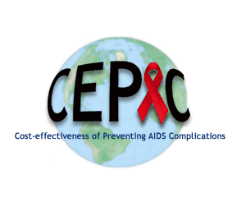

Modeled Two Different Strategies for Women
Dugdale C et al. IAS, Amsterdam July 2018, Late Breaker
CEPAC computer simulation evaluation of public health approach – assume only one ART regimen can be recommended as 1st-line for all women of childbearing-age
Parameterized: South Africa data
Dolutegravir (DTG): Initiation of/switch to dolutegravir-based ART
Efavirenz (EFV): Initiation of/continuation of efavirenz-based ART
Women’s cohort: Women 15-49y living with HIV in South Africa
  1.7M on ART + 1.8M to start over five years = 3.5M )
Pediatric cohort: HIV-exposed children
  1.1M children (age-stratified HIV prevalence & fertility rates)
Benefit of
Maternal
Treatment
Balancing act
Risk of
Adverse
Fetal Effects
All women of
childbearing-
potential
should get DTG
All women of
childbearing-
potential
should get EFV
DTG:
Rapid VL decline
Better tolerated
Less expensive
DTG:
Potential signal for NTD with preconception exposure
Notes:
Modeling benefits vs risks comparison of women of childbearing age if ONLY DTG-based ART was provided or ONLY EFV-based ART was provided
Use of DTG DTG-based ART for all women would avert >25,000 deaths among women of childbearing age and 5,000 new pediatric HIV infections vs EFV-based ART for all women over 5 years in South Africa
These benefits may come at expense of overall pediatric survival if increased risk of NTDs with DTG from Tsepamo persists with additional data
However, there would be approximately 3-fold more deaths averted among women than pediatric deaths added with use of DTG for all women of childbearing age with HIV in South Africa compared with use of EFV for all women
Did not assess an “INDIVIDUALIZED APPROACH” to ART recommendations, with DTG for some women and EFV for other
Facilitating access to contraception or women’s individual choice of ART could lead to different results for both women and their children

Slide 28
Model inputs
Dugdale C et al. IAS, Amsterdam July 2018, Late Breaker
Input Parameter | Base case | Ref (s)
Neural tube defect (NTD) risk, %* | DTG: 0.9% EFV: 0.05% | Zash IAS 2018 Ford AIDS 2014
Fertility rates per 1,000 women (range by age) | 2-139 | 2016 South Africa Key Indicators Report
Sexual transmissions, rate/100PY (range by HIV RNA) | 0.16-9.03 | Attia AIDS 2009
Peri- and postnatal transmission risks (range by material ART, CD4, and virologic suppression status) |  | Myer HIV Med 2017, Iliff AIDS 2005 Petra Lancet 2002, Shapiro NEJM 2010 Ngoma JIAS 2015, Mandelbrot CID 2015
Perinatal transmission, one-time % | 0.44-27
Postnatal during breastfeeding, %/mo | 0.05-1.28
* Assumed 100% mortality with NTDs
SINGLE Trial: Largest published RCT comparing DTG and EFV
Strategy | 48w suppressive efficacy* | CD4 increase at 48w on suppressive ART
DTG | 94% | 267 cells/µL
EFV | 86% | 208 cells/µL

Slide 29
Results: Five-Year Outcomes for Women and Children in South Africa
Dugdale C et al. IAS, Amsterdam July 2018, Late Breaker
Outcome* | DTG | EFV | Δ | Δ
DTG demonstrated benefit DTG better by:
Number of deaths among women | 263,200 | 291,600 |  | 28,400
Sexual transmissions | 192,500 | 245,300 |  | 52,800
Pediatric HIV infections | 14,900 | 19,900 |  | 5,000
Non-neural tube defect-related pediatric deaths | 90,800 | 92,400 |  | 1,600
EFV demonstrated benefit EFV better by:
Neural tube defects | 10,600 | 600 |  | 10,000
Cumulative pediatric deaths** | 101,400 | 93,000 |  | 8,400
Children alive and HIV-free | 1,015,700 | 1,021,100 |  | 5,400
3.4x
*Out of projected 3.5 million women ever on first-line ART and 1.1 million HIV-exposed children.
**Cumulative pediatric deaths = non-neural tube defect-related + neural tube defect-related deaths

Slide 30
Results: Five-Year Outcomes for Women and Children in South Africa
Dugdale C et al. IAS, Amsterdam July 2018, Late Breaker
DTG-based ART for all women would avert >25,000 deaths among women of childbearing age and 5,000 new pediatric HIV infections vs EFV-based ART for all women over 5 years in South Africa
These benefits may come at expense of overall pediatric survival if increased risk of NTDs with DTG from Tsepamo persists with additional data
However, there would be approximately 3-fold more deaths averted among women than pediatric deaths added with use of DTG for all women of childbearing age with HIV in South Africa compared with use of EFV for all women
Outcome* | DTG | EFV | Δ | Δ
DTG demonstrated benefit DTG better by:
Number of deaths among women | 263,200 | 291,600 |  | 28,400
Sexual transmissions | 192,500 | 245,300 |  | 52,800
Pediatric HIV infections | 14,900 | 19,900 |  | 5,000
Non-neural tube defect-related pediatric deaths | 90,800 | 92,400 |  | 1,600
EFV demonstrated benefit EFV better by:
Neural tube defects | 10,600 | 600 |  | 10,000
Cumulative pediatric deaths** | 101,400 | 93,000 |  | 8,400
Children alive and HIV-free | 1,015,700 | 1,021,100 |  | 5,400
3.4x
*Out of projected 3.5 million women ever on first-line ART and 1.1 million HIV-exposed children.
**Cumulative pediatric deaths = non-neural tube defect-related + neural tube defect-related deaths

Slide 31
Limitations
Dugdale C et al. IAS, Amsterdam July 2018, Late Breaker
We did not assess an “individualized approach” to ART recommendations, with DTG for some women and EFV for others
  Facilitating access to contraception or women’s individual choice of ART could lead to different results for both women and their children
ART efficacy inputs were informed by the SINGLE Trial
  Trial was performed in resource-rich settings; >10% pre-treatment drug resistance has been reported in sub-Saharan Africa
Unclear whether the early signal of increased neural tube defects with DTG will be borne out over time

Slide 32
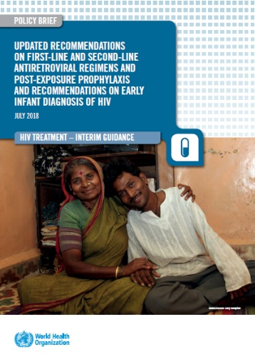

Main Subject -
Everything Dolutegravir
WHO 2018 Guidelines Update

Slide 33
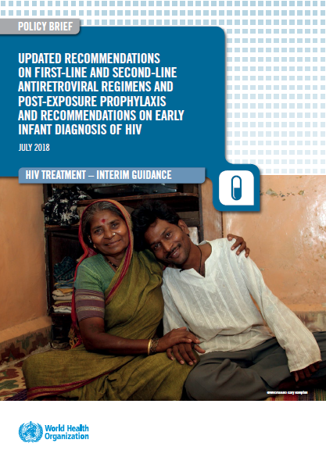
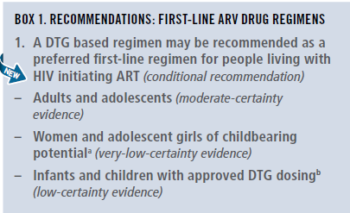

New WHO Recommendations 1st Line ART
Meg Doherty, WHO - IAS July 24 2018
DTG also preferred for 2nd line and PEP

Slide 34
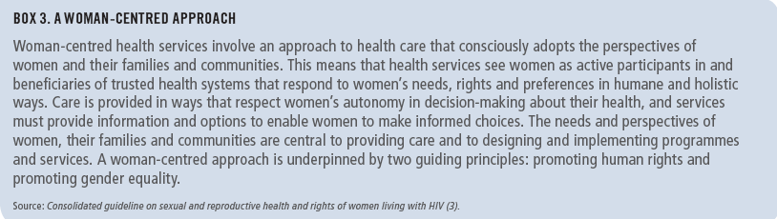
Note of Caution for Using DTG in Women and Adolescent Girls of Childbearing Potential
Exposure to DTG at the time of conception may be associated with NTD risk among infants.
DTG appears to be safe when started after the period of risk of neural tube defects (ie, up to 8 weeks after conception).
Adolescent girls and women of childbearing potential who do not currently want to become pregnant can receive DTG together with consistent contraception (hormonal contraception and DTG have no reported or expected drug–drug interactions).
An EFV-based regimen is a safe and effective first-line regimen and can be used among women of childbearing potential during the period of potential risk for developing NTDs.
National programmes should consider the balance of benefits and risks when selecting the optimal ARV regimen for women and adolescent girls of childbearing potential (fertility levels, contraceptive availability and coverage, pretreatment resistance to NNRTIs at the population level, drug availability and the maternal and infant toxicity profile).

Slide 35

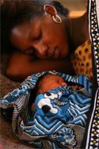
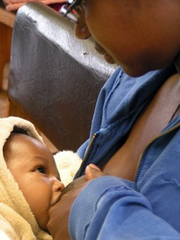
Prevention of
Mother to Child
HIV Transmission

Slide 36
PMTCT in Malawi - Malawi Population-Based HIV Impact Assessment (PHIA)
Auld F et al. IAS, Amsterdam July 2018 Abs. THAC0303
Used MPHIA data 2015-2016 to measure PMTCT/EID cascade
  Women consented/interviewed about most recent pregnancy in last 3 years and PMTCT/EID cascade
Attend ANC
HIV status ascertained
Mother on ART
Infant on prophylaxis
EID testing
  Analysis limited to women aged 15-49 years reporting a live birth in the 3 years before the survey (N=3,598)
    HIV status known: 3,209 HIV-; 302 HIV+
      HIV+ vs HIV-:
        older (47% vs 28% >30yr)
        higher parity (53% vs 32% parity>4)
        more likely pregnancy unplanned (61 vs 52%)
Notes:
ANC attendance, awareness of HIV status, and uptake of PMTCT were high
EID testing within two months of birth, as recommended in the Malawi National Guidelines, was the largest gap in the PMTCT/EID cascade
Family disclosure, maternal education, and infant prophylaxis were significantly associated with timely EID testing
Temporality of EID testing and family disclosure cannot be established in this cross-sectional survey
Limitation - data are all self-report, so possible social desirability bias in self-reported HIV status, ARV use during pregnancy, and EID testing

Slide 37
PMTCT in Malawi - Malawi Population-Based HIV Impact Assessment (PHIA)
Auld F et al. IAS, Amsterdam July 2018 Abs. THAC0303
HIV+
Of those reporting EID testing, 3.9% (95% CI: 1.4-6.4) reported a + result (3.9% transmission self-report)
EID independently associated with higher maternal education level, maternal disclosure – and higher infant uptake of CTX
Notes:
While findings confirm good PMTCT performance, identifying remaining gaps and areas for intervention are key to achieving EMTCT in Malawi; EID is major gap

Slide 38

Birth Outcomes and HIV-Free Survival, Lesotho
Tiam A et al. IAS, Amsterdam July 2018 Abs. THAC0304
PEA-WIL observational study enrolled 941 HIV-negative and 653 HIV+ (98% on ART) pregnant women seeking ANC from selected facilities from June 2014 to August 2015 (Option B+).
 | Birth Outcomes HIV- vs HIV+ |  |  | P-value
 | HIV-negative N=941 | HIV-positive N=653 | HIV-positive N=653
Birth Outcome
Liveborn | 841 (96.7) | 603 (96.6)
Liveborn, died<2hrs | 12 (1.4) | 4 (0.6) |  | 0.031
Fresh (during delivery) stillbirth | 12 (1.4) | 5 (0.8)
Macerated (before delivery) stillbirth | 5 (0.6) | 12 (1.9)
Missing data | 71 | 29
Prematurity
Premature | 35 (4.0) | 52 (8.3)
Term | 830 (96.0) | 572 (91.7) |  | 0.001
Missing data | 76 | 29
Congenital Anomalies
No | 861 (99.0) | 620 (99.4)
Yes | 9 (1.0) | 4 (0.6)
Missing data | 71 | 29
Birth Weight (kg)
Mean (SD) | 3.1 (0.5) | 3.0 (0.5) | 3.0 (0.5) | 3.1 (0.5)
HIV+ vs HIV- women
Fewer fresh (during delivery)
stillbirths
More macerated (pre-delivery)
stillbirths
More preterm
No diff birth defect
No diff BW
Notes:
Higher rates of prematurity and higher rates of macerated stillbirth (stillbirth occurring prior to delivery) among infants born to HIV-positive mothers but neonatal death and fresh stillbirth (stillbirth occurring around time of delivery) slightly higher among HIV-uninfected women
Six-week survival among HIV-exposed infants was comparable to HIV-unexposed infants
MTCT rate by six weeks was low (1.3%) and HIV-free survival (96.5% excluding and 93.7% including stillbirths) was high among mother-infant pairs enrolled in a universal ART prevention of mother-to-child transmission program

Slide 39
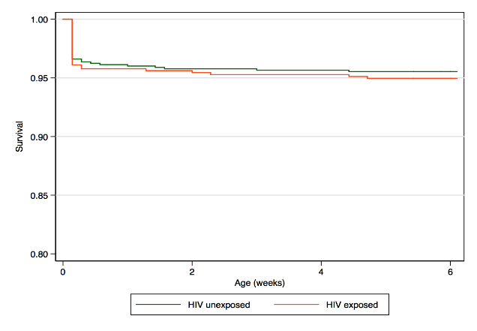
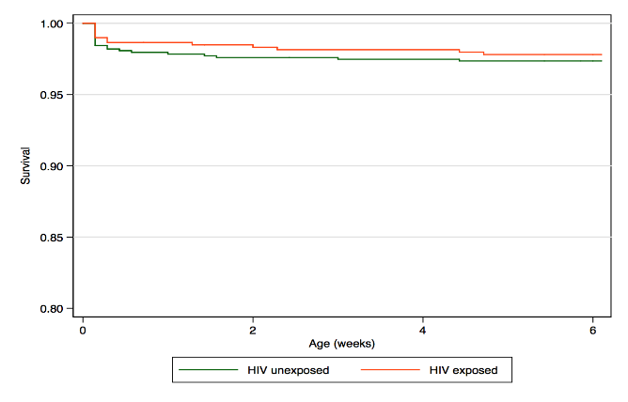
No Difference 6-Week Survival HUU vs HEI
Tiam A et al. IAS, Amsterdam July 2018 Abs. THAC0304
6-Week HIV Infection Rate Low
6 Week Survival – HUU vs HEI
 | HIV-Unexposed |  | HIV-Exposed |  | P-value
 | Death (Rate) | Survival (95% CI) | Death (Rate) | Survival (95% CI)
Including stillbirths | 38/853 (4.5%) | 95.5 [93.9 – 96.7] | 31/616 (5.0%) | 95.0 [92.9 – 96.4] | 0.604
Excluding stillbirths | 22/834 (2.6%) | 97.4 [96.0 – 98.2] | 13/596 (2.2%) | 97.8 [96.3 – 98.7] | 0.582
K-M of 6-Week Survival HUU vs HEI
Including
stillbirths
Excluding
stillbirths
Log Rank test p-0.60
Log Rank test p-0.58
Eight infants (1.3%, 95% CI 0.3-1.9%) were HIV-infected by six weeks:
    + at birth (IU infection): 0.8% (N=5) (95%CI: 0.26 - 1.90)
 | Infected or Death | HIV-Free Survival
Including stillbirths | 39/616 (6.3%) | 93.7 [91.4 – 95.3]
Excluding stillbirths | 21/596 (3.5%) | 96.5 [94.6 – 97.8]
6-Week HIV-Free Survival
Notes:
In era of universal life-long ART for all HIV+ mothers:
Six-week survival among HIV-exposed infants was comparable to HIV-unexposed infants
6-week HIV infection rate low and HIV-free survival high among HIV-exposed infants

Slide 40
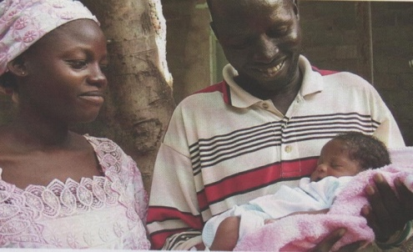
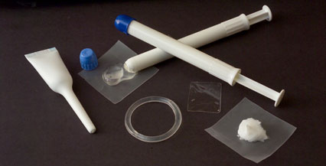


Safer Conception

Slide 41

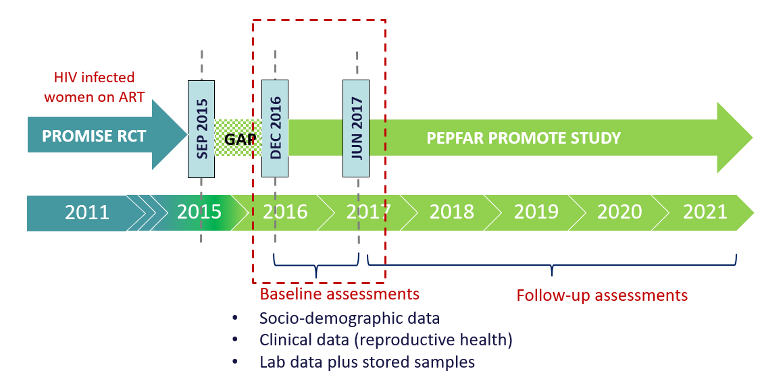


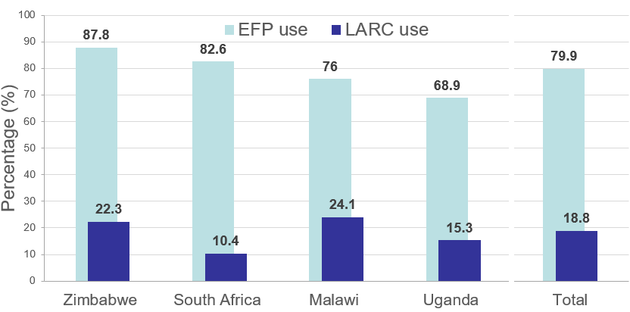
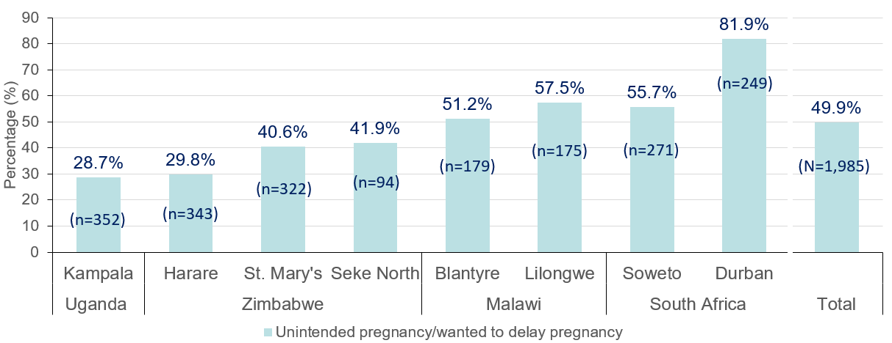
High Frequency Unintended Pregnancy in African Women
on Life-Long ART: PEPFAR PROMOTE study
Aizire JK et al. IAS, Amsterdam July 2018 Abs. THAB0301
8 sites in 4 countries with continued FU of HIV+ women on ART from the PROMISE perinatal trial
Most women on EFV-based ART
High rates of reported unintended pregnancy at last pregnancy, with significant variation by site/country
Use of effective contraception also varied by country
P =<0.001
P =<0.001
P =<0.001
Women with VL >1000 were less likely to report EFP or LARC use
Notes:
Baseline data on continued follow-up of women on ART from the PROMISE perinatal study after completion of breastfeeding – study end Sept 2015, PROMOTE follow-up study initiated Dec 2016; enrollment Dec 2016 through June 2017 for baseline assessment – follow-up through 2021
Unintended pregnancy was common among these HIV-infected African women - at baseline, there were high rates of reported subsequent to PROMISE delivery of unintended pregnancy, with significant variation by site; use of effective contraception also varied significantly by site – LARC were underutlizied
Women with VL >1000 were less likely to report use of effective contraception of long-acting reversible contraception
Programmatic research should explore integrated ART and LARC delivery in consideration of the unique reproductive health challenges among HIV-infected African women on universal ART

Slide 42

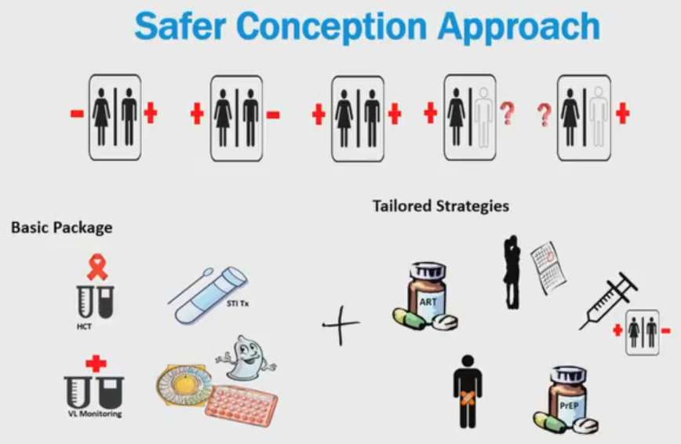
Safer Conception Clinic
Demonstration Project, S Africa
Schwartz S et al. IAS, Amsterdam July 2018 Abs. THAC0301
Adults trying to conceive and in discordant partnership were enrolled in a demonstration project dedicated safer conception clinic in S Africa July 2013-July 2017
Q mo counseling/clinical monitoring; fertility services if >6 mos unsuccessful
Enrolled:
  334 women, 87% HIV+ (of HIV+, 84% on ART, 61% suppressed)
  192 men, 69% HIV+ (of HIV+, 76% on ART, 46% suppressed)
Basic
HIV CT
STD rx
VL monitoring
Contraception
Tailored
ART
Timed condomless sex
Self-insemination if HIV- man
VMC
PrEP
Notes:
Real-world data on implementation safer conception servies
Feasible to implement services with women and men
Pregnancy incidence relatively how but HIV+ women had lower conception than HIV- women and took longer to conceive (many >6 mos)
Viral suppression cannot be assumed in pt trying to conceive even if already on ART – particularly given prolonged time attempting conception
Fertility planning especially important with DTG roll-out

Slide 43
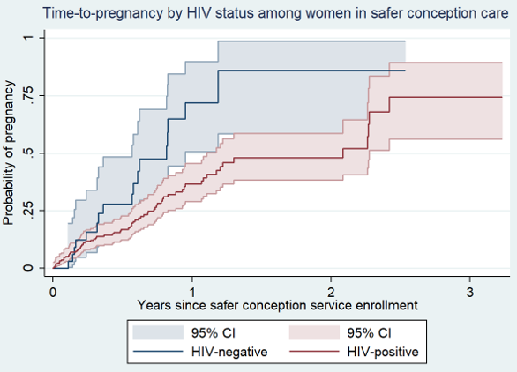
Safer Conception Clinic
Demonstration Project, S Africa
Schwartz S et al. IAS, Amsterdam July 2018 Abs. THAC0301
Safer conception visits: 2,956
>1 FU visit: 293/334 (88%) couples (mean # visits 7.5 per woman, 3.8 per man)
Median 4 months [IQR:2-8] to be given the go-ahead to start trying to conceive
98 pregnancies in 88 women, 47.9/100 person-years (95%CI:38.9,59.1)
  HIV+ women 52% less likely to conceive as HIV- (IRR:0.48, 95%CI:0.28,0.87)
  Median time-to-pregnancy:
    0.8 years for HIV- women
    2.1 years for HIV+ women

Slide 44
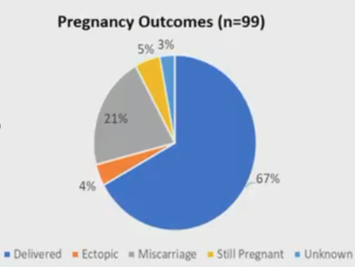
Safer Conception Clinic
Demonstration Project, S Africa
Schwartz S et al. IAS, Amsterdam July 2018 Abs. THAC0301
17% conceived via self-insemination, 83% through timed condomless sex
67% of HIV- negative partners retested during FU
  Mean # tests during study: women 5.8, men 2.5 (p<0.01)
HIV Prevention Indicators
Conceived on PrEP | 11/21, 52%
VL <50 at pregnancy | 68/78, 87%
VL <1000 at pregnancy | 77/78, 99%
EID for baby HIV+ mother | 41/47, 87%
Infections in infants | 0
Infections in HIV- partners | 0

Slide 45
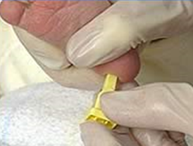
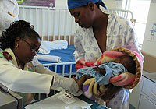
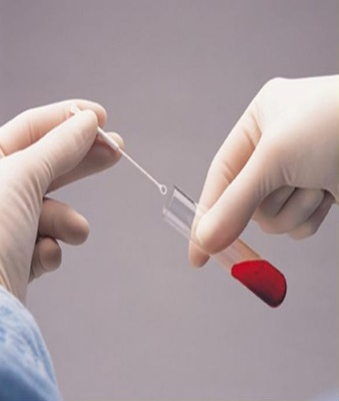
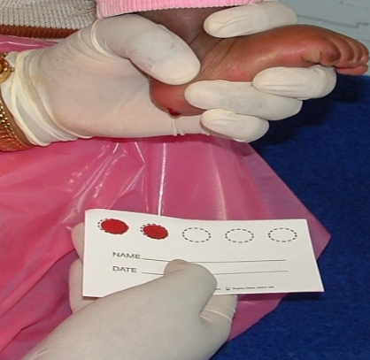
Infant HIV Diagnosis and
HIV Testing Older Children

Slide 46


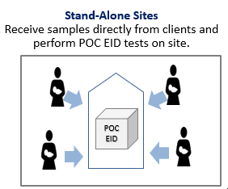
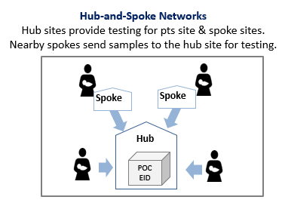
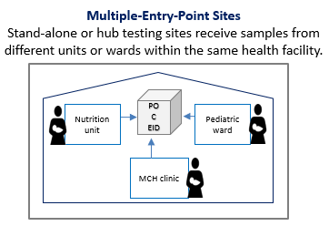
POC Test Implementation, 9 Countries
Bianchi F et al. IAS, Amsterdam July 2018 Abs.TUAE0102
EGPAF/UNITAID is implementing POC in 9 countries; compared pre- and post-POC intervention data
Site types to maximize access to testing
Pre-intervention data – Conventional EID
Retrospective, 8 countries: 30 consecutive HIV-exposed infants tested, register data collected from Mar 2014-May 2017 from facility registers from subset of sites (up to 20/country)
Sample: 2,899 tests from 2,875 HIV-exposed infants from 96 sites
Post-intervention data – POC EID
Prospective all POC EID sites, 8 countries, data collected until Dec 2017 in 339 sites (106 primary, 233 spoke sites)
Sample: 19,071 tests from 18,220 HIV-exposed infants
Notes:
To optimize access, have both standalone testing sites, where tests are processed on-site and created the hub and spoke network, where hub testing sites receive samples from surrounding spoke sites that alone could not support the placement of a platform but when combined with other sites to form the network, it increase platform throughput.
Additionally, tests from multiple entry points beyond ANC/PMTCT clinics, including from maternity, pediatric inpatient wards, vaccination clinics, outpatient clinics received.
POC testing resulted in rapid turnaround of results to caregivers and rapid start on ART for HIV+ children after result return. While Spoke a little bit slower for result return than Hub, % HIV+ starting ART same.
POC especially useful in ped inpt and OPD, where HIV+ rate higher and children sicker and hence need ART quickly

Slide 47
POC Test Implementation:
Pre vs Post-Implementation/Hub vs Spoke
Bianchi F et al. IAS, Amsterdam July 2018 Abs.TUAE0102
CONVENTIONAL PRE VS POC POST | PRE: Conventional EID | POST: POC EID | p value
Number of infants tested | 2,875 | 18,220 | ---
Number of EID tests | 2,899 | 19,071 | ---
Median TAT blood sample to result return to caregiver (IQR) | 55 days (31-77) | 0 days (0-1 ) | p<0.001
Results received by caregiver within 30d | 18.7 % (542/2,899) | 98.3% (18,737/19,058) | p<0.001
% HIV+ infants started on ART within 60d sample collection | 43.3% (42/97) | 92.3%(639/692) | p<0.001
Median TAT blood sample to ART start HIV+ infants (IQR) | 49 days (30-68) | 0 days (0-3) | p<0.001
HUB VS SPOKE | Hub Sites (n = 106) | Spoke Sites (n = 233 ) | p value
Number of infants tested | 13,070 | 5,155 | ---
Number of EID tests | 13,673 | 5,398 | ---
Median TAT blood sample to result return to caregiver (IQR) | 0 days (0-0) | 2 days (1-7) | p<0.001
Results received by caregiver within 30d | 99.4% (13,591/13,667) | 95.5% (5,146/5,391) | p<0.001
% infected infants | 4.1% (534/13,019) | 3.1% (161/5,136) | P=0.002
% HIV+ infants start ART within 60d sample collection | 91.9% (488/532) | 94.4% (151/160) | p=0.270
Median TAT blood sample to ART start for HIV+ infants (IQR) | 0 days (0-1) | 3 days (1-5) | p<0.001
Notes:
Conventional vs POC: Our data show that POC did significantly better across all our indicators as compared to conventional EID. HIV-infected infants can be started on treatment on the same day they are tested.
Hub vs spoke: Despite a statistically significant difference for most outcomes, there really is no clinical difference in key outcomes for children tested at either a spoke or testing site. Importantly, there is no difference, statistically or clinically, for HIV positive infants who are initiated on treatment within 60 days, which is very encouraging.

Slide 48
POC Test Implementation:
Entry Point and Proportion with HIV Infection
Bianchi F et al. IAS, Amsterdam July 2018 Abs.TUAE0102
Entry Point | Infants Tested (% of all infants tested) | % HIV-infected infants | % HIV+ infants started on ART
PMCT | 15,493 (85.4%) | 3.2% (494/15,493) | 95.1% (470/494)
Maternity | 1,078 (5.9%) | 1.1% (12/1,078) | 66.7% (8/12)
Pediatric Inpatient | 526 (2.9%) | 15.2% (80/526) | 86.3% (69/80)
Immunization | 412 (2.3%) | 2.9% (12/412) | 83.3% (10/12)
Outpatient | 265 (1.5%) | 17.7% (47/265) | 87.2% (41/47)
POC EID appears to be particularly beneficial for alternative entry point testing, such as pediatric inpatient and outpatient wards.
These entry point had higher HIV+ rates than PMTCT (15-17% vs 3%)
Children presenting at these entry points often at an advanced stage of illness and starting ART rapidly important

Slide 49




Intensifying Efforts to Diagnose HIV+ Children & Youth
Suggu K et al. IAS, Amsterdam July 2018 Symposium THSA01
HIV+ women who don’t access ANC services at all
Women who seroconvert after testing negative in ANC
Women who drop off from PMTCT programs
Majority of 180k new infections
HIV-exposed and positive infants
Adolescents with complex behavioral challenges
Majority of unmet need for peds & adolescents
Children being missed in very high volume settings like OPD
Asymptomatic (or well) children not coming to the health facility
Children and adolescents
An approach that targets this hard-to-reach heterogeneous group of mothers, infants, young, and older children is needed
Notes:
UNAIDS 2018 Estimates:
New infections among children (0-14): 180,000

Slide 50
An Optimal Mix of Testing Strategies to
Maximize Identifications is Needed
High Volume
Community Testing
Low-yield; screening needed given risk of massive volumes
OPD
Underutilized; high volume, screening impacts yield
Index Testing
underutilized, High-yield potential
Low Yield
High Yield
Inpatient Testing
Nutrition, TB
High yield but limited volume
Low Volume

Slide 51
Intensifying Efforts to Diagnose HIV+ Children & Youth
How Do We Get to the Finish Line?
Suggu K et al. IAS, Amsterdam July 2018 Symposium THSA01
  Be more strategic: The right testing mix may vary by context. Use data to prioritize mix of testing strategies, set identification targets, re-assess regularly, and adapt to evolving context.
  Scale-up underutilized strategies: Finish the job in sick wards, optimize OPD testing, improve index testing, and consider making self-tests available to parents/caregivers.
  Adopt a comprehensive approach to case-finding: Support policies with clear operational guidelines, provide training and mentorship, use analysis to inform and update strategy.
  Improve coordination: Improve coordination, especially with faith-based and community organizations. Ideally, all partners should be informed by, and working towards one comprehensive strategy.

Slide 52





Pre-Exposure Prophylaxis
PrEP
Family planning/MCH
Youth
Pregnancy

Slide 53

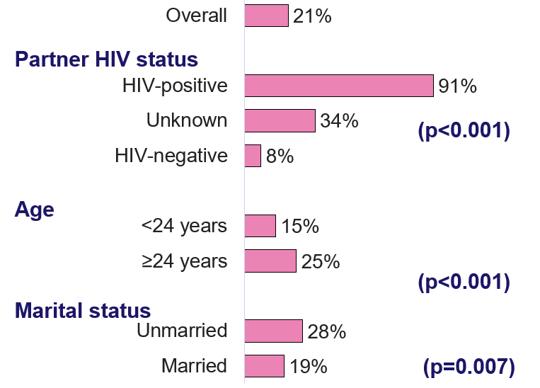


Uptake PrEP in Clinics with Integrated
MCH/Family Planning/PrEP Services, Kenya
Pintye J et al. IAS, Amsterdam July 2018 Abs. TUAC304
PrEP offered to 1122 HIV-uninfected women attending routine family planning visits at 18 sites in Kisumu county, Kenya
PrEP Uptake by Pt Characteristics
PrEP Uptake by FP Method
Opted for PrEP 232 (21%)
Evaluated associated factors for decline/ accept
Known HIV+ partner
Use implant, OCP
Older age
Factors Associated with Acceptance PrEP
Unmarried
N=1122 Crude Odds Ratio (95% CI)
Diagnosed with STI¹ | 10.6 (4.1-27.1)**
Forced to have sex¹ | 6.6 (2.2-20.3)*
Experienced IPV¹ | 4.8 (2.3-10.1)**
Partner HIV status unknown | 3.5 (2.1-5.6)*
Age ≥24 years | 1.9 (1.3-2.6)**
Condom use | 1.4 (0.9-2.0)
OCP use (vs injectables/LARC)² | 1.8 (1.0-3.2)*
Reasons for Declining PrEP in Women with HIV Risk
*p<0.05; **p<0.001; ¹ In the last 6 months ;² Including injectable, implants, and IUDs
Notes:
Routine FP visit attendees were interested in PrEP
PrEP initiators were more likely to have HIV risk factors
Adolescents less likely to use PrEP than older women
PrEP may be easier to navigate for OCP users

Slide 54


PrEP Update in Pregnant
and Postpartum Women, Kenya
Kinuthia J et al. IAS, Amsterdam July 2018 Abs. WEAE0403
PrEP offered in 16 sites in Kisumu county, Kenya to 9,171 pregnant/postpartum women in routine MCH clinics
PrEP Uptake by Pt Characteristics
1992 women opted for PrEP (21%) (45% preg, 55% PP)
Known HIV+ partner
Postpartum
Older
Factors Associated with Acceptance PrEP
Unmarried
N=9171 Crude Odds Ratio (95% CI)
Transactional sex¹ | 3.1 (1.4-6.8)*
Diagnosed with STI¹ | 3.0 (1.5-6.0)*
Forced to have sex¹ | 4.7 (2.4-9.3)**
Experienced IPV¹ | 3.2 (1.4-7.2)*
Partner HIV status unknown | 3.7 (2.8-4.9)**
Age <24 years | 1.2 (1.1-1.4)*
Postpartum (vs pregnant) | 1.5 (1.0-2.1)*
Reasons for Declining PrEP in Women with HIV Risk
*p<0.05; **p<0.001; ¹ In the last 6 months
Notes:
1 in 5 pregnant & postpartum women accepted PrEP
PrEP initiators were more likely to have HIV risk factors
IPV or fear of effects on babies were infrequently reported as barriers
One third had a partner of unknown HIV status
Routine MCH clinics can be an important platform for PrEP delivery
Innovations are needed to increase knowledge of male partner HIV status

Slide 55







Integrating PrEP in Family Planning
or Youth Centers, Zimbabwe
Gombe MM et al. IAS, Amsterdam July 2018 Abs. TUAC0307LB
PrEP offered in 2 pilot sites since Jan 2018, one an urban family planning clinic Harare, one a rural youth center in Chimanimani
Only 5% uptake: differed btn rural (9%) & urban (2.7%)
Most starting PrEP did not know partner’s status or new/known HIV+ partner
26% on PrEP 16-24 yr, 20% male
Notes:
Lessons learned
PrEP training: From post-training: participants wanted a longer training (2 days vs 1), more time on clinical scenarios
M&E training: from post-training: participants wanted more time on M&E paired with clinical scenarios
ART training: From post ART training: participants felt the ART training gave them more confidence in providing PrEP and deeper understanding of ARVs
“Virally suppressed” – for patient, question is on whether the partner has been adherent/ taking medicines consistently since VL is a technical term and is not yet widely available
In protocol development, assumed a 10% uptake among clients testing HIV negative based on data from previous local studies and demonstration projects; given the higher testing volumes at Spilhaus (Harare) and bigger staff complement expected higher PrEP uptake compared to the rural youth center. In practice, the proportion of those testing HIV negative taking up PrEP at Ngorima (9.0%) was almost 4 times higher than at Spilhaus (2.7%)
Potential reasons for this include differences in communities supported by both facilities: dispersed urban vs clustered rural, endorsement of PrEP by traditional leaders
Other interesting stats: 40 (26.4%) clients are between 16 and 24 years old, 30 (20%) clients are male

Slide 56



Poor PrEP Retention Kenya – FSW, MSM, Young Women
Kyongo JK et al. IAS, Amsterdam July 2018 Abs. WEAE0403
Demonstration project PrEP in 3 sites in Kenya 2015-17
Focus FSW (N=796), MSM (N=597), young women (N=723) – monthly visits for refill, FU visit 1, 4, 7 & 10 mo
Retention by Time After PrEP Initiation
2 wk screen → start
-Time for lab tests
-Time to decide
Initial drop-off btn screening & PrEP start (2 weeks btn screen and start)
  1,585 (73%) of 2,166 screened, eligible, & consented started PrEP
Biggest drop-off btn start and 1 month
  <50% came back after 1 month
  AGYW, only 1/3 back for 2nd visit
Notes:
Visits – requirement for monthly refill and quarterly assessments – may be too complex?
Eligibility screening visit: Risk screening as per tool with low cut-off point, provision of PrEP and project information, consenting, HTS, collect behavioral and demographic data, medical assessment and lab tests (urine pregnancy test, creatinine level testing, gonorrhea, clinical evaluation and documentation of adverse events)
PrEP initiation visit: risk screening, review lab test results, confirm consent, adherence and risk behavior counseling, PrEP prescription
Follow-up visits: Risk screening, HTS, standard medical assessment, standard lab tests, adherence and risk behavior counseling, 1 month prescription, client exit survey
Refill visits: Risk screening, counseling and PrEP refills
Retention
Initial drop off observed between screening and initiation onto PrEP. Total # initiated on PrEP was 1,585. This is down 25% from the 2,116 that were screened, eligible and consented. Clients had been given two weeks to think about their decision to take PrEP but also to give time for lab tests to be done i.e. HIV test (already know), Hepatitis B, Creatinine Clearance
Biggest drop-off between initiation and 1 month post-initiation. Less than 50% of all clients came back after one month – for AGYW, only one third came back for a second visit.
FSW <23 years were more likely to drop off compared

Slide 57
Qualitative Data on PrEP Retention: FSW, MSM, Young Women
Kyongo JK et al. IAS, Amsterdam July 2018 Abs. WEAE0403
Reasons for Dropping Out
All
  Side effects
  ↓ self-perception of HIV risk
  Negative attitudes from HCW
  PrEP myths/misconceptions
Key Populations (FSW, MSM)
  PrEP packaging, pill colour, pill size
  Challenges accessing study sites
  Tedious recruitment processes & biomedical assessment at facility
Priority Population (AGYW)
  Risk of social harm
  Disclosure/community stigma
  Lack of partner/peer/guardian support
Motivators for Continuous Use
All
  Peer/Guardian/Partner Support
  Access to combination HIV prevention services i.e. STI screening, condoms, lubricants etc.
  Social responsibility
Key Populations (FSW, MSM)
  KP-friendly services, positive health care worker attitudes
  Awareness of continuous high risk of HIV acquisition
Priority Population (AGYW)
  Friendly services and positive health care workers attitudes
Notes:
Reflections from qualitative data on implementation
INDIVIDUAL
PrEP is a choice – Track uptake of HIV prevention options; track risk: objective/subjective
Provide correct information to address myths, misconceptions and side effects
HEALTH SYSTEMS
Health care workers – continuous training & values clarification
Differentiated prevention delivery – individualized, flexible, community level
COMMUNITY LEVEL
It is important to understand the CONTEXT of PrEP use (sexual partners, guardians, peers, community gate keepers, school context)
Need for increased community education and engagement

Slide 58





Pediatric
Antiretroviral
Treatment and Care

Slide 59

Same Day ART Start Does Not Worsen
12-Month Retention in Ugandan Children
Kekitiinwa A et al. IAS, Amsterdam July 2018 Abs. WEAE0503
Retrospective evaluation: 12-mo retention in 784 HIV+ children <15yr starting ART June 2015-Mar 2015, 42 clinics in Uganda starting ART on same day (N=317) vs 2-14d (N=155) or >14d (N=312) from HIV diagnosis
12 Month Retention by Time ART Start
Of the 784 children, by 12 mos:
  713 (91%) stayed in care
  15 (2%) died
  56 (7%) LTFU
Retention by time ART start:
  2-14 d: 94%
  >14 d: 90%
  Same day: 89%
  P=0.3 for difference
p=0.3
2-4 d 0.94 (0.87-0.97)
>14d 0.90 (0.86-0.93)
Same day 0.89 (0.86-0.93)
Notes:
12 month retention was good at 91% overall
Starting ART in children on the same day of diagnosis vs delay 2-14 or >14 days did not reduce 12-month retention among HIV infected children initiated on treatment – all groups did reasonably well

Slide 60







Effect of Interruption of Care on Mortality in HIV+ Children in South Africa
Davies C al. IAS, Amsterdam July 2018 Abs. THAC0305
Period of study: 2004 - 2016
126 clinics across 6 countries: Lesotho, Malawi, Mozambique, South Africa, Zambia, and Zimbabwe
Number of children in study: 46,356
Number of person-years: 180,446
Age range of children: birth to <16 y
Number of children who died: 1,393
No LTFU
LTFU <6 mos, then back
LTFU >6 mos, then back
Notes:
Used South African IeDEA database to define time in care and for those who left and returned, the time not in care due to interruption and when it occurred (early in first 6 mos after ART start vs later >6 mo after ART stop) and association with mortality
Early care interruptions were significantly associated with mortality
Need to strengthen retention of children in the early period after ART initiation

Slide 61
Person-Time Allocation
Effect of Interruption of Care on Mortality
in HIV+ Children in South Africa
Davies C al. IAS, Amsterdam July 2018 Abs. THAC0305
Child starts ART
Child hasn’t returned to clinic for 180 days: care interruption (theoretical clinic date)
Database closes/ Child dies
180 days
Clinic visits
Child attends regular clinic visits
Child returns to clinic
Group 1: Time before a care interruption
Group 2/3: Time after a care interruption
Characteristic | Group 2 Lost after <6 mo ART | Group 3: Lost after >6 mo ART
Length of first interruption (median) | 322 days | 244 days
Median % of follow-up time lost | 71% | 30%
% lost when the database closed | 50% | 35%

Slide 62
Effect of Interruption of Care on Mortality in HIV+ Children in South Africa
Davies C al. IAS, Amsterdam July 2018 Abs. THAC0305
Variable | Adjusted RR Death (95% CI) | P-value
Care Interruption status
No Care Interruption | 1.00 | <0.001
Care Interruption before 6 months | 3.23 (2.56 to 4.08)
Care Interruption after 6 months | 1.19 (0.91 to 1.56)
Current Age
<2 years | 1.00 | <0.001
2-5 years | 0.27 (0.20 to 0.36)
6-9 years | 0.10 (0.07 to 0.14)
>=10 years | 0.05 (0.03 to 0.08)
Age at ART initiation
<2 years | 1.00 | <0.001
2-5 years | 1.08 (0.83 to 1.40)
6-9 years | 2.19 (1.50 to 3.20)
>=10 years | 5.21 (3.37 to 8.06)
Year of ART initiation
2004 – 2007 | 1.00 | <0.001
2008 – 2009 | 0.83 (0.69 to 0.99)
2010 – 2011 | 0.59 (0.47 to 0.74)
2012 – 2016 | 0.36 (0.26 to 0.49)
INTERRUPTED CARE BEFORE 6 MOS
YOUNGER CURRENT AGE
OLDER AGE ART START
EARLIER ART ERA
Notes:
Strong associations with mortality
Care interruption before 6 months
Younger age (<2 years)
Older age at ART initiation (>6 years)
Earlier time of ART initiation (<2008)

Slide 63





Outcome of 2nd Line ART in Children
CIPHER Global Collaboration
Patel K et al. IAS, Amsterdam July 2018 Abs. WEAB0203
Individual level data through 2015 from 11 cohort networks
Children <10 yrs at cohort enroll (proxy for perinatal HIV)
Age <18 yr at start 1st-line ART; ≥1 day of follow-up after switch
Final cohort switch 2nd line
N=3555
44% female
Med age 8.4 yr (5.3-11.4)
Med time on 1st line 2.8 yr (1.6-4.7)
Med WAZ -1.5 (-2.5, -0.5)
Most failing NNRTI start LPV/r- based 2nd line, but differs by region
Most failing PI start EFV-based 2nd line, but differs by region
Notes:
Children with perinatally acquired HIV have responded well to 2nd line ART with increases in CD4 and low to moderate rates of early LTFU and mortality
Current generation on second-line ART largely switched before adolescence after less than 3 years on 1st line ART
Emphasizes importance of providing adherence support for those on 1st line ART and those who have already switched to 2nd line ART
Raises concerns about future drug options should the need for third- and fourth-line regimens arise through adolescence and adult life

Slide 64


Outcome of 2nd Line ART in Children
CIPHER Global Collaboration
Patel K et al. IAS, Amsterdam July 2018 Abs. WEAB0203
Median C4% (IQR) Over 2 Year FU by Region
Median WAZ (IQR) Over 2 Year FU by Region
CD4 counts at 2nd line switch varied by region; median <350 in Latin America, Asia, and SSA
Almost all regions saw ↑ CD4 over time, largest ↑ in regions with lower baseline (US starts and stays high).
Median WAZ at 2nd line switch -1.5, IQR -0.5 to -2.5
WAZ scores stayed ~ same over FU in all regions, suggesting 2nd line ART not associated with much improvement in weight.
Notes:
At start of 2nd line ART, age & CD4 count varied by region. Improvements in CD4 counts over time seen in settings with lower CD4 counts at start of second-line ART. By 2 years of follow-up, median CD4 counts >600 cells/mm³ across all regions
No improvements in weight for age z-scores on second-line ART with median z-scores below population norms

Slide 65

Outcome of 2nd Line ART in Children
CIPHER Global Collaboration
Patel K et al. IAS, Amsterdam July 2018 Abs. WEAB0203
LTFU Over 2 Year FU by Region
Mortality Over 2 Year FU by Region
LTFU = no visit for ≥1 yr (≥2 yr in US/Europe) before last cohort visit.
Cumulative LTFU incidence was <5% in all regions except Africa where incidence of LTFU by 2 years was slightly over 7%.
Risk of mortality was <3% at 2 yr FU in all regions, except SSA where cumulative mortality at 2 yrs was 5.5%.
Notes:
Lost to follow-up rates were moderate but higher in sub-Saharan Africa
Cumulative mortality by 2 years ranged from 1.3-5.7% across regions which may be conservative estimates in some regions due to higher LTFU in these regions

Slide 66


Adolescents and HIV

Slide 67
90-90-48 – South Africa Adolescent Cascade
Haghighat R et al. IAS, Amsterdam July 2018 Abs. THPDE0104
Mzantsi Wakho is a longitudinal cohort of ALHIV in the Eastern Cape, South Africa with 1058 HIV+ adolescents.
At baseline, participants receiving care at 52 health facilities; paper-based and electronic record underwent extraction.
Allows capture “silent” transfers between facilities participating in cohort.
Participants (n=943) were female (54.0%), median age 13 years (IQR 11-16), urban-living (76.8%).
30.0% of participants attended ≥2 healthcare facilities, and 51.1% received de-centralized care.
Notes:
Viral testing and VL reporting levels were high but often significantly outdated (>2 years old)
Viral suppression rates remain low among youth
Older, recently initiated and adolescents in decentralized care were least likely to be virally suppressed
Perinatally-infected older (>15 years) boys may be at particular risk of adverse viral outcomes (data not shown)

Slide 68

Adolescent HIV Treatment Cascade
Haghighat R et al. IAS, Amsterdam July 2018 Abs. THPDE0104
Only 62.9% (n=665) had VL≤1000 copies/mL; 48.5% (n=513) undetectable
Only 63.1% of viral loads were measured within the past 2 years; if look at undetectable among only those with VL past 2 years, 30.8%

Slide 69
Predictors Along Treatment Cascade
Haghighat R et al. IAS, Amsterdam July 2018 Abs. THPDE0104
Predictor OR(95%CI) | Found patient file (n=1058) | Patient file has VL (n=943) | VL within past 2 yrs (n=872) | VL ≤ 1000 copies/mL (n=872) | Undetectable VL (≤ 50 copies/mL) (n=872)
RIP during study | 0.01 (0.00-0.07)** | -
Age (≥15 years) | - | 0.34 (0.18-0.66)** | 0.65 (0.47-0.89)** | 0.48 (0.35-0.66)** | 0.65 (0.49-0.87)**
Gender (female) | - | 0.42 (0.23-0.77)** | - | - | -
MOI (horizontal) | - | 0.30 (0.16-0.56)** | - | - | -
Rural living | - | 2.89 (1.32-6.32)** | - | 0.67 (0.47-0.96)* | -
Decentralised care |  | - | 2.71 (2.00-3.68)** | - | 0.75 (0.57-0.99)*
On ART ≥2 years |  | - | 6.17 (3.82-10.00)** | 1.69 (1.07-2.67)* | 1.53 (1.00-2.33)*
Least likely to have viral suppression:
  Older age (>15 years)
  Adolescents in decentralized care
  More recently initiated (< 2 years ART)

Slide 70




Third Generation of HIV Infection
Toska R et al. IAS, Amsterdam July 2018 Abs. WEAD0208LB
Mzantsi adolescent cohort: interviewed 549 adolescent HIV+ girls baseline and 1 year
  Girls with pregnancy:
  44% stopped ART when pregnant
  23% mixed fed their child
  68% ART non-adherent last 3 days
  17% did not know status of children
  4.4% had >1 HIV+ child
  More likely to have dropped out school
% of Girls with Pregnancy
Postpartum Sexual Risk Taking
Mental Health Issues with Incident Pregnancy
Transactional sex driven by
adolescent motherhood not HIV
Interaction of HIV x adolescent motherhood
for older partners

Slide 71



Factors Associated with Adherence and Viral Suppression in Youth, Kenya
Wekesa P et al. IAS, Amsterdam July 2018 Abs. THAC0405
Retrospective review 2,814 adolescent records from care at 119 health facilities (initiating ART between 2000 and 2017)
52.8% female; mean age 13.3 yr (10-19)
Caregivers: 56% attend support group, 51% HIV+ - 99% on ART, 88% report good adherence
Factors for good adherence
Viral suppression (OR11)
Caregiver adherence (OR9)
Freq clinic visits >2 mos (OR3)
Region (Siaya, Ugunja)
Factors for viral suppression
Good reported adherence (OR11)
Freq clinic visits >2 mos (OR2.8)
Region (Rarieda)
Regimen (2nd/3rd line OR3.8; TDF OR1.5)
Notes:
Good adherence among adolescents was associated with viral suppression (11x), caregivers’ good SRA (9X), region (3 and 4x – Siaya and Ugunja) and frequency of clinic visits (3x)
Viral suppression among adolescents was associated with good SRA (11x), clinic visit intervals of 2 months or more (2.8x), region (Rarieda 1.9x) and Regimen (2nd/3rd line -3.8x/Tenofovir-based ART regimens -1.5x)

Slide 72

Youth Friendly Services, Malawi
Rosenberg N et al. IAS, Amsterdam July 2018 Abs. THPDE0101
Evaluated if a platform for integrated SRH services (Clinics 2/3/4) for young women increased use of HIV and family planning services compared to SOC (Clinic 1)
 | Clinic 1 Standard of Care (SOC) | Clinic 2 Youth-Friendly Health Services (YFHS) | Clinic 3 Youth-Friendly Health Services (YFHS) | Clinic 4 Youth-Friendly Health Services (YFHS)
Vertical services
HIV testing | X | X | X | X
STI syndromic management | X | X | X | X
Hormonal contraception | X | X | X | X
Youth Friendly health services (YFHS)
Integrated youth services |  | X | X | X
Removal of access barriers |  | X | X | X
Privacy from older adults |  | X | X | X
Youth-friendly/young providers |  | X | X | X
Other Services
Empowerment sessions |  |  | X | X
Cash transfer |  |  |  | X
Comparison of Clinic 1 (SOC) with Clinics 2-4 (YFHS)
Notes:
Adolescents have distinct needs that require different models of service delivery to improve use of services
Youth-friendly clinics that address provider, privacy, and access barriers improves use of HIV services including HIV testing and condom/contraceptive use

Slide 73


Youth Friendly Services, Malawi
Rosenberg N et al. IAS, Amsterdam July 2018 Abs. THPDE0101
Significant Increase in % Using Each Service at Least Once
Clinic 1
vs 2-3-4
RD: 25% (20%, 31%)
RD: 57% (50%, 63%)
RD: 43% (38%, 48%)
Significant Increase in Mean # Times Service Used
Clinic 1
vs 2-3-4
IRR: 2.8 (2.5, 3.2)
IRR: 2.4 (1.9, 2.9)
IRR: 6.0 (4.2, 9.7)

Slide 74



RCT of Patient-Centered
Disclosure Counseling Intervention, Kenya
Vreeman R et al. IAS, Amsterdam July 2018 Abs.THPDE0105
Clinic cluster randomized RCT to evaluate intervention to increase disclosure to HIV+ children
285 child-caregiver dyads (children ages 10-14, mean 12.3 yr) attending 8 clinics in Kenya; mean time child on ART 4.4 yr.
FU on study 24 mos
Clinic randomization:
Notes:
Disclosures in both control and intervention arms increased over follow-up, but intervention arm had significantly more and earlier disclosures than control arm
Initially more mental distress at 6 mo in intervention arm but then decreased compared to controls thereafter

Slide 75
RCT of Patient-Centered
Disclosure Counseling Intervention, Kenya
Vreeman R et al. IAS, Amsterdam July 2018 Abs.THPDE0105
At baseline, 32% children reported knew their HIV status (no difference between control and intervention groups).
Using child-reported disclosure, prevalence of disclosure increased significantly between baseline and 24 months:
  29.2% to 58.5% control vs 33.2% to 74.0% intervention
  Significant difference at 24 months: 15.5% difference, 95% confidence interval: 3.7, 27.3
Both more disclosures and early disclosures for intervention group, with largest increase at 6 months
Trends suggested mental and behavioral distress increased at month 6 in intervention group as disclosures increased, and then decreased compared to controls thereafter (PHQ-9, SDQ)

Slide 76


HIV and Violence Prevention
Parenting for Lifelong Health Intervention
Cluver L et al. IAS, Amsterdam July 2018 Abs. THPDE0103
Assessment of impact of 'Parenting for Lifelong Health: Sinovuyo Teen', a parenting program for adolescents (10-18 yr) in LMIC on abuse and parenting practices
14-session program conducted by trained community members in village halls, churches, under trees
Cluster RCT in 40 communities Eastern Cape S Africa including 552 families reporting conflict with their youth (control sites got hygiene/handwashing program)
Reducing violence/economic strengthening
Monitoring and praising teens
Family problem-solving
Family budgeting and saving
Safety planning
Pre and 9 month post abuse/parenting practices evaluated
Notes:
Program designed to address structural drivers of adolescent HIV risk behaviors
Community-based and run
Demonstrated promise for reducing violence, improving parenting and family functioning in low-resource settings
At 5-9 months postintervention, the intervention was associated with lower abuse and corporal punishment; improved positive and involved parenting; less poor supervision; reductions in caregiver corporal punishment endorsement, mental health problems, parenting stress, substance use and increased social support (all caregiver report). Intervention adolescents reported no differences in mental health, behaviour or community violence, but had lower substance use (all adolescent report). Intervention families had improved economic welfare, financial management and more violence avoidance planning (in caregiver and adolescent report). No adverse effects were detected.
Now published: Cluver L, Meinck F, Steinert J et al. BMJ Global Health 2018;3:e000539
Being scaled up in several other LMIC countries

Slide 77
Parenting for Lifelong Health Intervention
Cluver L et al. IAS, Amsterdam July 2018 Abs. THPDE0103
14-session parenting program, ‘Sinovuyo Teen’, run by a local NGO Clowns Without Borders South Africa and funded by UNICEF South Africa.
Weekly sessions (10 jointly attended by caregivers and adolescents, 4 attended separately) were conducted in local community halls, churches and outdoors under trees.
19 locally recruited community members, one staff member from a regional NGO (Regional Psychosocial Support Initiative) and 5 local social auxiliary workers were trained for 1 week by Clowns Without Borders South Africa, with weekly peer-led supervision throughout the program.
Training was activity based, and emphasized program delivery using non-didactic and participatory methods (stories, songs, role play, modeling, home practice).
Notes:
Weekly sessions followed a manual that used collaborative learning techniques, including traditional stories and songs, role plays, modelling and home practice (manuals are available at WHO website: http://www.who.int/violence_injury_prevention/violence/child/PLH-manuals/en/)

Slide 78
HIV and Violence Prevention
Parenting for Lifelong Health Intervention
Cluver L et al. IAS, Amsterdam July 2018 Abs. THPDE0103
Positive intervention effects | IRR/d (95% CI)
Less violence | IRR.55 (.4,.75)***
More positive parenting | d.25 (.03,.47)*
More involved parenting | d.86 (.64,1.1)***
Less poor supervision | d-.05 (-.7,-.03)***
Less corporal punishment | d.-46 (-.7,-.24)***
Less depression (carer) | d-.33 (-.5,-.11)**
Less parenting stress | d-.37 (-.6,-.15)***
Less alcohol/drug use (carer) | IRR.67 (.49-99)*
Less alcohol/drug use (teen) | IRR.55 (.33-93)*
More social support (carer) | d.31 (.09-.52)**
More planning to protect teens in the community | d.48 (.24-.72)***
Less shortfalls of food | d.-62 (-.8-.40)***
More family savings | d.31 (.09-.53)**
Negative effects
None
No intervention effects
Neglect
Inconsistent discipline
Depression (adolescent)
Behavior problems
Community violence exposure

Slide 79


The 2030 Agenda for Sustainable Development:
Impact of SDG-Aligned Services and HIV in Youth
Cluver L et al. IAS, Amsterdam July 2018 Abs. MOSA4604
HIV Prevention in Youth Cannot be Conceptualized Within SDG3 Alone
Service Provisions Aligned with a Range of SDG are Strongly Associated with HIV Prevention in Youth
Sustainable Development Goals
3.3 END HIV
Cluver L. Sustainable Survival for adolescents living with HIV: do SDG-aligned provisions reduce potential mortality risk? JIAS 2018 Feb Suppl 1

Slide 80







Issues Associated with HIV Risk in Youth in Adolescent Cohort South Africa Overlap Many SDG
Cluver L et al. IAS, Amsterdam July 2018 Abs. MOSA4604
South African Youth Cohort
Interventions to meet SDG3 Will Also Be Able to Affect HIV Risk for Youth

Slide 81

Used national Spectrum files for 2017 in 141 countries with history incidence data, comparing current and fast track scenarios
Demographic Transitions and Future HIV Epidemic for Children and Adolescents: SPECTRUM Modeling
Khalifa A et al. IAS, Amsterdam July 2018 Abs.THAC0105
Assumptions | Current trend scenario (log-linear) | Fast track scenario (linear)
HIV Incidence | Extrapolated from 2016-2021 modeled trends (linear for increasing trends) | Extrapolated from 2016 to 2020 and 2016 to 2030 to reach fast track goals of reduced new HIV infections
ART Coverage | Extrapolated ART coverage based on 2010-2016 trend | Extrapolated ART coverage to achieve 81% coverage by 2020 and 90% coverage by 2030
PMTCT Coverage | Extrapolated PMTCT coverage based on 2010-2016 trend | Extrapolated PMTCT coverage to achieve 75% coverage by 2020 and 95% coverage by 2026
2020 Goal Start Free: 95% reduction in new HIV infections among children aged 0-4 by 2020
  Current trend scenario: 42% reduction
  Fast track scenario: 49% reduction
2020 Goal Stay Free: 75% reduction in new HIV infections among adolescents aged 15-19 by 2020
  Current trend scenario: 28% (girls), 25% (boys)
  Fast track scenario: 68% (girls), 68% (boys)
Notes:
Our findings demonstrate the need for child and adolescent specific targets, and the resources to meet those targets.
The good news is, we already have the Three Free’s framework which aims to achieve an AIDS-free generation.
The bad news is, we are from reaching the Three Free’s 2020 targets.
Start Free calls for a 95% reduction in new HIV infections among children under five
In our current trend scenario, we only project a 42% reduction
In the fast track scenario, we only project a 49% reduction
Stay Free calls for a 75% reduction in new HIV infections among adolescents
In our current trend scenario, we only project a 28% reduction in girls and 25% in boys
In the fast track scenario, we only project a 68% reduction in both girls and boys
It is possible that 2020 targets are out of reach- and thus we must plan for longer-term and more sustainable interventions to achieve, and then secure an AIDS-Free generation over future decades.

Slide 82
Used national Spectrum files for 2017 in 141 countries with history incidence data, comparing current and fast track scenarios
Demographic Transitions and Future HIV Epidemic for Children and Adolescents: SPECTRUM Modeling
Khalifa A et al. IAS, Amsterdam July 2018 Abs.THAC0105
It is possible that 2020 targets are out of reach
Thus we must plan for longer-term and more sustainable interventions to achieve and secure an
AIDS-Free generation over
future decades.
Assumptions | Current trend scenario (log-linear) | Fast track scenario (linear)
HIV Incidence | Extrapolated from 2016-2021 modeled trends (linear for increasing trends) | Extrapolated from 2016 to 2020 and 2016 to 2030 to reach fast track goals of reduced new HIV infections
ART Coverage | Extrapolated ART coverage based on 2010-2016 trend | Extrapolated ART coverage to achieve 81% coverage by 2020 and 90% coverage by 2030
PMTCT Coverage | Extrapolated PMTCT coverage based on 2010-2016 trend | Extrapolated PMTCT coverage to achieve 75% coverage by 2020 and 95% coverage by 2026
2020 Goal Start Free: 95% reduction in new HIV infections among children aged 0-4 by 2020
  Current trend scenario: 42% reduction
  Fast track scenario: 49% reduction
2020 Goal Stay Free: 75% reduction in new HIV infections among adolescents aged 15-19 by 2020
  Current trend scenario: 28% (girls), 25% (boys)
  Fast track scenario: 68% (girls), 68% (boys)
Notes:
Our findings demonstrate the need for child and adolescent specific targets, and the resources to meet those targets.
The good news is, we already have the Three Free’s framework which aims to achieve an AIDS-free generation.
The bad news is, we are from reaching the Three Free’s 2020 targets.
Start Free calls for a 95% reduction in new HIV infections among children under five
In our current trend scenario, we only project a 42% reduction
In the fast track scenario, we only project a 49% reduction
Stay Free calls for a 75% reduction in new HIV infections among adolescents
In our current trend scenario, we only project a 28% reduction in girls and 25% in boys
In the fast track scenario, we only project a 68% reduction in both girls and boys
It is possible that 2020 targets are out of reach- and thus we must plan for longer-term and more sustainable interventions to achieve, and then secure an AIDS-Free generation over future decades.

Slide 83

Life Cycle of Aging Epidemic
Khalifa A et al. IAS, Amsterdam July 2018 Abs.THAC0105
Increased survival perinatal children
Steady flow of new HIV infections youth
  Feeds into adult population living with HIV
Population (youth) growth in certain regions
  →Varying geographic effects
Includes
aged-up youth:
Perinatal survivors
Youth sexual tx
Notes:
Finally, our results illustrate the concept of ageing populations living with HIV – from childhood to adulthood.
For example, the 190,000 children who were infected before the age of five grow up and eventually contribute to the 3.5 million adults 35-39 living with HIV in 2050, consisting of both those who were infected at birth and those were infected through sexual transmission along the way.
This ageing concept can be understood from three factors in our predictive model:
Increased survival
Steady flow of new HIV infections
Population growth in certain regions, especially the ones with persistent HIV incidence rates.
→ These three factors vary by region and thus influence the regional epidemics in different ways

Slide 84


% Distribution of New HIV Infections by Region, Children (0-4) and Adolescents (15-19), 2016-2050, Current Trend Scenario
Khalifa A et al. IAS, Amsterdam July 2018 Abs.THAC0105
E Europe/
Central Asia
Latin America/
Caribbean
In prior years, about 50% of all ped infections in Eastern/Southern Africa, 25-30% West/Central Africa
By 2050, West/Central Africa contribute to 48% of new HIV infections among children & 35% of new HIV infections among adolescents
Notes:
This chart shows the distribution of new HIV infections among children and adolescents by geographic region. In previous years, about half of all infections occurred in Eastern and Southern Africa, and about 25-30 percent occurred in West and Central Africa.
By 2050 West and Central Africa will contribute to 48% of new HIV infections among children and 35% of new HIV infections among adolescents- both of which are greater than Eastern and Southern Africa’s share.
Other notable changes include the projected increase in the share of new adolescent infections in Latin America and the Caribbean (dark green) and Eastern Europe and Central Asia (pink). As infections decline in Eastern and Southern Africa, these are signals of a globalizing epidemic among adolescents.

