Slide 1
IMPROVING AND OPTIMIZING EARLY INFANT DIAGNOSIS

Slide 2
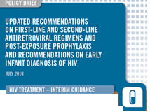
Definitions
Non-negative: any positive or indeterminate result
Indeterminate: PCR instrument reports detectable, but is classified as indeterminate based on other data (ie. CT value)
May also be called ‘not confirmed’, ‘equivocal’, ‘irreproducible positive’
Discordant: positive/detectable first test; negative second test

Slide 3
MTCT rate across countries, 2017
Source UNAIDS Estimates
Notes:
This charts presents the estimated Mother to child transmission rate estimates for 2017 from UNAIDS.
As results of the B+ implementation the MTCT rate has reached values of 5% or less at 6 weeks in some high prevalence countries (all countries below the green line).
It is also important to note that transmission and new infant infections are occurring more often now in the postnatal period, after the 6-week test is performed.

Slide 4
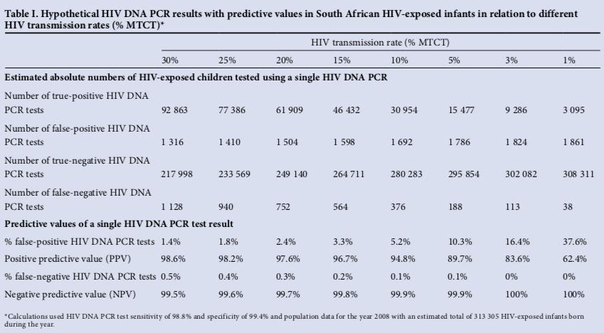
Positive predictive value decreases with
reduced prevalence
Feucht SAMJ 2012
Notes:
The positive predictive value of the NAT decrease with the decreasing of the HIV prevalence (as per any test). This table shows how this value change with lowering mother to child transmission rates. The red squares shows the number and the % of False positive results, particularly when the MTCT rate is 5% or below, which is generally near the positivity rate of most programs EID testing. Important to note that this is not the overall national MTCT (which can be much higher taking non-PMTCT enrolled mother-baby pairs into consideration), but should be the positivity rate at testing. This is not a technological issue, but due to reducing prevalence rates. The same phenomenon exists with HIV testing, for example, and the rationale for why we have multiple test algorithms for adults.

Slide 5
As the MTCT rate decreases, so does the confidence in a positive result (positive predictive value)
20% MTCT
True positive
False positive
5% MTCT
10% MTCT
1% MTCT
Notes:
Why is this all an issue. The red/pink babies represent all ‘detectable’ results out of a total population of 10K HEI tested. So as MTCT rates decline, out of all detectable results, the proportion of false positive infants increase.

Slide 6
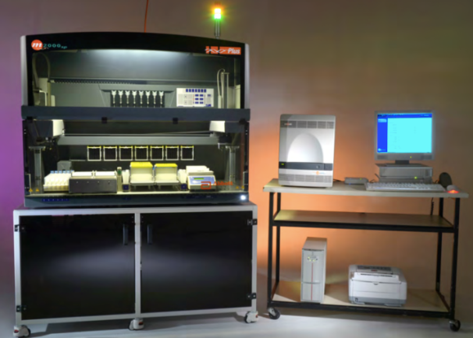
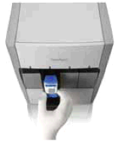
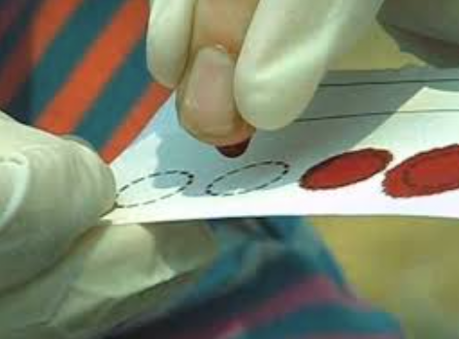
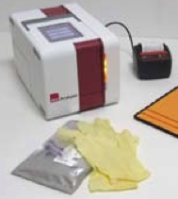
Several technologies are available for EID testing
Qualitative technologies generally report ‘detected’ or ‘not detected’, which gets understood as ‘positive’ or ‘negative’, respectively.
All tests with WHO-PQ have high specificity
> 98%
Notes:
Several technologies are used for the NAT test, all test with WHO pre-qualification have high specificity meaning that they generally accurately detect infants who are negative. However, lowering PPV is not technologically-caused, but due to lowering prevalence. And no test is ever likely to be perfect.
Qualitative technologies, however, report the result as ‘detected’ or ‘not detected’, which gets understood as ‘positive’ or ‘negative’, respectively, but things are a bit more complicated….

Slide 7
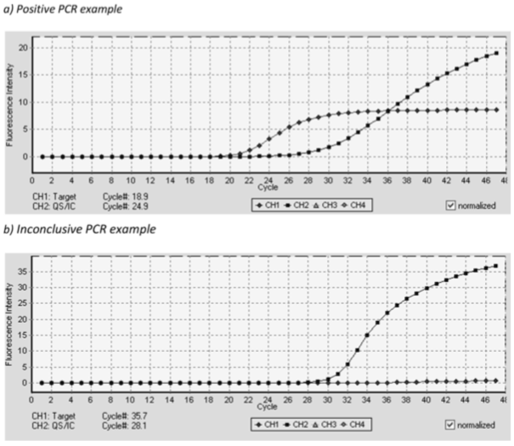
100,000 cp/ml
1,000 cp/ml
10,000,000 cp/ml
10,000 cp/ml
1,000,000 cp/ml
Maritz JCV 2017
Notes:
This is what a typical EID readout looks like. The curve further to the right is the positive control, while the curve on the left is a patient sample. The cycle threshold (Ct) values are labelled on the x-axis. As the Ct threshold increases, that means there is less virus in the sample (more cycles are need to amplify and detect the RNA). EID technologies consider a sample positive as soon as the sample’s curve starts to move above the baseline. In this case, that happens at about the 19th cycle, as indicated by the red arrow. This sample has a lot of virus.
Now we can roughly estimate the quantity of virus in a sample based on the Ct value. For example, … (go through animation)
It is important to note that the exact relationship between CT and VL depend on the technology that is used.

Slide 8
10,000,000 cp/ml
1,000 cp/ml
? cp/ml
Maritz JCV 2017
Notes:
By comparison, the figure on the bottom looks a little different. The obvious curve is the control. The technology would call this detectable because there is a slight increase in the curve at about the 35th cycle (red arrow). You’ll also notice that this does not look like a nice clean sigmoidal curve similar to the others. So without an indeterminate range, this would be considered a detectable or positive test result, but in South Africa for example this would be called indeterminate and retested.

Slide 9
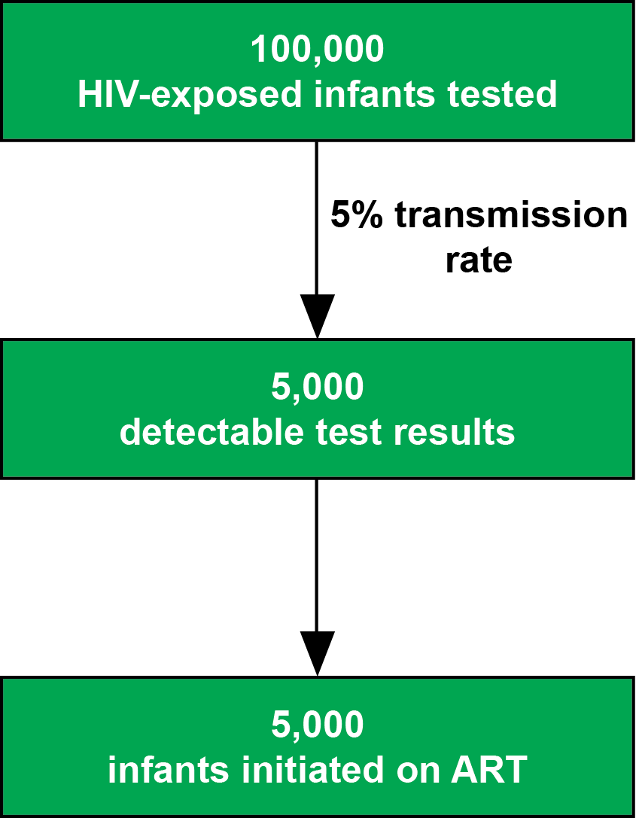
Without any indeterminate range…
Notes:
We can think about this another way, taking into account the PPV and positivity rate of about 5%. Without any indeterminate range the results will be defined just as positive or negative.
In the context of MTCT 5% there will be 5,000 detectable (positive result) and so, theoretically, all these 5,000 will be considered positive and started on ART.

Slide 10
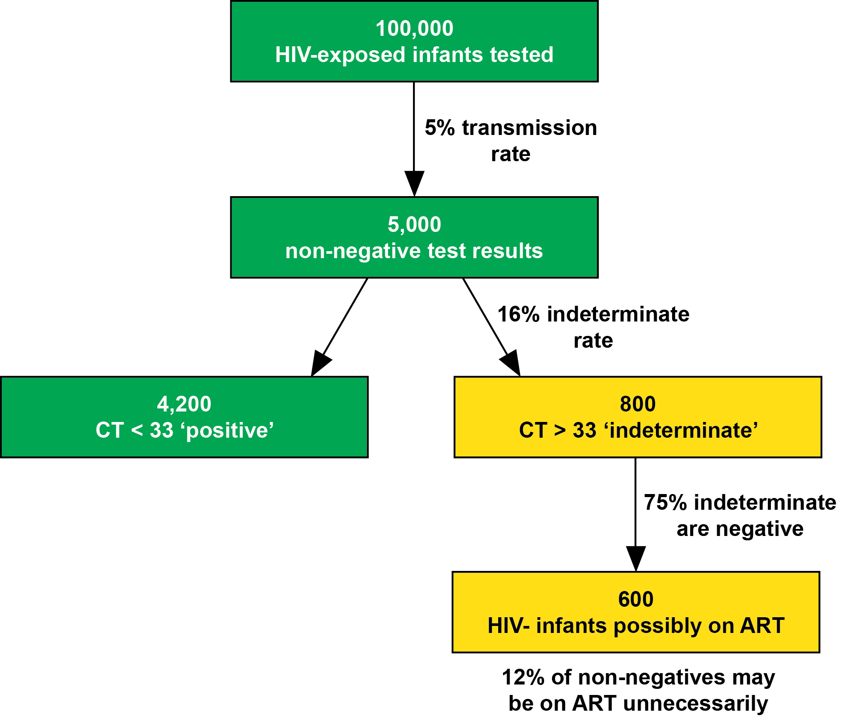
However, not all ‘detectable’ results are truly HIV-positive infants
Based on a meta-analysis of data from Botswana, Namibia, Uganda, South Africa
Notes:
Further, of those indeterminate, it was found that 75% are actually negative. So of the 800 indeterminate cases, 600 would be negative. Without an indeterminate range, these infants (12%) would be put on treatment unnecessarily.

Slide 11
New WHO Recommendation
Qualitative technologies generally report ‘detected’ or ‘not detected’, which is interpreted as ‘positive’ or ‘negative’, respectively.
THEREFORE
Identifying and repeat testing samples with low level viremia by introducing an indeterminate range can minimize unnecessary treatment initiation.
Notes:
WHO recommendation to implement an indeterminate range
We can work in the laboratory where very sensitive technologies exist, these technologies typically report on detectable virus which is then interpreted. This however pick up low level of viremia that may not reflect infection and rather reflect contamination at the point of collection or in the laboratory. Identifying and repeat testing those samples before via introduction of an indeterminate range can minimize unnecessary treatment.
Introduction of an indeterminate range is now recommended to improve the accuracy of all NAT assays
The indeterminate range should be the equivalent of the Roche COBAS v2 cycle threshold of 33 or greater. We are working with several groups to try to translate that to all technologies.

Slide 12
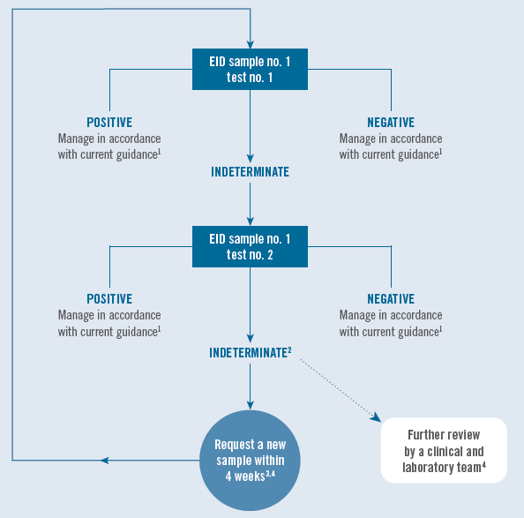
SOP for managing indeterminate test results
All indeterminate tests should be repeat tested on the same specimen, if and when available. If the same specimen cannot be repeat tested, then a new specimen should be requested and tested as quickly as possible.
For specimens with two indeterminate test results, a new specimen should be requested. For infants repeatedly testing indeterminate, it is suggested that a team of experts review clinical and test information to determine the best follow-up care.
Notes:
It is expected that most indeterminate results will be resolved upon the repeat test, so requiring indeterminate test results returning to the facility should be rare. However, these cases should be treated as you would a failed test, requesting a new sample and expediting testing.

Slide 13
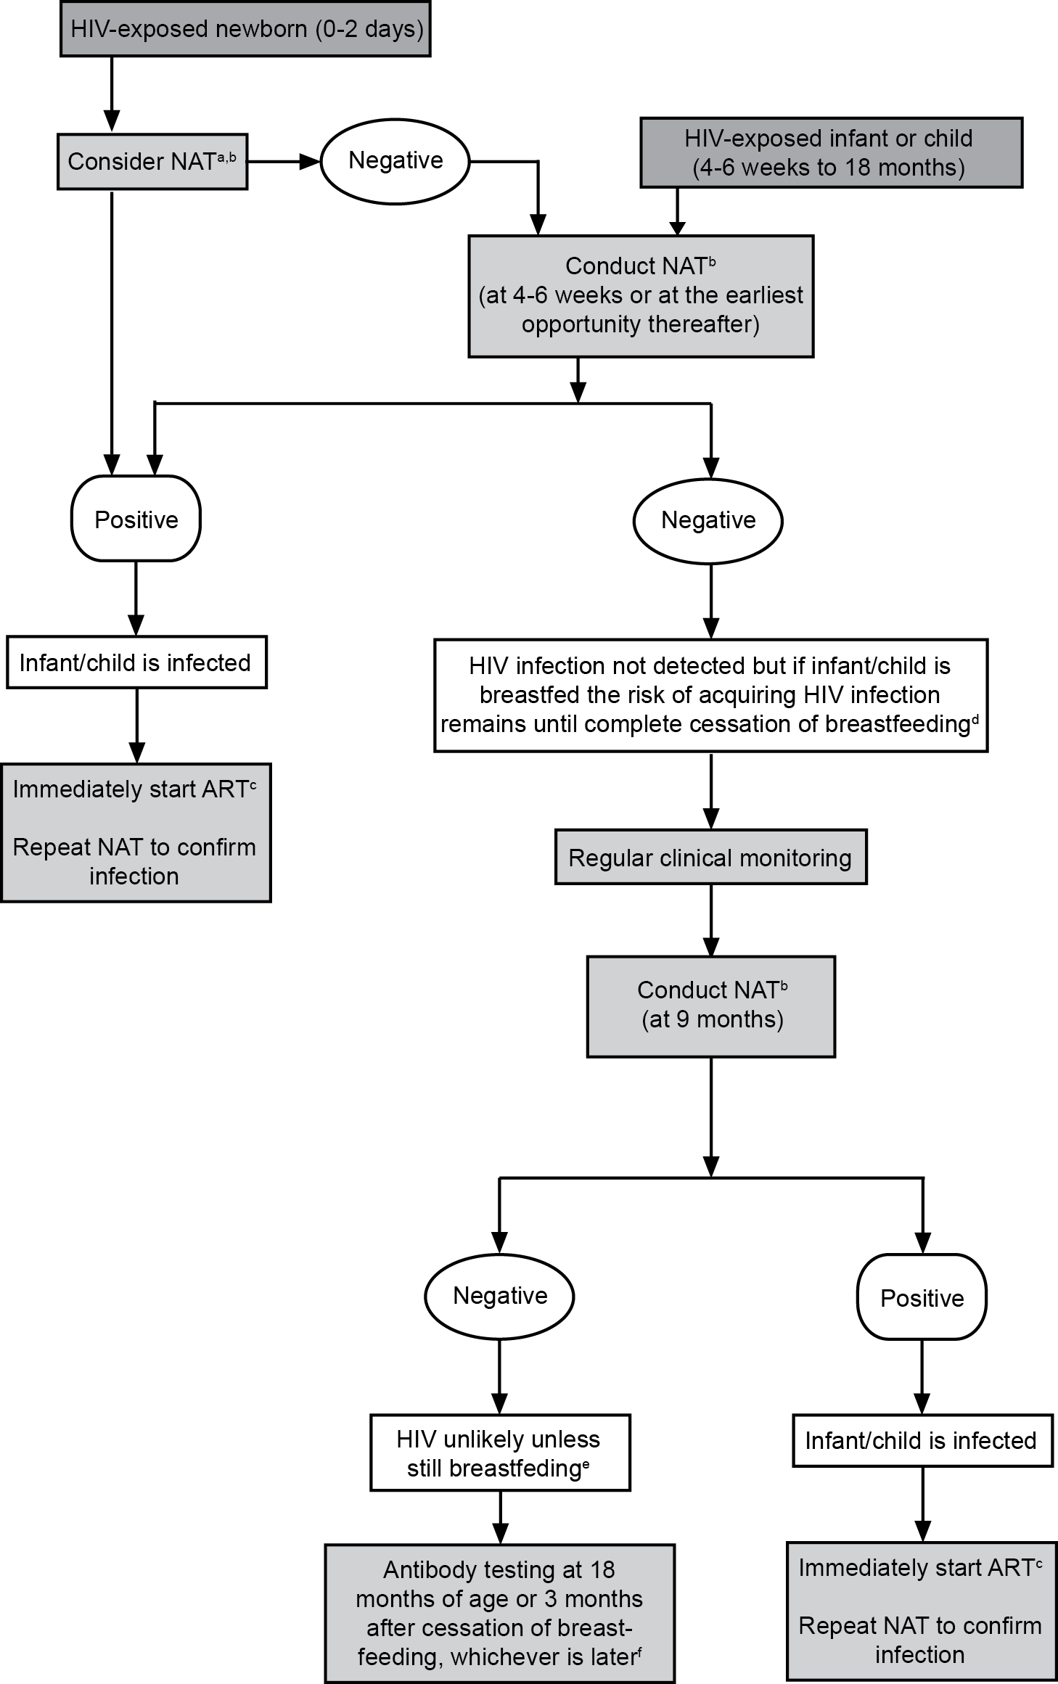
Infant diagnosis is a process! Not just the 6-week test
Move to a multi-NAT algorithm:
Birth (where of value)
6 weeks
9 months (NAT not RDT)
Any time HIV exposed infants present sick
At nutrition and inpatient wards after determining exposure through maternal testing
Ensure confirmatory testing of all positive results
Complete diagnosis after exposure period ends
Notes:
This recommendation needs to be seen in the context of implementing infant diagnosis as a process made on multiple actions over time and not one off event at 6 weeks.
It is important to note that transmission and new infant infections are occurring more often now in the postnatal period, after the 6-week test is performed, so testing at 9 months and after the end of exposure/breastfeeding. We recommend testing 3 months after complete cessation of breastfeeding. If that occurs before 18 months of age, use a NAT. If cessation occurs after 18 months of age, use the adult RDT algorithm.
(I have bolded the 9 months test as it is new in the algorithm to test with NAT – countries may want to prioritize implementation to do so.)

