Slide 1
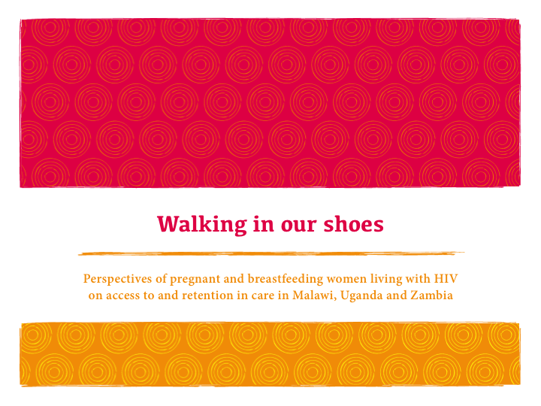

Slide 2




Community–led qualitative research
    Coordinated by the Global Network of People Living with HIV (GNP+) and the International Community of Women Living with HIV (ICW) in partnership with ICW Malawi, ICW Eastern Africa and the Network of Zambian People Living with HIV/AIDS (NZP+).
    With support from UNICEF and Johnson & Johnson.

Slide 3

Research methodology
3 countries - Malawi, Uganda and Zambia – all early implementers of lifelong treatment (Option B+) for pregnant women living with HIV.
In at least 3 sites in each country, peer researchers held focus groups discussions with women living with HIV and interviews with healthcare workers.
In addition, researchers also interviewed national stakeholders with expertise on preventing vertical transmission of HIV (or PMTCT) representing government, international NGOs and community organisations.

Slide 4
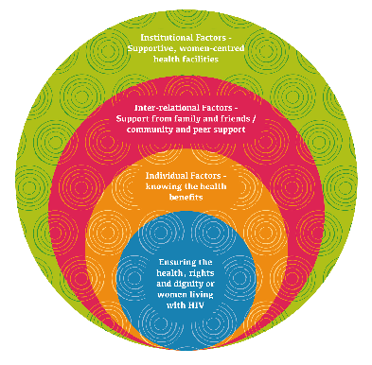
This research set out to discover the factors that help pregnant and breastfeeding women living with HIV adhere to treatment and remain in care?
Research aim
Notes:
In addition the research set out to answer these questions:
What is the role of healthcare workers in promoting adherence and retention
for women living with HIV in lifelong care and treatment?
What are the strategies currently in place to promote adherence and retention
and how can they be improved?

Slide 5

Key findings
Now countries offer lifelong treatment to pregnant women living with HIV, how can healthcare systems retain women living with HIV in lifelong care? The study sought to understand the factors that facilitate women to adhere to treatment and return to health facilities from their own perspectives.
Primary facilitators
giving practical and emotional support to empower women living with HIV
improving the quality of services
respecting the rights and dignity of women living with HIV by addressing stigma and discrimination

Slide 6

Support and empower women living with HIV
Key facilitators
Knowing the health benefits of treatment
Encouragement from family and friends
Support from peers and the wider community
Psycho-social support
“At the support group, we share with each other the challenges that we are facing while taking the ARVs and encourage one another on how we can overcome them.”
Woman living with HIV, Makata, Malawi
Notes:
Recommendations
Provide comprehensive counselling;
Invest in peer-support initiatives at community & health facility level;
Scale-up comprehensive treatment literacy programmes;
Ensure male involvement initiatives are sensitive to women’s realities.

Slide 7

“Women should get good counselling and encouragement. They should be told how they will feel when they start taking treatment …. They should be told the benefits, this is not the same for everyone; sometimes you can be sickly if you do not take medication however, with medication that can stop.”
Woman living with HIV, Chimtende, Zambia

Slide 8

Improve the quality of health services
Key facilitators
Women-centred health services
Well-staffed and equipped facilities
Free services and nutritional assistance
“The clinic has special days for appointments i.e. teenagers come on Saturdays, breastfeeding and pregnant mothers on Tuesdays and the rest of the clients on Thursdays. As a result, we do not wait long on the queue.”
Woman living with HIV, Lambulira, Malawi
Notes:
Recommendations:
Design and implement health services that are person-centred;
Invest in adequate trained & motivated healthcare workers
Ensure that all women have access to healthcare

Slide 9

“Systems of registers monitor retention and a lot of volunteers help to provide the service: support groups provide encouragement; expert clients provide counselling and do follow-ups.” Healthcare worker, Makata, Malawi

Slide 10

Respect women’s rights and dignity
Key facilitators
Respectful and considerate health workers
Non-judgemental counselling for women and their partners
“What motivates me to come for medication is that the doctors do not treat us badly. They do not bark at us and order us around saying, “I told you to go there”. The doctor handles you very well. He or she cares to look for your file if it gets lost so that you leave this place with medication.”
Woman living with HIV, Entebbe, Uganda
Notes:
Recommendations:
Invest in efforts to end stigma, discrimination and violence;
Embed respect for human rights in service delivery;
Meaningfully involve women living with HIV.

Slide 11
“We have seen better retention amongst those enrolled in the support groups, because they are able to get the peer counselling … stigma is still very high, but you realise that if you enrolled within the psycho-social support groups, then stigma can easily be addressed.”
Implementing partner, Uganda

Slide 12
Recommendations
Support and empower women living with HIV:
Provide comprehensive counselling
Invest in peer-support initiative at community and health facility level
Scale up comprehensive treatment literacy programmes
Ensure male involvement initiatives are sensitive to women’s realities
Improve the quality of health services:
Design and implement health services that are person-centred
Invest in adequate numbers of trained and motivated healthcare workers
Ensure that all women have access to healthcare
Respect women’s rights and dignity:
Invest in efforts to end stigma, discrimination & violence
Embed respect for human rights in service delivery
Meaningfully involve women living with HIV

Slide 13
Resources
Reports of community-led research
Walking in our shoes: Perspectives of pregnant and breastfeeding women living with HIV on access to and retention in care in Malawi, Uganda and Zambia
Early Infant Diagnosis: Understanding the Perceptions, Values and Preferences of Women living with HIV in Kenya, Namibia and Nigeria
Training guide for communities
Positive Health, Dignity and Prevention for Women and their Babies: A treatment literacy guide for pregnant women and mothers living with HIV

