Slide 1

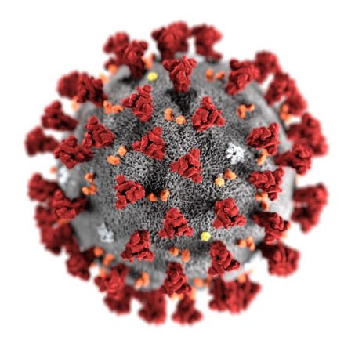
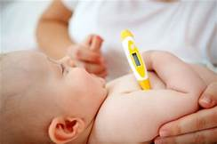
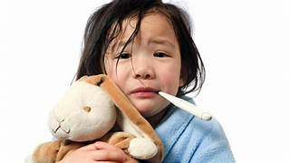
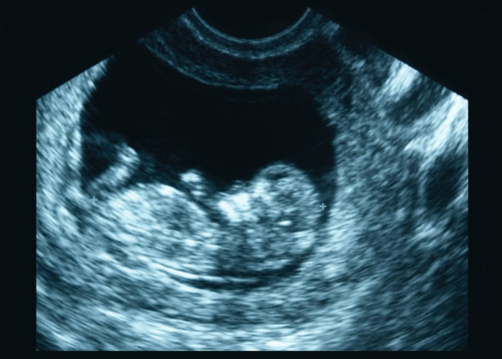



COVID-19: What Pediatric
HIV Programs Need to Know
What’s New Regarding SARS CoV-2 and
Effect on Mothers and Children
Lynne M. Mofenson, M.D.
May 28, 2020

Slide 2


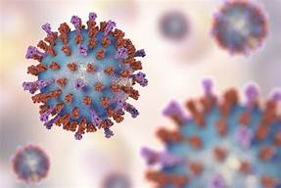
Please Note that Data Continue to be Preliminary, Some of Poor Quality, and Change Almost Daily
General update SARS-CoV-2
Update on COVID-19 in children
Newly recognized COVID-19 clinical syndrome in children
Health system impacts

Slide 3
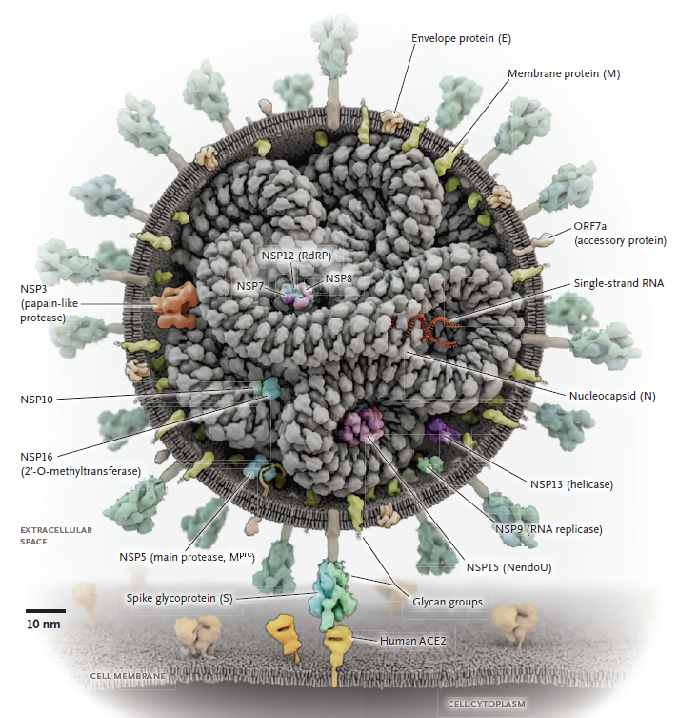
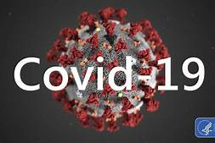
What is New:
SARS-CoV-2/
COVID-19
- more data on timing of diagnostic testing
- data on HIV coinfection
- a bit on treatment

Slide 4
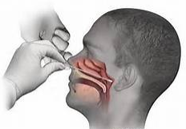

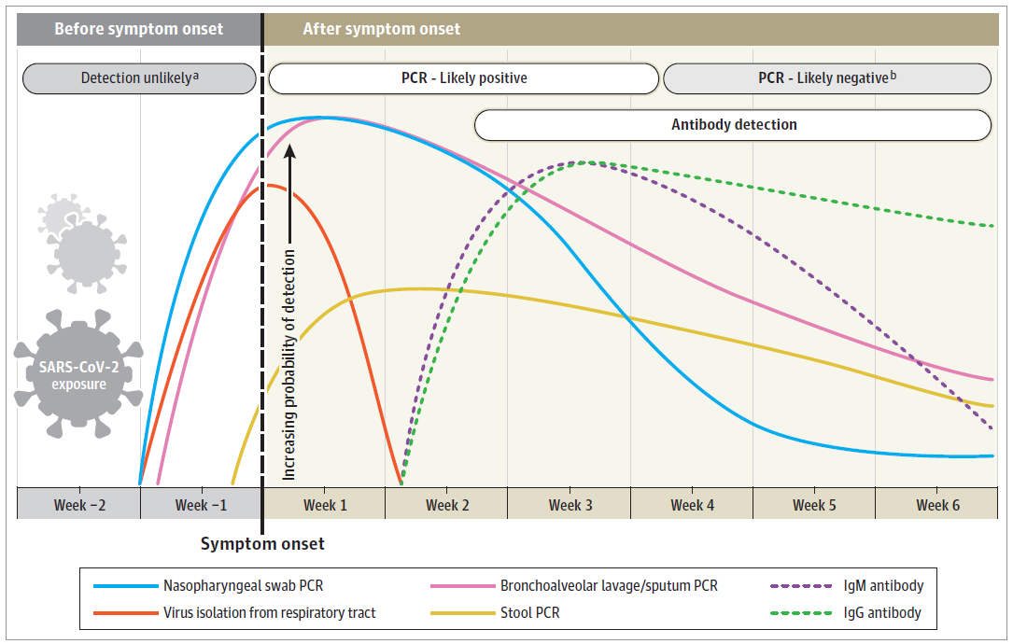

Viral RT-PCR Testing for SARS-CoV-2/COVID-19 and Test Timing
RT PCR detects gene segments of viral genome, not necessarily infectivity
Respiratory samples (NP, upper RT, BAL) become + several days prior to sx; stool + ~57% pt, starts later, persists longer
Persists for duration of sx (or about 12-14 days if no sx); shedding can be prolonged; related to severity of illness
Can be + after recovery but may be detecting viral fragments not infectious virus
Incubation
range 2-11 d
Symptoms
Mean 12.8 d
Convalescence
Sethuraman N et al. JAMA 2020 May 6 (epub)

Slide 5
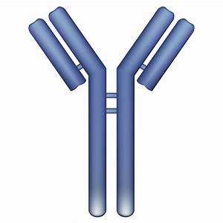
Antibody Testing for SARS-CoV-2/COVID-19 and Test Timing
IgM and IgG Ab start to develop ~7 d; median seroconversion time IgM is 18 d post-exposure (10 d post sx onset) and IgG is 20 days post-exposure (12 d post sx onset)
Lou B et al. Eur Resp J 2010 May 19
A negative IgM/IgG test early in the course of illness does not rule out infection
IgG indicative of prior infection; duration of IgG not known; presumed to indicate immunity but not proven
Incubation
range 2-11 d
Symptoms
Mean 12.8 d
Convalescence
Sethuraman N et al. JAMA 2020 May 6 (epub)

Slide 6
COVID-19 and HIV – Outcome Similar to Overall COVID-19 Patients
 | Country | # | Age (y) | ART | CD4/VL | Comorbidity | Sx | Outcome
Baluku J Med Virol | Uganda | 1 | 34 | Yes | 965 / <1000 | No | No (later diarrhea) | mild; hosp 24 d
Patel J Med Virol | US (FL) | 1 | 58 | Yes | 497 / NP | Yes | Yes | Mild, hosp 5 d
Benkovic J Med Virol | US (NY) | 4 | 56-65 | Yes | 794-1412 / 3/4 <50 | 4/4 Yes | Yes | 3 mild, 1 hosp (also flu A) 14 d
Gervasoni CID | Italy | 47 | Mean 51 | Yes | Mean 636 (3<200) / 44/47 <20 | 30/47 | 46/47 | 34 mild;13 hosp, 2 deaths (both comorbidities)
Haddad ID Cases | US (PA) | 1 | 41 | Yes | 605 / <50 | No | Yes | Enceph/sz, critical; recovered
Schoergenhofer Ann Int Med | Austria | 8 | 22-36 | Yes | NP | 5/8 Yes | NP | 8 Mild, hosp
Wu J Med Virol | China | 2 | 47, 60 | Yes 1 No 1 | NP | 1/2 (1 new dx with PCP | Yes | Severe pneumonia, recovered
Wang Int J Infect Dis | China | 1 | 37 | Yes | 34 / NP | NP | Yes | Moderate, hosp
Harter Infection | Germany | 33 | 31-70 | Yes | 69-1750 / 30/32 <50 | 20/33 | Yes | 19 mild;14 hosp; 6 ICU; 3 died (old; CD4 69; mult comorb)
Aydin J Med Virol | Turkey | 4 | 34-44 | Yes 3 No 1 | 396-1385/ 3/4 <50 | 1/4 | Yes | 1 death (multiple comorbidities)
Su AIDS | China | 1 | 32 | Yes | 430 / NP | No | Yes | Moderate; hosp
Blanco Lancet | Spain | 5 | 29-49 | Yes | 13 (new dx)-1140 / 4/5 <50 | 2/5; 1 new dx with PCP | Yes | 3 mild; 2/5 ICU; 1 vent/ECMO
12 reports, 108 patients - all adults; 99.2% on ART; most CD4 >500; 93% suppressed; 59% comorbidities; 1.9% asymptomatic; most mild-moderate disease; 5% mortality

Slide 7
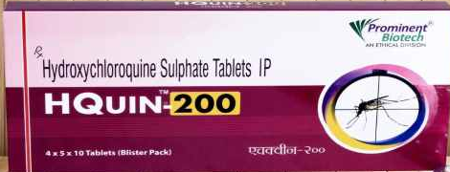

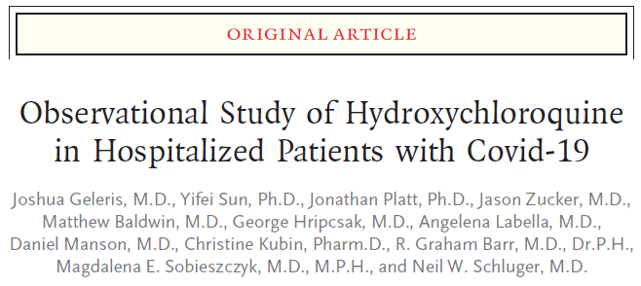
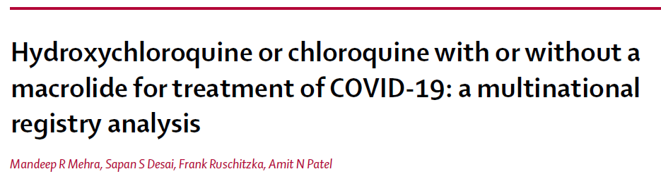
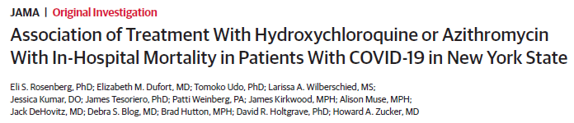

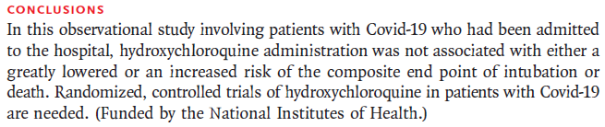

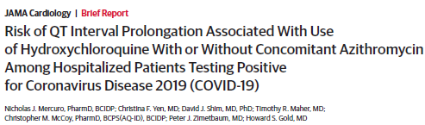
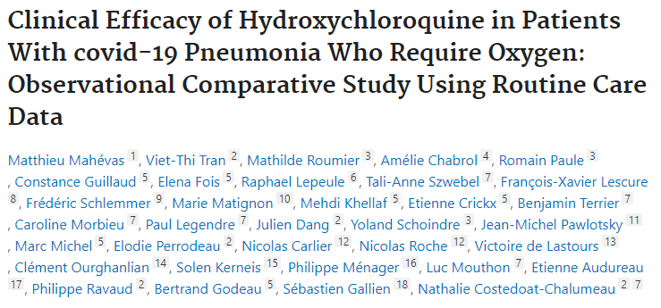
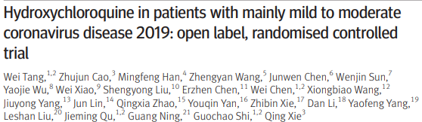
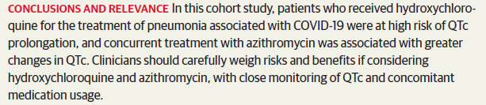

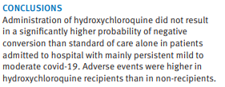

Results from Treatment Studies for COVID-19:
Hydroxychloroquine
Hydroxychloroquine/chloroquine +- azithromycin does not appear effective in hospitalized COVID-19 patients and may be harmful, although is still being evaluated in some clinical trials (in adults).
..unable to confirm benefit..
..not associated…difference mortality..
..not associated with…endpoint
intubation or death..
..high risk QTc prolongation..
..raises safety concerns…
..adverse events higher..
..do not support its use..

Slide 8
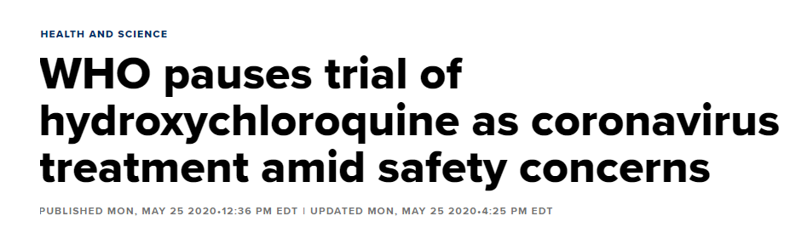
Results from Treatment Studies for COVID-19:
Hydroxychloroquine
Hydroxychloroquine/chloroquine +- azithromycin does not appear effective in hospitalized COVID-19 patients and may be harmful, although is still being evaluated in clinical trials (in adults).
..unable to confirm benefit..
..not associated…difference mortality..
..not associated with…endpoint
intubation or death..
..high risk QTc prolongation..
..raises safety concerns…
..adverse events higher..
..do not support its use..

Slide 9

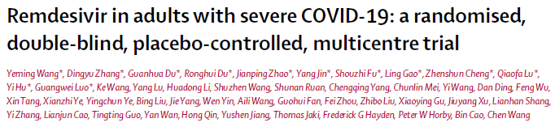
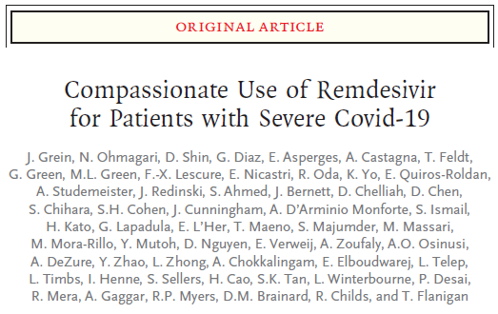
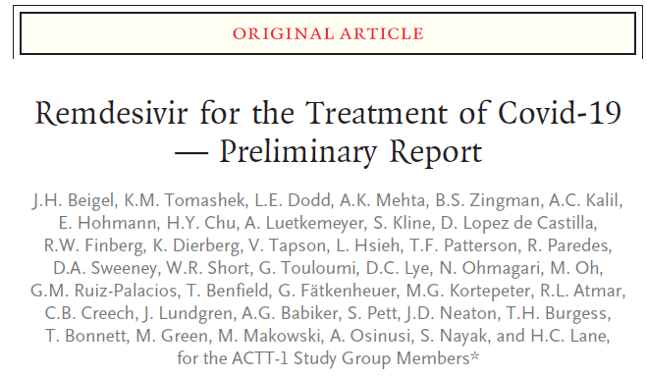
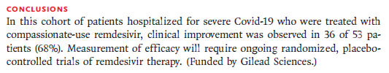

Results from Treatment Trials for COVID-19:
Remdesivir
Remdesivir is a nucleotide analogue; conflicting results on efficacy in observational studies but in a randomized trial of 1,063 patients, showed efficacy in shortening time to recovery in hospitalized adults and trend toward improved survival (7.1% remdesivir vs 11.9% placebo, HR 0.70, 95% CI 0.47-1.09); further trials ongoing.
Case reports of use in pregnancy (Pierce-Williams R. AJOG 2020 May 8; Hirshberg A. AJOG. 2020 May 2) and children (Chao JY. J Pedatrics. 2020 May11), available by compassionate use, but no clinical trials.

Slide 10

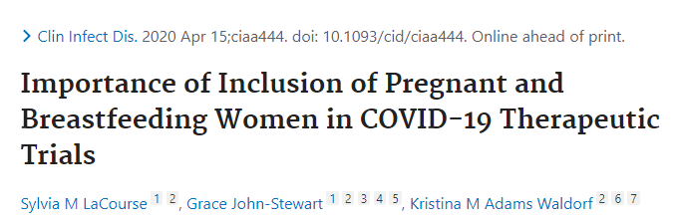

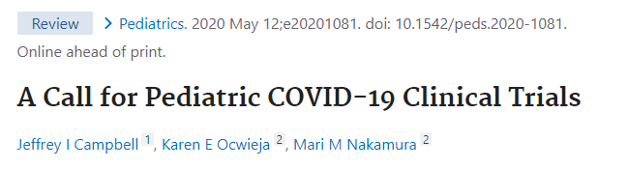
Results from Treatment Trials for COVID-19:
Remdesivir
Remdesivir is a nucleotide analogue; conflicting results on efficacy in observational studies but in a randomized trial of 1,063 patients, showed efficacy in shortening time to recovery in hospitalized adults and trend toward improved survival (7.1% remdesivir vs 11.9% placebo, HR 0.70, 95% CI 0.47-1.09); further trials ongoing.
Has been used in pregnancy (Pierce-Williams R. AJOG 2020 May 8; Hirshberg A. AJOG 2020 May 2) and children (Chao JY. J Pedatric 2020 May11), available by compassionate use, but no clinical trials.
HIV drugs in pregnant women and children
TB drugs in pregnant women and children

Slide 11
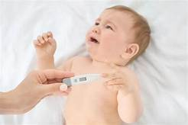

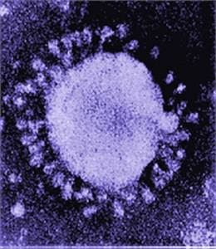
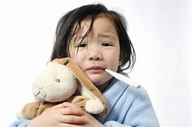
Update:
SARS-CoV-2/
COVID-19 in Children

Slide 12
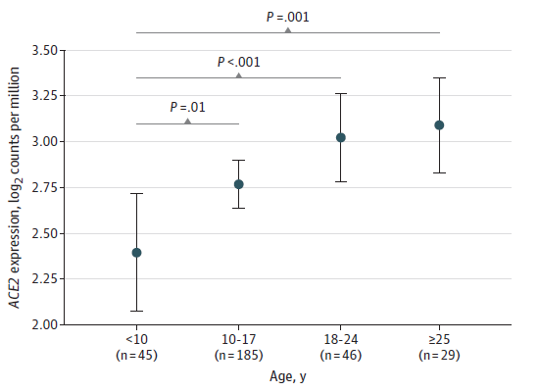
Children May Have Lower Levels of Nasal ACE-2 than Adults,
Potentially Making Them Less Susceptible to Infection and/or Replication
Bunyavanich S et al. JAMA. 2020 May 20 (epub)
Retrospective exam stored nasal epithelium from 305 persons age 4-60 years from a study evaluating nasal markers of asthma 2015-2018 (50% of sample had asthma and 50% did not).
Evaluated ACE-2 enzyme gene expression in stored samples.
ACE-2 enzyme gene expression was age-dependent, being lowest in children <10 years, then ↑ with age.
ACE-2 was significantly lower in children <10 year than older persons, independent of sex and asthma.
mean 3.0
mean 3.1
mean 2.8
mean 2.4

Slide 13
Prevalence of COVID-19 Disease in Children
Prevalence of COVID-19 in children has been cited as 1-2% of all COVID-19 cases.
However, this is based on initial data from China.
There is no easy way to get global age-related data for pediatric age groups.
When examine individual data by country, prevalence may actually be higher than often cited 1-2%.
Additionally, under-reporting of pediatric COVID-19 from Africa appears to be happening.

Slide 14
Prevalence of COVID-19 Reported in Children
Country (date of data) | Total # cases | 0-19 Years | 0-9 Years | 10-18 Years
Africa (May 22) ¹ | 70,124 | 413 0.6% | 176 0.3% | 237 0.3%
China (Feb 11) ² | 44,672 | 965 2.1% | 416 0.9% | 549 1.2%
EU/EEA/UK (May 20) ³ | 592,138 | 23,847 2.0% | 7,667 1.1% | 16,180 0.9%
United States (May 23) ⁴ | 1,271,490 | 43,614 3.4% | - | -
Brazil (May 23) ⁵ | 117,598 | 4, 019 3.4% | 1,973 1.7% | 2,046 1.4%
Japan (May 21) ⁶ | 10,306 | 402 3.9% | 158 1.5% | 244 2.4%
Australia (May 21) ⁷ | 7,068 | 314 4.4% | 91 1.3% | 223 3.1%
Canada (May 21) ⁸ | 39,456 | 2,306 5.7% | - | -
South Korea (May 22) ⁹ | 11,142 | 780 7.0% | 148 1.3% | 632 5.7%
Moscow (new cases May 21) ¹⁰ | 2,988 | 224 7.5% | - | -
New Zealand (May 22) ¹¹¹ | 1,504 | 156 10.4% | 36 2.4% | 121 8.0%
TOTAL | 2,168,486 | 77,040 3.6% | 10,665 1.2% | 20,232 2.4%
¹ https://www.afro.who.int/health-topics/coronavirus-covid-19
⁷ https://www.statista.com/statistics/1104012/australia-number-of-coronavirus-cases-by-age-group/
² https://www.statista.com/statistics/1095024/china-age-distribution-of-wuhan-coronavirus-covid-19-patients/
³ https://covid19-surveillance-report.ecdc.europa.eu/
⁸ https://health-infobase.canada.ca/covid-19/epidemiological-summary-covid-19-cases.html
⁴ https://www.cdc.gov/coronavirus/2019-ncov/cases-updates/cases-in-us.html
⁹ https://www.statista.com/statistics/1102730/south-korea-coronavirus-cases-by-age/
¹⁰ https://www.statista.com/statistics/1109859/covid-19-cases-by-age-group-moscow/
⁵ https://portalarquivos.saude.gov.br/images/pdf/2020/May/21/2020-05-19---BEE16---Boletim-do-COE-13h.pdf
¹¹ https://www.health.govt.nz/our-work/diseases-and-conditions/covid-19-novel-coronavirus/covid-19-current-situation/covid-19-current-cases
⁶ https://www3.nhk.or.jp/news/special/coronavirus/data-rate/

Slide 15
Prevalence of COVID-19 Reported in Children
Country (date of data) | Total # cases | 0-19 Years | 0-9 Years | 10-18 Years
Africa (May 22) ¹ | 70,124 | 413 0.6% | 176 0.3% | 237 0.3%
China (Feb 11) ² | 44,672 | 965 2.1% | 416 0.9% | 549 1.2%
EU/EEA/UK (May 20) ³ | 592,138 | 23,847 2.0% | 7,667 1.1% | 16,180 0.9%
United States (May 23) ⁴ | 1,271,490 | 43,614 3.4% | - | -
Brazil (May 23) ⁵ | 117,598 | 4, 019 3.4% | 1,973 1.7% | 2,046 1.4%
Japan (May 21) ⁶ | 10,306 | 402 3.9% | 158 1.5% | 244 2.4%
Australia (May 21) ⁷ | 7,068 | 314 4.4% | 91 1.3% | 223 3.1%
Canada (May 21) ⁸ | 39,456 | 2,306 5.7% | - | -
South Korea (May 22) ⁹ | 11,142 | 780 7.0% | 148 1.3% | 632 5.7%
Moscow (new cases May 21) ¹⁰ | 2,988 | 224 7.5% | - | -
New Zealand (May 22) ¹¹¹ | 1,504 | 156 10.4% | 36 2.4% | 121 8.0%
TOTAL | 2,168,486 | 77,040 3.6% | 10,665 1.2% | 20,232 2.4%
It Shouldn’t Be This Hard to Get Age-Related Data
¹ https://www.afro.who.int/health-topics/coronavirus-covid-19
⁷ https://www.statista.com/statistics/1104012/australia-number-of-coronavirus-cases-by-age-group/
² https://www.statista.com/statistics/1095024/china-age-distribution-of-wuhan-coronavirus-covid-19-patients/
³ https://covid19-surveillance-report.ecdc.europa.eu/
⁸ https://health-infobase.canada.ca/covid-19/epidemiological-summary-covid-19-cases.html
⁴ https://www.cdc.gov/coronavirus/2019-ncov/cases-updates/cases-in-us.html
⁹ https://www.statista.com/statistics/1102730/south-korea-coronavirus-cases-by-age/
¹⁰ https://www.statista.com/statistics/1109859/covid-19-cases-by-age-group-moscow/
⁵ https://portalarquivos.saude.gov.br/images/pdf/2020/May/21/2020-05-19---BEE16---Boletim-do-COE-13h.pdf
¹¹ https://www.health.govt.nz/our-work/diseases-and-conditions/covid-19-novel-coronavirus/covid-19-current-situation/covid-19-current-cases
⁶ https://www3.nhk.or.jp/news/special/coronavirus/data-rate/

Slide 16

Among Children with COVID-19, Difficult to Get Disaggregated Data to Evaluate Proportional Representation by Age
Country/Reference | # Children 0-19 yr | Number/Proportion of Pediatric Cases by Age
 |  | <1 yr | 1-4/5yr | 6/5-9/10 yr | 10/11-14/15 yr | 15/16-17/18yr
US (MMWR)1 (population data) | 2,572 | 393 (15.2%) | 1-4 291 (11%) | 5-9 388 (15%) | 10-14 682 (27%) | 15-17 813 (32%)
Italy (Garazzino, Euro Surv)3 (pediatric hospitals Italy) | 168 | 66 (39.3%) | 1-5 38 (22.6%) | 6-10 24 (14.3%) | 11-17 40 (23.8%)
Italy (Dodi I, Acta Biomed)4 (screening of contacts, Parma) | 14 | 7 (50%) | 1-5 3 (21.4%) | 6-10 1 (7.1%) | 11-15 3 (21.4%) | -
Italy (Taracio I, Acta Biomed)4 (screening of contacts, Calabria) | 10 | 0-5 1 (10%) |  | 6-10 2 (20%) | 11-15 4 (40%) | 16-18 3 (30%
China (Cui X, J Med Virol)5 (analysis all China reports incl Dong) | 2,492 | 446 (17.9%) | 1-5 593 (23.8%) | 6-10 626 (25.1%) | 11-15 492 (19.7%) | 16-18 335 (19.7%)
TOTAL | 5256 | 912 ~18% | 925 ~18% | 1041 ~20% | 1181 ~22% | 1151 ~22%
About 1/3 cases are 0-5 years
Near 45% of cases are 10-18 years
1 CDC COVID-19 Response Team. MMWR 2020 Apr 6
2 Garazzino S et al. Euro Surveill. 2020 May;25 (18)
Dodi I et al. Acta Biomed. 2020;91:214-15
Talarcio V et al. Acta Biomed. 2020;91;232-3
4 Cui X et al. J Med Virol. 2020 May 17 (includes Dong Y et al. Pediatrics. 2020 Mar 16)
Caveat: Younger children may have less typical symptoms and therefore be less likely to be tested

Slide 17
Among Children with COVID-19, Difficult to Get Disaggregated Data to Evaluate Proportional Representation by Age
Country/Reference | # Children 0-19 yr | Number/Proportion of Pediatric Cases by Age
 |  | <1 yr | 1-4/5yr | 6/5-9/10 yr | 10/11-14/15 yr | 15/16-17/18yr
US (MMWR)1 (population data) | 2,572 | 393 (15.2%) | 1-4 291 (11%) | 5-9 388 (15%) | 10-14 682 (27%) | 15-17 813 (32%)
Italy (Garazzino, Euro Surv)3 (pediatric hospitals Italy) | 168 | 66 (39.3%) | 1-5 38 (22.6%) | 6-10 24 (14.3%) | 11-17 40 (23.8%)
Italy (Dodi I, Acta Biomed)4 (screening of contacts, Parma) | 14 | 7 (50%) | 1-5 3 (21.4%) | 6-10 1 (7.1%) | 11-15 3 (21.4%) | -
Italy (Taracio I, Acta Biomed)4 (screening of contacts, Calabria) | 10 | 0-5 1 (10%) |  | 6-10 2 (20%) | 11-15 4 (40%) | 16-18 3 (30%
China (Cui X, J Med Virol)5 (analysis all China reports incl Dong) | 2,492 | 446 (17.9%) | 1-5 593 (23.8%) | 6-10 626 (25.1%) | 11-15 492 (19.7%) | 16-18 335 (19.7%)
TOTAL | 5256 | 912 ~18% | 925 ~18% | 1041 ~20% | 1181 ~22% | 1151 ~22%
It Shouldn’t Be This Hard to Get Age-Related Data
About 1/3 cases are 0-5 years
Near 45% of cases are 10-18 years
1 CDC COVID-19 Response Team. MMWR 2020 Apr 6
2 Garazzino S et al. Euro Surveill. 2020 May;25 (18)
Dodi I et al. Acta Biomed. 2020;91:214-15
Talarcio V et al. Acta Biomed. 2020;91;232-3
4 Cui X et al. J Med Virol. 2020 May 17 (includes Dong Y et al. Pediatrics. 2020 Mar 16)
Caveat: Younger children may have less typical symptoms and therefore be less likely to be tested

Slide 18
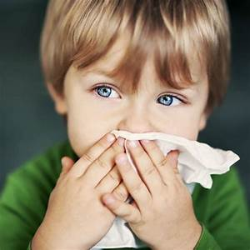

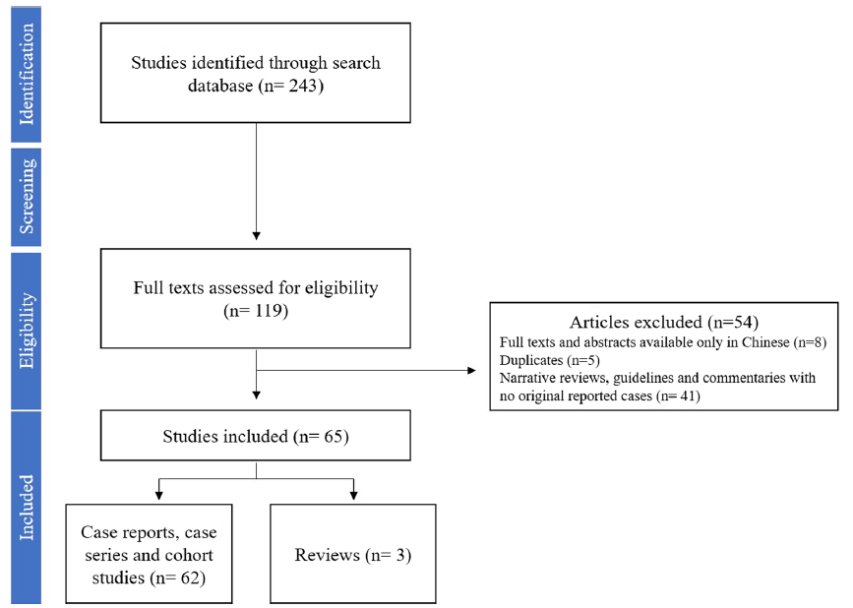
Updated Data on Clinical Characteristics and Outcome
Systematic review of pediatric SARS-CoV-2 publications Jan 1 to May 1 2020 , included 62 studies and 3 reviews and 7,480 children 0-18 years.
Mean age 7.6 years, 52% male
44% Italy, 34% US, 18% China
73.3% exposed in family, 13.5% unknown exposure
Only confirmed cases considered in the review
Liguoro I et al. Eur J Pediatr. 2020 May 18

Slide 19
Data Continue to Show Children Generally Have Mild-Moderate Disease
Liguoro I et al. Eur J Pediatr. 2020 May 18
Disease Severity in 1,780 Children with SARS-CoV-2 Infection
96%
15% of adults have severe disease
(Gaun W-J. NEJM. 2020;382:1708-20)
57%
N=1780 223 618 568 30 10

Slide 20
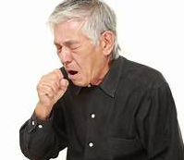
Children Have Fewer Symptoms Than Adults
Most Common Fever and Cough
Liguoro I et al. Eur J Pediatr. 2020 May 18
Disease Symptoms in 1,780 Children 0-18 Years
with SARS-CoV-2 Infection
Disease Symptoms in 10,944 Adults 18-64 Years
in US with SARS-CoV-2 Infection
Lower rates of all symptoms, including
fever and cough, and much less
dyspnea than adults
Systematic Review - Liguoro I et al. Eur J Pediatr. 2020 May 18
CDC COVID-19 Response Team. MMWR 2020 Apr 6;69 (US data)

Slide 21
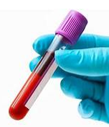
Consistent with Less Severe Disease, Laboratory Findings in Children with COVID-19 Less Abnormal than in Adults
Liguoro I et al. Eur J Pediatr. 2020 May 18
Laboratory Findings in 655 Children 0-18 Years
with SARS-CoV-2 Infection
Laboratory Findings in 1,099 Adults 18-64 Years
in China with SARS-CoV-2 Infection
Lower rate lymphopenia and lower rate elevated CRP levels (both associated with more severe disease in adults)
Systematic Review - Liguoro I et al. Eur J Pediatr. 2020 May 18
Guan W et al. N Engl. J Med. 2020 Feb 28 (China data)

Slide 22

Consistent with Less Severe Disease, Children Were
Less Likely to Require ICU or Significant Treatments
Liguoro I et al. Eur J Pediatr. 2020 May 18
Treatment in 1,402 Children 0-18 Years
with SARS-CoV-2 Infection
Treatment in 1,099 Adults 18-64 Years
in China with SARS-CoV-2 Infection
Mortality 0.08%
Mortality 1.4%
Less likely to require oxygen, ICU admission or mechanical ventilation than adults, and
less likely to require adjunctive therapy (antibiotics, steroids, IVIG) than adults
Systematic Review - Liguoro I et al. Eur J Pediatr. 2020 May 18
Guan W et al. N Engl. J Med. 2020 Feb 28 (China data)

Slide 23
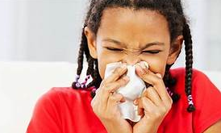
Do Symptoms Differ in Youngest Infants
Compared to Older Children?

Slide 24
Higher Proportion Newborns/Children Age <3 Months
Have Severe Disease than Older Children
Liguoro I et al. Eur J Pediatr. 2020 May 18
Disease Severity, Newborns/Infant <3 Months
11 Studies, N=25
Disease Severity, Children Overall
49 Studies, N=1,780
96%
88%

Slide 25
Newborns/Infants Age <3 Months Less Likely Fever/Cough but More Likely Dyspnea Than Older Children
Liguoro I et al. Eur J Pediatr. 2020 May 18
Disease Symptoms Newborns/Infants <3 Months
11 Studies, N=25
Disease Symptoms in Children 0-18 Years
49 Studies, N=1,780
Dyspnea most common
Fever and cough less usual
Fever and cough most common,
dyspnea rare

Slide 26
Laboratory: Newborns/Infants Age <3 Months Have
Lower Markers of Inflammation than Older Children
Liguoro I et al. Eur J Pediatr. 2020 May 18
Lab Findings in Newborns/Infants <3 Months Old
11 Studies, N=25
Lab Findings in Children 0-18 Years
38 studies, N=655
Leukocytosis (high WBC) more common;
lower inflammatory markers
(c-reactive protein, CRP)

Slide 27
Newborns/Infants Age <3 Months Less Likely to
Require Specific Treatment but More Go to Neonatal ICU
Liguoro I et al. Eur J Pediatr. 2020 May 18
Treatment in Newborns/Infants <3 Months
11 studies, N=25
Treatment in Children 0-18 Years
40 Studies, N=1,402
More symptomatic treatment only but higher admission NICU (possibly due neonates being more likely preterm or admitted for observation due to COVID-19 in mother)

Slide 28


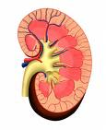
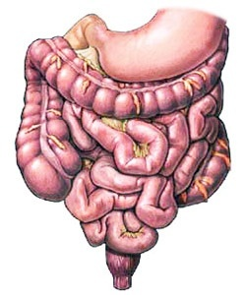


Comorbidities and Hospitalization for COVID-19 in Children

Slide 29
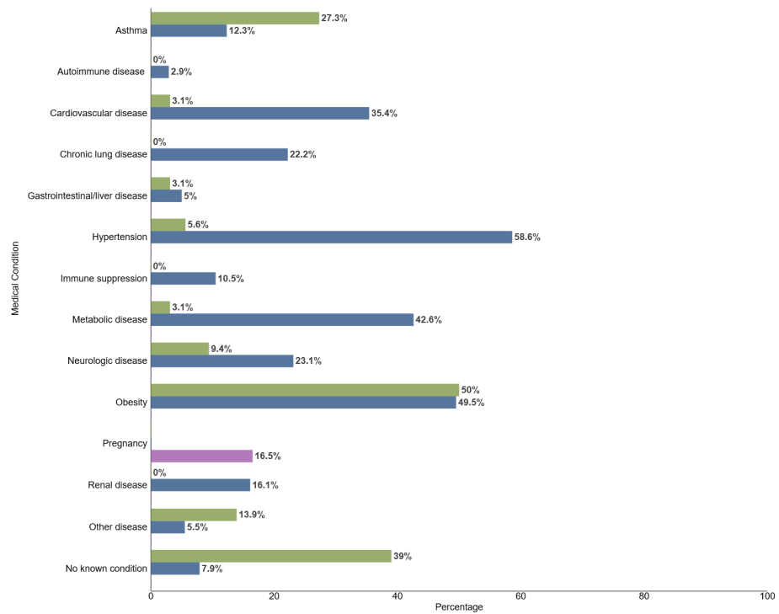

Underlying Conditions in Children Hospitalized with COVID-19,
While Less Frequent than in Adults, Occurs in Significant Proportion
92% of hospitalized adults with COVID-19 had at least one underlying medical condition; most common:
  Hypertension, obesity, metabolic disease and cardiovascular disease
Only 61% of hospitalized children with COVID-19 had at least one underlying condition; most common:
  Obesity, asthma, neurologic disease
COVIDView Week 20, ending May 16 2020

Slide 30
What Do Children With Severe COVID-19 Look Like?
Characteristics and Outcomes of Children with COVID-19 Disease Admitted to US/Canadian Pediatric Intensive Care Units
Shekerdemian LS et al. JAMA. 2020 May 11 (epub)
Cross-sectional study of 48 children with COVID-19 admitted to 46 North American PICUs between March 14 and April 3 2020
40 (83%) had preexisting underlying medical conditions
35 (73%) presented with respiratory symptoms
18 (38%) required invasive mechanical ventilation
Hospital mortality was 4.2% (vs 0.08% overall in systematic review)
While children have milder disease than adults, they can be extremely ill and if admitted to PICU, have elevated mortality

Slide 31

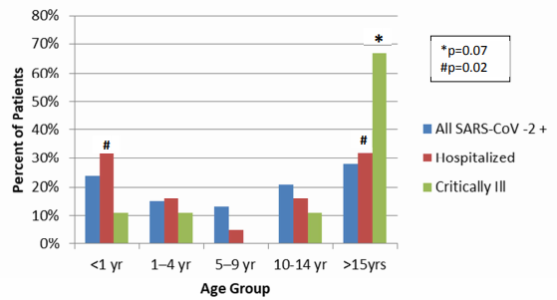
Severe COVID-19 in Children and Young Adults, Washington DC
DeBiasi RL et al. J Pediatr. 2020 May 13 (epub)
177 children with COVID-19 symptoms seen DC Children’s Hospital
  133 not hospitalized, 44 (25%) hospitalized - 9 (5%) needing critical care including mechanical ventilation (4)
  Comorbidity in 39% - more common in those hospitalized (63% vs 32%)
  Median age 9.6 years, however youngest (<1 year) and oldest (15-25 years) most likely to need hospitalization
    Critically ill patients more likely to adolescent/young adult (mean 17.3 years)
Adolescents and young adults with COVID-19 disease may be more likely to have “cytokine storm” picture seen in adults

Slide 32
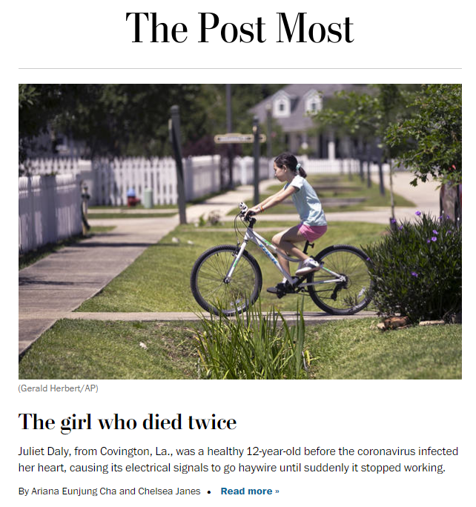
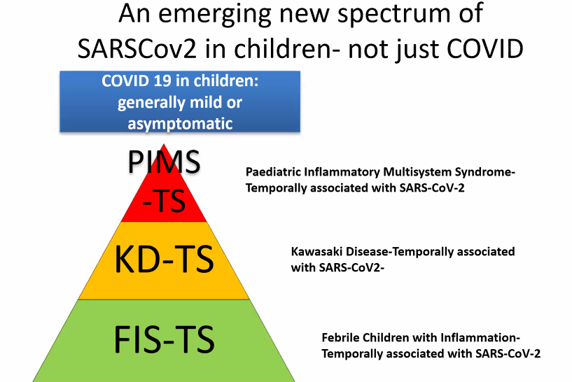
Multi-System Inflammatory Syndrome Temporally Associated with COVID-19 in Children

Slide 33
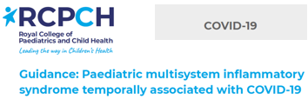

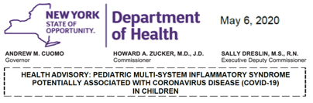
Emerging Potential New Manifestation of SARS-CoV-2 in Children
Multi-System Inflammatory Syndrome in Children (MSIS or MIS-C)
In mid-late April reports from Western Europe identified a new febrile pediatric entity involving:
  systemic hyperinflammation, multi-organ involvement, abdominal pain and GI symptoms, features similar to Kawasaki disease, with prominent cardiogenic shock and myocardial dysfunction.
  Most children tested + rtPCR and/or had IgG/IgM antibody to SARS-CoV-2 although may not have had symptoms.
By early May, cases reported in NYC, with health alert issued 1st by NYC May 4, then NY State on May 6 after 64 cases; by May 12, 102 cases reported with 3 deaths in NY State.

Slide 34
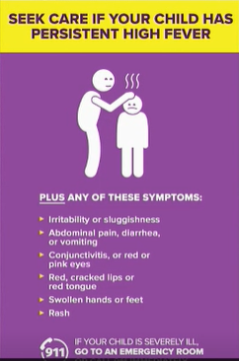
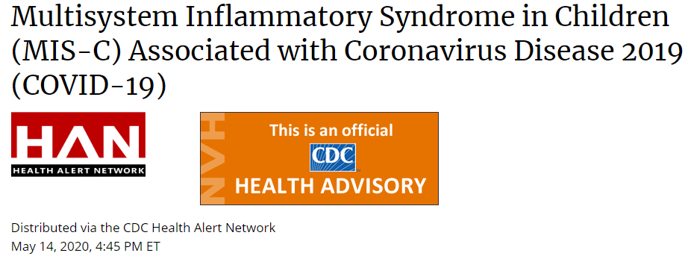
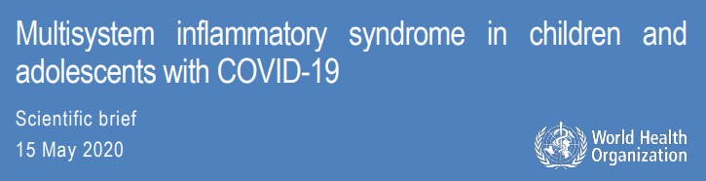
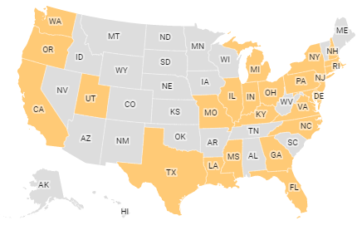

Emerging Potential New Manifestation of SARS-CoV-2 in Children
Multi-System Inflammatory Syndrome in Children (MIS-C)
May 14, CDC issued health advisory with case definition and requested reporting of cases in US.
May 15, WHO issued scientific brief, preliminary case definition, request for reporting to Global COVID-19 Clinical Data Platform and set up a global collaborative research forum.
By May 26, MIS-C reported in children from 23 states in the US.

Slide 35
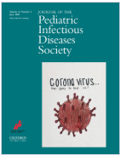


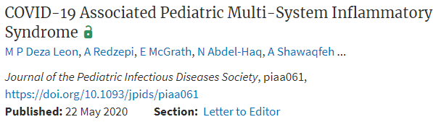























Since First Published Report on MIS-C in April,
Explosion of Publications From US and Europe – 17 in 4 Weeks!

Slide 36
Multi-System Inflammatory Syndrome
Temporally, MIS-C began to manifest approximately ~1 month after the peak of COVID-19 cases in Europe and US rather than contemporaneously with epidemic peak.
Most children have evidence of SARS-CoV-2 but not necessarily current infection (rtPCR+) but IgG/IgM indicating past infection.
Suggests a post-infectious inflammatory process that may be immune complex-mediated.
Resemblance to Kawasaki Disease/Shock Syndrome.
Clinical picture possibly resembles later phase of adult COVID-19 characterized by cytokine storm, hyperinflammation, multi-organ damage including severe myocarditis and acute kidney injury.

Slide 37


Kawasaki Disease (KD) and Kawasaki Shock Syndrome
Self-limited vasculitis of childhood, thought precipitated by common infection pathogen resulting in immune-mediated response in genetically pre-disposed children; most important complication coronary artery aneurysms.
(at least 4)
Adriana Tremoulet, Kawasaki Disease Research Center, UCSD

Slide 38
Differences Kawasaki Disease and Multi-System Inflammatory Syndrome
Demographic features differ from KD, where 50% are <24 months and 80% <5 years, compared to mean age 8-10 years with MIS-C including adolescents. KD more frequent in Asian countries but MIS-C not seen in Asia yet; in several series, more often in children of African ancestry.
Clinical features include more impressive abdominal pain, diarrhea, vomiting and multi-organ involvement including acute kidney injury.
Cardiac features show moderate to severe myocardial involvement (by imaging and very high NT-pro-BNP and troponin levels), greater than KD or KD shock syndrome.
Laboratory features distinct from KD with hyperinflammation with elevated ferritin, D-dimers, IL-6, CRP, lymphopenia, thrombocytopenia.

Slide 39

Manifestations of Multi-System Inflammatory Syndrome
Red=signs/symptoms consistent with Kawasaki Disease
Black=signs that are rare in Kawasaki Disease
Percentages come from case series of 35 cases over 2 months from 14 centers France and Switzerland (Belhadjer Z et al. Circulation 2020 May 17)
Belhadjer Z et al. Circulation 2020 May 17 (epub)

Slide 40


Treatment of Multi-System Inflammatory Syndrome
Primary supportive care of acute organ dysfunction and shock.
Most improve with IVIG with or without steroids, which act to modulate cytokine activation.
Other immune modulators have been used if non-responsive to IVIG/steroids (anakinra – IL1 blockade; sarilumab/tocilizumab – IL6 blockade).
Not reported from Asian countries at this time, or from Africa – but surveillance for the syndrome has also been limited to non-existent until now.

Slide 41

Possible Widening Spectrum of Disorders in Children that May be Associated with SARS-CoV-2 Infection
Dr. Michael Levin, Imperial College, United Kingdom

Slide 42




WHO Website for Multi-System Inflammatory Syndrome https://www.who.int/news-room/commentaries/detail/multisystem-inflammatory-syndrome-in-children-and-adolescents-with-covid-19
Preliminary case definition and global reporting clinical data platform.

Slide 43

COVID-19 Disease in Children
While COVID-19 seems relatively less frequent and more benign in pediatric populations, severe cases have been reported and this appearance may be biased by our incomplete knowledge of this new disease.
Similar to adults, children with comorbidities appear over-represented in those with more severe disease.
Recent emergence of multi-system inflammatory syndrome in children with SARS-CoV-2 infection (either current infection or infection in recent past) demonstrates how disease due to SARS-CoV-2 in children remains yet to be defined.

Slide 44


Impact of COVID-19 Response on HIV and Maternal and Child Health Services
Modeling Exercises

Slide 45



Potential Impact of COVID-19 Responses on Maternal/Child Mortality
Robertson T et al. Lancet Global Health. 2020 May 12 – modeled 3 scenarios where coverage of essential maternal and child health interventions are reduced by 5-10-15% and child wasting increases by 5-10-15% in 118 LMIC.
Framework Effects of Health System Components on Health Service Coverage
Child Deaths per Month
Maternal Deaths per Month
44.7%↑
38.6%↑
9.8%↑
17.3%↑
14.7%↑
8.3%↑
Disruption in service coverage:
Scenario 1: Small ↓ services
Scenario 2: Moderate ↓ services
Scenario 3: Large ↓ service
Depending on scenario, there could be an increase of 9.8 to 44.7% in under age 5-child deaths per month and 8.3% to 38.6% increased in maternal deaths per month across 118 countries.

Slide 46

Potential Impact of COVID-19 Responses on Pediatric HIV Epidemic
Stover J et al. MedRxiv doi.org/10.1101/2020.05.04.20090399 – examined effects of 3- or 6-month service disruption due to lockdown/health system capacity constraints on HIV incidence, including MTCT, in 4 African countries.
Currently PMTCT coverage is high in most countries with few new child infections.
Any disruption in PMTCT services could lead to large increases in new child infections, from about 10% if disruption for new patients only; to ~50% for 3-month if disruptions for all PMTCT services; and 100% or more for 6-month if disruptions to all PMTCT services.
Percentage Increase in New Child HIV Infections

Slide 47








Impact of COVID-19 Response on HIV, TB and Malaria in LMIC
Hogan AB et al; Imperial College COVID-19 Response Team 2020 May 1 https://www.imperial.ac.uk/media/imperial-college/medicine/mrc-gida/2020-05-01-COVID19-Report-19.pdf
Potential Service Disruptions
Modeled 5 intervention scenarios for COVID-19 (no action, mitigation, suppression-lift, unmanaged, and well-managed suppression) and potential service disruptions, and impact on extra deaths due to HIV, TB and malaria 2020-2024.
For HIV, up to 10% ↑ HIV deaths, primarily ART interruption during high/extreme health system demand.
Excess deaths 2020-2024, COVID-19,
HIV, TB or Malaria in Each Scenario
High Burden Setting
Excess deaths

Slide 48
Impact of COVID-19 Response on HIV, TB and Malaria in LMIC
Hogan AB et al; Imperial College COVID-19 Response Team 2020 May 1 https://www.imperial.ac.uk/media/imperial-college/medicine/mrc-gida/2020-05-01-COVID19-Report-19.pdf
Potential Service Disruptions
Modeled 5 intervention scenarios for COVID-19 (no action; mitigation; suppression-lift; well-managed and unmanaged suppression) and potential service disruptions, and impact on extra deaths due to HIV, TB and malaria 2020-2024.
For HIV, up to 10% ↑ HIV deaths, primarily ART interruption during high/extreme health system demand.
For TB, up to 20% ↑ TB deaths, primarily reductions in timely dx/rx new cases from long period of COVID-19 unmanaged/well-managed suppression interventions that limit activities.
Excess deaths 2020-2024, COVID-19,
HIV, TB or Malaria in Each Scenario
High Burden Setting
Excess deaths

Slide 49
Impact of COVID-19 Response on HIV, TB and Malaria in LMIC
Hogan AB et al; Imperial College COVID-19 Response Team 2020 May 1 https://www.imperial.ac.uk/media/imperial-college/medicine/mrc-gida/2020-05-01-COVID19-Report-19.pdf
Potential Service Disruptions
Modeled 5 intervention scenarios for COVID-19 (no action; mitigation; suppression-lift; well-managed and unmanaged suppression) and potential service disruptions, and impact on extra deaths due to HIV, TB and malaria 2020-2024.
For HIV, up to 10% ↑ HIV deaths, primarily ART interruption during high/extreme health system demand.
For TB, up to 20% ↑ TB deaths, primarily reductions in timely dx/rx new cases from long period of COVID-19 unmanaged/well-managed suppression interventions that limit activities.
For malaria, up to 36% ↑ malaria deaths, primarily reduced prevention activities (eg distribution ITN) in all phases of response.
Excess deaths 2020-2024, COVID-19,
HIV, TB or Malaria in Each Scenario
High Burden Setting
Excess deaths

Slide 50
Impact of COVID-19 Response on HIV, TB and Malaria in LMIC
Hogan AB et al; Imperial College COVID-19 Response Team 2020 May 1 https://www.imperial.ac.uk/media/imperial-college/medicine/mrc-gida/2020-05-01-COVID19-Report-19.pdf
Potential Service Disruptions
Modeled 5 intervention scenarios for COVID-19 (no action; mitigation; suppression-lift; well-managed and unmanaged suppression) and potential service disruptions, and impact on extra deaths due to HIV, TB and malaria 2020-2024.
All illustrate the critical importance of maintenance of maternal and child health services and HIV, TB and malaria-specific services as much as possible as a part of the COVID-19 response to reduce the broader potential public health impact of our interventions
Excess deaths 2020-2024, COVID-19,
HIV, TB or Malaria in Each Scenario
For HIV, up to 10% ↑ HIV deaths, primarily ART interruption during high/extreme health system demand.
For TB, up to 20% ↑ TB deaths, primarily reductions in timely dx/rx new cases from long period of COVID-19 well/unmanaged suppression interventions that limit activities.
For malaria, up to 36% ↑ malaria deaths, primarily reduced prevention activities (nets) in all phases of response.
High Burden Setting
Excess deaths

Slide 51




Thank You For
Your Attention!

