Slide 1
Adapting Lesotho’s Young Mothers Programme to COVID-19
COVID-19, Paediatric and Adolescent HIV Programme Delivery Webinar
Maria L. Vivas, HIV Specialist, UNICEF Lesotho
Shadrack Mutembei, Country Director, Help Lesotho
Shasha Makhauta, Youth and Gender Coordinator, Help Lesotho
28 May 2020
Notes:
Thank you for the introduction. I am joined by Shadrack Mutembei, the Country Director for Help Lesotho, and Shasha Mahhauta, the Youth and Gender Coordinator For Help Lesotho and we will be talking to you today on the programmatic adaptations we included into the Lesotho’s Young Mothers Programme to respond COVID-19.

Slide 2
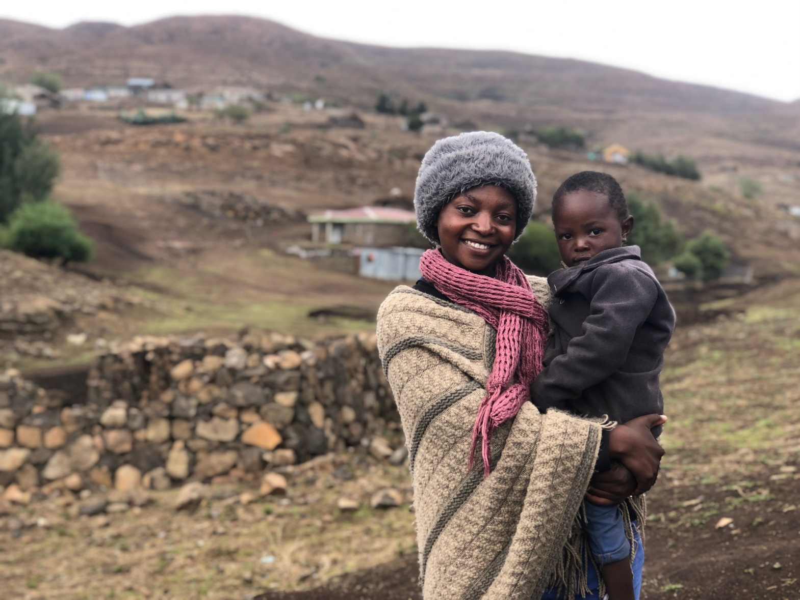
OUTLINE
Young Mothers Programme (YMP) Overview - UNICEF
Theory of Change - UNICEF
COVID-19 in Lesotho - UNICEF
COVID-19 Adaptations - UNICEF
Implementing Partners Perspectives- HL
Lessons Learned-HL
UNICEF for every child
Notes:
So this is what we will be talking to you about today, but I will go right into the content

Slide 3
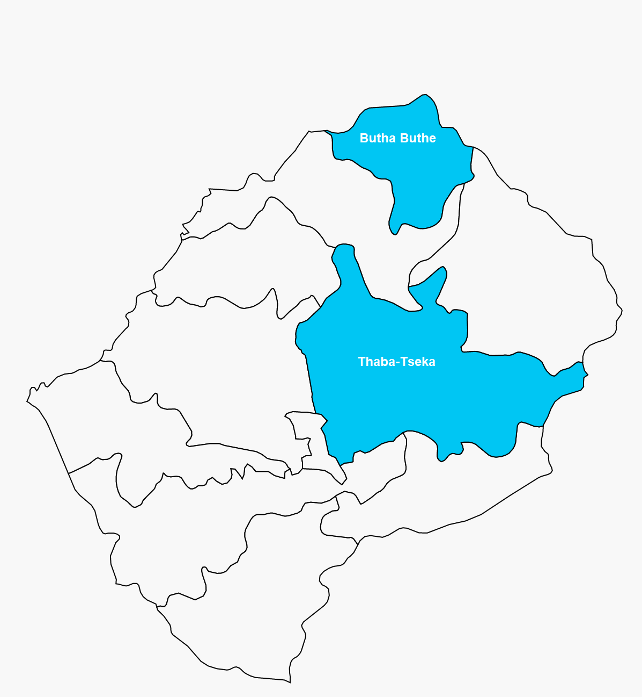
THE YMP IS BEING IMPLEMENTED IN 2 DISTRICTS
PURPOSE
Strengthen integrated SRHR/HIV and SGBV services in East and Southern Africa
Use of peer to peer mentorship as an approach to improve health and HIV outcomes for young mothers and their children
Empower young mothers to access the SRHR/HIV/MNCH and SGBV services of their choice
Empower communities to support the needs of pregnant and breastfeeding young mothers.
Generate evidence to advocate for action on adolescent mothers’ issues
UNICEF for every child
Notes:
The Young Mothers Programme is an activity under 2Gether4SRHR, a 4 year Joint UN regional programme funded by the Swedish International Development Cooperation Agency, that aims to strengthen integrated SRHR-HIV and SGBV services in East and Southern Africa. The Young Mothers Programme aims to improve the health and HIV outcomes of pregnant and breastfeeding adolescent girls and young women and their children using peer to peer mentorship as the main approach to achieving results. Through peer to peer mentorship, young mothers will be empowered to access health services, and empower communities to support their needs. The programme is also generating evidence to advocate action on adolescent mothers’ issues.

Slide 4
THE YMP AIMS TO IMPROVE THE HEALTH AND HIV OUTCOMES OF PBF-AGYW AND THEIR CHILDREN
Pregnant and BF AGYW and their children have improved health and HIV outcomes
Change in Systems
Health system responsive to needs of pregnant and breastfeeding girls and young women
Improved quality of health services—adapted for PBF-AGYW
Change in Behavior
Young Mothers seek health services
PBF Young mothers practice positive health practices
Parents/caregivers and community leaders have increased understanding of the needs of PBF AGYW and their children
Change
Demand:
PBF-AGYW have improved knowledge of their SRHR services and provide feedback on the quality of services.
Partners and Caregivers of PBF AGYW have improved knowledge on SRHR/HIV/SGBV and ECD
Enabling Environment:
PBF-AGYW have improved participation and agency
Communities support the needs of pregnant and breastfeeding young mothers.
UNICEF
Partners
Facility Level
Young Mothers Programme
Community Level
Health Education Trainings
Monthly Wellness Checks
Psychosocial Support
Cross Sectoral Linkages and Referrals
SRHR/HIV Services
MNCH Services
Partner/mother in law and care giver trainings
P2P Village Support Groups
IGAs-Social Protection Packs
Community mobilization
Health Education
Linkages & Referrals through VHP
Community Dialogues
Evidence Generation & C4D
Pregnant and BF Young Mothers
Participation & Cross-Sectoral Linkages
Underlying problems
High Adolescent Pregnancy Rates
High HIV incidence and MTCT rates among AGYW
Low Comprehensive Knowledge of HIV among adolescents
UNICEF for every child
Notes:
I will now take you through the intervention’s Theory of Change. (Click) AGYW in Lesotho face underlying issues that put them at higher risk of HIV such as low comprehensive knowledge of HIV and high HIV incidence. To tackle these issues, (Click), The Young Mothers Programme hinges on evidence generation, C4D, adolescent participation, and cross sectoral linkages to achieve the desired results. (ClickX2) The Young Mothers Programme focuses on strengthening the Community-Facility linkage. At the facility level, the young mothers are trained monthly on topics around SRHR/HIV/SGBV/ mental health, and ECD—to name a few and are empowered to invite their partners and mother in laws for trainings. They are also supported with PSS and receive monthly wellness checks for themselves and their children. All this is done with the health center staff to support sustainability. Special linkages are made at district levels with line ministries to support Young Mother's access to other social services such as birth registration, and long distance education.
At the community level, the young mothers reach other young mothers in their communities with the information they received at the facility level through the Village Support Groups. The Village Support Groups are the basis of the programme, and where the young mothers support other young mothers and collectively find solutions to community issues affecting them. Additionally, the young mothers conduct community dialogues, health education (along with the Village Health Worker), and create linkages with the village leaders for action on issues affecting them. The young mothers also receive social protection starter packs(Click)
The intervention is expected to empower young mothers and improve their knowledge of their SRHR; improve the knowledge of their partners and caregivers , and enable communities to support the needs of young mothers. (Click)
Ultimately, through stakeholders and partner contributions, it will contribute to health systems being responsive to the needs of young mothers, improved quality of health services adapted to young mothers, and improved health seeking and positive health practices among young mothers. It will also contribute to partners/caregivers/ and community leaders having an increased understanding of the needs of young mothers and their children. (Click) This will lead to pregnant and breastfeeding adolescent girls and young women and their children having improved health and HIV outcomes.

Slide 5
SINCE APRIL 6, THE MOH CANCELED ALL COMMUNITY LEVEL C4D INTERVENTIONS
MOH Cancels Community Level C4D interventions
State of Emergency Declared
1st COVID-19 Confirmed Positive Test
May 22
April
1
MOH cancels all community level health education, demand generation, outreach and C4D activiies
May
5
Initial restrictions imposed and most borders close.
.
March 18
April
6
May
13
Ease of Lockdown Restrictions
Lock Down Begins
2nd COVID-19 Confirmed Positive Test
3 week lock-down. Only essential services to be provided. All schools close. Health facilities remain open
General lockdown restrictions lifted. Ban on community level C4D interventions remain.
UNICEF for every child
Notes:
Lesotho was in emergency preparedness phase until the 13th of May, when the first confirmed COVID-19 case was announced. In preparation, the Government imposed a 3-week lockdown starting in April where only essential services were to be provided. As a response, on the 6th of April, the Ministry of Health announced the cancelation of all community level C4D interventions, including health education, demand generation, and community outreach. As of today, all community level interventions remain cancelled.

Slide 6
THE COVID-19 ADAPTATIONS ARE ALIGNED TO UNICEF ESARO’s GUIDANCE ON HIV PROGRAMMING IN THE CONTEXT OF COVID-19
Short-Term (Lockdown)
Remote psychosocial support through WhatsApp and phone calls
Health Education (SRHR/HIV/COVID-19) through WhatsApp and SMS
Wellness checks (HIV/MNCH/SRH/COVID-19/food insecurity)
Referrals to health center through Village Health Worker Programme
Medium Term (Post-Lockdown)
PPE for village support groups
Health Information (SRHR/HIV/COVID-19)- and link to U-Report
Provide outreach in small groups as permitted by the government
Social Protection (food parcels & IGA seed funding)
Community dialogues with partners and mothers in laws
Linkages to long-distance education, ECD, and vocational training
*All following physical distance measures and as allowed by the MOH
Long-Term (Recovery)
SGBV Community Dialogues
Cohort 3 training and mentorship
Cohort 2 graduation
Continue with remote PSS for those young mothers interested
Increase linkages with Child Help Line
Documentation of COVID-19 & SRHR/HIV
Facility Level
Young Mothers Programme
Community Level
Health Education
Monthly Wellness Checks
Psychosocial Support
Cross Sectoral Linkages and Referrals
SRHR/HIV Services
MNCH Services
Partner/mother in law and care giver trainings
Evidence Generation & C4D
P2P Village Support Groups
IGAs – Social Protection Starter Packs
Community mobilization
Health Education
Linkages & Referrals through VHP
Community Dialogues
Participation & Cross-Sectoral Linkages
Pregnant and BF Young Mothers
UNICEF for every child
ACTIVITIES CANCELLED DURING THE LOCKDOWN
Notes:
As such, all community level interventions of the Young Mothers Programme were cancelled—and this is where Help Lesotho and UNICEF had to adapt the approach. We are currently implementing the short-term adaptations, but here we present the medium term and long term plans. Our adaptations are aligned to the guidance provided by UNICEF ESARO on HIV Programming in the context of Covid-19: mainly Continuity of services, Prevention and protection for people at risk or living with HIV and , Research & Documentation. (Click)
In the short term, we are concentrating on continuity of services and prevention: we are providing remote PSS , health education around COVID-19 & SRHR/HIV, and providing wellness checks through a simplified questionnaire looking at food insecurity, HIV, MNCH and SRH. All this is being done through Whatsapp, phone calls, and SMS. Those young mothers identified as high-risk are referred to the health center through the Village Health Worker. (Click)
Post lockdown, and when the Government allows, we plan on providing PPE for village support groups, continue with the Health information and linking it to U-Report; provide outreach in small groups to identify young mothers lost to follow up, and engage in community dialogues with partners and mothers in laws. We will also be strengthen linkages with education and social protection. (Click)
Finally, in the recovery phase, we will concentrate on documentation of COVID-19 & SRHR/HIV; provide remote PSS to those interested young mothers, and link with the Child Help Line.

Slide 7
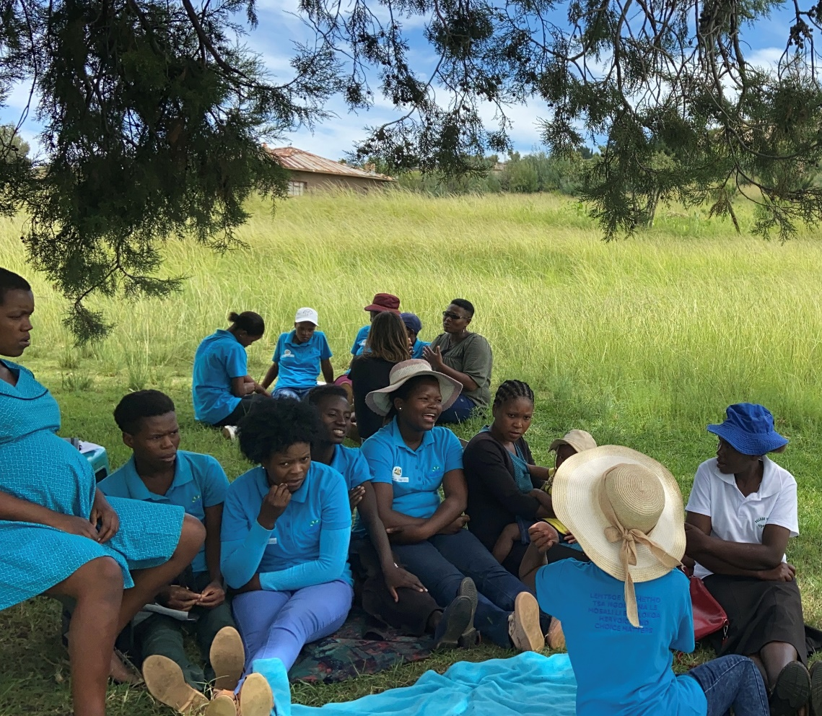
IMPLEMENTING PARTNER’S PERSPECTIVE
PREPARING FOR COVID-19
Development of guiding documents on COVID-19
Support to programme staff to work from home & COVID-19
Understanding community myths on COVID-19
Notes:
Now over to Shadrack for the implementing partner’s perspectives

Slide 8
LESSONS LEARNED
WHAT WE’VE LEARNED SO FAR
What we’ve learned so far
Referrals
Community Level
Programme Implementation
While health centers continued providing services, young mothers were not aware or were afraid — referrals through the Village Health Worker were important to provide on continuity of services to ensure adherence to key services (contraceptives, HIV services, immunization, nutrition counselling).
Village Support Groups are important for young mothers’ support network. It is essential to continue discussing issues remotely.
Approximately 60% of young mothers have access to cell phones. They were encouraged and shared COVID-19 information with their neighboring young mothers while staff reached other small groups through cell phones on loud speakers to cater for those without cell phones.
Young mother mostly living in remote and hard to reach areas had little knowledge & myths about COVID-19 which caused them anxiety and stress. They felt relaxed after receiving the facts about COVID-19, how to protect themselves, and others.
Notes:
Add a bit on numbers of young mothers reached….. (ie, programme implementation)
We have had many lessons learned in the month and a half we’ve adapted the programme. We were able to directly reach 187/300 AGYW with remote information and PSS—which is 62%. These are the young mothers who have access to cellphones. The other young mothers without cellphones were reached informally by their peers. It shows the important of the village support groups and the importance to continue discussing issues with the young mothers, remotely.
The lockdown was very stressful for the young mothers, and there was a lot of misinformation around COVID-19, which increased their anxiety and stress. The young mothers felt relived having the facts on how to protect themselves, their children and others. Finally, while health centers were providing services—young mothers were not aware. It was important to provide information on continuity of services to ensure YM adherence and access to key services such as contraceptives, HIV services, immunization, and nutrition counselling.
COVID-19 situation in the community

Slide 9
UNICEF LESOTHO WOULD LIKE TO EXPRESS ITS APPRECIATION TO LESOTHO’S MINISTRY OF HEALTH FOR ITS LEADERSHIP AND ACKNOWLEDGE HELP LESOTHO FOR THEIR CONTRIBUTION TOWARDS THE PROGRAMME’S IMPLEMENTATION.
FOR MORE INFORMATION CONTACT:
MARIA VIVAS
HIV SPECIALIST
mvivasalicea@unicef.org
Notes:
Thank You!

Slide 10
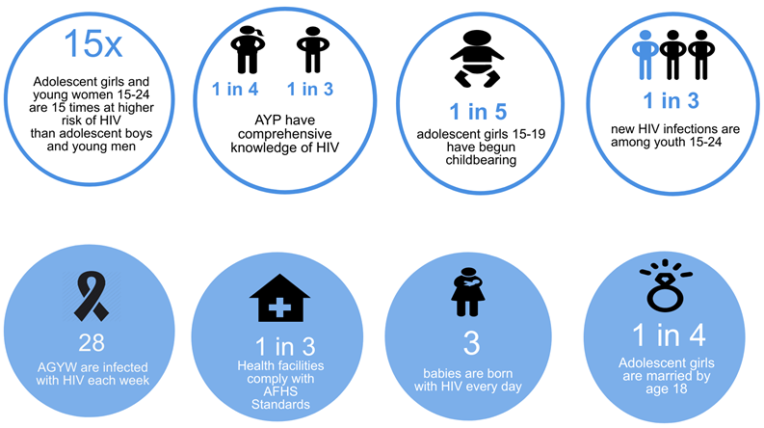
SIGNIFICANT PROGRESS TO ACHIEVE THE 95-95-95 FAST TRACK TARGETS
…BUT AGYW IN LESOTHO FACE MULTIPLE OVERLAPPING RISK FACTORS
UNICEF for every child
Notes:
To start, I would like to give you a quick context of Lesotho. Despite improvements towards the achievement of 95-95-95 fast track targets (68%KS-91%Tx-77%VS) among AYP 15-24, adolescents in Lesotho, especially AGYW, face multiple overlapping risk factors that put them at higher risk of HIV infection. These include: greater proportions of HIV infection among adolescent girls and young women than boys and young men; unacceptably low comprehensive knowledge of HIV, high teenage pregnancy rates, and low compliance with AFHS standards at health facilities
Sources: L to R (LePHIA 2017; LePHIA 2017; LDHS 2014; Spectrum Modelling Estimates 2018; Spectrum Modelling Estimates 2018, UNFPA 2017; Spectrum Modelling Estimates 2018, LDHS 2014)

