Slide 1
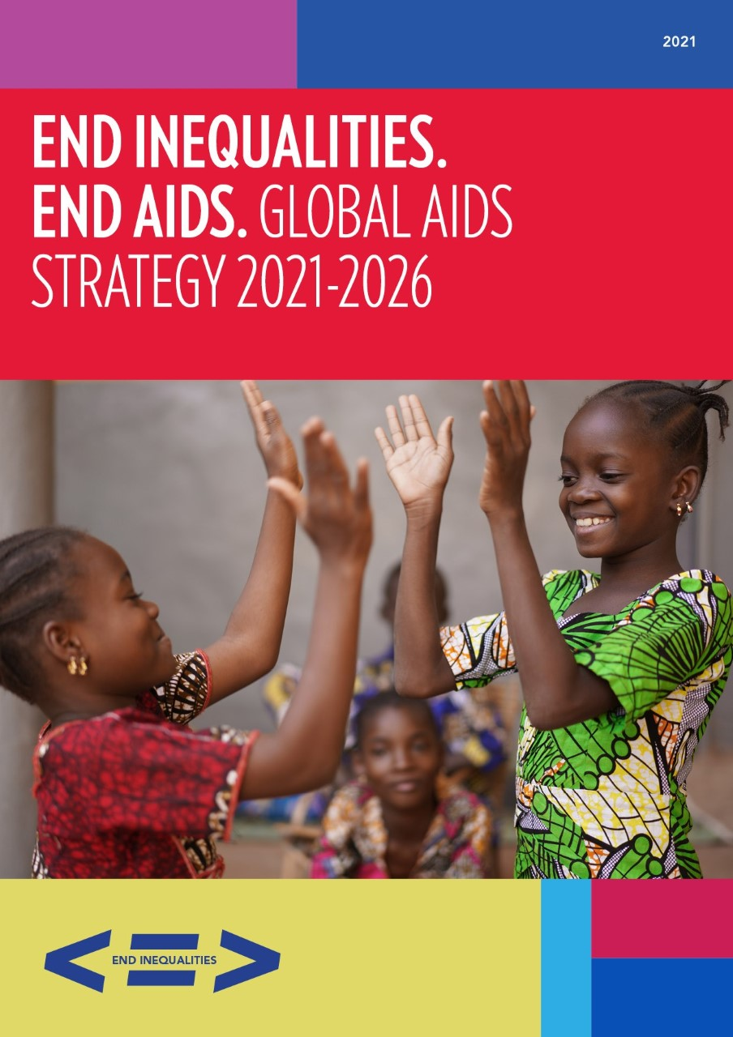
Global AIDS response for children
Where are the gaps?
Unicef Webinar
20 April 2021
Notes:
Hello and thank you to Unicef for organizing this exciting webinar and for giving me the opportunity to give an overview of the Global AIDS response for children, highlighting the main gaps.
The new Global AIDS Strategy was adopted by consensus by the UNAIDS programme coordinating Board on 25th March and will be discussed by a Multistakeholder Task Team on Friday before being presented to the UNGA in June for adoption of a new political declaration to end AIDS.
The new Strategy focuses on the inequalities driving the AIDS pandemic. Children living with or at risk of HIV face some of the starkest inequalities in the global AIDS response and I will try to highlight these inequalities in my presentation.

Slide 2
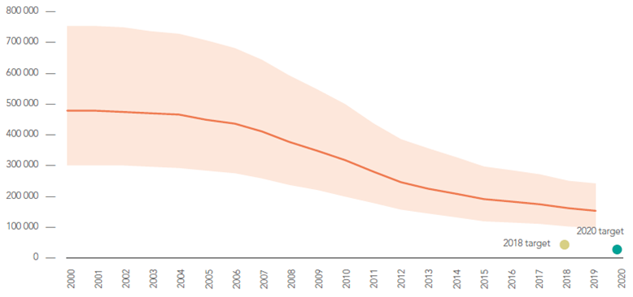
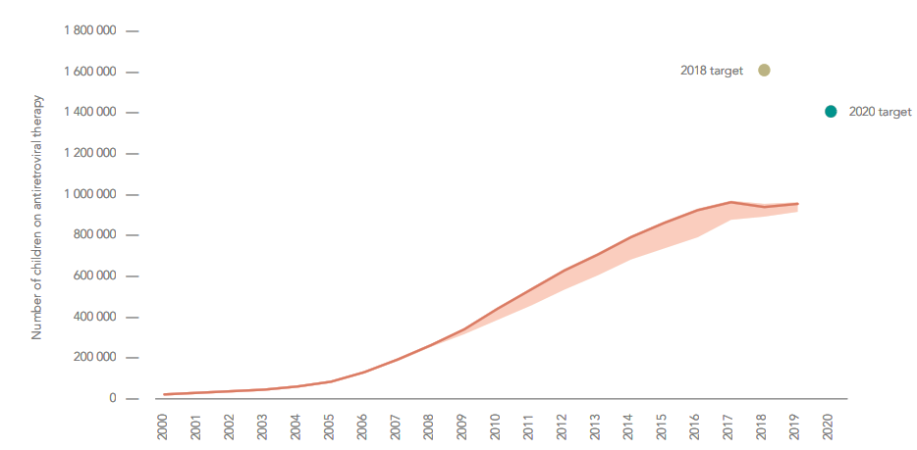
Number of new child HIV infections, global, 2000–2019 & targets
2016-2020 Start Free Stay Free AIDS Free Super Fast-Track strategy
Two commitments for children
We will miss them both
Number of children accessing antiretroviral therapy, global, 2000–2019 & targets
Source: UNAIDS estimates & Global AIDS monitoring 2020 see https://aidsinfo.unaids.org/
Notes:
Reductions in the number of children acquiring HIV constitute one of the most important achievements of the HIV response, having more than halved in the last decade, but progress has stagnated.
In 2019, there were still 150 000 new HIV infections among children – far from the global 2020 target of 20 000, with declines in new child infections having slowed dramatically after 2016
Treatment coverage for children living with HIV is even further from the target with only 950 000 children on treatment at end 2019, far from the 2020 target of 1.4 million

Slide 3
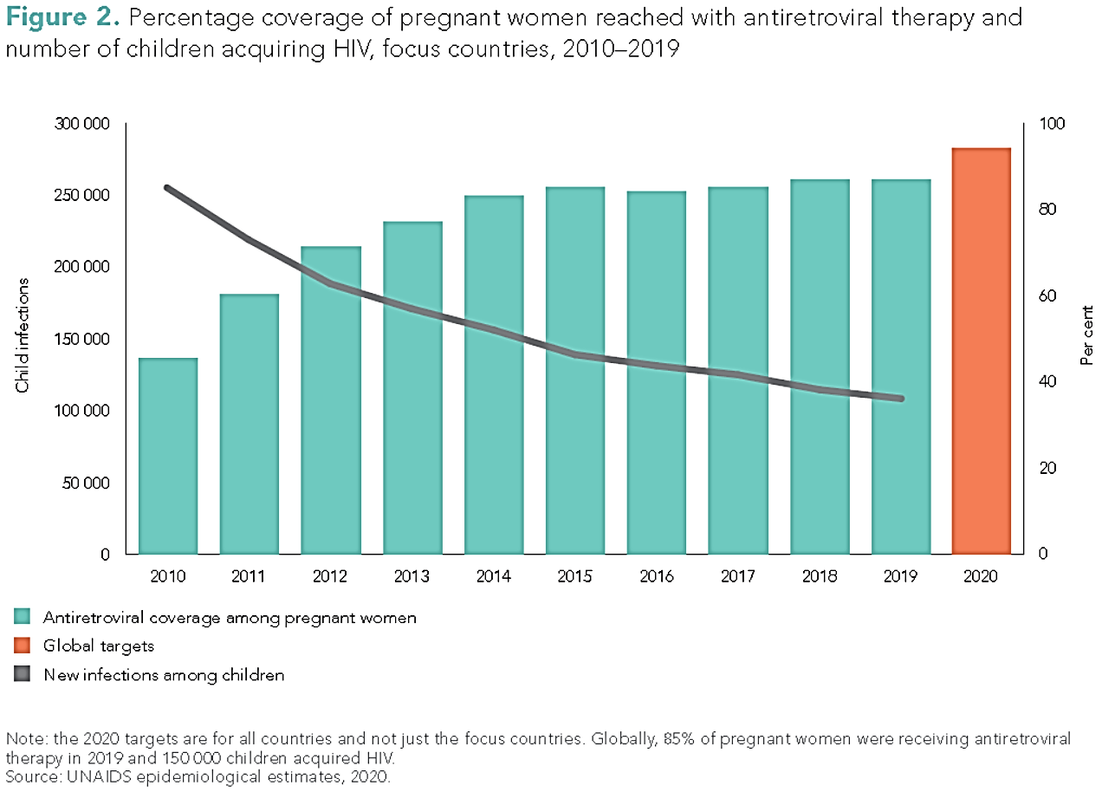
Despite high ART coverage for pregnant women living with HIV (85%), new child infections persist
Notes:
Despite high levels of ART coverage for pregnant women living with HIV (85% globally), new child infections persist and the decline in new infections has slowed.
However, the decline in new HIV infections among children was faster than that among adults showing that success is possible with concerted effort.
In 2019, the 21 focus countries comprised 84% of the global number of pregnant women living with HIV, 81% of children living with HIV and 76% of the young women aged 15–24 years acquiring HIV.
Focus countries: Angola, Botswana, Burundi, Cameroon, Chad, Côte d’Ivoire, Democratic Republic of the Congo, Eswatini, Ethiopia, Ghana, Kenya, Lesotho, Malawi, Mozambique, Namibia, Nigeria, South Africa, Uganda, the United Republic of Tanzania, Zambia and Zimbabwe.

Slide 4
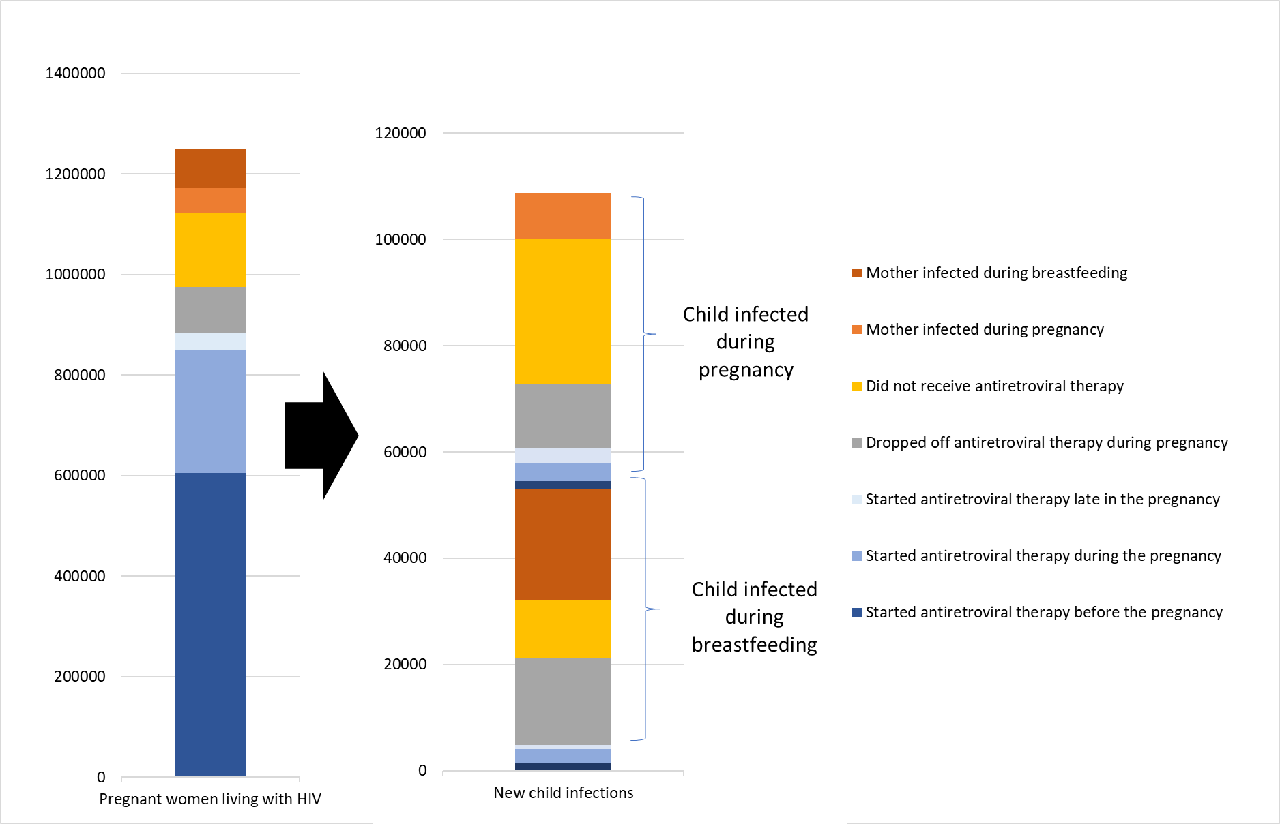
Why do new child infections continue to occur?
Inequalities:
Poor access to HIV testing & treatment before or early enough in pregnancy
Women become newly infected with HIV during pregnancy & breastfeeding
Women do not have the support they need and drop of HIV treatment during pregnancy & breastfeeding
Number of pregnant women living with HIV and new child infections by missed opportunities, 21 focus countries, 2019
UNAIDS 2020 epidemiologcal estimates.
Notes:
Better use of more granular data helps us to identify where the problems are and how to better target resources for maximum impact in reducing new child infections.
Among the 21 focus countries, the commonest reason is because women living with HIV are not tested and given HIV treatment during pregnancy and breastfeeding.
Other new child infections occur when a mother becomes HIV positive during pregnancy and breastfeeding, due to lack of HIV testing and retesting during pregnancy and breastfeeding and access to tailored combination HIV prevention services.
Some mothers start on treatment but drop off treatment, as they are not provided with the support they neeed and are lost to follow up during pregnancy and breastfeeding.
We can also see that about half of all new child infections occur during the breastfeeding period and so better support and retention of the mother and baby pair during the breastfeeding period is needed.

Slide 5
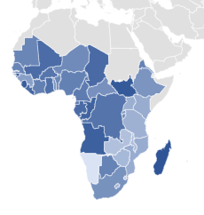
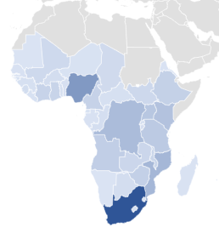


Inequalities:
Where are the missing children?
Percent of children living with HIV not on treatment
Number of children living with HIV not on treatment
Absolute number and percent of children living with HIV not receiving treatment
Almost 50% of missing children are in South Africa, Nigeria, Mozambique, DR Congo, and Kenya
Global | 850,000 | 47%
Eastern and southern Africa | 490,000 | 42%
Western and central Africa | 290,000 | 67%
Asia and the Pacific | 48,000 | 35%
Latin America | 17,000 | 54%
Caribbean | 6,400 | 56%
Middle East and North Africa | 5,600 | 58%
Notes:
Where are the children not on treatment located.
If looking at absolute numbers almost 50% of the missing children are in just 5 countries
But looking at the percentage of children living with HIV who are not on treatment in each country we can see that the problem is more widespread.
Looking at the regional picture almost 60% occur in eastern and southern Africa and over a third in western and central Africa.
There is considerable regional variation in treatment coverage from 65% in Asia Pacific to 33% in WCA

Slide 6
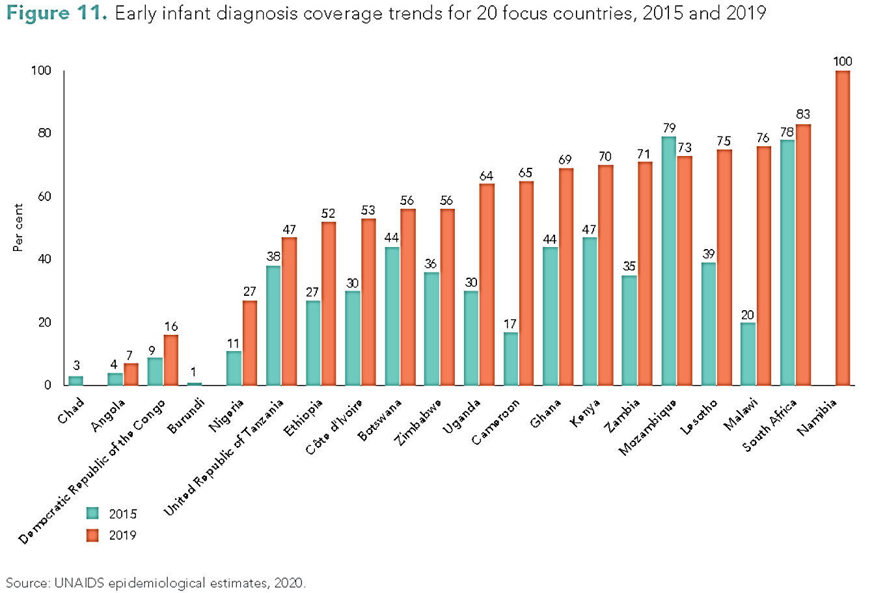
Early infant diagnosis is still surprisingly low
Inequalities:
Some gains since 2015 but not fast enough & many countries lagging
Move to POC EID
Use available tools
Even with perfect EID and all infants
identified in EID were started on treatment,
they only represent 10% of children not
currently on treatment
Notes:
This graph shows the change in coverage of EID between 2015 and 2019 in 20 of the 21 focus countries.
There is progress but it is not fast enough.
Coverage of EID is not enough if the results do not get back to the mother/baby pair and are acted on. POC EID has shown to greatly reduce the turnaround from testing to acting on the results and a much higher proportion (over 80% in some studies) of infants found to be living with HIV start on ART within 60 days of birth. Lifesaving and cost effective.
These tools are available and must be scaled up.

Slide 7
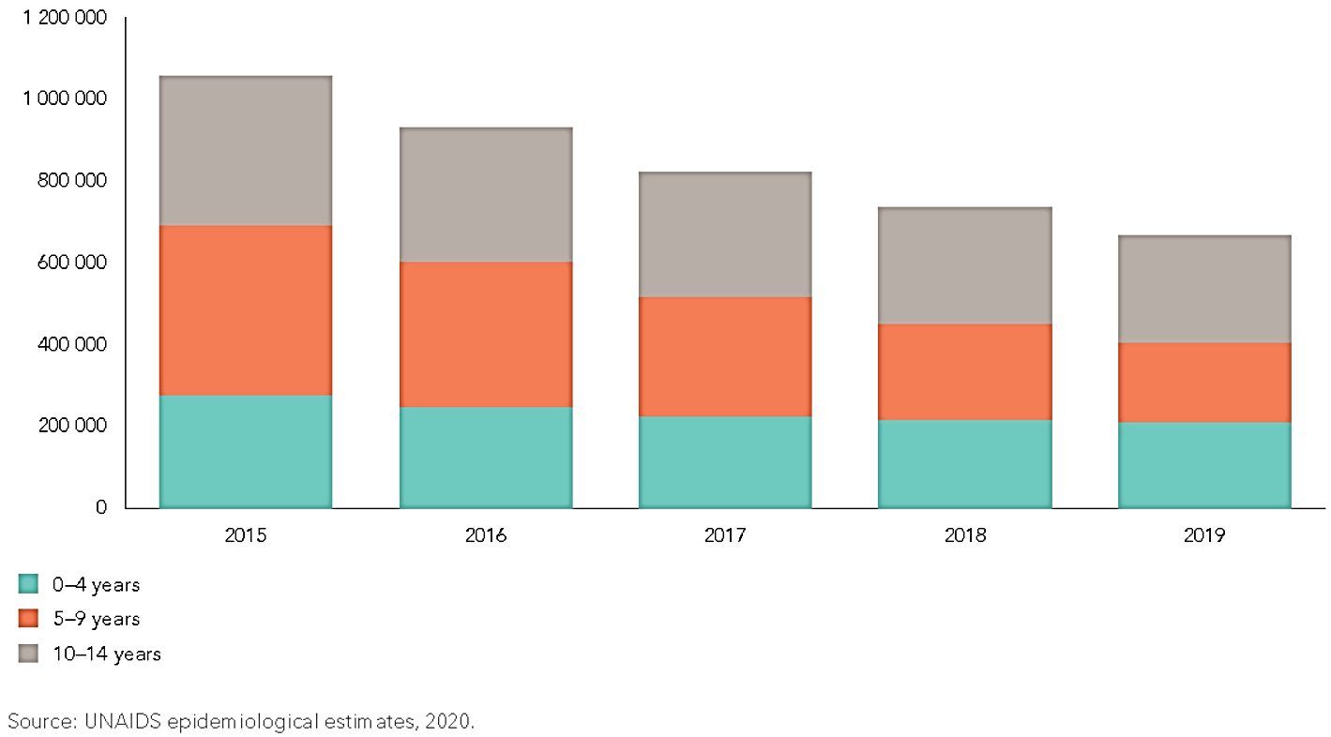
Two thirds of children not on treatment are >5 years
Inequalities:
Inadequate use of index, family, household, community and self testing to identify older children not yet on treatment
Slow scale-up of optimized treatment options & formulations to improve retention in care
Adolescents are vulnerable to dropping off treatment & lack the additional support needed during this transition to adult care
Children living with HIV not on ART by age group, focus countries, 2015-2019
69%
Notes:
Where can we find the rest of the missing children?
Globally 850 000 children living with HIV are missing out on lifesaving ART, 2/3rds are over the age of 5 years —the result of many years of missed opportunities for prevention, diagnosis and treatment.

Slide 8
Inequalities: Children living with HIV much less likely to receive treatment than adults or pregnant women globally
(53% v 68% v 85%)
Source: UNAIDS 2020 Estimates
Numbers of children living with HIV declining as children age into adulthood
850,000 children living with HIV NOT ON TREATMENT in 2019
COVID-19 hasn’t helped.
Notes:
This graph
In this graph the black line shows the total number of children living with HIV reducing over time, in part due to better prevention of vertical transmission and in part due to children maturing into adulthood
Again it shows that treatment coverage among children is stagnating, 53% coverage globally and that children living with HIV are being left behind compared to adults with 68% ART coverage and 85% coverage of pregnant women in 2019
Modelling suggests that COVID will particularly impact on efforts to prevent vertical transmission and to scale up paediatric treatment

Slide 9
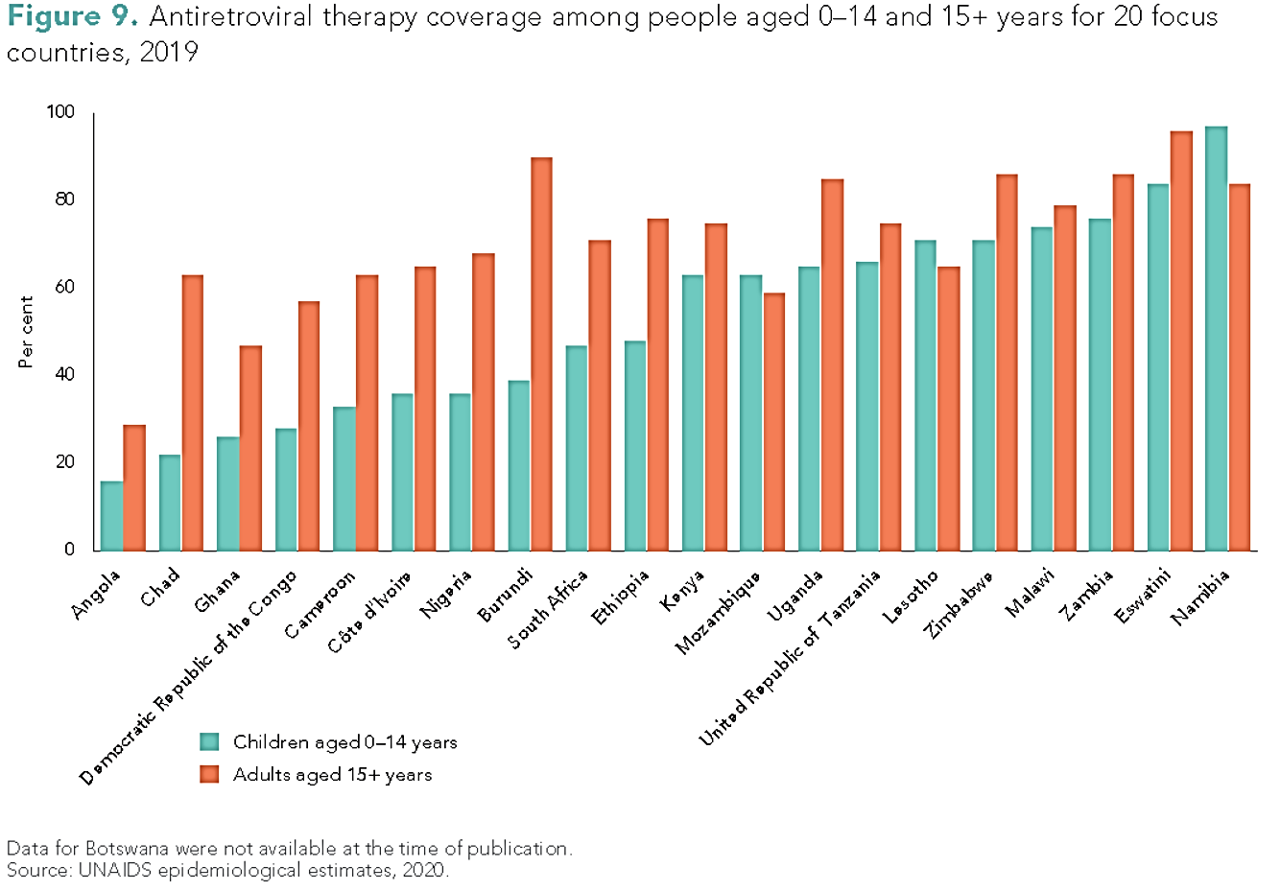
Paediatric ART is still far behind adult coverage in 17 of 20 focus countries
Inequalities: Children living with HIV much less likely to receive treatment than adults in most focus countries
Notes:
This slide further emphasizes the disparities in treatment coverage between children and adults living with HIV in 17 of the focus countries

Slide 10
Gaps to the 90-90-90 targets for children v adults: 1st & 3rd 90s
Inequalities:
90-90-90 coverage compared to adults
Children less likely to be diagnosed with HIV
Children on HIV treatment are less likely to have suppressed viral loads
Only 37% of all children living with HIV were virally suppressed in 2019, compared to 60% of adults
Source: Thembisa Model 2020.
Notes:
low rates of VLS among children on first line Nevirapine, there is an urgent need to transition
children to more efficacious Lopinavir and Ritonavir-based or Dolutegravir-based regimens in line with
current WHO guidelines.

Slide 11
End Inequalities. End AIDS
Global AIDS Strategy 2021-2026
The Global AIDS Strategy aims to end the inequalities that prevent progress to ending AIDS.
The Strategy features new bold targets and evidence-based actions for 2025 to get every country and every community on-track to end AIDS as a public health threat by 2030.
#GlobalAIDSStrategy
#EndInequalities
#OntracktoEndAIDS
Notes:
As you may already be aware, the Strategy was developed by UNAIDS, the UNAIDS Secretariat & our 11 UN cosponsor agencies, over the last 15 months. It features the inputs and engagement from over 10,000 participants from 160 countries.
Almost a month ago, the Strategy was adopted by consensus by the UNAIDS PCB
Allow me to begin with the universal nature of the Strategy. This is not a UNAIDS Strategy, it is a Global AIDS Strategy. It provides a road map for all countries and all communities to reach ambitious targets by the end of 2025 and get ontrack to end AIDS by 2030
And while the Strategy is not legally binding document on any member state, it provides the best synthesis of evidence, policies and priority actions to support every country, every continent, and every community to make breakthrough progress
This is a short, elevator pitch, summarizing the Strategy, which even fits into a tweet:
> The Global AIDS Strategy aims to end the inequalities that prevent progress to ending AIDS.
> The Strategy features new bold targets and evidence-based actions for 2025 to get every country and every community on-track to end AIDS as a public health threat by 2030.

Slide 12
Global AIDS Strategy 2021-2026: What is New / Prioritized
01
Inequalities lens
02
HIV combination prevention
03
2025 targets and commitments
04
Resource needs: US$ 29B p.a. (2025)
Communities, stigma & discrimination, youth, humanitarian settings & pandemics (COVID-19)
05
05
Regional profiles: incl ESA, WCA & MENA
05
06
Notes:
This highlights only what is new and different in this Strategy from the previous UNAIDS Strategy.
First, an inequalities lens to identify, reduce and end inequalities across all areas of the Strategy; this is more than a cross-cutting issue; it is the DNA of the Strategy that frames its focus, guides its implementation and highlights what and how it must be monitored
Third, a comprehensive new set of ambitious targets to be implemented as a package and to be reached by 2025. What is different is that these need to be reached in every country and every subpopulation and age group.
Sixth and finally, the Strategy features 7 separate regional profiles, with specific Strategy priorities for the needs and epidemiological profile of specific regions and groups of countries.

Slide 13
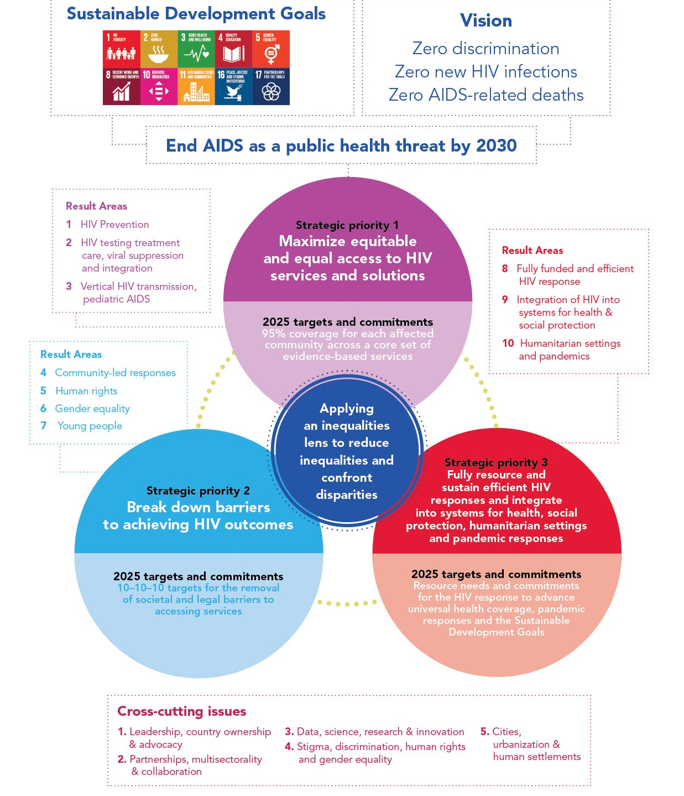
End Inequalities
End AIDS
Global AIDS Strategy
2021-2026:
Framework
Notes:
The Strategy is not one-size fits all. Different countries are explicitly encouraged to prioritize the aspects that address the needs of their epidemics.
But the Strategy is also not a pick and choose menu.
The Strategy is designed to be implemented as a package, with its 3 priorities and 10 result areas as equally important and mutually reinforcing.
This Framework shows how, guided by and contributing to 10 SDGs and the vision of the three zeros, the strategy aims to get the world, every country and every community on track to end AIDS as a public health threat by 2030.
Across all the SPs and RAs, the Strategy uses an inequalities lens to identify, reduce and end inequalities that prevent all people living with and affected by HIV from benefitting from the HIV response.

Slide 14
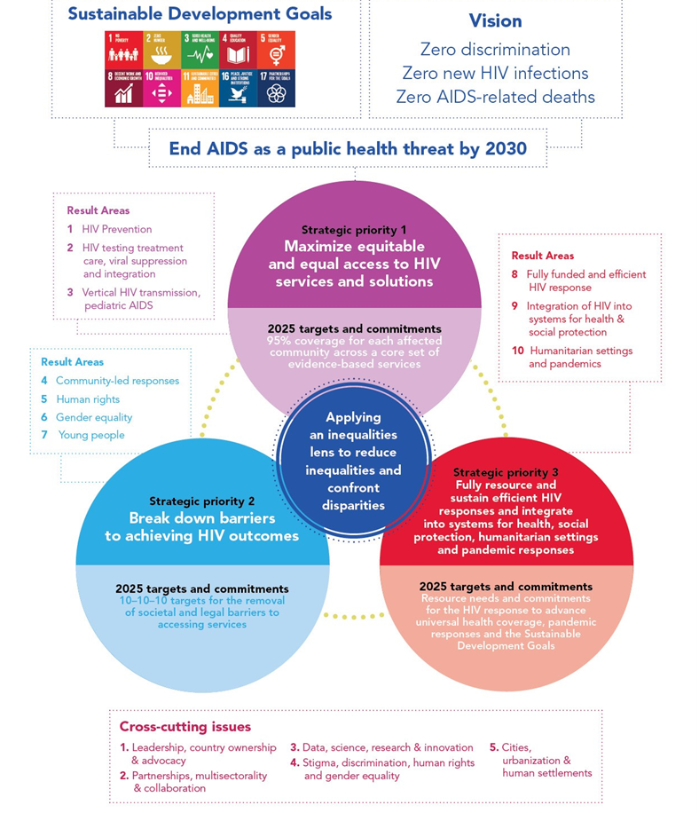
Result Area 2: Adolescents, youth and adults living with HIV, especially key populations and other priority populations, know their status and are immediately offered and retained in quality, integrated HIV treatment and care that optimize health and well-being
Global AIDS Strategy and targets – child focused
Inequality lens will focus targets on children and adolescents
Result areas identify clear actions for children and adolescents
Result Area 9 Integrated systems for health and social protection schemes that support wellness, livelihood and enabling environments for people living with, at risk of and affected by HIV to reduce inequalities and allow them to live and thrive
Result Area 3: Tailored, integrated and differentiated vertical transmission and paediatric service delivery for women and children, particularly for adolescent girls and young women in locations with high HIV incidence
Result Area 7: Young people fully empowered and resourced to set new direction for the HIV response and unlock the progress needed to end inequalities and end AIDS

Slide 15
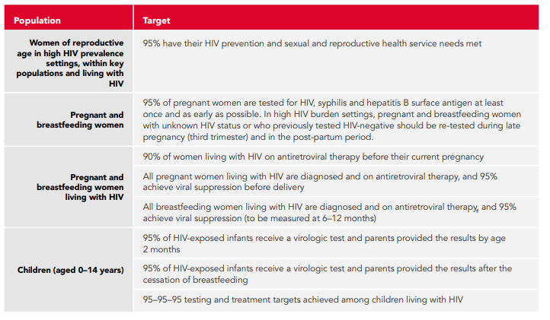
DETAILED TARGETS: vertical transmission and paediatrics
***2023 Interim Target: 75% treatment coverage for children

Slide 16
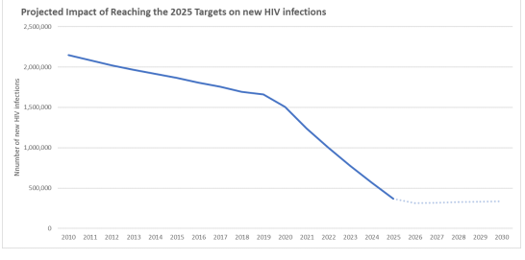
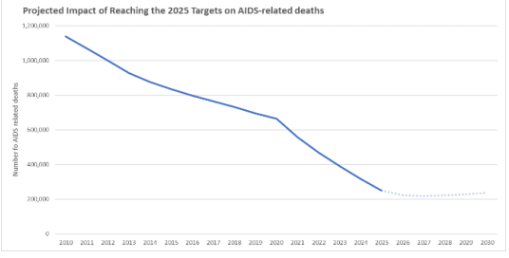
Impact of reaching the strategy’s targets and commitments
Reaching the 2025 targets will reduce new HIV infections to under 370 000 in 2025
Reaching the 2025 targets will reduce AIDS-related deaths to under 250 000 in 2025
This degree of success in the HIV response will put the international community firmly on-track to end the AIDS epidemic in all settings and for all populations by 2030
Notes:
And this is what is most precious.
If all the targets and commitments in the Strategy are achieved, the number of people who newly acquire HIV will decrease from 1.7 million in 2019 to less than 370 000 by 2025, and the number of people dying from AIDS-related illnesses will decrease from 690 000 in 2019 to less than 250 000 in 2025.
This will put every country firmly ontrack to end AIDS by 2030, which is defined as a 90% reduction in new HIV infections and AIDS-related deaths, against the 2010 baseline.
In the interest of time, we will not show the slides with the detailed resource needs. Rest assured that strategy has been full costed to reflect resource needs in specific regions and across all programmatic areas.

Slide 17
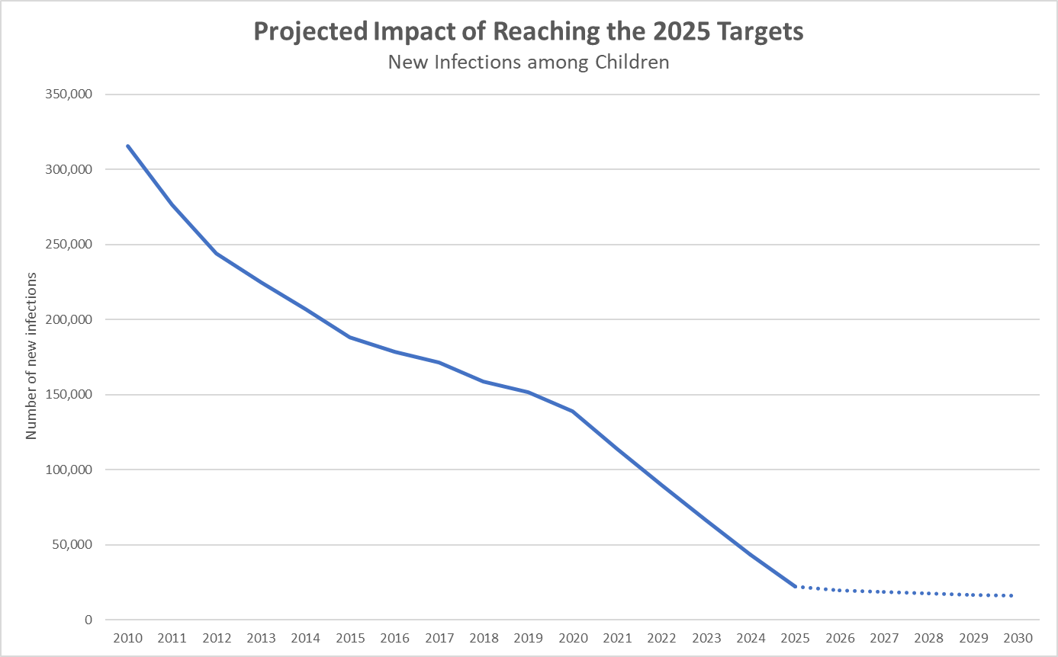
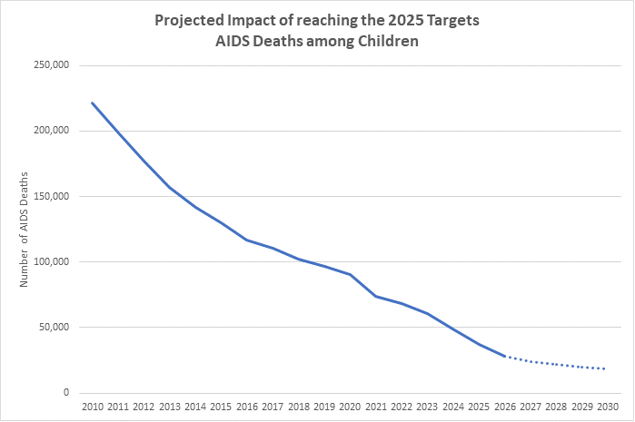
Impact of reaching the strategy’s targets and commitments for children aged 0-14 years
New child infection reduced < 22 000 by 2025
AIDS-related deaths in children reduced to < 37 000 by 2025

Slide 18
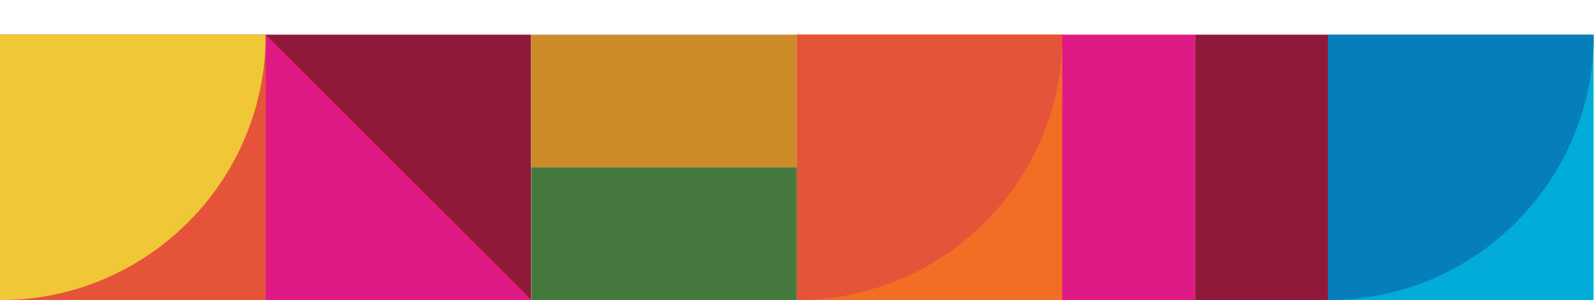
NEW YORK | 8–10 JUNE 2021
Co-facilitators: Namibia, Australia
Multi-stakeholder Task Team Hearing: 23 April
2020 Results Report

Slide 19
Thank you!
Acknowledgements
Shannon Hader
Mary Mahy
Tim Rwabuhemba

