Slide 1
HIV Viral Load Suppression (VLS) in Children
Dr. Geoffrey Chipungu
HIV/AIDS Specialist
UNICEF ESARO
20 April 2021

Slide 2
Outline
Background
Methodology
Findings
Conclusion
Taking Action

Slide 3
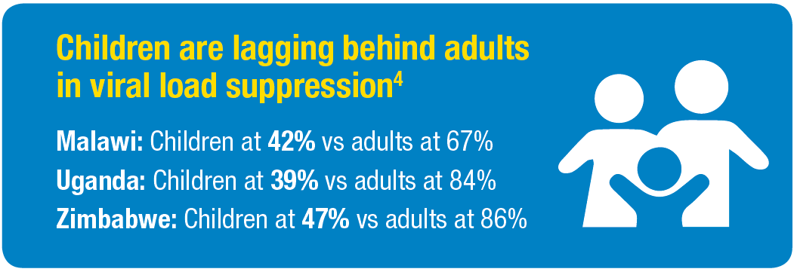
Why this study?
VLS indicates successful virologic, immunologic and clinical outcomes.
Population-based studies found sub-optimal VLS for children with HIV (0-14 years), especially compared to adult VLS.
VLS among children with HIV falls short of the 3rd 95 of the UNAIDS 95-95-95 targets.
We set out to explore the rates, trends and factors associated with VLS to inform paediatric HIV policies and programmes

Slide 4
Study Framework
Literature Review
Quantitative Data Collection & Analysis 1.LIMS secondary data analysis (Malawi, Uganda, Zimbabwe) 2. Clinical records review (Malawi)
Qualitative Data Collection & Analysis (Malawi) 1. Caregiver Interviews 2. Health worker interviews
Guidelines
Program reports
Peer reviewed journals
Triangulate
Results
Report and advocacy brief

Slide 5
Viral load volumes and data quality
Finding | 2016 | 2017 | 2018
# of VL eligible for analysis for <15 y.o. | 66,158 | 71,941 | 121,370
The reason for viral load test was not always indicated | 93% | 81% | 82%
ART regimen was not always indicated | 68% | 59% | 57%
Duration of ART was not always indicated | 75% | 66% | 71%
Disproportionately few viral loads were done post IAC | 1.2% | 3.9% | 4.2%
Yet fewer VL were done for suspected treatment failure | 0.3% | 0.2% | 0.1%

Slide 6
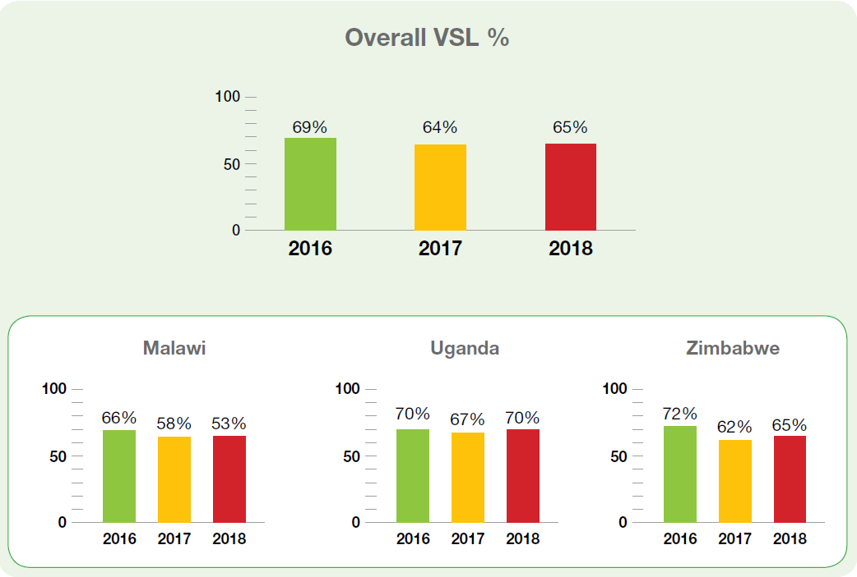
Viral Load Suppression Trends in children
The study found that one out of every three children who had a viral load test had not achieved viral load suppression.
Notes:
Across all three years and all three countries, one in every three children was not virologically suppressed.

Slide 7
Combined VL Cascade for CLHIV for the 3 countries
https://data.unicef.org/resources/dataset/hiv-aids-statistical-tables/
Notes:
Most VL testing was routine. Despite small increases in intensive adherence counselling, overall IAC remained low and did not always result in VLS.

Slide 8
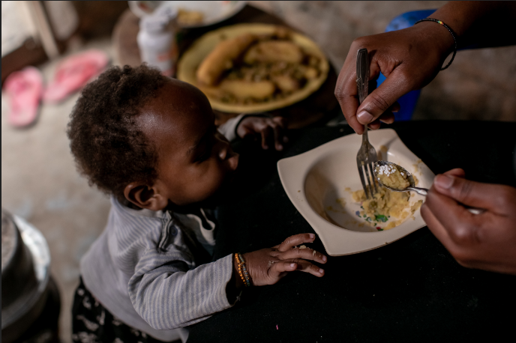
Factors associated with VLS
Duration on ART
70% (5-9 years) vs 65% (<5 years)
ARV formulation
Initial 74% vs Switched 60%
Adherence
Clinic appointments: 64% vs 59% VLS
Nutrition status (n=66)
Normal 87%, moderate 50%, severe 77%
Health facility-related
Schedules, staff shortage, perceived child-unfriendly setup, space
Psychosocial support for the caregiver and child
Notes:
Children on ART for more than 4 years were more likely to achieve VLS, suggesting better adherence with disclosure and ART literacy.
ARV complexities, unpalatability and pill burden were primary factors for non-adherence, and subsequently non-suppression.
Optimal adherence to both clinic appointments and pill counts were associated with higher VLS.
Although numbers were small, moderate malnutrition was associated with non-suppression.
Qualitative interviews indicated facility-related factors affected adherence and VLS, including health clinic hours and distance to facilities and rushed appointments with health workers.
Similarly, interviews with HCWs and caregivers indicated that psychosocial support was strongly associated with adherence, retention and treatment success.

Slide 9
Conclusion
To reach the third 95 target much more needs to done on VL coverage and follow-up.
Children are more likely to achieve VLS when they and their caregivers have support from families, communities and health workers.
Drug regimens and formulations continue to impede children’s VLS.
Health care quality, accessibility and affordability have a direct impact on children’s adherence.
Multi-sectoral challenges (food security, poverty) affect treatment success.
Lack of documentation, storage and utilization of data in both the LIMS and patient records was common.

Slide 10
Taking Action
Provide multi-year support to caregivers and children with HIV.
Promote paediatric viral load testing and adopt efficacious, child-friendly regimens.
Strengthen paediatric service delivery coverage, accessibility and quality.
Improve case management with multi-sectoral linkages and referrals.
Work toward smarter paediatric HIV data management systems.
Generate useful paediatric HIV implementation research.
http://www.childrenandaids.org/vls-clhiv
Notes:
Build on existing platforms, such as PMTCT, to provide multi-year support to caregivers and children with HIV.
As VL testing becomes more common, we need to ensure children are included in routine VL testing and continue to be initiated on or switched to more efficacious regimens.
Strengthening paediatric service delivery includes improving health worker competencies and decentralizing differentiated services for children.
We need to improve paediatric case management, addressing children’s co-morbidities as well as household challenges.
The data gaps found in this study reenforce the call for greater investments in data management systems that will enhance clinical care.
CLHIV are not a homogenous group; we need further evidence generation to deliver the right services, differentiated according to children’s unique circumstances.

Slide 11
Acknowledgements
Children, caregivers and health workers who participated in the study
Respective Ministries of Health
UNICEF ESARO and country offices
Kundai Moyo and Edward Chigwedere, V and E Consultants
Judith Sherman, Independent Consultant

