Slide 1
Addressing adolescent girl and young women’s risk and empowerment:
Emerging lessons from the DREAMS Partnership
UNICEF (NY)—HIV Prevention with Adolescent Girls and Young Women
11 July 2018

Slide 2

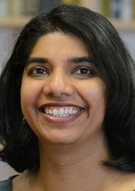

Today’s presenters
Julie Pulerwitz, ScD
Director, HIV and AIDS Program
Co-PI DREAMS Male Partners Studies
Sanyukta Mathur, PhD, MHS
Project Director
DREAMS Implementation Science
Miriam Temin, MSc
Project Director
Building Capacity for DREAMS Girl Platforms

Slide 3
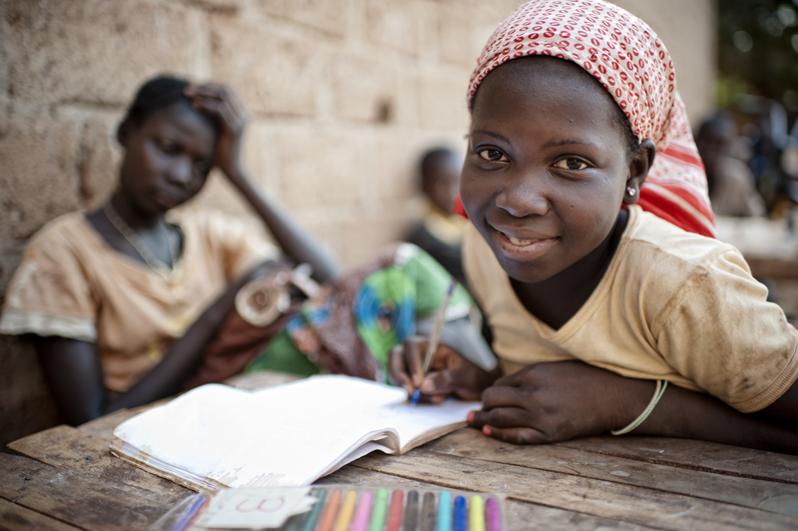
The Population Council
conducts biomedical, social science, and public health research. We deliver solutions that lead to more effective policies, programs, and technologies that improve lives around the world.
Notes:
Founded in 1952; work in 50 countries; 60% of staff based in Global South / developing world

Slide 4
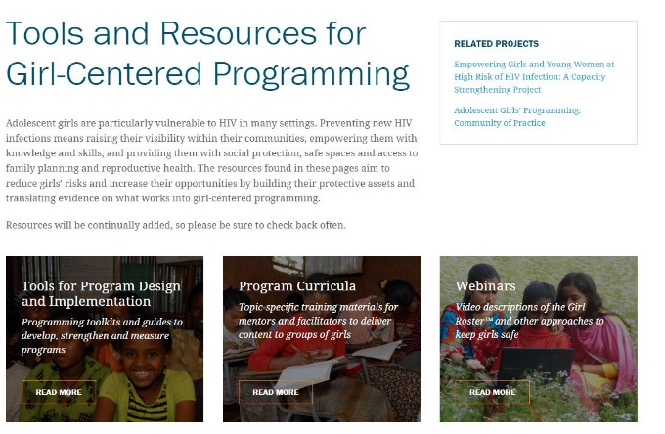
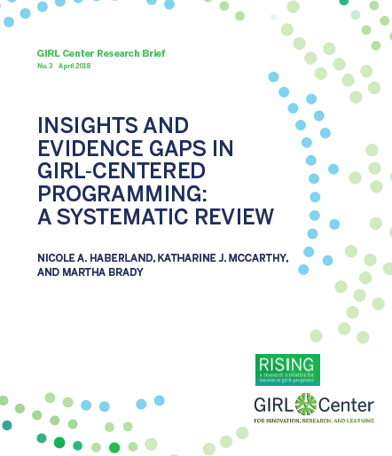
Focus on adolescent girls’ empowerment
Rigorous research to improve health & development outcomes for vulnerable AGYW
Intentional design—starting with the perspective of the beneficiary

Slide 5
Focus on identifying effective solutions to improve HIV response
Generate practical evidence to answer “how to” questions about HIV programs /services
Address socio-structural context:
Hard to reach populations
Gender inequities & relationship power
Stigma

Slide 6
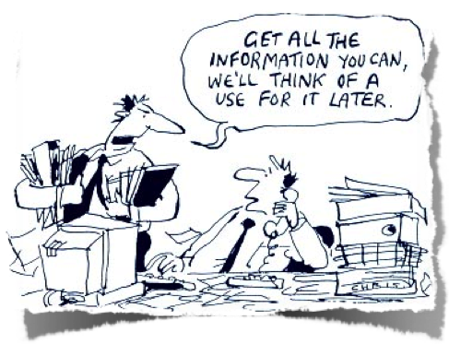
Fostering research impact / use
Ensuring relevance of study objectives and results
Promoting use of study results to guide planning and implementation
Building bridges between researchers and program managers / policy makers
Strengthening capacity to produce and use evidence
Notes:
We do this by:

Slide 7
Why are we talking about AGYW and HIV?
Source: UNICEF analysis of UNAIDS 2017 estimates.
Notes:
7000 AGYW a week acquire HIV (UNAIDS 2016)
Girls and young women account for two-thirds of new HIV infections among adolescents in sub-Saharan Africa
Nearly half of new infections among girls and young women in 2014 occurred in 10 countries

Slide 8
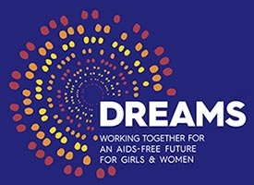
DREAMS Initiative
Goal: help girls develop into Determined, Resilient, Empowered, AIDS-free, Mentored, and Safe women
Aims to reduce HIV infection rates among adolescent girls and young women in 10 sub-Saharan Africa countries, and additional 5 countries last year
Public-Private partnership
  PEPFAR, BMGF, Girl Effect, Johnson & Johnson, Gilead Sciences, ViiV Healthcare

Slide 9
What is different about DREAMS?
Focus on (most vulnerable) adolescent girls and young women
Interventions are multi-sectoral, address structural determinants, explicit about gender
Includes several ‘new’ interventions:
  Pre-exposure prophylaxis (PrEP)
  Social asset building
  Cash transfers
Addresses range of AGYW, including very young adolescent girls (ages 10–14)

Slide 10
DREAMS package: Combination of “evidence-based” interventions layered in same location
Mobilize
Communities
for change
Empower
Adolescent Girls & Young Women (AGYW)
and reduce risk
Reduce risk of
Male sexual partners
Strengthen
Families
Adapted from: Preventing HIV in Adolescent Girls and Young Women: Guidance for PEPFAR Country Teams on the DREAMS Partnership, March 2015

Slide 11
Population Council's role in DREAMS
Generate evidence
↕
Build capacity to translate
evidence into programming
Funding from Bill & Melinda Gates Foundation, PEPFAR/USAID (via Project SOAR), & Girl Effect

Slide 12
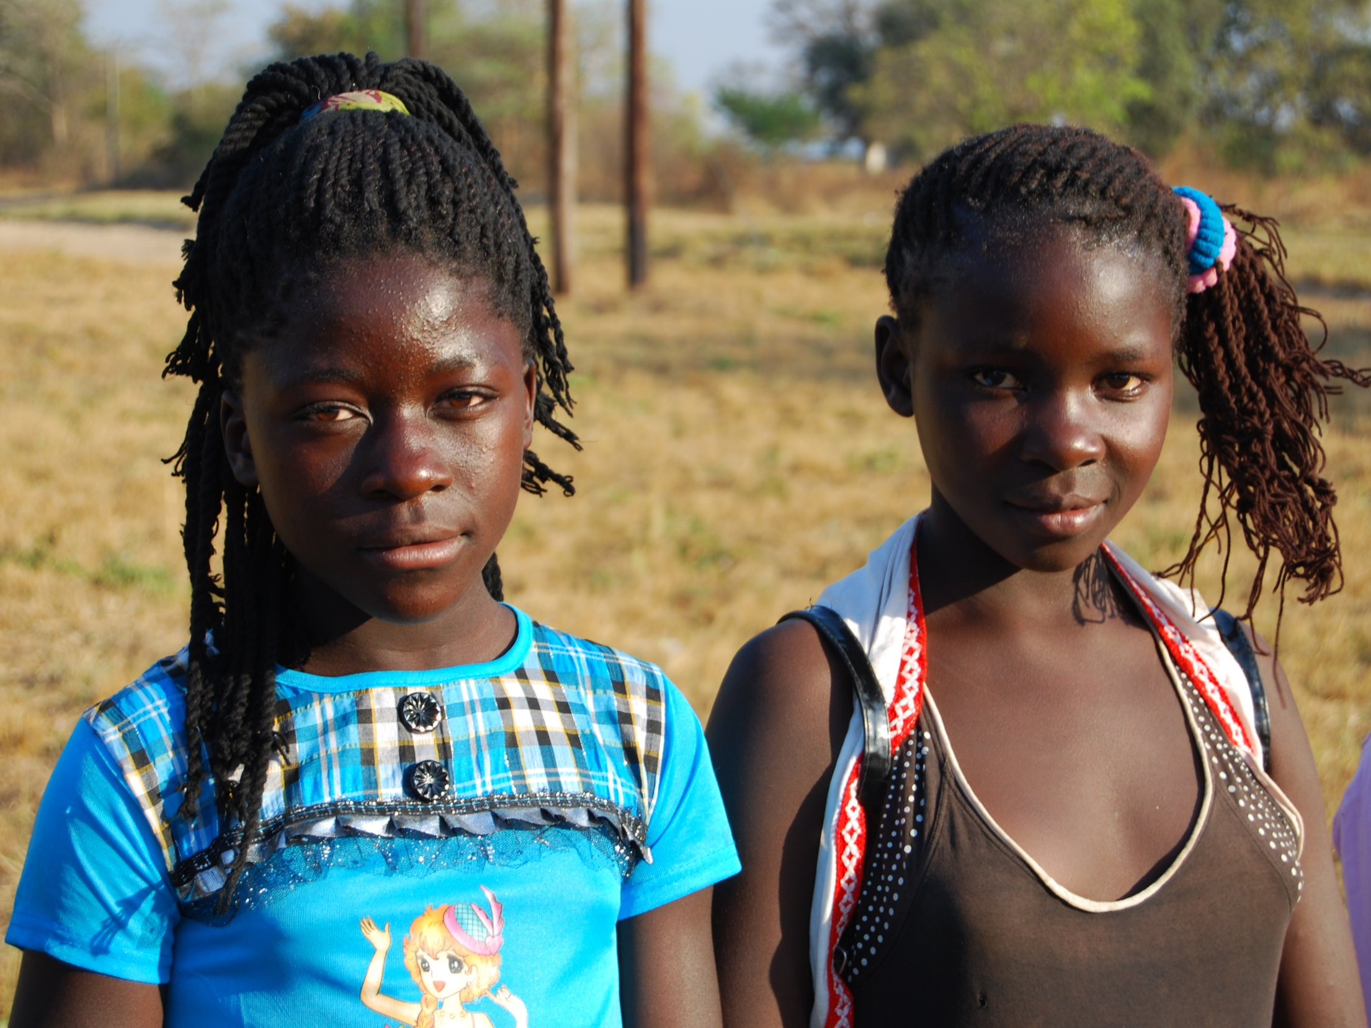
Using Implementation Science to Strengthen HIV Prevention for Adolescent Girls and Young Women
Sanyukta Mathur, DrPH MHS
Project Director, DREAMS Implementation Science Research
11 July 2018 UNICEF

Slide 13



Generating evidence around DREAMS
3 cross-cutting themes—focusing on unique features of DREAMS
Assessing effectiveness of community-based girl-centered programming
Identifying and reaching male partners of adolescent girls and young women in HIV services
Introducing oral PrEP among adolescent girls and young women

Slide 14
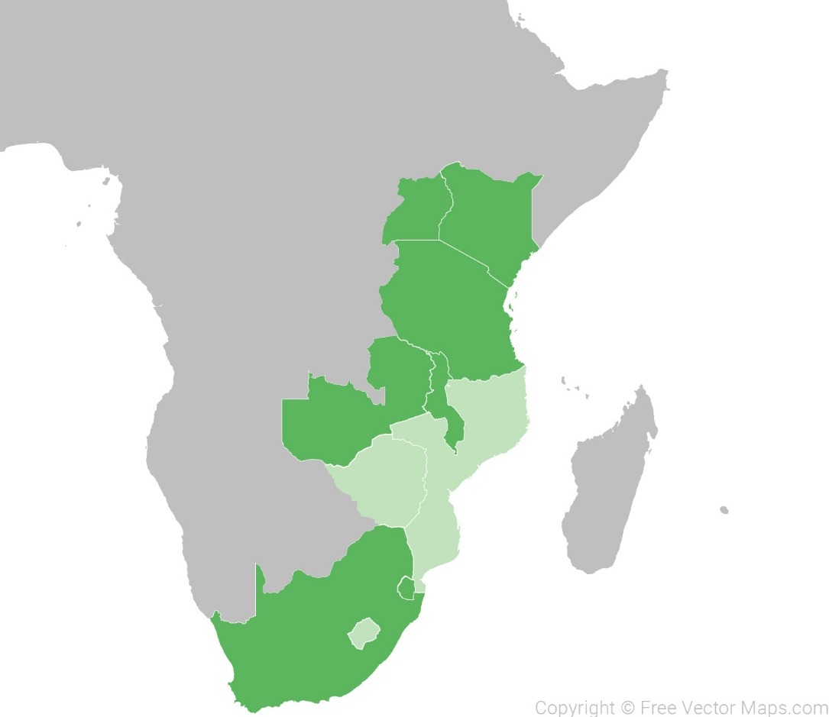
Implementation science research sites
Uganda
10 research activities across 7 DREAMS countries
Male Partner
PrEP (TA)
Kenya
AGYW
Tanzania
PrEP
Malawi
AGYW
Male Partner
Zambia
AGYW
Swaziland
Male Partner
South Africa
Male Partner
AGYW (TA)

Slide 15






Research approach
2-phased study design
Mixed methods
Multiple perspectives
Engaging stakeholders

Slide 16
Very high concentrations of HIV risk among AGYW
Violence experience in the last 12 months | Kenya (n=1,778) % | Zambia (n=1,915) %
Physical violence from partners | 24 | 23
Sexual coercion from partners | 19 | 21
Sexual violence from non-intimate partners | 24 | 17
AGYW who experienced sexual violence were 2x as likely to report an STI symptom and anxiety and depression
Mathur, Okal, Musheke, et al. Under review (Plos One). High rates of sexual violence by both intimate and non-intimate partners experienced by adolescent girls and young women in Kenya and Zambia: Findings around violence and other negative health outcomes.

Slide 17
DREAMS is reaching many at-risk AGYW
Vulnerable households
  Experienced parental loss
Increased biological vulnerability
  High STI experience
High-risk sexual behaviors
  Multiple partnerships
  Don’t use condoms consistently
  Use alcohol before sex
High-risk sexual relationships
  Experienced sexual violence in the last 12 months
  Partners have other partners (partner sexual concurrency)
Notes:
Zambia
Kenya
DREAMS
Non-DREAMS
DREAMS
Non-DREAMS
Orphanhood (both parents deceased)
9%
12%
14%
19%
Zambia
Kenya
DREAMS
Non-DREAMS
DREAMS
Non-DREAMS
STI symptoms in last 6 months
15%
14%
19%
17%

Slide 18
Some sub-populations of AGYW not as well represented
Out of school
Sexually active
 | Zambia |  | Kenya
 | DREAMS % | Non-DREAMS % | DREAMS % | Non-DREAMS %
Currently in school | 71% | 37% | 58% | 27%
Sexually active | 41% | 66% | 62% | 78%

Slide 19
Can we better identify whom to reach?
Innovative analysis for better identification of vulnerable sub-groups within high-risk geographic contexts
Segmentation based on multiple characteristics
SOCIODEMOGRAPHICS
Schooling status, age, income, geography
ATTITUDES
Beliefs, perspectives
BEHAVIORS
Risk behaviors, service use/non-use
Sophisticated context-specific profiles to
inform differentiated programming and evaluation

Slide 20




Vulnerability profiles of AGYW, Kisumu, Kenya
Preliminary findings from latent class analysis using survey data (n=1.014)
Double orphan
Sometimes hungry
Not connected to adult in HH
Sexual debut ≤14
Moderate HIV risk perception
High gender inequity
No comprehensive knowledge of HIV
Non-orphan
Connected to adult in HH
Comprehensive knowledge of HIV
AGYW with higher vulnerability were more likely to report sexual risk behaviors
OUT-OF-SCHOOL LOWER VULNERABILITY 71% of sample
OUT-OF-SCHOOL HIGHER VULNERABILTY 29% of sample

Slide 21
AGYW’s relationship power & HIV risk
AGYW reported limited power in their sexual relationships,
  however older respondents consistently reported lower levels of power compared to younger respondents.
Relationship power was strongly associated with
  Less likely to experience sexual violence
  Less likely to experience physical partner violence
  More likely to report condom use at last sex
  More likely to have increased knowledge of partner’s HIV status
Pulerwitz, Mathur, and Woznica. Under Review at Plos One. How empowered are girls/young women in their sexual relationships?: relationship power, HIV risk, and partner violence in Kenya.

Slide 22
Men’s sexual relationships with AGYW
13% of men were in relationships with multiple AGYW who were all 10+ years younger.
54% had both AGYW partners & partners age 25+ in last year (cycle of transmission)
AGYW partners in last year
Study site: Durban, South Africa (n=941)

Slide 23
Men’s multiple concurrent partnerships: Characterized by conflict & miscommunication
Study site: Uganda (n=94 IDIs)

Slide 24
Men’s history of trauma & HIV risk for AGYW
Ever
Before age 18
Adult experiences of violence associated with multiple sexual partners (p=0.001)
Childhood experiences of violence associated with multiple sexual partners in the last year and inconsistent condom use (both p<0.05)
Study site: Durban, South Africa (n=941)

Slide 25
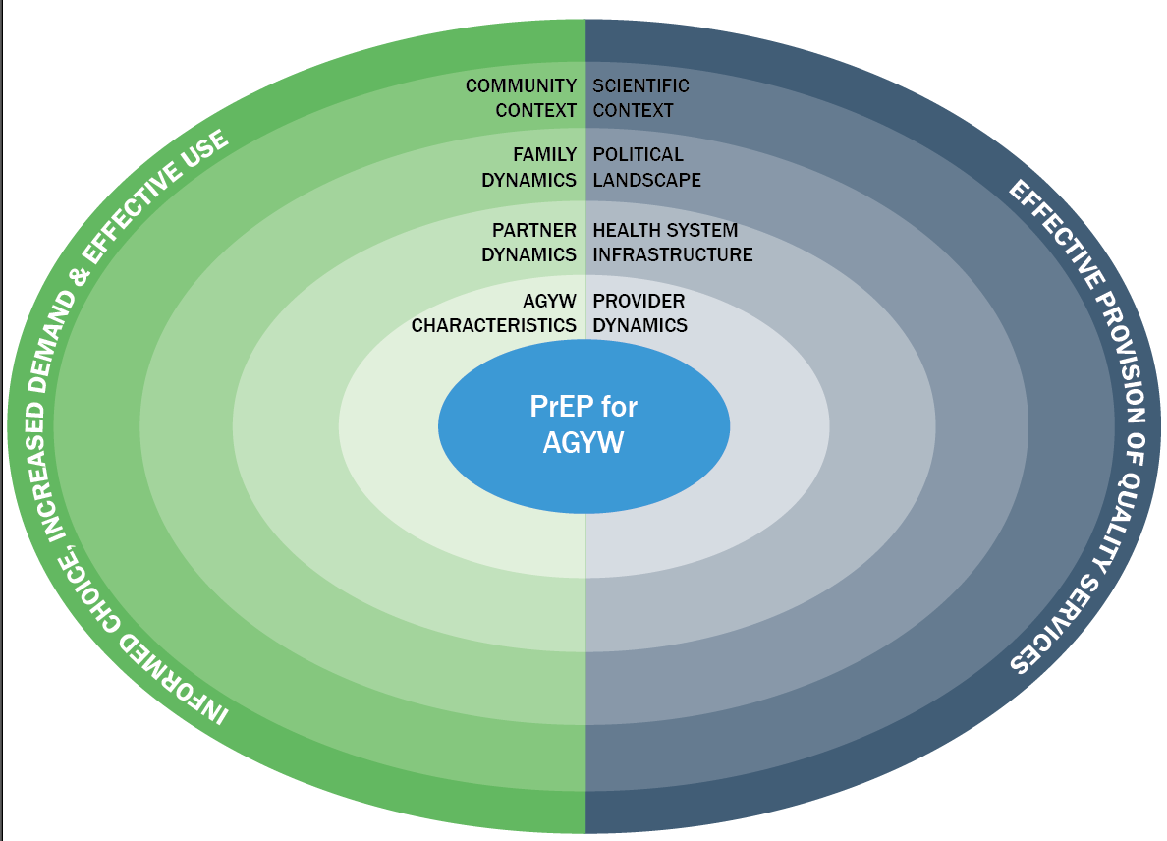
Expanding the HIV prevention package for AGYW
High congruence among respondents: AGYW need PrEP due to
sociocultural circumstances that increase their HIV risk
Study site: Tanzania
Mathur, Pilgrim, and Pulerwitz. 2016. “PrEP introduction for adolescent girls & young women,” The Lancet HIV 3(9): e406-e408.
Notes:
Our IS framework positions young women in the context of their partner, peers, family, health providers and services, social values/community context, and broader scientific knowledge about PrEP. The right side (blue side) focuses on the main factors that determine the feasibility of effective introduction of quality PrEP services for AGYW. The left side (green side), focuses on the main factors that determine whether young women are able to make informed decisions around PrEP uptake and its effective use. The two sides are connected to illustrate the interplay between them, which is critical to understanding how to effectively introduce PrEP to AGYW.

Slide 26




Key considerations for PrEP introduction
Challenges: side effects, cost & frequent HIV testing, stigma
Facilitators: Technology (e.g., social media) & support groups)
Challenges: Stigma & concerns about condoning sexual activity
Facilitators: Need strategies to support daughters’ PrEP use
Challenges: concerns of relationship trust
Facilitators: Inclusion in partner’s decision-making process, education & availability of PrEP for selves
Challenges: negative attitudes toward adolescent girls’ sexuality, short staff, inadequate training on counseling strategies, stigma
Facilitators: use of para-medical professionals, integrate PrEP into existing SRH services, counseling tools and training

Slide 27
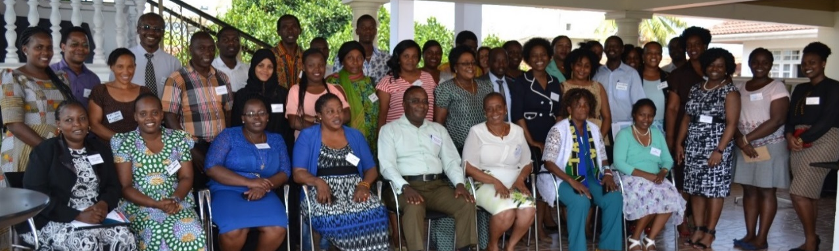
Early engagement of stakeholders
1st study in Tanzania to assess feasibility & acceptability of oral PrEP for young women outside of a clinical setting
Involved and robust RU process (e.g., gain insights into study before data collection, frequent communication and data sharing)
Contributed to Tanzania’s decision to implement PrEP in 2018

Slide 28
Identifying major facilitators & barriers to program implementation
Implementing Structures & Cost
Models of implementation
Implementer Perspectives
Project start-up: community engagement, recruitment, strategies, staff capacity
Beneficiary Perspectives
Intervention package & implementation processes
Factors affecting implementation
Coordination mechanisms
Cost per beneficiary
Experience with the program participation
Motivations for participation
Program exposure & influence

Slide 29
Emerging insights on programming
Importance of developing coordination and cooperation among IPs for different types of implementation models
in-country
Programs need refined approaches and tools to identify and reach at-risk AGYW (e.g., Girl Roster)
Critical to gain buy-in from parents/guardians and male partners of AGYW
  “…some were ready to be assisted but their husbands were not ready…. You know generally men fear when women make such steps....”
  —DREAMS Implementing Partner
Community-based mentors key for effectively connecting AGYW to DREAMS activities

Slide 30





Key IS takeaways to-date
  Identify context-specific vulnerability profiles to inform more targeted outreach and programming.
  Target programs toward men to address their high-risk behaviors and vulnerabilities to reduce risk for AGYW.
  Engage AGYW and key actors to support HIV prevention & introduction of oral PrEP for AGYW.
  Robust RU processes can lead to rapid program and policy changes.
Stay tuned! popcouncil.org/DREAMS_IS

Slide 31
Overview of dreams capacity strengthening efforts
Miriam Temin
UNICEF (NY)—HIV Prevention with Adolescent Girls and Young Women
11 July 2018

Slide 32




WE
DON’T
REACH GIRLS
BECAUSE WE
ASSUME WE HAVE
Notes:
Pillar 1 + 2
The other stumbling block is we don’t reach girls because we think we ALREADY are, through programs for children, youth and women. . . . When in fact we might not be.
This oversight is glaring in the health sector, where girls are reached through early childhood programs -- until the age of 5.
The next time health systems see a girl is when she is pregnant.
Missing from the system are all the girls at critical transitional ages of early adolescence, when she needs health services and information the most.

Slide 33


DREAMS Core Package
Empower Girls & Young Women and reduce risk
Mobilize Communities for change
Reduce Risk of Sex Partners
Strengthen Families
Community Mobilization & Norms Change
School-Based
Interventions
Additive Funding VMMC
Parenting/ caregiver Programs
Additive Funding
TX for Men
Characterization of male partners to target highly effective interventions (HTS→ART, VMMC)
Social Protection
(Cash Transfers, Education Subsidies, Combination
Socio-Economic Approaches)
Youth-friendly sexual and reproductive health care (Condoms, HTC, PrEP, Contraceptive Mix, Post-violence care)
Social Asset Building

Slide 34
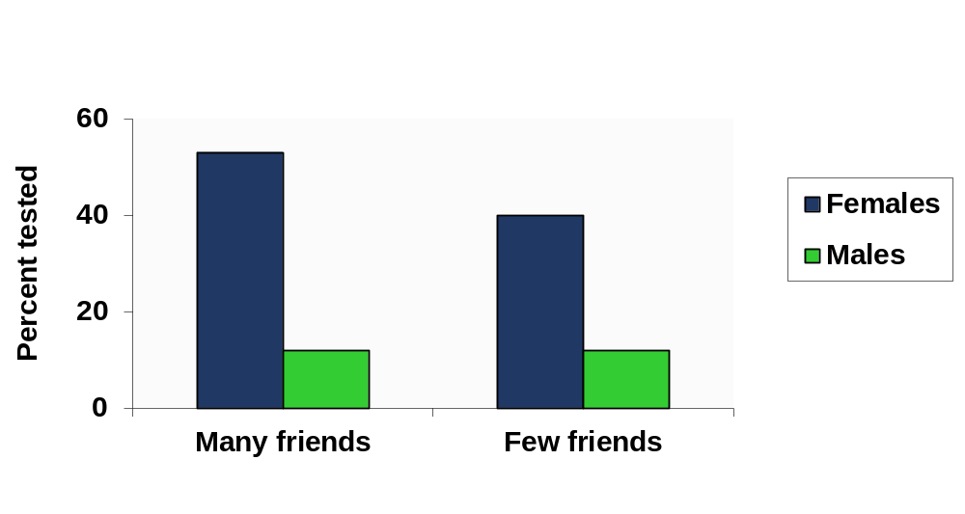
Friends are social assets
For AGYW:
More friends, more HIV testing
Ever tested for HIV: 16-24-year-olds in Siyakha Nentsha project, South Africa
Hallman, Kelly. Population Council, Poverty, Gender and Youth Program. “Siyakha Nentsha”: Enhancing Economic, Health, and Social Capabilities of Highly vulnerable Adolescents in South Africa.” December 2008.
Notes:
Social isolation and lack of friends not only increases risk, it also inhibits opportunities.
South Africa again
Diffs. for females (and obviously males) not statistically significant (sample size was too low)

Slide 35
Social assets also good for condom use
Trust in community, group participation, condom use at last sex
14–18 year old girls KwaZulu-Natal. Longitudinal analysis: FE logit
Adjusted odds ratio
*** p<0.001
Kelly Hallman. 2011. “Social exclusion: The gendering of adolescent HIV risks in KwaZulu-Natal, South Africa,” pp. 53-80 in J. Klot and V. Nguyen eds., The Fourth Wave: An Assault on Women - Gender, Culture and HIV in the 21st Century. Social Science Research Council and UNESCO. http://www.ssrc.org/publications/view/the-fourth-wave-violence-gender-culture-hiv-in-the-21st-century/
Notes:
These are girl-only sports groups – regular, predictable, team-building
*** is significant with p<0.001

Slide 36




The whole girl: Protective assets reinforce each other
Girls-only safe spaces
Mentorship
Trust
Negotiating Power
SOCIAL ASSETS
Confidence
Communication Skills
Literacy
COGNITIVE ASSETS
Access to health clinic
Sexual health knowledge
Autonomy
Self-esteem
HUMAN/HEALTH ASSETS
Knowledge of budgets
Savings
Vocational training
ECONOMIC ASSETS
Hallman, K. (2004) Population Council.
Notes:
We promote a multi-sectoral approach to building protective assets [social, cognitive, health, and economic] that consider the whole girls.
Through our research, we understand that one asset can reinforce the other. For EXAMPLE….
This approach allows programs to reduce a wide range risks that adolescent girls face.

Slide 37
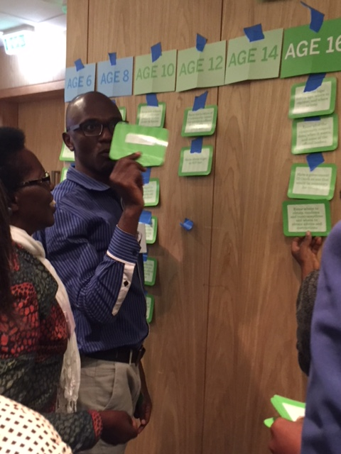
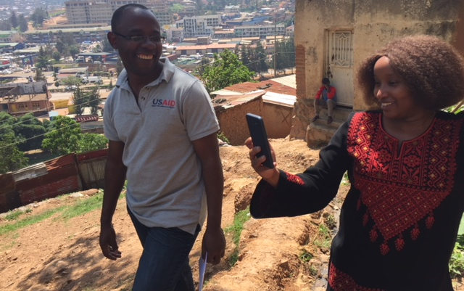
DREAMS Capacity Strengthening Project
Workshops
Webinars
Remote coaching
Practical tools & resources

Slide 38
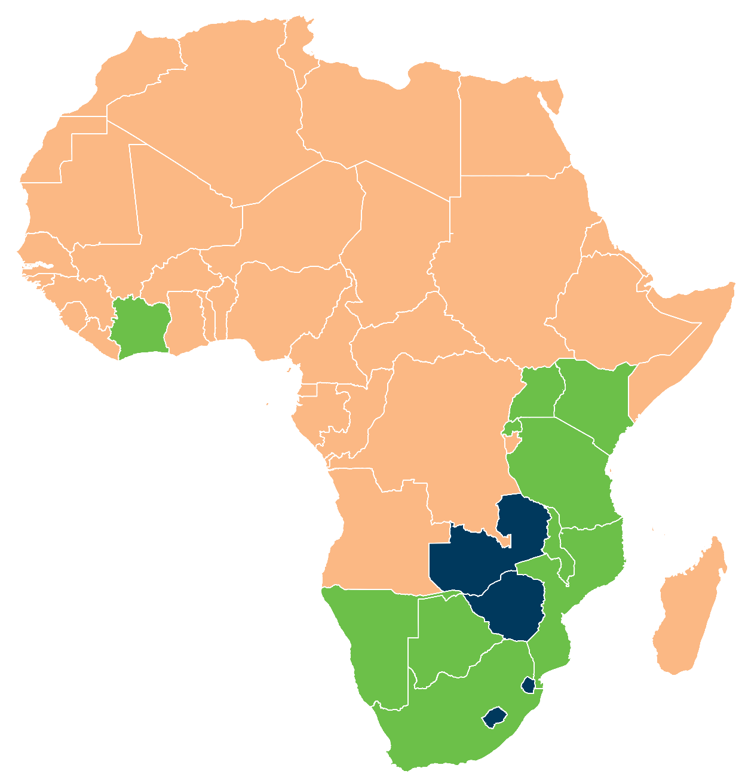

Overview of DREAMS capacity strengthening efforts
Capacity strengthening sites
Haiti
Rwanda
Namibia
Botswana
Cote d’Ivoire
South Africa
Malawi
Mozambique
Tanzania
Kenya
Uganda
Other DREAMS
countries
Lesotho
Zambia
Zimbabwe
Swaziland

Slide 39
Protective Asset-Building Strategy House
VISION
40% reduction in HIV
among 10-24 year old
girls and young women
MISSION
Help girls develop into Determined, Resilient, Empowered, AIDS-free, Mentored, and Safe women
Build social and other protective assets
Segment to find the right girls
Establish community based platforms
Start with the girls to see the girls
Concentrate on the walkable community
Overcome Exclusion

Slide 40
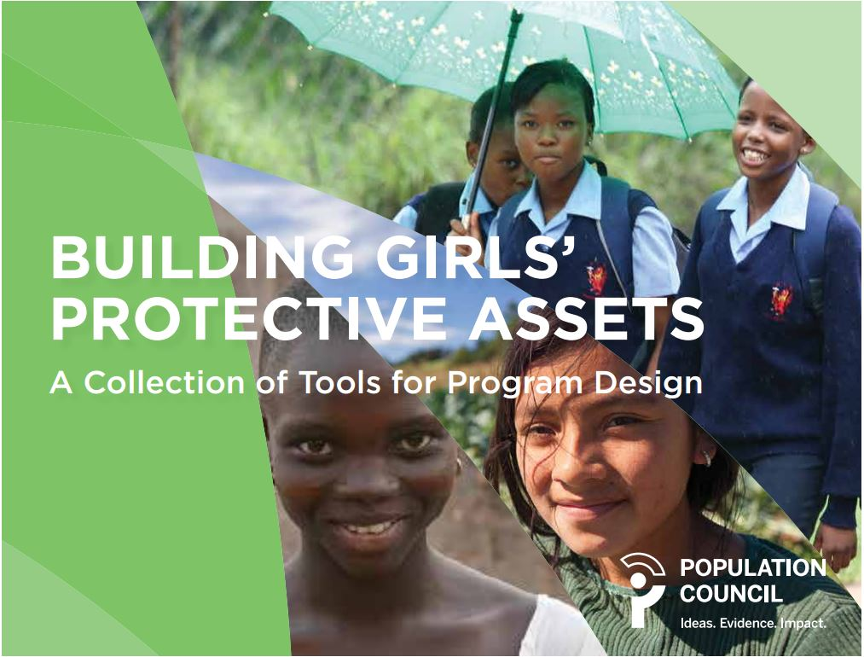
popcouncil.org/uploads/pdfs/2016PGY_GirlsProtectiveAssetsTools.pdf

Slide 41
Girl Roster™ Tool
Brief questionnaire administered via Android phones by program staff using non-sensitive questions in 7–10 minutes
User-friendly, easy to implement program design not research tool
Lays foundation for targeted, evidence-based girl-centered program design decisions
 | Unmarried |  |  |  | Married
Age Group | In School |  | Out Of School |  | Has A Child | Does Not Have A Child | Total
 | Living with both parents | Living with just one or neither parent | Living with both parents | Living with just one or neither parent
06-09 | 62 | 7 | 55 | 15 | — | — | 139
10-14 | 60 | 10 | 22 | 11 | 1 | 9 | 113
15-17 | 19 | 1 | 3 | 2 | 9 | 5 | 39
 |  |  |  |  |  |  | 291
291 girls 6–17 were identified in 278 households. Nearly half “off-track.”
Prepared by Omar Robles, Women’s Refugee Commission

Slide 42
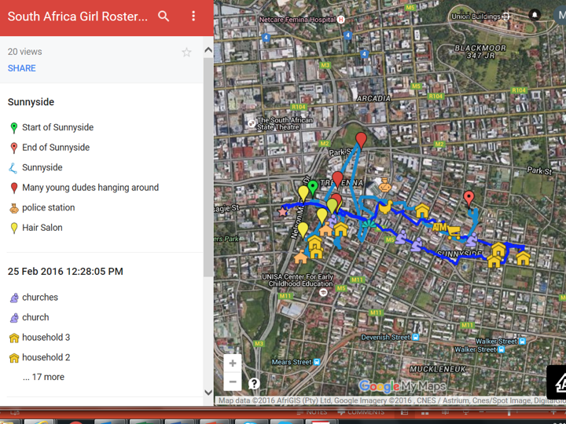

Community resource scan

Slide 43










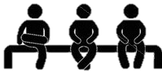


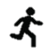
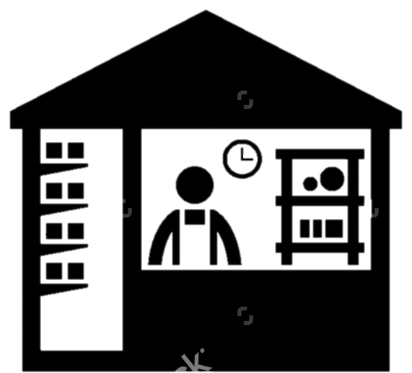



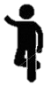
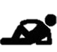

Community mapping: Programming guided by girl’s perspective
COMMUNITY CENTER
CHURCH/
RELIGIOUS CENTER
HEALTH CENTER
SCHOOL
WELL
BAR/STORE
MALE HANGOUT
FEMALE MENTOR
Notes:
Many of the Council’s approaches are grounded in the theory of intentional design, which states that to create inclusive programming, you must start from the perspective of the beneficiary (i.e., AGYW). (Questions you can raise to generate interest and/or make them reflect on the idea: “How does the girl interpret her social, geographical, and physical landscape? How can this inform programming?”)
While not a new concept to many of the IPs we work with, the novel and unique tactics and theories we introduce to them or expand upon during the workshops widen their understanding of participatory programming. We also train them to use tools that enable them to translate these concepts into program design, delivery, and M&E. All of these resources are informed by years of the Council’s experience and research in how to reach adolescents who are “hard to reach” and empowering them to reduce risks.

Slide 44
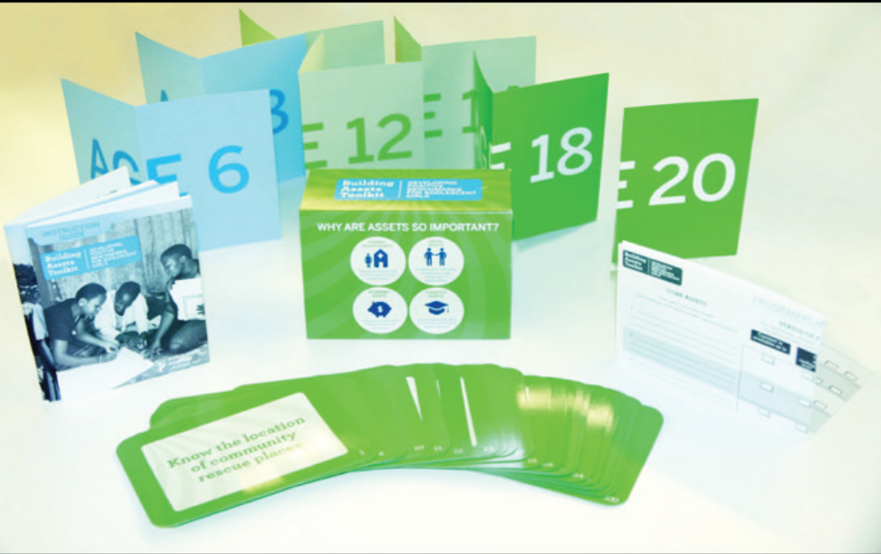
Define content for girl segments with
Building Assets Toolkit©
Notes:
MIRIAM’s SLIDES

Slide 45
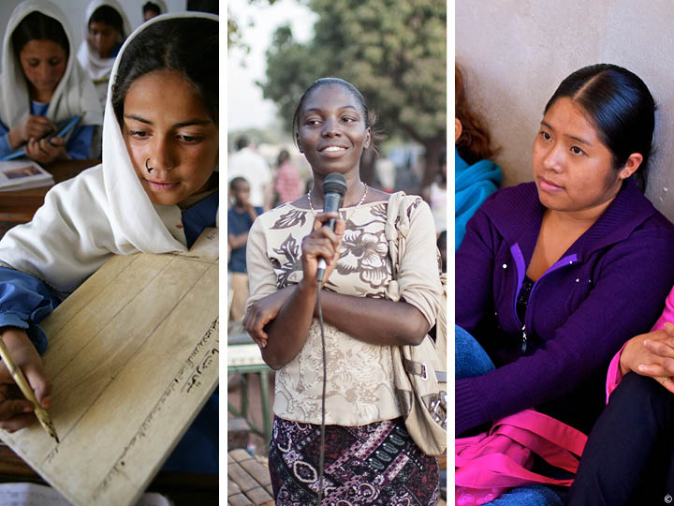
Practical resources for evidence informed AGYW centered programs
Coverage: use girl & young women information to overcome exclusion
Content: build social & other protective assets
Monitoring: track progress at beneficiary level
Notes:
MIRIAM SLIDES

Slide 46
Funding
DREAMS Implementation Science project is funded by the Bill & Melinda Gates Foundation.
DREAMS Capacity Strengthening project is funded by Girl Effect, and PEPFAR and USAID through Project SOAR.*
The Malawi DREAMS study is funded by PEPFAR and USAID through Project SOAR.*
*Cooperative Agreement AID-OAA-A-14-00060
The contents of this presentation are the sole responsibility of the Population Council and do not necessarily reflect the views of USAID, PEPFAR, or the United States Government.

Slide 48
Pulerwitz, Julie, Sanyukta Mathur, and Miriam Temin. 2018. “Addressing adolescent girl and young women’s risk and empowerment: Emerging lessons from the DREAMS Partnership.” Presented at HIV Prevention with Adolescent Girls and Young Women, UNICEF, New York, NY, 11 July.

