Slide 1
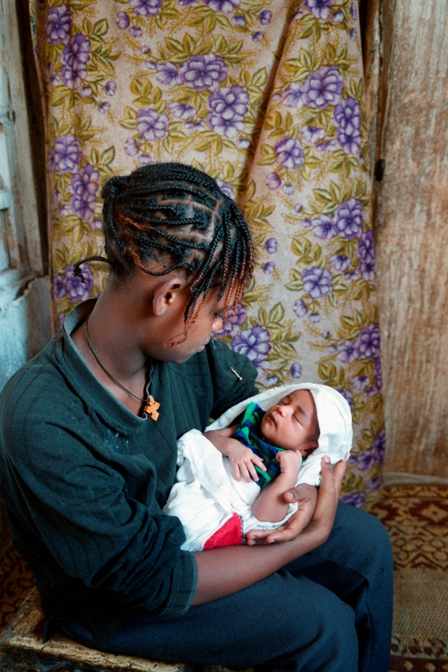

Global updates on elimination and the concept of pre-elimination
Shaffiq Essajee
WHO HIV Department
IATT Webinar: March 17th 2016

Slide 2
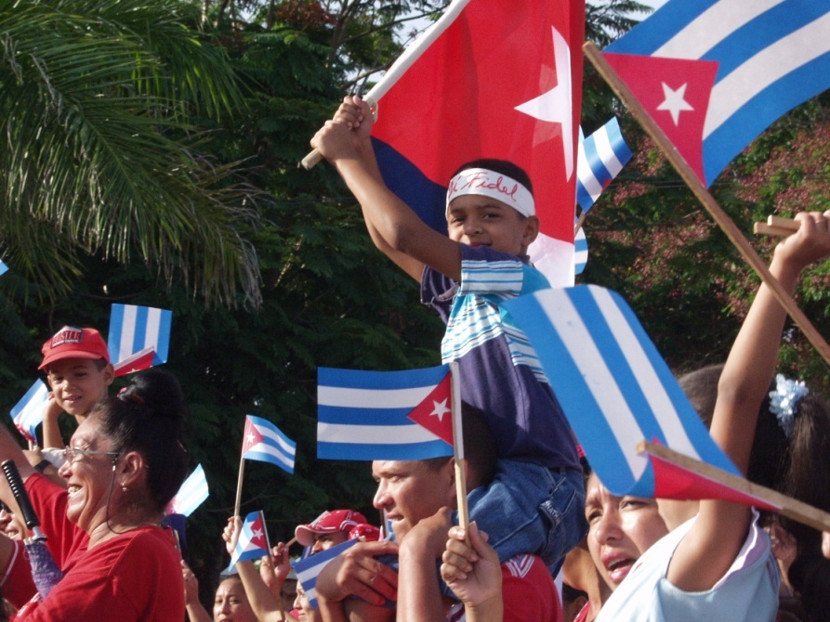
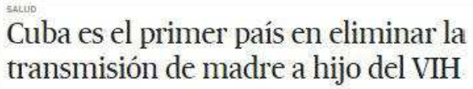



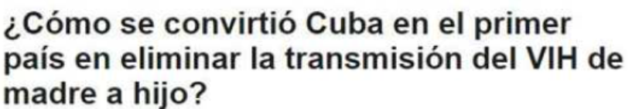
WHO announces Cuba as the first country to eliminate MTCT of HIV and syphilis
June 30, 2015

Slide 3
In order to achieve this certification, Cuba had to meet a number of impact and process criteria
 | ELIMINATION
 | HIV | Syphilis
IMPACT criteria | MTCT < 2% OR < 5% in BF populations Case rate ≤ 50 per 100,000 live births | Case rate ≤ 50 per 100,000 live births
PROCESS criteria | ANC coverage ≥ 95% Testing coverage ≥ 95% ART coverage ≥95% | ANC coverage ≥ 95% Testing coverage ≥ 95% Treatment coverage >95%

Slide 4
Since Cuba, many countries in Asia, Europe and South America are close to being validated for EMTCT of HIV
None are in SSA, which accounts for 90% of burden of global MTCT of HIV

Slide 5
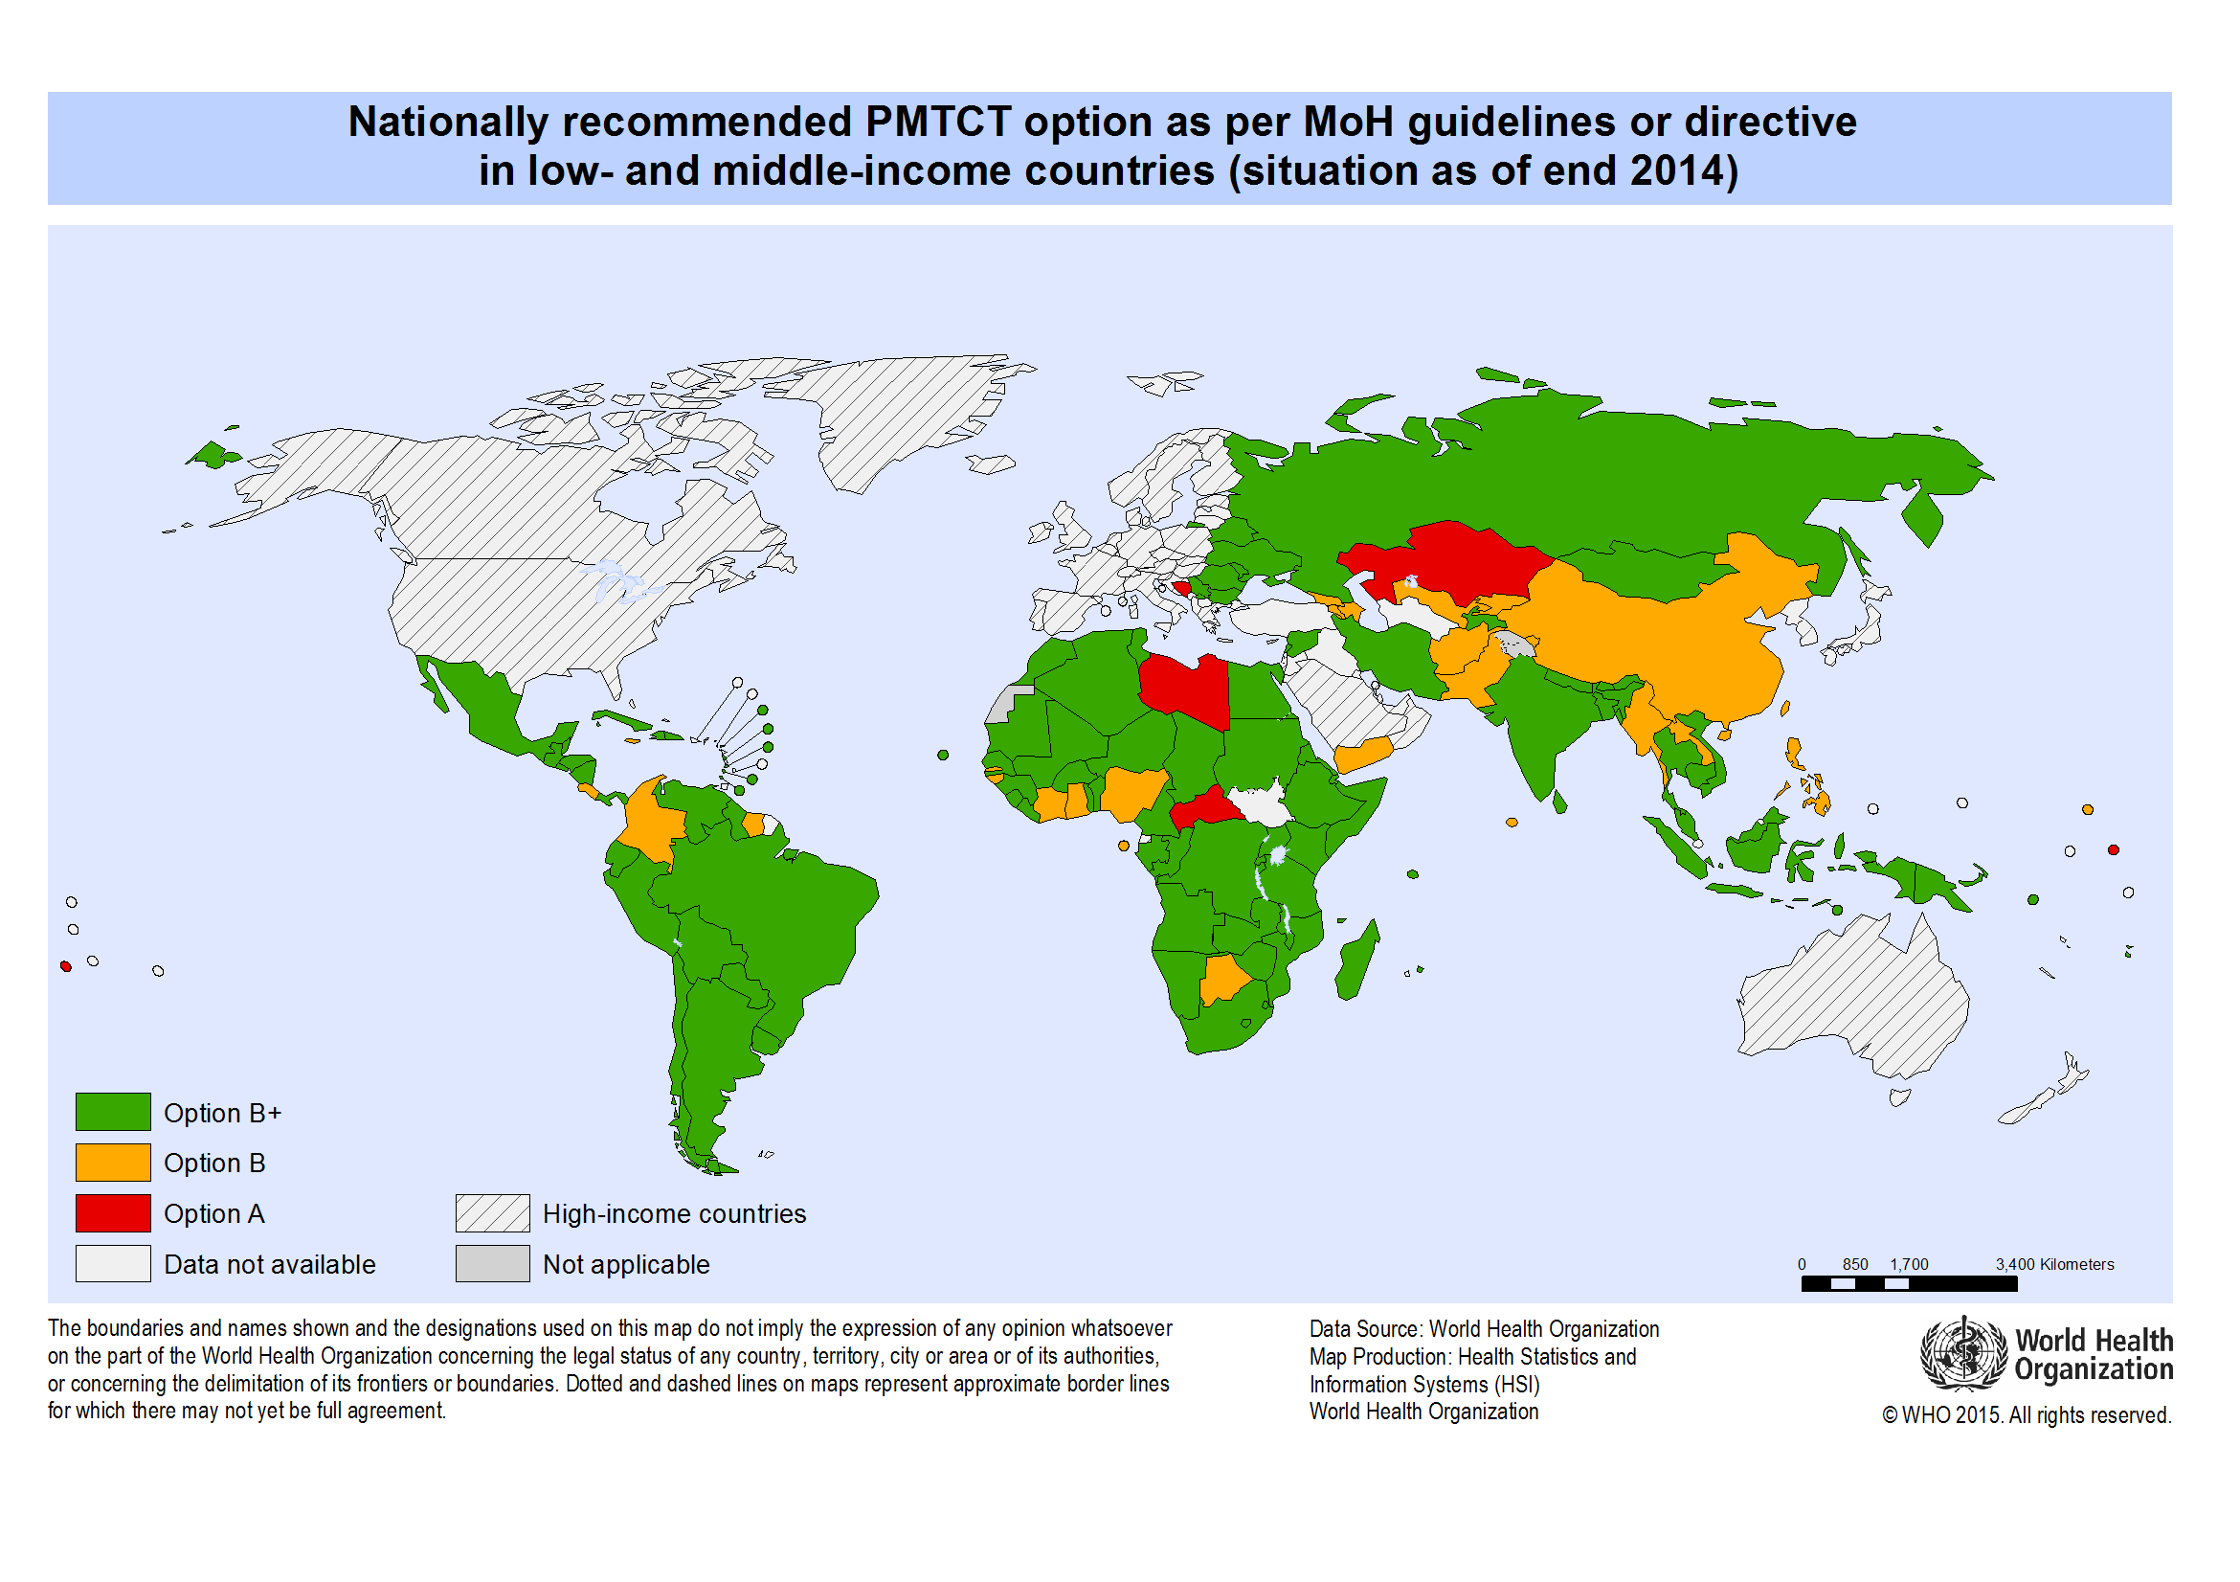
High burden countries in sub-Saharan Africa have made significant progress in reducing PMTCT of HIV
Among 144 LMIC, 80% use Option B+
Inception of Global Plan
New Infections in children
Source: WHO Policy Uptake data. UNAIDS Global Plan Status Report 2015
Notes:
And there is a desire to recognise this progress

Slide 6
Among the global plan countries, several have achieved or are close to achieving elimination criteria…
Rwanda is not shown, but ARV coverage is >95% and MTCT rate <2%

Slide 7
But the problem is the stringent case rate definition
 | ELIMINATION
 | HIV | Syphilis
IMPACT criteria | MTCT < 2% OR < 5% in BF populations Case rate ≤ 50 per 100,000 live births | Case rate ≤ 50 per 100,000 live births
PROCESS criteria | ANC coverage ≥ 95% Testing coverage ≥ 95% ART coverage ≥95% | ANC coverage ≥ 95% Testing coverage ≥ 95% Treatment coverage >95%

Slide 8
All the 21 Global Plan countries have estimated case rates well above the elimination threshold
2424
1019
798
154
Source: UNAIDS GARPR 2015 data
Notes:
Didn't have point estimate for Malawi, Ethiopia, India for EMTCT Global Plan baseline

Slide 9
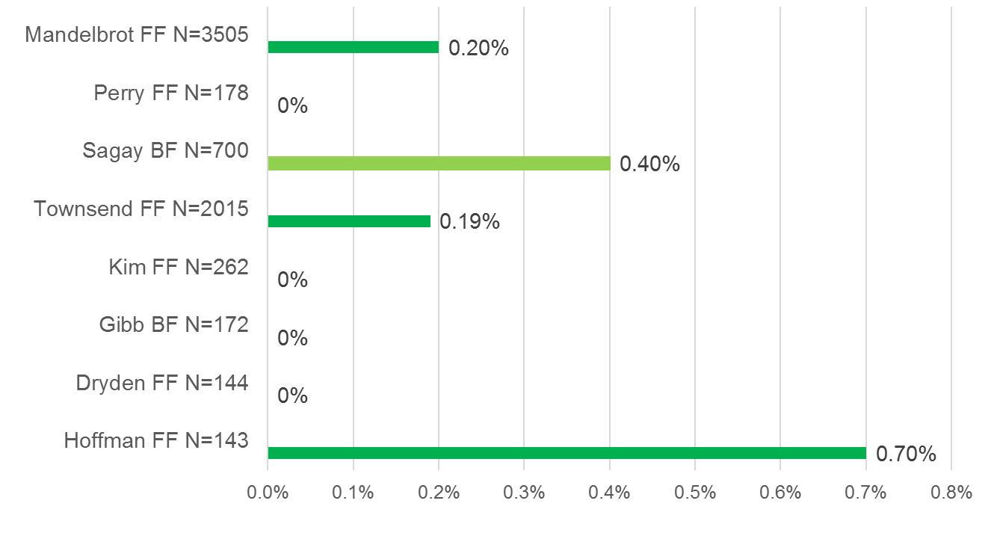
But…there are reasons to be optimistic!
Recent meta-analysis suggests that MTCT rates for women on ART pre-conception are very low
Median MTCT rate at 6 weeks is 0.19%
Source: Mofenson for SPECTRUM modelling

Slide 10
DRAFT
“Pre-elimination” is an attempt to specifically recognize this progress in HIV PMTCT in high burden countries
 | ELIMINATION
 | HIV | Syphilis
IMPACT criteria | MTCT < 2% OR < 5% in BF populations Case rate ≤ 50 per 100,000 live births | Case rate ≤ 50 per 100,000 live births
PROCESS criteria | ANC coverage ≥ 95% Testing coverage ≥ 95% ART coverage ≥95% | ANC coverage ≥ 95% Testing coverage ≥ 95% Treatment coverage >95%

Slide 11
DRAFT
“Pre-elimination” is an attempt to specifically recognize this progress in HIV PMTCT in high burden countries
 | ELIMINATION |  | PRE-ELIMINATION
 | HIV | Syphilis | HIV
IMPACT criteria | MTCT < 2% OR < 5% in BF populations Case rate ≤ 50 per 100,000 live births | Case rate ≤ 50 per 100,000 live births | MTCT < 2% OR < 5% in BF populations No case rate minimum
PROCESS criteria | ANC coverage ≥ 95% Testing coverage ≥ 95% ART coverage ≥95% | ANC coverage ≥ 95% Testing coverage ≥ 95% Treatment coverage >95% | ANC ≥ 90% Testing in ANC ≥ 90% ART coverage ≥90%
Plan to get to Elimination for HIV and syphilis

Slide 12
The 95:95:95 and 90:90:90 process indicators are not the same as the Fast Track 90:90:90 cascade targets
90 90 90
Of all PLHIV
Denominator
Of all
PLHIV
Of those
diagnosed
Of those
treated

Slide 13
DRAFT
For Elimination and Pre-elimination the denominators are distinct from the Fast Track targets
95 95 95
Aligned with GARPR for PMTCT coverage indicators
Allows countries a choice for reporting testing coverage which might be especially important for countries with concentrated epidemics
Indicators are intended to be independent measures of programme efficacy
Denominator
Of all
pregnant women
Of all pregnant women
OR
Of all PW with HIV
Of all PW with HIV

Slide 14
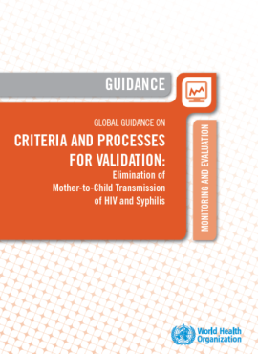
Additional Requirements to qualify for Validation
National-level evidence of achievement of the process indicators for 2 years and impact indicators for 1 year
Evidence that EMTCT of HIV (and syphilis for Elimination) has been achieved in at least one of the lowest-performing sub-national administrative units (ie there are no “hotspots”where services are lacking)
Existence of an adequate national M&E system that can capture data and detect the majority of cases of MTCT from both the public and private health sectors
Criteria must have been met in a manner consistent with basic human rights considerations
TIME
GEOGRAPHY
QUALITY
EQUITY

Slide 15
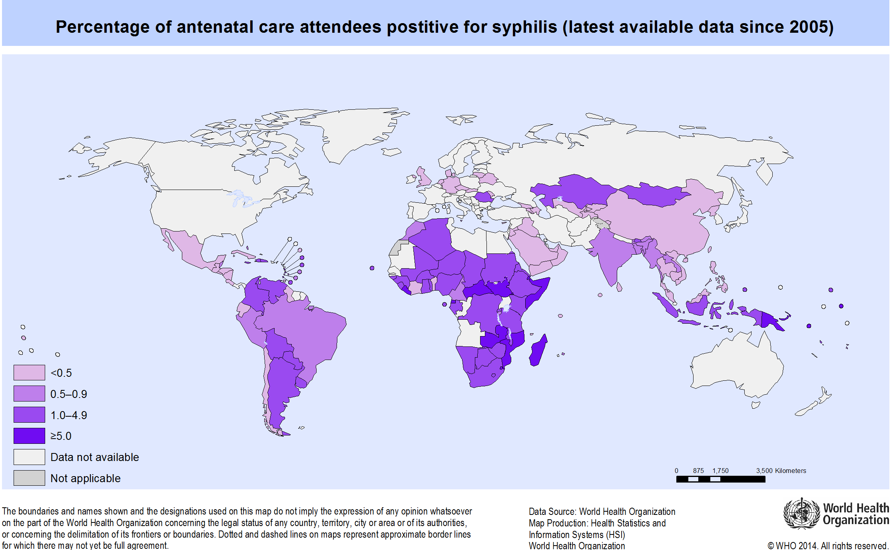
Syphilis infects >1% of ANC attendees in 1 in 3 countries
Notes:
31.4%

Slide 16
MTCT rates of HIV and Syphilis and morbidity/mortality of congenital infection without treatment
MTCT transmission:
HIV: around 1/3 (15-45%)
Syphilis: >1/2 (52-90%, depending on maternal stage)
Mortality and morbidity without treatment:
HIV: ~1/3 with HIV die <12 months
~1/2 die by <24 months
Syphilis: 52% perinatal deaths, 31% congenital disease, 12 % preterm or low birthweight (at risk for infant death)
Notes:
2012 estimates (preliminary)
950,000 pregnant women with syphilis
150,00 early fetal deaths or stillbirths
60,000 neonatal deaths
50,000 preterm or
low birth-weight infants
110,000 infants with congenital disease

Slide 17
This large burden of disease is preventable!
Burden
HIV: estimated 220,000 MTCT infections in 2014
Syphilis: estimated 350,000 adverse outcomes in 2012 (including 143,000 perinatal deaths)
Impact of treatment interventions
HIV: early and continued ART can reduce transmission from 15-45% to <2% or <5%
Syphilis: Screening and treatment of syphilis-infected mothers < 30 days before delivery can dramatically reduce transmission and thus prevent perinatal morbidity and mortality

Slide 18
In addition to meeting criteria, an Elimination Plan is needed for a country to be certified for pre-elimination
Proposed elements in the Elimination Plan
1 | Addressing tracking, control and prevention of congential syphilis
2 | Retention both antepartum and post partum
3 | Prongs 1 and 2
4 | Incident HIV reduction through partner testing and treatment, PrEP for negative women during pregnancy and breastfeeding and other interventions
5 | Re-testing for negatives to identify incident HIV and prevent
6 | MTCT Infant prophylaxis strengthening
7 | Uptake of Treat All to ensure that more and more women are on ART pre-conception

Slide 19
Case rate is a function of ANC prevalence and MTCT rate so to get below 50 these factors must be addressed
Maternal Prevalence
X
MTCT Rate
=
Case Rate
Time (epidemic decline)
FP access (fewer pregnancies)
Men on ART (fewer transmissions)
Women focused prevention eg education awareness, PREP, condoms (fewer infections among women)
Coverage of testing and ART (even small gaps in coverage result in lots of MTCT)
Timing of ART start relative to pregnancy (early ART and preconception ART)
Incident HIV (reduce very high risk events)
  Partner testing
  PREP for neg PW
  Retesting of PW
Retention on ART (less transmission in BF)

Slide 20
Based on current levels of coverage we think that 3 countries may be eligible for pre-elimination
Botswana
South Africa
Rwanda

Slide 21
Pre-elimination is on a spectrum with elimination but in some cases it may take YEARS to get to elimination…
Coverage ≥90% for testing and treatment. HIV MTCT rate <5% or <2% if formula fed.
NO CASE RATE REQUIREMENT for HIV plus a country plan
Coverage >95% for testing and >90% for treatment. HIV MTCT rate <5% or <2% if formula fed. HIV/Syphilis case rate <50/100,000 live birht
Pre-Elimination
Elimination
Does country meet criteria for pre-elimination?
Assessment of pre-elimination
Pre-validation of elimination
Does country meet elimination criteria?
Can a pre-elimination certificate be issued?
Certification of pre-elimination
Validation of elimination
Can a MTCT Eliminated certificate be issued?
Maintenance of elimination
Is elimination status maintained?

Slide 22
Pre-elimination is on a spectrum with elimination but in some cases it may take YEARS to get to elimination…
Coverage ≥90% for testing and treatment. MTCT rate ≤5% or ≤2% for HIV.
NO CASE RATE REQUIREMENT for either HIV or syph plus a country plan
Coverage >95% for testing and >90% for treatment. MTCT rate <5% HIV, <2% syphilis. HIV/Syphilis case rate <50/100,000
Pre-Elimination
Elimination
Does country meet criteria for pre-elimination?
Assessment of pre-elimination
Pre-validation of elimination
Does country meet elimination criteria?
Can a pre-elimination certificate be issued?
Certification of pre-elimination
Validation of elimination
Can a MTCT Eliminated certificate be issued?
Maintenance of elimination
Is elimination status maintained?

Slide 23
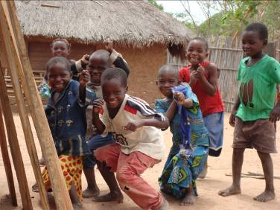
Acknowledgements
Mary Mahy
Maura Laverty
Chika Hayashi
Karusa Kiragu
Lynne Mofenson
Notes:
ADD HIV website link

