Slide 1
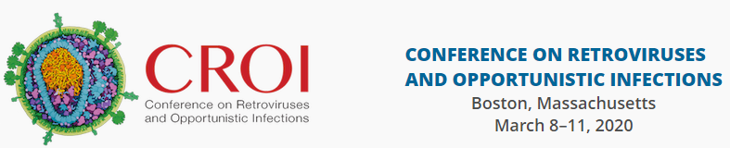
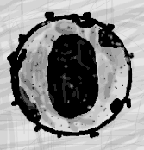






CROI 2020
Selected
Pediatric, Adolescent, and Maternal/Adult
Abstracts
Lynne M. Mofenson MD
March 25 2020

Slide 2
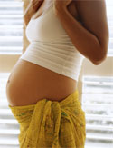
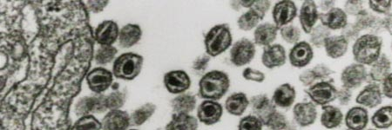


Pregnancy,
Viral Suppression,
ARV Drugs

Slide 3
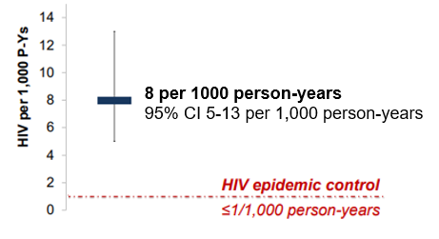
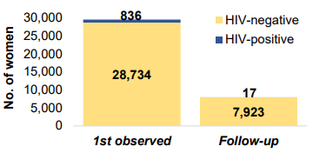
Acute Infection in Pregnancy Remains a Problem
HIV Seroconversion During Pregnancy at Routine ANC, Botswana
Ortblad KF et al. CROI, 2020 Boston Abs. 779
Program data from routine ANC HIV testing of women at 139 ANC sites Jan 2018-Sept 2019.
Among women without known HIV infection who were tested at first ANC visit, 2.9% tested newly HIV+.
Evaluated seroconversions in 7,940 women who tested HIV-negative at first ANC and repeat test HIV+:
  17 seroconversions; HIV incidence of 8/1,000 PY, above the incidence levels needed for HIV epidemic control of <1/1,000 PY
Real-World Maternal HIV Incidence
HIV-Positivity Among Those Tested
(2.9%)
Median time to HIV re-testing: 92 days (IQR 70-11)

Slide 4
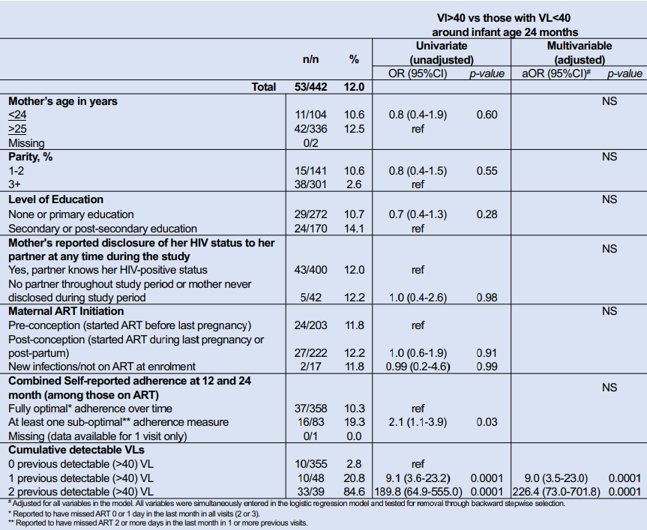
Detectable VL in the Early PP Period Signals Risk of Ongoing Viremia and Risk for Infant Transmission, Malawi
Landes M et al. CROI, 2020 Boston Abs. 765
Data from 425 HIV+ mothers on ART (median 30.1 mo) in Malawi HIV clinics, enrolled at 1-6 mo PP and VL at enrollment,12 and 24 mo PP.
12- and 24-Month Suppression in 359 Women
on ART With Enrollment VL <40
Unsuppressed viral load at 24 months only associated with prior undetectable VL in adjusted analysis
98.3%
Majority of women with 1st PP VL <40 remained suppressed
96.4%
1.7%
3.6%
12- and 24-Month Suppression in 66 Women
on ART with Enrollment VL >40
Over half of women with 1st PP VL >40 stayed unsuppressed
54.5%
57.6%
45.5%
42.4%
MTCT
No infections in 345 (0%) with women with all VL <40
7 infections in 64 (10.9%) women with >1 VL >40
4 infections in 33 (12.1%) with all 3 VL >40

Slide 5
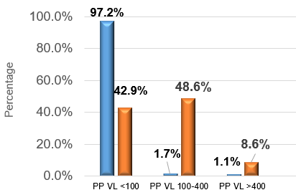
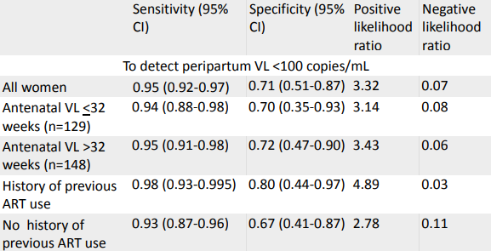
Detectable VL in the Antepartum Period Signals Risk for Postpartum Viremia, South Africa
Odayar J et al. CROI, 2020 Boston Abs. 766
S Africa: 322 HIV+ women starting EFV ART with VL test in pregnancy (median 33 wks), and in those with initial VL <400, repeat VL c/in 10 wk PP (median 9 d).
  For those with initial VL <400: 89.1% <100, 10.9% 100-400.
AP VL <100 highly predictive of PP VL <100
AP VL 100-400 predicts PP VL >100
Ability of AP VL to predict peripartum VL was similar across strata of gestation at antenatal VL testing & history of ART use.
Postpartum VL Results Stratified by Antenatal VL > or <100 c/mL
Performance characteristics of antenatal VL testing to predict postpartum viraemia in a routine care setting
Sensitivity Specificity Positive Negative
(95% CI) (95% CI) Likelihood Likelihood
Ratio Ratio
All women 0.95 (0.92-0.97) 0.71 (0.51-0.87) 3.32 0.07
Postpartum VL Categories

Slide 6
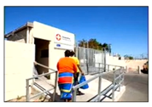

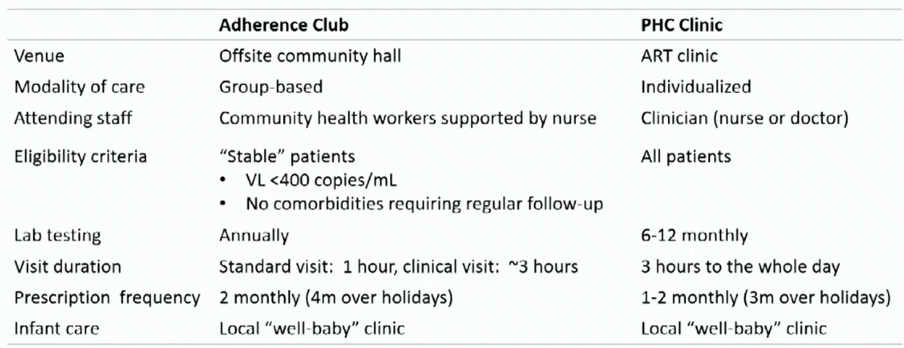
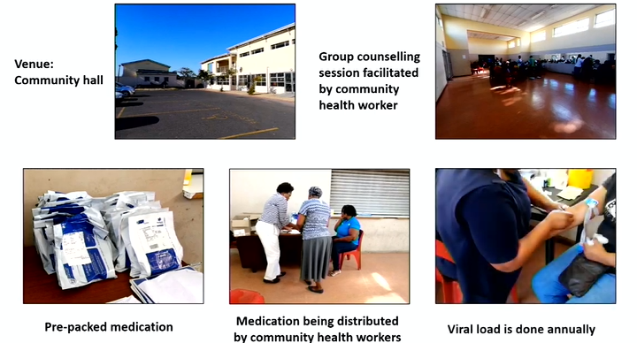
Community-Based Adherence Clubs To Reduce Viral Rebound Postpartum, Western Cape, South Africa
Odayar J et al. CROI, 2020 Boston Abs. 131LB
Compared community-based vs facility-based care for postpartum women who started ART in pregnancy and were “stable” (suppressed viral load) and seen within 70 d of delivery; with FU through 24 months postpartum .
412 PP women starting EFV ART during pregnancy and clinically stable with VL <400 c/mL (88% <50)
AC: Community-Based Adherence Club (lay worker led, 20-30 pt with q 2-4 mo ART dispensing community location)
PHC: Standard of Care Primary Health Facility Care

Slide 7
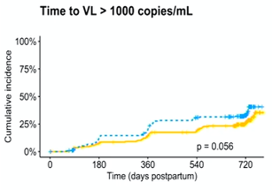
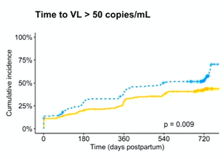
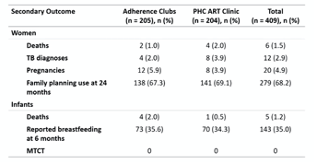
In Suppressed Women, Community-Based Adherence Clubs Result in Lower Viral Rebound PP Compared to Facility Care
Odayar J et al. CROI, 2020 Boston Abs. 131LB
Attendance at allocated service within 3 mo of referral was higher with AC (77%) vs PHC (68%); 90% completed 24 mo PP both arms.
~30% reduction viral rebound in women in community Adherence Club compared to primary health facility at 24 mos (even so, 29% VL >1000, 44% VL >50!)
24 mo VL >1000 | AC | PHC
12 mo | 16% | 23%
24 mo | 29% | 37%
24 mo VL >50 | AC | PHC
12 mo | 32% | 42%
24 mo | 44% | 56%
PHC
HR 0.67 (0.5-1.00)
PHC
HR 0.71 (0.52-0.92)
AC
AC
p=0.056
p=0.009
Although there was a significant reduction in postpartum rebound viremia, there were no significant differences in other maternal and child health outcomes.

Slide 8
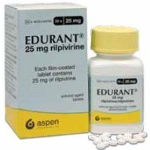
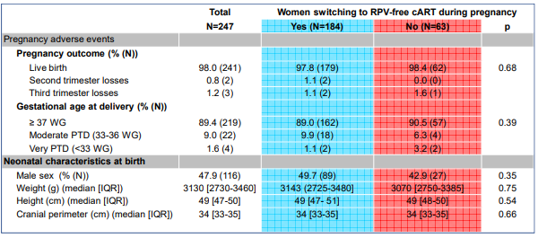
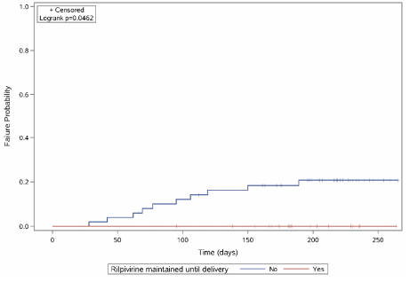
Rilpivirine in Women Who Become Pregnant:
Switch or Not Switch?
Frange P et al. CROI, 2020 Boston Abs. 776
Compared viral suppression and pregnancy outcomes in 247 women in French Perinatal Cohort who were on RPV at time of conception 2010-2018; 184 switched (median 8 wk GA) to alternative ART, 63 remained on RPV ART.
Probability Viral Rebound (>50 c/mL) in 69 Women
Receiving RPV and Suppressed at <14 Wk GA
Higher risk of viral rebound in women who underwent ART switch (21%) compared to those continuing RPV (0%) (p=0.046)
VL nearest delivery <50 c/mL in 95.7% women.
No difference pregnancy/neonatal outcomes between women who stayed on RPV vs switched.
No infant infections.
7 birth defects (3.8% prevalence) (3 cardiac, 2 limb, 1 renal).

Slide 9
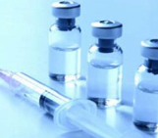

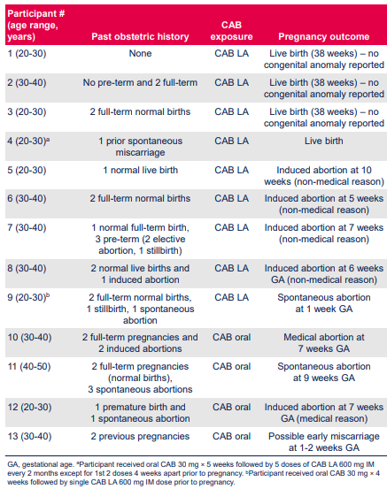
Cabotegravir PK Tail in Pregnancy and Neonatal Outcomes
Patel P et al. CROI, 2020 Boston Abs. 775
Phase 2/3 study data on long-acting CAB/RPV in 13 women who became pregnant while on study (9 on CAB LA, 4 while oral CAB lead-in dosing).
Following pregnancy confirmation, all women stopped CAB/RPV oral dosing/injections and went on alternative ART.
Outcomes:
  4 live births (no defects)
  1 possible early miscarriage
  2 spontaneous abortions (prior history)
  6 induced abortions

Slide 10
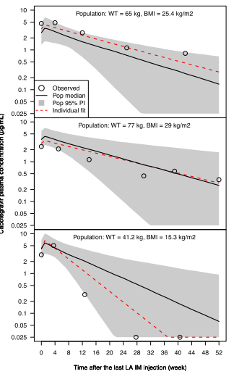
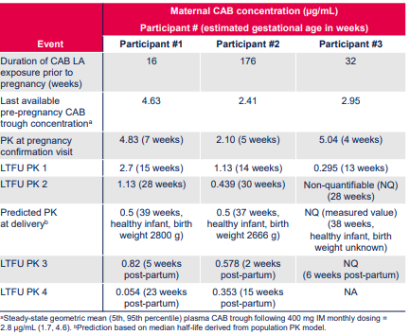
Cabotegravir PK Tail in Pregnancy and Neonatal Outcomes
Patel P et al. CROI, 2020 Boston Abs. 775
PK data: pre-pregnancy CAB levels (range 2.4-4.6 ug/mL) in expected range.
After CAB d/c, residual CAB levels remained measurable throughout pregnancy in 2 of 3 pt.
CAB levels remained measurable PP (range 2-23 wk) in 2/3 women.
Maternal CAB PK Tail After CAB LA Stopped
Pre-
pregnancy
AP1
AP2
AP3
Delivery/
PP1
PP2
Rate of decline of CAB levels during the PK tail in pregnancy was within the expected range for non-pregnant women.
CAB levels declined mono-exponentially during pregnancy (predicted CAB level 3× protein adjusted- IC90 at time of delivery [8-9 mos after stopping] in 2 of 3 women with live births).

Slide 11
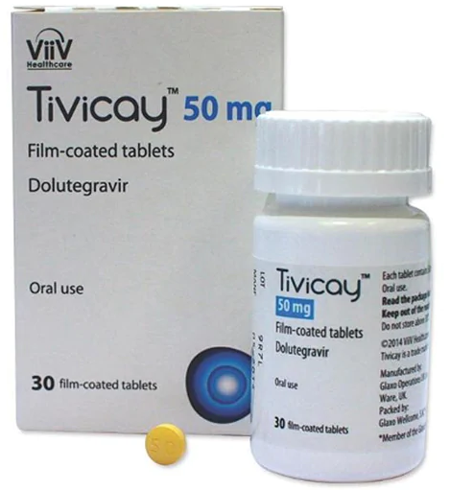
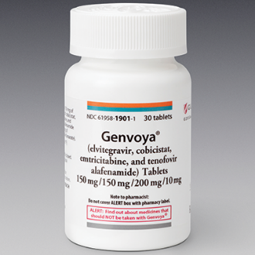
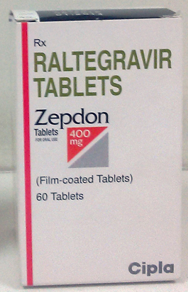
Dolutegravir and Other Integrase Strand Transfer Inhibitors (InSTI) in Pregnancy

Slide 12

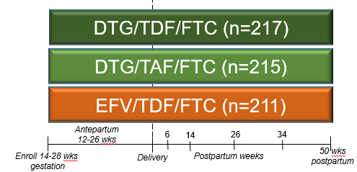
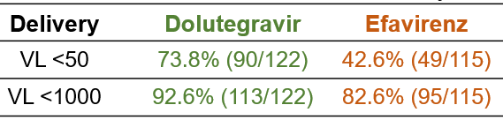
Superior Viral Response at Delivery with DTG (with TDF or TAF) vs EFV ART in Pregnancy
Chinula L et al. CROI, 2020 Boston Abs. 130LB
Comparison of DTG/TDF/FTC, DTG/TAF/FTC, and EFV/TDF/FTC ART initiated after 14 weeks gestation in HIV+ pregnant women .
Median GA at enrollment 21.9 weeks (similar btn arms)
DTG ART (with TAF or TDF) associated with significantly higher viral suppression (VL <200) at delivery than EFV ART.
 | Combined DTG Arms | EFV/TDF/FTC | Estimated risk difference (95% CI) | P value
Delivery RNA <200 c/mL, ITT | 395/405, 97.5% | 182/200, 91.0% | 6.5% (2.0, 10.7%) | 0.005
Delivery RNA <200 c/mL, per protocol | 389/399, 97.5% | 171/187, 91.4% | 6.0% (1.6, 10.3%) | 0.008
Comparison DolPHIN-2 results (enrolled 28-36 wks gestation, median 31 wks)

Slide 13
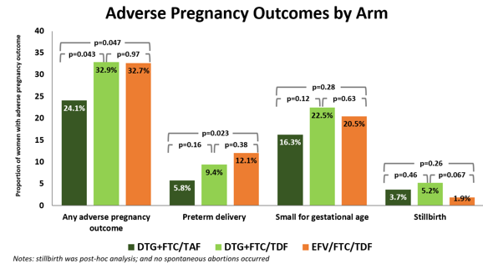
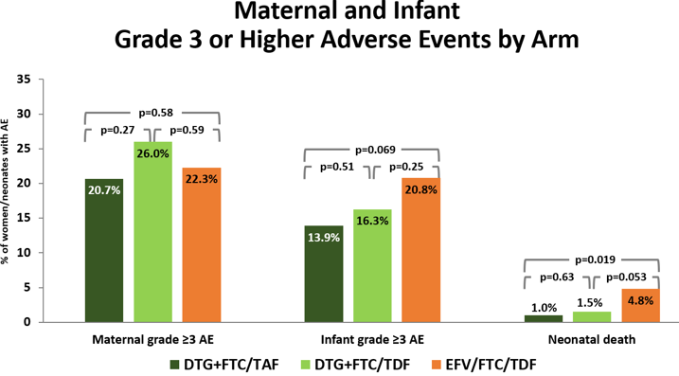
Fewer Adverse Pregnancy Outcomes/Neonatal Death with DTG-TAF Than EFV ART
Chinula L et al. CROI, 2020 Boston Abs. 130LB
DTG-TAF was associated with significantly fewer adverse pregnancy outcomes (driven by lower preterm rates) than DTG-TDF and EFV/FTC/TDF, which were similar.
No difference in adverse events between study arms.
Fewer neonatal deaths with DTG-TAF and DTG-TDF than EFV/FTC/TDF.
2 infant infections, both in DTG arms, 1 maternal delivery VL 58,000, 1 delivery VL <40.
DTG-TAF:
1 infant
HIV+
(VL 58K)
DTG-TDF:
1 infant
HIV+
(VL <40)
EFV-TDF:
0 infant
HIV+

Slide 14
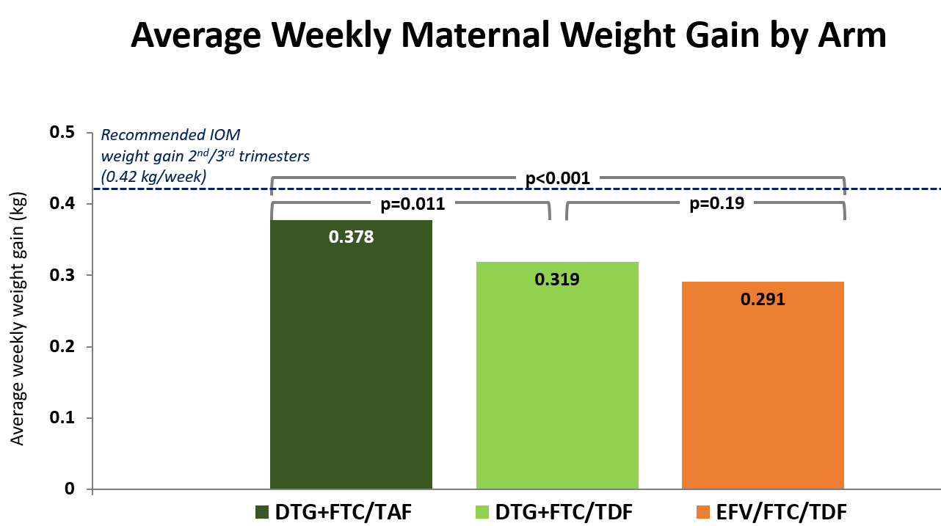
Weekly Weight Gain During Pregnancy Highest with DTG-TAF compared to DTG-TDF and EFV
Chinula L et al. CROI, 2020 Boston Abs. 130LB
Weekly maternal weight gain significantly higher in DTG-TAF arm than DTG/TDF or EFV/FTC/TDF arm (similar).
However, weekly weight gain was less than recommended for the general population.
All regimens showed high efficacy (>90%) & safety similar to or better than that observed in other studies of ART in pregnancy.
DTG-containing ART had superior viral efficacy at delivery vs EFV ART.
DTG-TAF fewer adverse pregnancy outcomes (driven by lower preterm) and DTG (TAF or TDF) had fewer neonatal deaths than EFV.
Affirm WHO recommendation to use DTG in all populations, including during pregnancy, and suggest that TAF may be preferable to TDF in pregnancy.

Slide 15
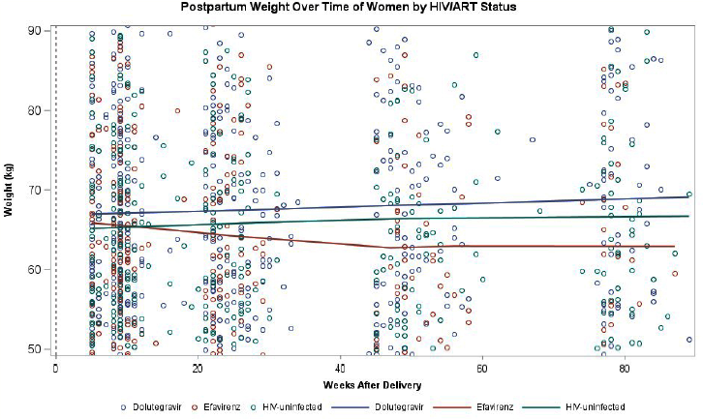
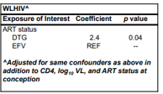
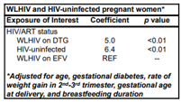
DTG ART is Associated with Higher Postpartum Weight Gain than EFV ART, Botswana
Jao J et al. CROI, 2020 Boston Abs. 772
Pregnant HIV+ women on DTG (n=170) or EFV (n=114) and HIV- (n=122) women followed in Tshilo Dikotla study Botswana.
Assessed the association of DTG with PP weight over 18 mos PP comparing DTG to EFV and to HIV- women.
HIV+ women on DTG had persistently higher weight gain (~5 kg) through 18 mos PP than those on EFV, even after adjustment for CD4, VL, and ART at conception.
However, compared to HIV-women, HIV+ women on DTG had similar PP weight gain.
HIV+ women on EFV have lower weight gain PP compared to HIV- women.
DTG
HIV-
EFV

Slide 16

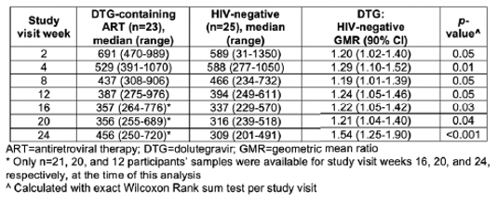
DTG ART Modestly Increases Etonogestrel
(ENG) Levels with ENG Implant
Patel R et al. CROI, 2020 Boston Abs. 129
PK study of 23 women HIV+ on DTG ART (median 6.7 mos) and suppressed, and 25 HIV- women, with ENG 68 mg subdermal implant; PK sampling 2, 4, 8, 12, 16, 20 and 24 wk post implant.
Etonogestrel Plasma Level (pg/mL) in HIV+ Women on DTG ART
and HIV-Uninfected Women by Study Visit
Modestly higher ENG levels (19-54% higher) were observed in women using DTG ART compared to HIV-uninfected women, which should not compromise contraceptive efficacy.
Given EFV ART reduces ENG levels & reduces contraceptive effectiveness, DTG ART is preferred for women using or desiring an ENG implant.

Slide 17

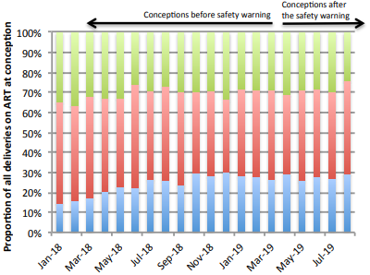
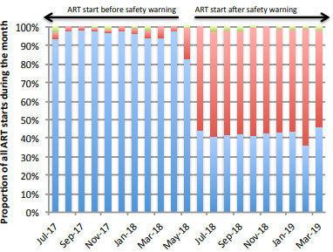
Changes in DTG Use After NTD Safety Signal, Botswana
Zash R et al. CROI, 2020 Boston Abs. 792
In country guidance following DTG-NTD report May 2018:
  Individualized counseling for pregnant women who had already conceived and those desiring pregnancy; continued use of DTG ART for new ART starts without specific mention of ART starting in pregnancy
Secondary analysis of data Aug 2016-Sept 2019 Tsepamo Study: 20,245 HIV+ women delivered – 65% on ART at conception; 28% started during pregnancy, 4.5% no ART in pregnancy, 2.1% unknown timing.
ART regimen at conception by month of delivery before and after DTG safety warning Botswana
ART regimen started during pregnancy by month of delivery before and after DTG safety warning Botswana
Switch/Termination
Among 441 who changed ARV in pregnancy, 177 (40%) switched from DTG to EFV ART (99% after May 18)
Only 71 (0.4%) stopped ART in pregnancy (35 DTG, 24 EFV)
Program guidance on individualized counseling regarding pregnancy intention had no apparent effect on DTG exposure at conception.
Pregnant women frequently initiated non-DTG ART but did so after the NTD risk period was over.
Clearer public health guidance needed when signals occur.
% deliveries with DTG at conception didn’t change:
5 mos before May 18 warning: 27%
6 mos after May 18 warning: 28%
Before May 2018, 97% of women starting ART were on DTG ART (1.6% <6 wk GA)
After May 2018, 43% of starts were DTG and 56% were EFV ART (1.6% <6 wk GA)

Slide 18


DOLOMITE-EPPICC –
Prenatal Exposure to DTG
Thorne C et al. CROI, 2020 Boston Abs. 791
Multi-cohort European observational study of DTG use in pregnant women; birth outcomes through February 2019 analyzed.
453 pregnancies (443 singleton, 10 twins).
18 induced abortions: 1 defect – neuronal migration disorder, preconception DTG
23 spontaneous abortions (all preconception DTG)
5 stillbirths (all preconception DTG, no birth defects)
400 live-born singleton (no defects in twins), 266 with preconception DTG
 |  | Earliest Dolutegravir exposure
 | Total (n=463¹) | Periconception² (n=325) | Later T1² (n=31) | T2 / T3² (n=106)
Induced abortion | 18 (3.8%) | 17 (5.2%) | 1 (3.2%) | 0
Spontaneous abortion | 23 (5.0%) | 23 (7.2%) | 0 | 0
Stillbirth | 5 (1.1%) | 5 (1.5%) | 0 | 0
Live birth | 417 (90.1%) | 280 (86.1%) | 30 (96.8%) | 106 (100%)
Singleton live birth | 400 | 266 | 30 | 104
Preterm delivery (<37 weeks) | 51/385 (13.2.%) | 32/254 (12.0%) | 3/29 (10.0%) | 16/102 (15.7%)
Low birth weight (<2500g) | 48/390 (12.3%) | 31/261 (11.9%) | 3/29 (10.3%) | 14/100 (14.0%)
Infant with birth defect * | 17/400 (4.3%) | 12/266 (4.5%) | 1/30 (3.3%) | 4/104 (3.8%)
¹ Includes outcomes from 10 twin pregnancies ² Periconception: up to 6 completed gestational weeks; Later T1: 7-12 weeks; T2/T3: from 13 weeks
* No NTD or other CNS defect reported; defects were GU (7), cardiac (3), limb (3), GI (2), other (3) (1 infant had GU and limb)

Slide 19

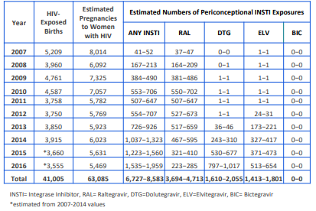
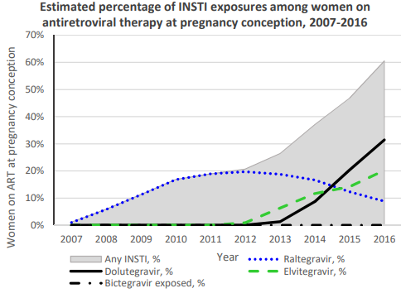
Estimates of Periconception InSTI Exposure, US
Lampe M et al. CROI, 2020 Boston Abs. 790
Estimated annual pregnancies to HIV+ women on ART at conception:
  Hospital d/c data (Healthcare Cost & Utilization Project) 2007-2014 to estimate number of births 2015-2017;
  Multiplied annual births by estimates of pregnancies resulting in live birth (65%) (Vital Statistics Report) and % HIV+ women dx prior to pregnancy (80%) and on ART (58%-74%) (using CDC estimates of suppression and being in HIV care)
  Used NA-ACCORD data from 2007-2016 and factor proportion of women age 15-45 yr with >1 mo InSTI exposure to estimate periconception exposures by year.
61%
1%
2007-2016 overall:
# estimated conceptions on ART: 29,272-37,346
23% were on InSTI: 55% RAL, 24% DTG, 21% EVG
In 2016, 61% all conceptions on ART were InSTI
Of 2016 InSTI exposures, 52% DTG, 33% EVG and 15% RAL

Slide 20
What Can We Say About NTD and InSTI Exposure Given Estimated U.S. Periconception InSTI Exposure?
Lampe M et al. CROI, 2020 Boston Abs. 790
In 2017, estimated 5,314 pregnancies to HIV+ women:
  Assuming 2016 proportions, annual periconception InSTI exposure would be 1,492-1,903: 217-277 RAL, 745-988 to DTG, 498-635 EVG.
Retrospectively, CDC not able to link ART-birth defect outcome as maternal ART data not routinely collected by states.(Reefhuis R, MMWR 2020 Jan 10)
Assuming complete ascertainment/linkage maternal ART, births and birth defects prospectively, with 2,000 DTG exposures over next 2-3 yr & 0.06% (6/10,000) NTD prevalence, expect #NTD = 1.
  If a 3-fold ↑ (the ↑ above population rate in Tsepamo) from 0.06% to 0.18%, # NTD ~ 4;
  If ↑ to 0.3% (Tsepamo data), # expected NTD ~ 6
Given low prevalence of NTD in the US, prospectively, need much improved ascertainment of exposures and defects to evaluate whether increase in risk of rare event such as NTD.

Slide 21
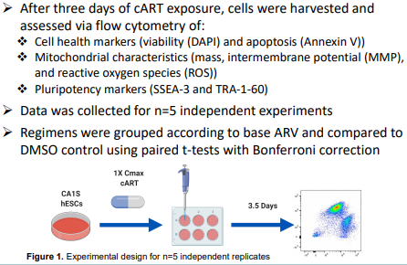

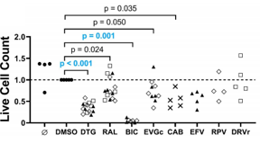
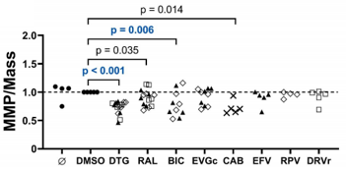
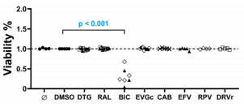
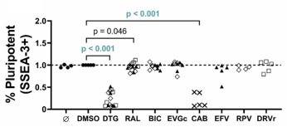
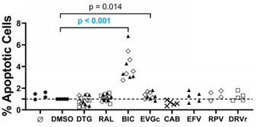
Toxicity of InSTI in Human Embryonic Stem Cell Model
Smith M-S R et al. CROI, 2020 Boston Abs. 789
Cultured human embryonic stem cells CAS1S in presence 0.1% DMSO (control) or DTG, RAL, BIC, EVG/COBI or RPV + TDF/FTC or TAF/FTC or ABC/ETC as well as CAB/RPG; drug levels used were 1xCmax.
Cells exposed to DTG &
BIC had 3-fold ↓ cell counts
Cells exposed to DTG &
BIC had ↓ mitochondrial MMP/Mass
Live Cell Line Count
Mitochondrial Intermembrane Potential/Mass
Cells exposed to BIC had
3-fold ↓ viability and ↑ apoptosis
P value significant after Bonferroni correction
Cell Line Viability
Certain InSTI drugs (DTG and BIC) had toxicity in a cultured human embryonic stem cell assay; did not vary by dual NRTI
However, appear to have used supraphysiologic drug levels as did not adjust for >90% protein binding of InSTI in plasma
Cells exposed to DTG &
had 80% ↓ pluripotency
Pluripotency Marker SSEA-3+
Apoptotic Cells

Slide 22
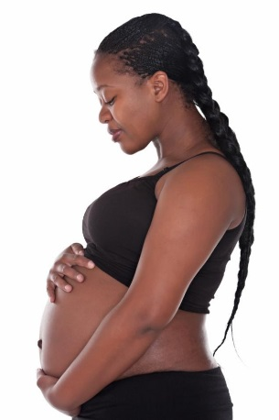

Maternal Health
Issues

Slide 23
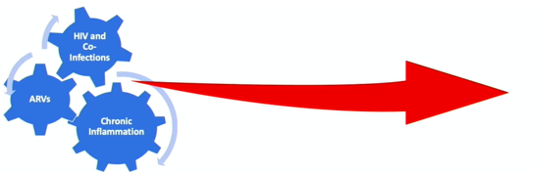
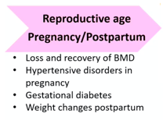
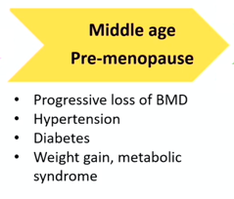
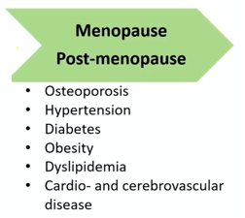
Introduction: Chronic Diseases in Maternal Health – Persistent Problems for Pregnant and Breastfeeding Women Hoffman R. CROI, 2020 Boston, Theme Discussion TD-03
HIV, coinfections, ARV drugs and chronic inflammation can interact to result in conditions beginning in pregnancy that can become chronic diseases affecting HIV+ women throughout their lifetime.

Slide 24
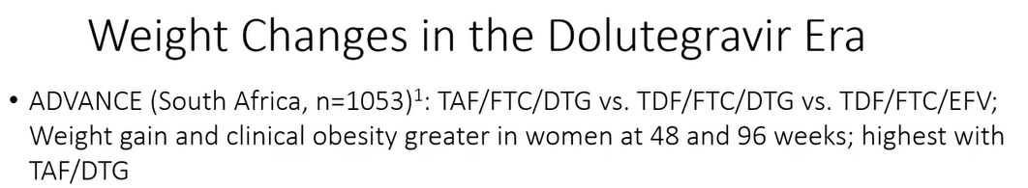






Introduction: Chronic Diseases in Maternal Health – Persistent Problems for Pregnant and Breastfeeding Women Hoffman R. CROI, 2020 Boston, Theme Discussion TD-03
Relevant reports at CROI:
NAMSAL (Cameroon, n=613): TDF/FTC/DTG vs TDF/FTC/EFV. At 48 weeks, DTG participants gained median 5 kg vs 3 kg with EFV. Gain >10% body mass was more likely in women on DTG (44%) vs EFV (34%) (p,).050

Slide 25




Higher BMD Loss HIV-Positive Women on ART During Lactation Compared with HIV-Uninfected Women, Uganda
Nabwire F et al. CROI, 2020 Boston Abs. 768
Compared DXA BMD changes (lumbar spine, whole body, femoral neck and hip) at 2, 14, 26 weeks PP during and 14 week after lactation in 95 Ugandan HIV+ women on TDF/3TC/EFV compared to 96 HIV- women.
BMD decreased during lactation at all sites in both groups.
Recovery to baseline occurred in HIV- women all measures.
For HIV+ women, accelerated loss:
  return baseline in LS
  but remained below baseline and less than HIV- women for whole body, femoral neck, and hip.
HIV-
HIV-
HIV+
HIV+
HIV-
HIV-
HIV+
HIV+
Adjusting for parity, age, body size, BF practice, duration BF, use of depo-provera, resumption of menses and other potential confounders did not attenuate the results

Slide 26





Postpartum Weight Gain in HIV+ Women Initiating DTG vs EFV ART in Late Pregnancy: DoLPHIN-2
Malaba T et al. CROI, 2020 Boston Abs. 771
Data from DolPHIN-2 trial of EFV vs DTG ART in 232 ART-naïve pregnant HIV+ women; maternal weight at enrollment (3rd trimester) and 1, 6, 12, 24, 48, 72 weeks PP.
3rd trimester weight (median GA 31 wks) and mean weight change differed by country (S Africa: 80 kg enroll, +2.8 kg PP; Uganda: 67 kg, -0.6 kg PP).
Mixed effects linear regression model
Higher PP weight gain in women starting DTG late pregnancy vs EFV
Large variability in weight gain btn countries
DTG effect was small compared to inter-country variability
Weight gain with DTG was 4.4 kg (95% CI 0.6-8.1) more than
with EFV overall
Weight gain in S Africa was 13.0 kg (95% CI 9.3-16.7) more than
with Uganda
S Africa vs
Uganda
Uganda
South Africa

Slide 27
DTG ART is Associated with Higher Postpartum Weight Gain than EFV ART, Botswana
Jao J et al. CROI, 2020 Boston Abs. 772
Pregnant HIV+ women on DTG (n=170) or EFV (n=114) and HIV- (n=122) women followed in Tshilo Dikotla study Botswana.
Assessed the association of DTG with PP weight over 18 mos PP comparing DTG to EFV and to HIV- women.
HIV+ women on DTG had persistently higher weight gain (~5 kg) through 18 mos PP than those on EFV, even after adjustment for CD4, VL, and ART at conception.
However, compared to HIV-women, HIV+ women on DTG had similar PP weight gain.
HIV+ women on EFV have lower weight gain PP compared to HIV- women.
DTG
HIV-
EFV

Slide 28




Higher Rate Gestational Diabetes Mellitus (GDM) in HIV+ vs HIV- Pregnant Women, India
Chebrolu P et al. CROI, 2020 Boston Abs. 774
Prospective observational study 79 HIV+ and 155 HIV- pregnant women 2nd/3rd trimester through 1 yr PP; screened for GDM - 75 mg oral glucose tolerance test at 24-34 wk gestation (GDM: 2 hr glucose >153 mg/dL or fasting glucose >92 mg/dL).
GDM 13.9% (11/79) HIV+ women, 6.5% (10/155) HIV-(OR 2.4, p=0.06).
No GDM in those <24.5 yr; if evaluate cohort >25 years, 7.6-fold ↑ odds GDM HIV+ vs HIV- women adjusted for BMI and age.
In HIV+, GDM was not associated with type ART, CD4, VL or time on ART.
N=79
N=155
OR 2.4 (0.95, 5.8)
p=0.06
Characteristic | Total cohort | GDM | Non-GDM | Unadjusted OR (95% CI) | P Value

Slide 29



High Blood Pressure and Adverse Pregnancy Outcome in HIV+ and HIV- Women, South Africa
Bengtson A et al. CROI, 2020 Boston Abs. 769
Prospective cohort 587 HIV+ women on EFV ART and 529 HIV- women with singleton birth enrolled in MCH-ART trial S Africa.
BP measured at entry into ANC (pre-ART), assessed BP association with birth outcomes; nearly 50% all women had ↑ BP.
HIV was associated with increased elevated BP at 1st ANC visit.
However, high BP was not major driver of PTD, LBW, SGA, regardless HIV status.
Adjusted Risk Ratio for Association Normal vs High BP and Adverse Outcome by HIV Status
N=113
N=118
N=96

Slide 30





Infant Prophylaxis,
HIV Testing of Children, Early Infant HIV Diagnosis

Slide 31

Maternal HIV Risk Stratification to Identify High-Risk Infants for HIV Birth Testing, Zimbabwe
Cohn J et al. CROI, 2020 Boston Abs. 782
HIV testing at birth in Zimbabwe is offered to “high-risk” infants, defined as: HIV diagnosed in L/D; started ART >32 wk GA; VL >1,000 c/mL; seroconversion; ART non-adherence.
At 10 study sites Nov 2018-July 2019, POC birth HIV testing was done on 1,970 HIV-exposed infants (HEI) irrespective of risk (29 HIV+, 1.5%).
5-item maternal risk screening tool given to mothers of all HEI (high risk defined as yes to >1 question).
Sensitivity, Specificity, PPV and NPV of Maternal Risk Screening Tool
“Yes” answer to starting ART >32 wk gestation had highest sensitivity in predicting HIV infection (59%), while not adhering to ART least (7%).
Requiring >2 “yes” to define high-risk ↓ sensitivity to 59%; requiring >3 “yes” ↓ sensitivity to 3%.
Risk-Strata | Infant HIV |  | Total | Predictive Value (PV)
 | Positive | Negative
High | 18 | 248 | 266 | Positive PV 6.8%
Average | 11 | 1693 | 1704 | Negative PV 99.4%
Total | 29 | 1941 | 1970
 | Sensitivity 62.1% | Specificity 87.2%
38% of in utero infected infants missed if birth testing was based solely on positive risk screen

Slide 32



Cost-Effectiveness of Broadly Neutralizing Antibodies (bNAbs) for Infant HIV Prophylaxis
Dugdale C et al. CROI, 2020 Boston Abs. 777
CEPAC- Pediatric model simulated 2 cohorts of children from birth in South Africa:
  HE: All children identified as HIV-exposed
  HR-HE: HIV-exposed and high-risk (defined as mothers >1,000 c/mL within 4wk of delivery, or incident HIV in pregnancy)
For each cohort, compared 4 strategies; outcomes: life expectancy, lifetime HIV-related costs, and total perinatal/postnatal infection
  SOC infant oral ARV prophylaxis for 6-12 weeks
  SOC + 1 dose of bNAb: at birth (1d bNAb)
  SOC + 2 doses of bNAb: at birth & 3 m (2d bNAb)
  SOC + bNAb dose q3 m while breastfeeding (Extended bNAb)
Model Assumptions

Slide 33




Cost-Effectiveness of Broadly Neutralizing Antibodies (bNAbs) for Infant HIV Prophylaxis
Dugdale C et al. CROI, 2020 Boston Abs. 777
Extended bNAb was the preferred strategy for both HE and HR-HE.
Sensitivity Analysis of Preferred Strategy at CE Threshold of Incremental
Cost-Effectiveness Ratio (ICER) <$900/YLS
Base Case
Total MTCT
Cost-effective
ICER=incremental cost-effectiveness ratio
YLS=years life saved
Cost-saving
For all HE, extended bNAb remained the preferred strategy unless bNAb efficacy <60% or cost >$100/dose
For high risk HE, extended bNAb remained the preferred strategy unless bNAb efficacy was <40% or costs exceeded $120/dose
Cost-effective
Cost-saving

Slide 34

Children are Less Likely to be an Index Testing Contact Compared to Adults – But Have High Testing Yield
Wolf HT et al. CROI, 2020 Boston Abs. 815
PEPFAR data from 8 sub-Saharan countries: assessed # new HIV+ patients who accepted index testing; then evaluated # pediatric/adult contacts elicited & % children receiving an HIV test and were seropositive (yield).
Each index case elicited more adult than ped contacts; % ped ranged from 12-40%.
Despite lower # tested, high HIV+ yield among pediatric contacts, ranging from 1.3-10.1%, with mean 5.0% across the 8 countries
Failure to identify child contacts of index
patients is a significant missed opportunity to find undiagnosed children.

Slide 35




Point-of-Care Infant Diagnostic Testing Superior Turn-Around-Time, Result Return and ART Start
Sachs E et al. CROI, 2020 Boston Abs. 132
Stepped wedge implementation of POC 4-8-week EID with pre-(standard central lab test=control) vs post-(POC intervention) comparison in 36 sites in Zimbabwe (18) and Kenya (18).
HUB and SPOKE sites performed similarly for key clinical outcomes (return by caregiver by 12 wk, start HIV+ on ART by 60 d) compared to SOC
Proportion of Infant HIV Test Results Returned to Caregiver Within 12 Weeks of Age with Standard of Care vs POC by “Step” Period
100%
100%
Result Return and ART Start by Country
 | Kenya
 | SOC | POC | LR (95% CI) | P value
% result to caregiver by age 12 wk | 76.0% | 99.3% | 1.29 (1.3, 1.3) | <0.001
% HIV+ infants start on ART within 60 d | 91.7% | 100% | 1.09 (0.99, 1.2) | 0.095
75 %
75%
% Return Caregiver by Age 12 Wk
% Return Caregiver by Age 12 Wk
SOC
POC
50%
50%
25%
25%
 | Zimbabwe
 | SOC | POC | LR (95% CI) | P value
% result to caregiver by age 12 wk | 21.1% | 93.4% | 4.56 (4.5, 4.6) | <0.001
% HIV+ infants start on ART within 60 d | 43.1% | 79.6% | 1.81 (1.3, 2.5) | <0.001
Step 0 Step 1 Step 2 Step 3
Step 0 Step 1 Step 2 Step 3
Step
Step
Mean TAT: POC 2.6 d
SOC 32.0 d
0.4 Hub
7.4 Spoke
0.4 Hub
3.4 Spoke
Mean TAT: POC 4.4 d
SOC 67.0 d
LR=likelihood ratio

Slide 36



Early Infant Diagnosis: Strengthen Existing Systems or Invest in Point of Care?
McCann N et al. CROI, 2020 Boston Abs. 785
CEPAC-Pediatric model to simulate infants getting EID at age 6 wk in Zimbabwe, 3 strategies:
  Standard of care lab-based EID (LAB) (Zimbabwe data)
  Strengthened lab-based EID (S-LAB) (improved transport, ↑ lab staff, SMS results) (Kenya data)
  POC EID (POC) (Zimbabwe data)
Assumptions
In Kenya, S-LAB gives results to 7% fewer infants, returns results ~50 d later, starts 15% less on ART, but costs $1.50 less per test
Base Case Scenario
In sensitivity analyses, POC remains more cost-effective than strengthened lab-based EID unless test turn-around time, % returned and % started on ART with S-LAB can match that for POC at lower cost.
Lowered cost of POC will make POC even more CE in future.
POC improved short-term survival, life expectancy, and was a more efficient use of resources than S-LAB.

Slide 37


POC EID Improved Test-Turn-Around Time and Rapid ART Start - But Not 12-Month Outcome, Zambia
Chibwesha C et al. CROI, 2020 Boston Abs. 133
Randomized 4,000 HIV-exposed infants age 4-12 wks (median 6 wks) to POC testing (n=1,989) vs “safety net” central lab SOC off-site testing (n=2,011) (tested archived specimen if no result by 4 weeks) at 6 clinics in Lusaka Zambia, with primary outcomes being alive, in care and VL <200 at 12 months.
All infants in POC received results same day, while SOC was 36 days (with most relying on safety net test)
Despite rapid identification and start on ART for HIV+, adverse long-term outcomes common.
Among 81 HIV+ infants, there were 15 deaths (19%), 15 LTFU (19%), 30 (38%) viral failures.
By 12 months, only 20 (25%) HIV+ infants were alive, in care and suppressed:
  13/43 (30%) in POC arm
  7/38 (19%) in SOC arm
For the 81 HIV+ children (2%), ART start high in both arms but more rapid with POC
Time to Receipt HIV Result
Time to ART Start in HIV+ Infant

Slide 38


POC EID Improved Test-Turn-Around Time and Rapid ART Start - But Not 12-Month Outcome
Chibwesha C et al. CROI, 2020 Boston Abs. 133
Randomized 4,000 HIV-exposed infants age 4-12 wks (median 6 wks) to POC testing (n=1,989) vs “safety net” central lab SOC off-site testing (n=2,011) (tested archived specimen if no result by 4 weeks) at 6 clinics in Lusaka Zambia, with primary outcomes being alive, in care and VL <200 at 12 months.
All infants in POC received results same day, while SOC was 36 days (most relying on safety net test)
Despite rapid dx & ART start in HIV+, adverse LT outcome common.
In 81 HIV+ infants: 15 deaths (19%), 15 LTFU (19%), 30 (38%) VF.
By 12 mos, only 20 (25%) HIV+ infants were alive, in care and suppressed:
  13/43 (30%) POC arm
  7/38 (19%) SOC arm
For the 81 HIV+ children (2%), ART start high in both arms but more rapid with POC
Time to Receipt of HIV Result
Time to ART Start in HIV+ Infant
Overall SOC
median 36 d

Slide 39



HIV-Free Survival and HIV- and ARV-Exposed Uninfected Children

Slide 40

Population-Level HIV-Free Survival Infant Survival Improved with Universal ART SEARCH Study in Uganda, Kenya
Gupta S et al. CROI, 2020 Boston Abs. 134LB
32 communities rural Uganda and Kenya received population-level HIV testing (coverage 90%) and randomized to:
  Intervention (immediate ART, annual population testing, patient- centered streamlined care [flexible hours, facilitation ANC-HIV clinic])
  Control (HIV care per national guidelines).
At year 3, 1,417 births to 1,332 women known HIV+; infant outcomes ascertained in 76% intervention, 78% control.
Universal testing and patient-centered care reduced 3-year population-level infant HIV infection/mortality by 50% and reduced MTCT to 0.5% in women with known HIV infection.
Higher maternal viral suppression at year 3 in mothers.
p=0.04
P<0.001
Died or HIV-infected
MTCT
 | Intervention | Control
% with viral suppression 3 yrs | 86% (80-90%) | 81% (75-87%)

Slide 41



Prolonged LPV/r vs 3TC Postnatal Prophylaxis Exposure: Similar Long-Term Outcomes in Uninfected Infants
Nagot N et al. CROI, 2020 Boston Abs. 799
ANRS 12174 PROMISE-PEP trial in Africa compared 50 weeks of infant LPV/r vs 3TC as prophylaxis against postnatal infection; both equally effective and safe but slower growth in those on LPV/r through 50 weeks.
Compared growth, neuropsychologic and clinical data on 553 uninfected children (50.2% of those eligible), 274 LPV/r and 279 3TC, at age 5-7 yrs.
Comparison of Growth, Neuropsychologic and Clinical Outcomes By Treatment Group, Uninfected Infants
No difference in growth, neuropsychologic testing, mental health or clinical outcomes in HIV-exposed uninfected infants who had prolonged infant prophylaxis exposure to LPV/r or 3TC.

Slide 42


Malnutrition in HIV-Exposed Uninfected Children in Long-Term Follow-Up from PROMISE Trial
Stranix-Chibanda L et al. CROI, 2020 Boston Abs. 800
Evaluation of rate of severe growth faltering and correlates stunting in 1,459 HIV-exposed uninfected children age 2-5 yr from PROMISE trial followed from birth in 4 African countries.
 | Malawi | S Africa | Uganda | Zimbabwe | Total
# children | 514 | 375 | 240 | 330 | 1,459
Mean WAZ | -0.7 | -0.2 | -0.5 | -0.6 | -0.5
Mean HAZ | -1.6 | -0.7 | -1.2 | -1.0 | -1.2
% Underweight | 7.1% | 3.7% | 3.2% | 4.9% | 5.1%
% Wasted | 1.1% | 3.0% | 0.4% | 2.5% | 1.8%
Mean z-scores were below population height and weight norms across 4,094 repeated measurements in the 1,459 infants.
  Stunted: 22.9%
  Underweight 5.1%
  Wasted 1.8%
Associations with stunting: Malawi vs S Africa (aOR 2.5, 1.7-3.6); mother who didn’t complete secondary school (aOR 1.47, 1.1-2.0); age (older age, lower odds aOR 0.96, 0.95-0.96).

Slide 43



More Severe Disease in Hospitalized HIV-Exposed Uninfected (HEU) than HIV-Unexposed Neonates (HUU)
Anderson K et al. CROI, 2020 Boston Abs. 803
Cohort of HIV+ on ART and HIV- pregnant women and their infants (457 HEU, 475 HUU) followed from birth in South Africa.
Medical records reviewed for hospitalization neonatal period.
Similar rates of neonatal hospitalization: 13% HEU, 16% HUU, p=0.21.
No significant difference in overall hospitalization rate or frequency infectious events.
However, hospitalized HEU had 2-2.6-fold increased risk very early PTD and very LBW, indicating increased severity of adverse birth outcomes.
HEU had 2-fold higher risk of ICU admission, indicating increased disease severity in neonatal period.

Slide 44





Infectious Morbidity of Breastfed HIV-Exposed Uninfected Infants (HEU), S Africa
Le Roux S et al. CROI, 2020 Boston Abs. 804 (epub Lancet Child Adoles Health 2020 Jan 10)
Cohort of 459 HIV+ women starting ART in pregnancy and 410 HIV- pregnant women with 12 mo FU infant postpartum, evaluated infection-related hospitalizations.
Incidence Rate Ratio by Maternal Health
Incidence Rate Ratio by BF and Timely Vaccine
Infection-Related Hospitalizations
34.2/100 CY
vs
9.8/100 CY
Incidence 100 Child-Years
aRR 3.49
(1.7-7.3)
HEU had 3.5-fold ↑ infection-related hospitalizations age 8 d-3 mo (43% LRTI, 37% diarrhea); similar at other ages.
HEU=HUU if mom ART <24 wk GA, CD4 >350 and VL <1000; HEU> HUU in mothers with late ART/ advanced disease.
HEU=HUU if EBF 1st 3 mo and timely vaccine; HEU>HUU if either no EBF/timely vaccine.
Between birth-6 mo, HEU had 4.7-fold ↑ in LRTI and 2.9-fold ↑ diarrhea reported by mothers, which resolved after 6 mo.
Conclude: Interventions to improve maternal HIV early diagnosis, early ART, viral suppression and EBF and timely vaccination may decrease this early increased morbidity.

Slide 45




Early Treatment,
Cascade of Care,
ARV Drugs in Children

Slide 46

Predictors of Persisting Viral Reservoir in Very Early Treated HIV+ Infants, South Africa
Paximadis M et al. CROI, 2020 Boston Abs. 135
Evaluated HIV reservoir in 63 HIV+ neonates who had been identified <48 hours after birth; PBMC were collected pre-treatment and 1, 3, 6 and 12 months after ART started.
31 infants started ART <48 hrs and remaining 32 at median age 7 d.
75% were infected despite maternal ART, 25% no maternal ART.
Infant HIV DNA significantly correlated with concurrent HIV viral load, lowest with undetectable VL.
Multivariate analysis of factors associated with DNA copies in first year post-ART: age start ART, pre-treatment CD4, maternal ART, duration ART.
HIV VL | Median DNA log copies | % with <10 DNA copies detected
VL not detected | 1.56 | 23.1%
VL <50 | 1.83 | 17.7%
VL 50-399 | 2.38 | 10%
VL 400-999 | 2.83 | 10.0%
VL >1000 | 3.15 | 0%

Slide 47




Poor Outcome in Early Treated Infants, Africa
Tagarro A al. CROI, 2020 Boston Abs. 806
Earth is multi-center cohort in Mozambique and S Africa enrolling HIV+ infants starting ART in first 3 mo life in Africa, enrolling since May 2018.
Evaluated risk factors for poor outcome (death or progression to WHO Stage 3/4 or CD4 <25%) in 135 enrolled infants to date (median age at ART start 38 d, median FU 5.5 mo)
32 infants (24%) had poor outcomes
12 (9%) infants died
7 (5%) progressed to WHO Stage 3 or 4
16 (12%) had CD4 <25%
Determinants of poor outcome (adjusting for site, baseline WAZ and ART regimen) were:
  VL during follow-up (not baseline): 2.7-fold ↑ risk for each log ↑ VL in FU
  Age at start of ART: 1.5-fold ↑ risk for each month delay

Slide 48


Problems in the Cascade of HIV Care for Children and Adolescents in West African Cohorts
Dahourou DL et al. CROI, 2020 Boston Abs. 816
IeDEA pediatric West African cohort 9 sites in 5 countries (Benin, Cote d’Ivoire, Ghana, Mali, Togo): 7,750 ART-naïve children/youth age <19 yr (median age 3.5 yr) enrolled 2004-2018.
Continued holes in the pediatric HIV care cascade for children and youth:
  22% attrition before ART started (3% died, 19% LTFU before starting ART)
Significantly lower ART access in children <5 yrs compared to those age 10-15 yr):
  Age <2 yrs, 41% less likely start ART (aHR 0.59, 95% CI 0.54-0.64)
  Age 2-4 yrs, 16% less likely start ART (aHR 0.84,95% CI 0.77-0.92)
Low access to VL testing (only 65% had >1 VL test)
Suboptimal viral suppression (<500 c/mL)in those tested (53% suppression)

Slide 49






Long-Term Treatment Outcomes in Immediate vs Deferred ART, PREDICT Trial*
Puthanakit T et al. CROI, 2020 Boston Abs. 136
*Puthanakit T. Lancet Infect Dis.
2012;12”933-41
PREDICT study in Thailand/Cambodia: ART-naïve HIV+ children age 1-12 years with CD4 15-24% (median baseline 21%) randomized to immediate ART vs deferred (until CD4 <15%); found no difference AIDS-free survival but better CD4 at 3 years FU.
10 yr FU in Resilience Study to evaluate LT outcomes (77% participation).
Immune Response
Virologic Response
Probability of Viral Failure
(RNA <1000 c/mL)
P=0.09
Log rank test: p=0.08
86%
78%
34.3% (95% CI 4.8-46.1%)
88%
76%
Cumulative Probability of Viral Failure
Deferred
Immediate
22.8% (95% CI 16.1-31.7%)
On ART
ART
Immediate ART resulted in 10-year superior immune status: CD4 >500 immediate 88%, deferred 76%
Immediate ART had trend at 10-years toward higher rate of undetectable VL (<50 c/L) compared to deferred (86% immediate, 78% deferred) and lower risk of viral failure (22.8% immediate, 34.3% deferred)
No difference in growth by timing ART but below HEU and HUU children.

Slide 50



PK of Raltegravir in HIV/TB Co-Treated Infants and Children Age 4 Wk to <2 Yr
Krogstad P et al. CROI, 2020 Boston Abs. 846
P1101 is dose finding study of RAL chewable tablet at 12 mg/kg/dose twice daily (twice approved pediatric dose) in 13 children age 4 wk-2 yr (median 12.3 months) receiving rifampin-containing TB therapy in 4 African sites.
PK targets met
No treatment- related AE
Double-dose of RAL (chewable tab crushed and dispersed in water) for TB-HIV coinfected very young children achieved adequate PK levels (as already shown in children 2-<12 yrs) and found to be safe.

Slide 51



Novel Approaches to Studying Pediatric ARV Dosing and Safety Themed Session
CROI, 2020 Boston
Very limited data on ARV in the youngest children.
Session focused on novel ways to obtain pediatric dosing information, including modeling, traditional PK including LBW infants, sub-study within larger phase III trial, and use of observational databases.

Slide 52




Novel Approaches to Studying Pediatric ARV Dosing and Safety Themed Session
CROI, 2020 Boston
Bunglawala FS, Abs. 839: used physiologically-based pharmacokinetic (PBPK) modeling to predict PK bictegravir in neonates and devise optimal dosing regimen; modeling suggested 5 mg once daily BIC may be suitable for neonates birth-28 d.
Rosebush JC, Abs. 842: Maraviroc oral solution in neonates. MVC 8 mg/kg/d median exposure exceeded PK target, but high variability, with 17% at wk 1 and 33% at wk 2 below PK target; similar regardless of maternal EFV. Was safe and well-tolerated in neonates to age 6 wk.
Target
Cressy, Abs. 843: Study of abacavir PK in LBW and normal BW HIV+ infants age <3 mo (combo with LPV/r/3TC). ABC dosed 8 mg/kg twice daily was well tolerated; exposures higher in 1st 3 mos than 3-9 mos but decreased as infant matured.
Infant >3 mos
PENTA

Slide 53





Novel Approaches to Studying Pediatric ARV Dosing and Safety Themed Session
CROI, 2020 Boston
Waalewijn H, Abs. 847: Evaluate impact of RIF on DTG levels in 12 children in Odessey substudy; safety data on 31 children. Twice daily DTG dosing was safe and sufficient to overcome the RIF enzyme-inducing effect in children with HIV/TB age 6-<18 yr.
De Waal, Abs. 845: Used routine clinical data from IeDEA Southern Africa Cohort Collaboration to describe safety and efficacy of ABC in 931 HIV+ infants aged <3 mo (10% <28 d) at ART initiation. ABC was discontinued in only 8%, only 1 for hypersensitivity. No safety issues identified with ABC including in infants <28 d or weight <3 kg. Viral suppression rates however were low relative to other studies.
12 Month VL <400 c/mL by Age and Weight

Slide 54








Safety, PK, Efficacy Low Dose B/F/TAF in
HIV+ Children Age >2 Yrs
Rodriguez CA et al. Majeed SR et al CROI, 2020 Boston Abs. 840/841
B/F/TAF is approved in HIV+ children >25 kg; evaluated PK/safety of co-formulated low dose B/F/TAF (30/120/15 mg) in 12 children >2 yr and 14-25 kg (median age 8 yr, weight 20 kg) who were virologically suppressed
Low-dose tablet well tolerated and swallowed; no grade 3 or 4 AE or SAE
Viral suppression maintained in all 12 children
PK data on BIC, TAF and FTC in Children 14-25 kg, >25 kg and Adults
BIC, FTC, and TAF exposure in children 14-<25 kg were within the range observed in adults and children ≥25 kg treated with B/F/TAF
Comparing child/adult PK parameters, trough BIC levels in children 14-25 kg and adolescents were lower than adults but still 11- to 12-fold higher than protein-adjusted IC95.
Percentage Ratio of Children vs Adult Geometric Mean BIC Level
Low-dose
Full-dose
Full-dose
BIC Child/Adult %
Geometric Mean Ratio
100% = same as adult

Slide 55




Bone Mass is Lower in HIV+ than HIV- Children and Higher in HIV+ Children on EFV than LPV/r ART
Shen Y et al. CROI, 2020 Boston Abs. 821
220 HIV+ (107 on EFV, 95 on LPV/r; 94% VL <400) and 220 HIV- children, median age 6.7 yr, in S Africa had evaluation bone mass, bone turnover & immune activation markers at baseline, 12 and 24 months.
At baseline, HIV+ vs HIV- children more likely stunted (27.7% vs 8.6%) and less pubertal development (8.6% Tanner 2 vs 21%).
HIV+ children on ART had lower BMC (& BMC z-score, BMD) and lower markers bone formation (P1NP) and resorption (CTx) than HIV- children at all time points.
Whole Body BMC, HIV+ vs HIV-
Lumbar Spine BMC, HIV+ vs HIV-
Mean WB BMC Z-scores were higher and immune activation markers IL-6 and TNFα lower in HIV+ children on EFV ART than LPV/r ART at all time points.
Mean Whole Body BMC Z-Scores in HIV+ Children on EFV vs LPV/r
Time | EFV | LPV/r | P value
Baseline | -0.77±0.8 | -1.14±0.8 | <0.01
12 mo | -0.94±0.8 | -1.34±0.7 | <0.01
24 mo | -1.01±0.8 | -1.40±0.7 | <0.01

Slide 56



Lower BMD and Muscle Function in Zimbabwe Children With HIV vs Without HIV
Rukuni R et al. CROI, 2020 Boston Abs. 820
HIV + children 8-16 yr (mean age 12.5 yr) on ART >2 yr from 2 public clinics matched by age/sex with uninfected children from schools serving same catchment area enrolled in IMVASK (IMpact of Vertical HIV infection on child and Adolescent SKeletal development).
HIV+ more likely to have pubertal delay, be stunted and underweight than HIV-
HIV+ had lower BMD than HIV-. For total body BMD but not LS BMD, this seemed to resolve in post-pubertal girls but not boys.
Total Body BMD by HIV Status and Sex
 | HIV+ (n=258) | HIV- (n=292) | P value
Mean age | 12.4 y | 12.5 y | 0.57
% female | 48.9% | 51.0% | 0.62
Mean ART duration VL <1000 TDF current use | 7.6 y 78.9% 21.6% | - - - | - - -
Pubertal delay (<Tanner II) | 7.3% | 0% | 0.02
Stunted (HAZ <-2) | 32.2% | 8.0% | <0.001
Underweight (WAZ <-2) | 26.9% | 8.6% | <0.001
Lumbar Spine BMD by HIV Status and Sex
Lean body mass, kg | 26.1 | 29.6 | <0.001
Hand grip strength, kg | 20.1 | 25.5 | <0.001
Long jump distance, cm | 125 | 133 | <0.001
HIV+ had lower muscle mass, and muscle strength than HIV-.

Slide 57




Adolescents and HIV

Slide 58








Age-Specific HIV Incidence Patterns Among Population Cohorts in Sub-Saharan Africa
Risher KA et al. CROI, 2020 Boston Abs. 851
Used Bayesian model to construct age-specific HIV incidence and mortality by age and sex from population-based sero-survey and HIV survival data collected in rural population cohorts in Tanzania, Uganda (2 communities), Malawi, Zimbabwe and South Africa.
Mean Age Infection at Site by Sex Over Time
Proportion New Infections by 5 Year Age Groups and Sex
Uganda men
Uganda men
S Africa men
Age-specific incidence patterns vary by site.
Women tend to become infected at younger age than men in each site.
While average age at infection has slightly increased in most sites since 2000, there were minimal changes over time.
In all sites in most recent 2015 estimate, about half (38-63%) of all women’s new infections were in adolescent girls and young women (age 15-24), and about a quarter (19-39%) of all men’s new infections were in adolescent boys and young men (age 15-24).
Mean Age at Infection
Zimbabwe men
Malawi men
Tanzania men
Mean Age at Infection
Uganda women
Uganda women
S Africa women
Mean Age at Infection
Zimbabwe women
Malawi women
Tanzania women
Mean Age at Infection
Unweighted: average of age-specific incidence
Weighted: average age-specific incidence applied to the susceptible population

Slide 59
Despite ↓ HIV Incidence & Country Meeting 90-90-90,
High Incidence in Adolescent Girls/Young Women, Botswana
Ussery F et al. CROI, 2020 Boston Abs. 149
Botswana Combination Prevention RCT demonstrated 30% ↓ in community HIV incidence through expanded HIV testing, linkage to care and universal ART.
30% residents received HIV testing >twice; this report evaluated incident infection rate /100 PY (IR) in these repeat testers; overall, there were 195 infections in 18,957 persons over 27,517 PY at risk.
 | Incidence Rate/100 PY
Overall | 0.17
Females | 1.01
16-24 yr | 1.87
25-34 yr | 1.24
35-64 y | 0.41
Males | 0.35
25-34 yr | 0.56
35-64 yr | 0.20
Overall IR 0.17/100 PY.
Females had higher IR than males (1.01 vs 0.35/100 PY).
Highest IR in females aged 16-24 yr (1.87/100 PY) while highest IR in men aged 25-34 yr (0.56/100 PY).
Gender and age both significantly associated with HIV incidence.
7-fold (95% CI 4-15) increased hazard incident infections in young women aged 16-24 yr.

Slide 60




PEFPAR DREAMS Intervention in Adolescent Girls and Young Women, Rakai, Uganda
Nakawooya H et al. CROI, 2020 Boston Abs. 94
Used population-based data from girls age 15-24 years who participated in Rakai community cohort study survey June 2018-August 2019, where reported on HIV risk behavior and were tested for HIV, to evaluate participation in any DREAMS program; Stepping Stones (SS) participatory intervention for HIV prevention, combined social economic approaches (SES), and HIV testing (HTC).
Coverage of DREAMS services
Completeness of Stepping Stone sessions by age
46%
39%
31%
32%
24%
23%
17%
16%
Of 979 age 15-19 yrs, 31% participated in SS, 24% in SES and 39% in HTS
Of 303 girls 15-19 yrs who participated in SS, 46% completed >10 sessions
Of 164 young women age 20-24 yrs who participated, 32% completed >10 sessions
Of 966 age 20-24 yrs, 17% participated in SS, 16% in SES, and 23% in HTS

Slide 61






PEFPAR DREAMS Intervention in Adolescent Girls and Young Women, Rakai, Uganda
Nakawooya H et al. CROI, 2020 Boston Abs. 94
Stepping Stone Session Number and Sexual Risk Behavior
Age 20-24
Age 15-19
Girls age 15-19 yrs participating in SS, significant ↓ in all sexual risk behaviors among those completing 10 SS sessions.
Young women age 20-24 yrs participating in SS, no significant difference in sexual risk behaviors.
Combined Social Economic Strengthening Approach and Sexual Risk Behaviors
No effect of social economic strengthening in either age group on sexual risk behavior.
Similarly, no effect of HTS in either age group on sexual risk behavior (not shown)

Slide 62




One Third of Adolescents and Young Adults in Kenya are Not Virally Suppressed
Njuguna I et al. CROI, 2020 Boston Abs. 817
Cross-sectional analysis of electronic medical record data on 10,096 adolescents/young adults on ART for >6 mos receiving care from 99 HIV clinics in Kenya between Jan 2016-Dec 2017.
Overall viral suppression 73%; only 14% clinics had suppression >80%.
Correlates of Viral Suppression
Viral suppression was lower:
  Younger age (<19 yrs)
  Male sex
Only 14% of clinics had >80% suppression.
Clinic factors associated with poor suppression:
  Long turn-around time for test
  Not mission/faith clinic setting
  No social worker
  Not having “adolescent space”
  Residing in a low/medium HIV burden county of country

Slide 63


Rapid ART Start Leads to Sustained Viral Suppression in Youth in Southern U.S.
Seybolt L et al. CROI, 2020 Boston Abs. 1073
Rapid Start is a linkage to care intervention in New Orleans where individuals newly diagnosed with HIV are inked to care within 72 hours of diagnosis (often same-day) and started on ART.
First dose is directly observed and pt are provided a 30-day drug pack.
Evaluated % achieving viral suppression (VS), sustained VS and in care at 12 mos post-diagnosis by age <24 vs >25 yr (18-24 yr: median 21 yr; 81% male, 68% black, 81% MSM]; >25 yr: median 33 yr; 69% male, 58% black, 54% MSM).
Initial VS, as well as sustained VS and engagement in care after 1 year, was very high & not significantly different by age.

Slide 64





Effects of Early ART in Youth with Acute/Recent HIV on HIV DNA and Antibody
Cortado R et al. CROI, 2020 Boston Abs. 379
ATN 143 enrolled 87 high-risk youth in LA and New Orleans with newly diagnosed HIV infection (32 acute and 5 recent) and immediately following dx began potent 4-drug ART; 20 (mean age 20.9 yr) reached >12 mo FU.
  11 complete response (sustained RNA <20 c/mL);8 partial (RNA <20 but rebound above); 1 non-responder (never <20).
HIV DNA Digital Droplet PCR
CD4 Cell Count
Mean baseline HIV DNA was 898 c/10⁶ PBMC, ↓ to 322 c/10⁶ at 12 mo (p=0.03). Mean ↓ 72% in 7 acute vs 27% 13 recent infections.
CD4 count ↑ from 407 to 682/mm3 at 12 mo (p=0.0004)
HIV Ab showed ↓ in bands resulting in indeterminate results in 14/20 at 12 mos.
Western Blot Ab Bands
Largest ↓ DNA in
sustained responders.

Slide 65


Linkage to Care after “Test and Start” in Youth in Rural Uganda
Kigozi et al. CROI, 2020 Boston Abs. 1123
Data from Rakai Community Cohort Study, comparing data on HIV testing and ART initiation for 1,669 HIV+ youth (15-24yr) to 9,158 adults (25-49 yr) after initiation of the “test and start” program”.
Adjusted Relative Risk for Not Starting ART in youth
Youth Characteristic | Adjusted RR | P value
Male | 1.21 (1.01, 1.44) | 0.04
Never married | 1.19 (0.99, 1.41) | 0.05
Don’t use alcohol | 0.63 (0..53, 0.75) | <0.01
1 sexual partner (vs none) | 1.39 (1.00, 1.95) | 0.05
2 sexual partners (vs none) | 1.50 (1.07, 2.11) | 0.02
71.2%
49.7%
2018
Increased risk of youth not starting ART associated with male sex, not married, and currently sexually active, and decreased risk of not starting ART if doesn’t use alcohol.
No significant difference in % youth and adults receiving HIV testing.
However, despite ↑ in ART over time, lower uptake in youth than adults (2018, 49.7% vs 71.2% respectively).

Slide 66



Bone and Renal Outcomes in Virologically- Controlled Youth Switching to TDF, S Africa
Braithwaite K et al. CROI, 2020 Boston Abs. 822
Enrolled 50 HIV+ youth 15-20 yr (median 15.8 yr), wt >40 kg, Tanner 4, VL <100 (76% <50) that switched from ABC- to TDF-based ART.
Evaluated BMD by DXA, bone formation/resorption markers, and renal function 24 weeks post switch.
Bone: no significant overall change in BMD or markers bone formation/ resorption 24 wk post switch.
  32% of youth had no change or decrease in LS BMD (at time when should be ↑), with mean change -1.6%; of these, 93% were female.
Renal: Statistically significant change in serum creatinine and eGFR, but not viewed as clinically significant.

Slide 67


Promising Data on Pilot RCT Mental Health Intervention for HIV+ Youth: Sauti ya Vijana (SYV) - The Voice of Youth
Dow DE al. CROI, 2020 Boston Abs. 836
Tanzania stepped wedge evaluation of pilot mental health and life skills intervention designed with HIV+ youth, consisting of 10 group sessions (2 joint with caregivers) and 2 individual sessions held weekly and delivered by group leaders 24-30 yr.
Data on 93 youth (mean age 18 yr, 84% perinatal infection, 51% female) who have had 6 mo FU visit included.
Improvement mental health symptoms and internal stigma both groups (no difference).
Self-reported adherence improved by 7.3 percentage points, more in SYV.
Standardized levels of ART levels in hair increased by 0.17 ng/mg, more in SYV.
Viral suppression <400 c/mL at baseline was 65% in both arms, but increased to 75% with SYV and did not change in SOC.

Slide 68







InSTI and Weight Gain in HIV+ Youth,
DC Cohort
Dirajlal-Fargo S et al. CROI, 2020 Boston Abs. 826
69 HIV+ youth age <24 yr (median 18 yr, 75% perinatal) enrolled in DC Cohort who initiated InSTI regimen between Jan 2011-Mar 2019 and had >2 BMI recorded at >6 mo apart and within 2 years pre- and post-InSTI start; compared trajectory of BMI pre and post InSTI.
BMI Measurements Before and After InSTI ART
(896 measures in 69 pt)
Compared to pre-InSTI period, during post-InSTI initiation period, HIV+ youth had trend to increase in BMI and significantly higher rates increase in BMI-for-age z-score.
BMI-for-Age Z-Score Before and After InSTI ART
(446 measures in 38 pt)
Rate BMI Change Youth 0-24 Years
N=69
Rate BMI Z-Score Change Youth 0-19 Yrs (N=38)

Slide 69


Substance Use in Adolescents With (Perinatal) HIV and Without HIV, South Africa
Brittain K et al. CROI, 2020 Boston Abs. 834
Cape Town Adolescent Antiretroviral Cohort: 515 HIV+ 9-14 yr on ART & 110 age/gender matched HIV- youth (med age 11.9/11.7 yr), FU up to 5 yr.
Self-reported substance use assessed annually and 6-panel urine tox screen (marijunana, methaqualone, cocaine, MDMA, methamphetamine, opiates) at enrollment, 36 and 48 mo.
1,491 tox screen done over median 4 yr
5.5% test + for >1 substance: marijuana 95%; methaqualone 17%; methamphetamine 9%
For females, no difference btn HIV+/HIV- & no association with age
For males, HIV+ less likely screen positive (aOR 0.15, CI 0.05-0.60); use in males associated with older age (p<0.001)
Adjusting for age/gender, in HIV+, VL did not correlate with substance use (78% <50 c/mL in FU).
Self-report performed poorly in detecting use of most common substances

Slide 70



Global Variations in Pubertal Growth in Youth Living with Perinatal HIV
Crichton S et al. CROI, 2020 Boston Abs. 824
CIPHER Cohort Collaboraion pooled observational data from 1994-2015 across 12 pediatric HIV cohort networks in 48 countries.
Included youth started ART before age 10 yr (perinatal infection), had >4 height measurements between 8-18 yr, and height/weight measurement at ART start to calculate HAZ and BMI-for-age-z-Score (zBMI) using WHO growth standard and looked at timing adolescent growth spurt.

Slide 71





Global Variations in Pubertal Growth in Youth Living with Perinatal HIV
Crichton S et al. CROI, 2020 Boston Abs. 824
Multivariable Analysis for Timing of Pubertal Growth Spurt
Association between region and HAZ at ART initiation
and timing female growth spurt
Association between Age and HAZ at ART initiation
and timing male growth spurt
Difference in timing of growth spurt:
HIGHER values =
LATER growth spurt
Starting ART while stunted was associated with delayed pubertal growth spurt in females regardless of timing ART start, but in males only in those starting ART at older age.
Growth spurts were later in sub-Saharan Africa in both males and females.

Slide 72



PrEP in Pregnant Women and Adolescents

Slide 73



Use of TFV-DP in DBS to Assess PrEP Adherence
Anderson PL et al. CROI, 2020 Boston Abs. 980LB
TFV-DP in red blood cells (dried blood spots) has been used to assess adherence to PrEP.
TFV-DP half-life in RBC is 17-20 days; concentration provides an objective measure of average adherence during the prior 6-8 weeks, analogous to Hgb-A1C for glucose (important to note that RBC is not the pharmacologically active site, interpretation is focused on adherence).
Intracellular TFV-DP in DBS used to estimate average doses/wk over ~8 wks, average doses/wk has correlated with efficacy in studies in MSM.

Slide 74



Use of TFV-DP from DBS to Monitor PrEP Adherence May Be Moderated by Hb Levels
Pyra M et al. CROI, 2020 Boston Abs. 1029
Open-label PrEP study enrolling women age 18-24 yr at high risk for HIV in Kenya; monitored adherence by daily electronic monitoring (Wisepill device) and DBS tested for TFV-DP in RBC.
Overall concordance btn # openings and TFV-DP levels high, 87%
Most women (82%) had low (<4 doses/wk) adherence
Concordance moderated by Hb, with 90% concordance in women with normal Hb but 67% in women with anemia (Hb<11 g/dL).
For women with 6-7 doses/week by EM, mean TFV-DP in those with normal Hb was significantly higher, 1297 fmol/punch, compared to those with anemia, 645 fmol/punch (p=0.003).
DBS TFV-DP levels in women with lower Hb may not be accurate measure of PrEP adherence.

Slide 75


IMPAACT 2009: TFV-DP in DBS in Pregnant and Postpartum Adolescent and Young Women on PrEP in Africa
Anderson PL et al. CROI, 2020 Boston Abs. 980LB
Intracellular TFV-DP in DBS measured weekly in 20 HIV- pregnant youth (age 16-24 yr) 14-24 wk GA and 20 at 6-12 wk PP following daily TDF/FTC PrEP x12 wk under direct observation (99% doses).
TFV-DP at Week 12 Visit Comparing Measures in Pregnancy vs PP
Intracellular TFV-DP in DBS was 31-37% lower in pregnant vs PP women, consistent with increase in renal ouput and lower Hb in later pregnancy (TFV-DP measured in RBC).
Clinical significance unclear as no ‘protective TFV level’ is known.
TFV-DP Concentration Time Profiles

Slide 76


Would Double Dose TDF/FTC for PrEP in Pregnancy Lead to Improved Levels?
Chaturvedula A et al. CROI, 2020 Boston Abs. 458
Used population PK modeling to evaluate TFV levels in pregnancy receiving standard 300 mg TDF/FTC dosing vs double 600 mg TDF/FTC dosing during pregnancy.
Simulated Plasma Trough TFV Levels During Pregnancy at Different Dose levels
Simulation showed that 47.2% and 62.6% of pt on standard 300 mg TDF/FTC PrEP dosing will have 2nd and 3rd trimester trough plasma TFV concentrations, respectively, below levels associated with protection.
The simulation indicates doubling the daily PrEP dose to 600 mg TDF/FTC results in <15% of pregnant women falling below protective levels.
Suggests a study of double TDF/FTC dosing in pregnancy may be warranted.
Estimated
protective
TFV
threshold
level
300 mg
600
mg mg
600
mg mg
600
mg mg
Non-
Pregnant
1st Trimester
2nd Trimester
3rd Trimester

Slide 77



Prenatal PrEP Exposure and Longitudinal Birth Outcome Kenya
Kinuthia J et al. CROI, 2020 Boston Abs. 1034
4,451 women enrolled in PrIMA study evaluating 2 strategies of PrEP counseling in ANC
4,261 had delivered as of Mar 2020: 3,540 PrEP-unexposed, 721 PrEP-exposed.
No significant difference in birth outcomes/adverse birth outcomes between infants born to mothers on PrEP or not on PrEP.
Birth Outcomes by PrEP Exposure Status
Adverse Birth Outcomes by PrEP Exposure

Slide 78




High Risk Young Kenyan Women Have Low
Objectively Measured PrEP Adherence
Haberer JA et al. CROI, 2020 Boston Abs. 1030
Open-label PrEP study enrolled 347 women age 18-24 yr at high risk for HIV in Kenya, FU 618 PY; monitored adherence by daily electronic monitoring Wisepill device. Participants randomized to receive SMS reminders (study arms combined for analysis).
Novel approaches needed to help young women understand risk and how to achieve effective HIV prevention
Long-acting PrEP may be preferable to daily medication?
49.6%
22.6%
14.3%
Only baseline factor significantly associated with high adherence (>85%) was VOICE risk score, with lower adherence in those with higher risk score: R 0.53 (95% CI 0.33, 0.85)
Interest in PrEP was high but objectively measured adherence was modest and decreased over time.

Slide 79

DISCOVER Trial: 96-Week Safety of
FTC-TAF and FTC-TDF for PrEP
Ogbuagu O A et al. CROI, 2020 Boston Abs. 92
DISCOVER RCT showed FTC/TAF was non-inferior to FTC/TDF for HIV prevention and had improved BMD and renal biomarkers at week 48; week 96 results reported.
Value/% change
Value/% change
Overall at week 96, those on TAF had increased BMD compared to decline BMD with TDF (hip 0.65 vs -1.01; spine 0.95 vs -1.39).
Older pt on TDF and those with impaired renal function at entry showed more adverse impact of TDF than TAF on renal biomarkers.
TAF was associated with slightly higher levels lipids (cholesterol, triglycerides) and increase in body weight compared with TDF (+1.7 vs +0.5 kg).
* P<0.001

Slide 80




TB and HIV
- Pediatrics
- Pregnancy

Slide 81




Rifapentine (RPT) PK/Safety in HIV+ and HIV- Pregnant Women on 3 Mo INH-RPT (3HP): IMPAACT 2001
Mathad JSet al. CROI, 2020 Boston Abs. 144LB
Multi-country, enrolled 50 pregnant women (HIV+ on EFV ART)
  Cohort 1 GA 14-<28 wk (n=25, 10 HIV+; median GA 20 wk)
  Cohort 2 GA 28-<34 wk (n=25, 10 HIV+; median GA 30 wk)
No RPT dose change needed in pregnancy.
In HIV+ on EFV, CL higher than expected in pregnancy but levels in therapeutic range (need to evaluate with DTG).
2nd and 3rd trimester, HIV status
AP vs PP by HIV Status
2nd trimester
3rd trimester
HIV negative
HIV positive
Safety: No TB or SAE related to RPT mothers or infants
Rifapentine Level (ug.mL
Rifapentine Level (ug.mL
 | HIV+ | HIV- | % vs HIV-
Clearance (L/hr) | 1.60 | 1.24 | ↑29%
AUC0-24 (mg/L*hr) | 512 | 736 | ↓30%
 | Antepartum | Postpartum | % vs HIV-
HIV+ | 1.60 | 1.61 | 0%
HIV- | 1.24 | 1.68 | ↑35%
HIV+ higher CL, lower AUC than HIV- women, resulting in slightly lower RPT levels
PP clearance 35% higher than AP in HIV- resulting in slightly ↓ RPT level in HIV- PP, but not HIV+ women

Slide 82




TB Infection & Disease in HIV- and
Perinatal HIV+ Adolescents on ART, South Africa
Frigati LJ et al. CROI, 2020 Boston Abs. 819
496 perinatal HIV+ youth age 9-14 yr on ART for >6 mo (76% VL <40) and 103 age-matched (median 12 yr) HIV- youth enrolled 2013-2015 in Cape Town Adolescent ART Cohort, FU Oct 2018
Annual screening for TB; examined incidence of QuantiFERON (QFT) conversion and TB disease
More HIV+ hx TB disease before enrollment (61% HIV+ vs 3% HIV- p<0.01)
No difference QFT positivity at enrollment (31% HIV+, 24% HIV-, p=0.05)
For HIV+ Youth: Cumulative Prevalence QFT + and TB Incidence by Age
Relative Hazard QFT Conversion Comparing HIV+ & HIV- Youth by VL Strata
Relative Hazard Incident TB Disease
Comparing HIV+ & HIV- Youth by VL Strata
overlaps 1
does not overlap 1
For HIV+ youth, both QFT + and TB disease increased with age of HIV+ youth; TB disease peaked at age 17-19 yr (8/100 PY), despite being on ART.
Adjusted analysis, no significant difference in QFT conversion (latent TB) by HIV status/viral strata, but somewhat higher rate incident TB in HIV+ youth with VL >1000.

Slide 83





Infant Tuberculosis Prevention Study (iTIPS) in HIV-Exposed Uninfected Infants
LaCourse S et al. CROI, 2020 Boston Abs. 138
Non-blinded RCT of IPT to prevent primary TB infection, enrolling 300 HIV-exposed uninfected infants age 6 weeks without known TB exposure, randomized to daily INH or no INH; primary outcome TB infection at age 12 months by IGRA or TST (assumed 20% incidence TB infection and 65% decrease with IPT); 96% retention.
Overall incidence TB infection 10.1/100 child-years
Although ~half as many children getting IPT had TB infection, this was not statistically significant.
Sample size may have been too small (had assumed 20 TB infections/100 PY in control group).
Few children developed TB or died.
INH was safe in HEU

Slide 84




Dolutegravir Studies in Adults and Adolescents

Slide 85
InSTI and Weight Gain in HIV+ Youth,
DC Cohort
Dirajlal-Fargo S et al. CROI, 2020 Boston Abs. 826
69 HIV+ youth age <24 yr (median 18 yr, 75% perinatal) enrolled in DC Cohort who initiated InSTI regimen between Jan 2011-Mar 2019 and had >2 BMI recorded at >6 mo apart and within 2 years pre- and post-InSTI start; compared trajectory of BMI pre and post InSTI.
BMI Measurements Before and After InSTI ART
(896 measures in 69 pt)
BMI-for-Age Z-Score Before and After InSTI ART
(446 measures in 38 pt)
Compared to pre-InSTI period, post-InSTI initiation, HIV+ youth had trend to increase in BMI and significantly higher rates increase in BMI-for-age z-score.
Rate BMI Change Youth 0-24 Years
N=69
Rate BMI Z-Score Change Youth 0-19 Yrs (N=38)

Slide 86

Risk of Metabolic Disease, Diabetes and CV Disease in ADVANCE Trial DTG vs EFV
Hill A et al. CROI, 2020 Boston Abs. 81
ADVANCE trial randomized 1,053 ART naïve pt (59% female) to 96 wks DTG + TAF/FTC or TDF/FTC or EFV/TDF/FTC. Weight, lipids, fasting glucose and BP were measured at baseline and week 48.
Calculated 10-year risk of CVD and type 2 DM using Framingham, QRISK and QDIABETES equations.
Summary of median change from baseline across lab parameters
and risk scores
Treatment emergent metabolic syndrome was 8% DTG-TAF, 6% DTG-TDF, 3% EFV-TDF (p=0.02).
Treatment with DTG-TAF-FTC led to greater rises in weight, lipids, and glucose than DTG-TDF-FTC, with small increase predicted 10-year risk of CVD and DM with DTG with TAF or TDF.
TAF DTG>
TDF DTG
TAF DTG>
EFV
TDF DTG>
EFV
Comparing DTG regimens: DTG-TAF worse wt/lipids/glucose than DTG-TDF
Comparing TAF to EFV: DTG-TAF worse wt/BP/lipids/glucose than EFV
Comparing TDF to EFV: DTG-TDF worse wt/lipids/glucose than EFV
Conclusion: Wt/lipids/glucose worse TAF than TDF; DTG with TAF or TDF worse than EFV

Slide 87


Weight Gain at 18-Months for ART-Experienced HIV+ Adults Switched to DTG, Nigeria
Campbell J et al. CROI, 2020 Boston Abs. 681
DTG recommended as alternative in Nigeria 2016 guidelines; 2017, a 12-mo FU study on early adopter acceptability at 3 high-volume sites done.
Weight/height data were extracted from 206 HIV+ pt who switched to DTG to analyze weight and BMI changes to 18 mo post DTG.
Baseline BMI
Underweight: 9%
Normal: 61%
Overweight: 22%
Obese: 8%
Overall for all BMI, significant weight gain and increase in % of weight at 6, 12, and continuing at 18 mo after DTG start (p<0.01).
Weight gain seen preferentially in those with normal BMI at baseline and not in those overweight or obese at baseline (although sample size small).
Time after switch to DTG
Time after switch to DTG

Slide 88






Pre-Treatment Drug Resistance and 48-Week Viral Outcomes DTG vs EFV ART ADVANCE Trial
Siedner MJ et al. CROI, 2020 Boston Abs. 518
Next-generation sequencing of pre-treatment plasma specimens; evaluated association of pre-ART drug resistance with outcomes.
Prevalence Pre-Treatment Drug Resistance
Secondary Outcome
17%
Primary Outcome
9%
FDA 48 Wk Snapshot
FDA 96 Wk Snapshot
Pre-treatment resistance to NRTIs and/or NNRTIs predicted virologic failure for both EFV and DTG-based regimens, before and after adjusting for clinical factors and ART adherence.

Slide 89




Prospective Enhanced Monitoring of DTG-Based 1st Line ART, Malawi
Temfack E et al. CROI, 2020 Boston Abs. 35
MSF-supported 3 health centers in rural Chiradzulu District south Malawi.
Evaluated viral response to DTG 1st line up to 18 mos in adults who transitioned from NNRTI to TLD (n=1,893, median 7.7 yr on ART, 5.3% RNA >50 at inclusion) or initiated ART with TLD (n=35) (excluded pregnant women or planning pregnancy, VL >1,000 c/mL in past 6 mos).
In cohort well-suppressed on NNRTI, high suppression with transition TLD.
Confirmed failure only 5 (0.3%)
Among these 5, prevalence of DTG resistance in 2/5 (40%):
  2/1786 (0.1%) whole cohort
  2/94 (2.1%) in subgroup with baseline VL >50
Suppression high at 6 mos (88.5% ART naïve, 98% ART experienced); higher prevalence failure in ART-experienced with baseline RNA >50 c/mL when switch.
Among those suppressed at baseline, only 1.3% had VL >50 copies/mL at 6 mos.

Slide 90




Test and Treat,
Community-Based Services,
Viral Suppression,

Slide 91


Population-Level Viremia and Non-Suppression in PLHIV Predict High HIV Incidence Across Universal Test & Treat Trials
Peterson M et al. CROI, 2020 Boston Abs. 47
Used data from 4 large cluster randomized Universal Test and Treat Trials to evaluate relationship of viremia and HIV incidence.
Population Viremia Associated with Higher HIV Incidence
N=105 communities
HIV prevalence (in 257,929 persons):
  2% to 40%
Non-suppression in HIV+ (in 39,928 persons):
  3% to 70%
HIV incidence (in345,844 persons):
  0.03 to 3.4/100 person-years
HIV incidence ↑ by 0.07/100 PY for each 1% absolute↑ in viremia (95% CI 0.05, 0.10, p<0.001) in evaluating overall (HIV+ and HIV-) population
Cross-study heterogeneity (different slopes)
↑ viremia associated with ↑ incidence in each study

Slide 92



Population-Level Viremia and Non-Suppression in PLHIV Predict High HIV Incidence Across Universal Test & Treat Trials
Peterson M et al. CROI, 2020 Boston Abs. 47
Non-Suppression in HIV+ Persons Associated with Higher HIV Incidence
Observed Differences in Viral Suppression Help Explain Incidence Findings in Studies
HIV incidence per 100 Person Years
Proportion all HIV+ adults with viral non-suppression
Adjusted for study and HIV prevalence
HIV incidence ↑ by 0.12/100 PY for each 10% absolute ↑ in non-suppression (95% CI 0.01, 0.23, p=0.03) in HIV+ population
Cross-study heterogeneity (different slopes, intercepts)
↑ non-suppression associated with ↑ incidence in each study
TasP
Ya Tsie
SEARCH
PopART
ArmA+B
Arm A
Arm B

Slide 93


Improved Viral Suppression in the Universal ART SEARCH Study, Kenya, Uganda
Hickey MD et al. CROI, 2020 Boston Abs. 45
32 communities rural Uganda and Kenya received population-level HIV testing (coverage 90%) and randomized to:
  Intervention (immediate ART, annual population testing, patient- centered streamlined care [flexible hours, facilitation ANC-HIV clinic])
  Control (HIV care per national guidelines).
Intervention
Evaluated viral suppression (RNA <500 c/mL) at 3 years in 4,390 HIV+ adults >15 yrs (35% men) in both arms (stratified by ART-experienced without [67%] or with baseline viremia [13%] or ART-naïve and CD4 <350 [20%]); all linked to care after baseline testing.

Slide 94





Improved Viral Suppression in the Universal ART SEARCH Study, Kenya, Uganda
Hickey MD et al. CROI, 2020 Boston Abs. 45
Viral suppression improved with intervention both men and women.
Greatest improvement in ART-experienced with baseline viremia.
ART-experienced with baseline viremia had more time in care and fewer missed visits with intervention, similar by sex.
While few switched to 2nd line, more switch in intervention group and more viral suppression after switch.

Slide 95


“Health Scout” plus mHealth Intervention, Rakai, Uganda
Chang LW et al. CROI, 2020 Boston Abs. 44
RCT in 40 community clusters in fishing community in Rakai to assess impact of community health worker intervention using motivational interviewing strategies (“Health Scouts”) and mHealth counseling support tools (20 clusters) vs SOC (20 clusters).
Community-wide surveys of 15-49 yr/o residents with VL testing if HIV+ conducted mid-study (~15 mos, n=2,533, 913 HIV+) and end- study (~39 mos, n=1,903, 679 HIV+).
At end of study, HIV care coverage and ART coverage improved with intervention, but not viral suppression or male circumcision coverage.

Slide 96



Community-Based Multi-Month Dispensing of ART is Non-Inferior to Facility-Based ART Dispensing, Lesotho
Tukei B et al. CROI, 2020 Boston Abs. 43
RCT adult >18 yr in 30 health facility clusters stratified into rural and urban.
  3 mo ART supply at health facility (3MF, n=1,898)
  3 mo ART supply community ART groups (CAG) (3MC, n=1,558)
  6 mo ART supply community ART HCW distribution (6MC, n=1,880)
Retention in Care 12 Mos After Enrollment
Viral Suppression 12 Mos After Enrollment
3MC and 6MC non-inferior to facility-based 3MF in terms of retention, viral suppression, mortality and LTFU
3MC and 6MC not significantly different
Mortality/LTFU 12 Mos After Enrollment

Slide 97





Community ART Increases Viral Suppression and Decreases Disparities Between Men and Women
Barnabus RV. CROI, 2020 Boston Abs. 49LB
RCT of Delivery Optimization of ART (DO ART): community-based HIV testing (home or mobile van); 1,531 ART-naïve HIV+ CD4 >100 (46% male) randomized to ART start at clinic vs mobile van same-day start, and decentralized quarterly monitoring and ART refill at clinic or mobile van.
Uganda, South Africa
mobile
van
Community ART resulted in superior viral suppression and eliminated disparities in viral suppression between men and women; hybrid ART was non-inferior to clinic ART.
12 Month Rate Viral Suppression
Viral Suppression by Gender
RR 1.18 (1.07-1.29) p<0.001
RR 1.08 (0.98-1.2)

Slide 98






Partner Notification

Slide 99


Optimizing Testing With Contact Testing Increased HIV Case Finding Yield in 24 Countries, 2018-2019
Remera E et al. CROI, 2020 Boston Abs. 942
PEPFAR data from 24 countries reporting >2,000 HIV+ tests/quarter.
Between 2018-2019, HIV test volume decreased from 92 million to 77 million (16% ↓) while yield increased by 12 % (from 3.4% to 3.9%).
Among adults, contact testing had highest yield of new HIV+ patients (12-22%) and was second highest contribution to HIV case finding.
92 M, yield 3.4%
77M, yield 3.9%
Adult testing | % ∆ in # tests, 2018-2019 | 2018 HIV+ yield | 2019 HIV+ yield | % ∆ yield 2018-2019
PITC in OPD | -23% | 3.8% | 3.8% | +1%
ANC | -3% | 2.4% | 2.6% | +7%
Voluntary testing | -37% | 4.0% | 4.7% | +5%
Mobile clinics | -13% | 4.0% | 4.7% | +16%
Contact testing | +4% | 12.1% | 22.0% | +69%
All other* | +72% | 3.9% | 3.4% | -12%

Slide 100
Optimizing Testing With Contact Testing Increased HIV Case Finding Yield in 24 Countries, 2018-2019
Remera E et al. CROI, 2020 Boston Abs. 942
Data from Q4 2019 show high rates of acceptance of contact tracing in both men and women (85%).
19/24 (70%) countries achieved >70% acceptance rate.
Men elicited more contacts than women.
Contribution to HIV case finding from contacts was greater among men than women.
Male contacts of women index cases had highest HIV+ rate.
PEPFAR Data from Quarter 4, 2019, 24 Countries
Adult testing | % accept APN (range) | Average # contacts (range) | % HIV+ among contacts (range) | Contribution APN to HIV cases found (range)
Adults | 85% (41-97%) | 1.4 (0.7-3.5) | 24.4% (5-38%) | 16% (5-31%)
Men | 85% (42-98%) | 1.9 (1.0-4.2) | 22.8% (4-31%) | 20% (7-36%)
Women | 85% (40-97%) | 1.1 (0.5-6.6) | 26.7% (6-46%) | 15% (4-35%)

Slide 101



Assisted Partner Notification (APN) Botswana, Uganda, Rwanda
Botswana (Golden M Abs. 939): Consisted of counseling to encourage index cases to notify partners themselves and counselors offering to notify partners jointly with index cases (counselors did not directly notify); 28% elected joint notification.
Uganda (Namimbi F Abs 947) : HCW trained to ID HIV+ clients >15 yr with STD or non-suppressed VL and partners with unknown status. HCW contacted partners by phone or home visit, notified of exposure, offered HIV testing.
Rwanda (Remera E Abs. 942): Active case-finding used 3 types of methods of referral for identified partners:
40.8%
17.9%
41.2%

Slide 102



Assisted Partner Notification (APN) Botswana, Uganda, Rwanda
Definitions
Reach: % new HIV+ who received APN
Contact index: # partners named/# index cases
Testing index: # partners tested/# index cases
Case-finding index: # partners HIV+/# index cases
No HCW direct notification
Countries varied widely in all parameters.
Rwanda (3 types APN) had best parameters but low HIV prevalence, low #s tested and hence case-finding lowest.
Uganda (phone/home visit) had highest #s, HIV prevalence and case-finding but lowest reach.
HCW phone or home visit
Client, provider, dual
Country | % index that got APN | Reach (# getting APN/# index) | Contact index (#partners/#index) | Testing Index (# tested/#index) | Case-Finding (HIV+/#index) | HIV+/ HIV tested
Botswana | 6,097 | 88% | 0.85 | 0.56 | 0.12 | 22.1%
Uganda | 35,704 | 67% | 1.4 | 0.54 | 0.16 | 29.7%
Rwanda | 2,391 | 91% | 1.6 | 0.93 | 0.08 | 9.0%

Slide 103

Scale-Up of Assisted Partner Notification (APN) Services in Botswana
Golden M et al. CROI, 2020 Boston Abs. 939
Evaluated partner notification services given to 7,015 index new HIV+ cases in 52 Botswana MOH clinics supported by ITECH Oct 2019-June 2019.
Consisted of counseling to encourage index cases to notify partners themselves and counselors offering to notify partners jointly with index cases (counselors did not directly notify); 28% elected joint notification.
Reach - % persons with new HIV who received APN: 6,097/6,959 (88%) received APN
Contact index - # partners named/# index cases: 5,182/6,097 = 0.85
Testing index - # partners tested/# index cases: 3,403/6,097 = 0.56 = 56%
Case-finding index - # partners newly test HIV+/# index cases: 751/6,097 = 0.12 = 12%
Assisted Partner Notification Services Continuum in 52 Clinics Botswana

Slide 104

Scale-Up of Assisted Partner Notification (APN) Services in Botswana
Golden M et al. CROI, 2020 Boston Abs. 939
Comparison Botswana data with other published data
Botswana program had high level reach compared to other African programs.
However, case-finding in Botswana was lower than in published African studies (although similar to US/UK).
Factors that may have contributed to lower case-finding include:
  Program model – no direct notification by counselors (Botswana now rolling out more active notification options)
  Suboptimal implementation (e.g. low contact index).
  Low proportion of HIV cases in Botswana are undiagnosed.
  Incomplete identification of partners at time of testing.
  Selection bias in previously published studies.

Slide 105


Assisted Partner Notification (APN) Services in Kampala, Uganda
Namimbi F et al. CROI, 2020 Boston Abs. 937
HCW trained to implement APN at 69 health facilities in 2 urban Ugandan districts Oct 2017-Sept 2018:
  ID HIV+ clients >15 yr with STD or non-suppressed VL and partners with unknown status.
  HCW contacted partners by phone or home visit, notified of exposure, offered HIV testing
Reach - % receiving APN: 35,704/53,152 (67%) received APN
Contact index - # named/# index: 49,314/35,704 = 1.4
Testing index - # tested/# index: 19,155/35,704 = 54%
Case-finding index - # test HIV+/# index: 5,690/35,704 = 16%
Outcomes APN Uganda Oct 2017-Sept 2018
Outcomes APN Uganda by Sex
More male than female partners identified, notified and tested
96% linkage rate
There were more men elicited, notified and tested for APN services compared to women. However, the proportions that tested HIV + comparable: 2,686 men (25.7% tested) HIV+ and 3,004 (34.4% tested) women
Assess for gender-based violence (GBV), 70% reported by women.

Slide 106
Assisted Partner Notification (APN) Services in Kampala, Uganda
Namimbi F et al. CROI, 2020 Boston Abs. 937
Comparisons with Botswana data (Abs. 939)
APN acceptability relatively good at 67%
There is high yield of 29.7%
High linkage HIV+ to care at 96%.
Country | # get APN | Reach | + Partners | Case-finding Index
Botswana | 6,097 | 88% | 22% | 0.12
Uganda | 35,704 | 67% | 29.7% | 0.16
Factors to consider regarding results:
  Investigation is needed to understand why fewer partners were elicited than suggested in the literature.
  Need to understand why 40% of notified partners did not access testing services at the notifying facility.
  A follow-up of those who were not tested is needed to ascertain if they were tested elsewhere and linked to care.
  Although <1% index clients reported GBV, recommend carefully monitoring GBV and linkage to GBV services to help improve APN programs.

Slide 107
Comparison of Index Testing Approaches for Assisted Partner Notification (APN) Services in Rwanda
Remera E et al. CROI, 2020 Boston Abs. 942
Between August 2018 and October 2019, 2,632 index cases identified in 23 clinics Kigali.
91% (2,632) received APN services (65% female, 35% male); eliciting 4,116 partners (ratio 1.7).
Active case-finding uses three methods of referral (below); 2,903 (71%) partners were identified and referred for testing:
40.8%
17.9%
41.2%
If partner identified by active case finding tests HIV+, linked to care

Slide 108
Comparison of Index Testing Approaches for Assisted Partner Notification (APN) Services in Rwanda
Remera E et al. CROI, 2020 Boston Abs. 942
APN cascade:
Assisted Partner Notification Services Continuum in 23 Clinics Kigali, Rwanda
Contact index: 1.56
Testing index: 0.93
91%
Case-finding index: 0.08
71%
85%
8.9%
92%
Index Received Partners Partners Partners Partners Linked
Cases APN Identified Notified Tested HIV+ to Care
Reach - % receiving APN: 2,391/2,632 (91%) received APN
Contact index - # named/# index: 4,116/2,391 = 1.56
Testing index - # tested/# index: 2,459/2,632 = 0.93
Case-finding index - # test HIV+/# index: 221/2,632 = 0.08
Linkage HIV+ to care: 92%

Slide 109





Special Session on Coronavirus – COVID-19
Tuesday March 10 noon
http://www.croiwebcasts.org/y/2020/10?link=nav&linkc=date

Slide 110




Scientific Data Are
Rapidly Changing Every Day
COVID-19 and Therapeutics
Fauci A, Director NIAID
March 10 2020
March 18 2020
no benefit
Will very briefly present the limited data on COVID-19 disease in pregnant women and children, some just off press data on shedding and ongoing therapeutic clinical trials

Slide 111








COVID-19 and Pregnancy
Two recent reviews of published data on 32 and 38 cases, respectively (which overlap, come from below references).
The clinical characteristics of COVID-19 pneumonia in pregnant women were similar to those reported for non-pregnant adult patients who developed COVID-19 pneumonia.
Pregnancy and childbirth did not aggravate the course of symptoms or CT features of COVID-19 pneumonia, although severe morbidity can occur.
Unclear if adverse pregnancy outcome more frequent.
No confirmed cases of intrauterine transmission of SARS-CoV-2 from 38 mothers with COVID-19 to their fetuses. All neonatal specimens tested, including in some cases placentas, were negative by rt-PCR for SARS-CoV-2.
n=10
n=9
n=1
n=11
n=13
n=16

Slide 112





COVID-19 and Children
731 confirmed, 1,412 suspected. Children of all ages susceptible (median 7 y, IQR 2-13 y); no gender difference. Majority (>80%) of children have only mild-moderate disease; minority (4-13%) asymptomatic. Infants (<1yr) were at greatest risk of more severe disease.
>80%
Report of 10 cases in children; 20% no fever, and those with fever had only 1 day; prolonged respiratory shedding 5-22 days; CoV +PCR in stool 5/6 patients but significance not clear.

Slide 113


COVID-19 Timeline Viral Clearance and Symptom Resolution
16 adults with COVID-19 from Beijing China
All had throat swabs qod until PCR negative (d/c after 2 negative PCR)
D0=
1st d sx
viral detection (1st box=1st d; last box = 1st neg PCR)
Resolution of symptoms
~half the patients were shedding virus for up to 8 days (median 2.5 d) after symptoms had resolved

Slide 114

COVID-19 and Therapeutics
Open Forum Infectious Diseases, 3 March 2020 https://doi.org/10.1093/ofid/ofaa105
COVID-19 Treatment: A Review of Early and Emerging Options
McCreary EK et al.
Focus has been on potential use of already existing drugs.
Approaches include:
  Targeting replication of virus (e.g. remdesivir, chloroquine, lopinavir/ritonavir, nitazoxanide)
  Prevent viral entry (COVID-19 monoclonal antibodies; angiotensin receptor blockers)
  Stimulate innate immune response(e.g., Interferon beta, alfa-2b)
  Adjunctive anti-cytokine storm agents (e.g., tocilizumab and sarilumab used to treat rheumatoid arthritis [monoclonals that are IL-6 receptor antagonists])

Slide 115




Clinical Trials on Novel Coronavirus (ClinicalTrials.gov)
Note: is Changing Every Day
March 25, 158 “COVID-19” studies in clinicaltrials.gov (include observational, most in China).
US, trials are adults >18 yrs, most specifically exclude pregnant women:
  NIAID trial of remdesivir (NCT04280705) hospitalized pt at 20 centers in US, Korea, Singapore
  Gilead trial (NCT04292899) of remdesivir with severe and (NCT04292730) with moderate COVID-19 at 17 centers US, Korea, Singapore, Hong Kong, Taiwan
  U. Minnesota trial of PEP with hydroxychloroquine (NCT04308668) and treatment with Losartan (angiotensin type 1 antagonist) in pt requiring (NCT04312009) and not requiring (NCT04311177) hospitalization
  Columbia U (NCT04318444) hydroxychloroquine PEP for household contacts
  U MD trial of CD24Fc monoclonal (anti-inflammatory) (NCT04317040)
  NY Regeneron Pharmaceutical trial of Sarilumab monoclonal (anti-IL-I6R alpha, used in rheumatoid arthritis) (NCT04315298)
WHO multicountry adaptive study of remdesivir, lopinavir/ritonavir, IFN-beta-1A vs SOC (NCT04315948) in hospitalized adults

Slide 116

COVID-19 and HIV
Does not appear to be increased risk/severity with HIV. The risk from immune suppression is not known, but with other viral respiratory infections, the risk for people with HIV getting very sick is greatest in people with low CD4 cell count and/or who are not on ART.
While data to date do not indicate increased risk of COVID-19 with HIV, disease has been in low HIV prevalence countries, not (yet) in areas with high HIV prevalence. However, it is starting, and we need to monitor.
March 25 2020 9:00am
WHO African Region
37 countries affected
1,529 confirmed cases reported to WHO
South Africa 554
Algeria 264
Burkina Faso 114
Senegal 86
Cameroon 72
Rwanda 58
Ghana 53
Cote d’Ivoire 50
DRC 45
Mauritius 42
Kenya 25
Nigeria 24
Togo 20
Madagascar 19
Ethiopia 12
Tanzania 12
Uganda 9
Seychelles 7
Equat. Guinea 6
Benin 5
CAR 4
Congo 4
Eswatini 4
Guinea 4
Namibia 4
Cabo Verde 3
Chad 3
Liberia 3
Mozambique 3
Zambia 3
Angola 2
Gambia 2
Mali 2
Niger 2
Zimbabwe 2
Eritrea 1
https://www.afro.who.int/health-topics/coronavirus-covid-19
Some Resources
WHO: https://www.who.int/news-room/q-a-detail/q-a-on-covid-19-hiv-and-antiretrovirals
CDC: https://www.cdc.gov/coronavirus/2019-ncov/specific-groups/hiv.html
AIDSinfo: https://aidsinfo.nih.gov/guidelines/html/8/covid-19-and-persons-with-hiv--interim-guidance-/554/interim-guidance-for-covid-19-and-persons-with-hiv
IDSA: https://www.idsociety.org/public-health/COVID-19-Resource-Center/
Pediatric Infectious Disease Society (links to other resources): https://www.pids.org/resources/covid-19.html

Slide 117




US Adult, Perinatal and Pediatric ART Guidelines Panel Issued Interim Guidance for COVID-10 and Persons with HIV
https://aidsinfo.nih.gov/guidelines/html/8/covid-19-and-persons-with-hiv--interim-guidance-/0?utm_source=AIDSinfo&utm_medium=email&utm_campaign=3-20-20-COVID19_Guidance

